Slide 1
LO: Solving Inequalities

Slide 2
Solve the Equation
2x + 1 = 7
2x = 6
x = 3

Slide 3
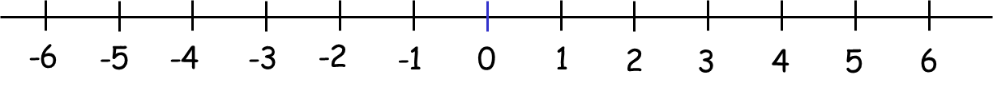
Solve the Inequality
2x + 1 ≥ 7
2x ≥ 6
x ≥ 3

Slide 4
Solve the Equation
4(x – 4) = x – 1
4x – 16 = x – 1
3x = 15
x = 5

Slide 5
Solve the Inequality
4(x – 4) < x – 1
4x – 16 < x – 1
3x < 15
x < 5

Slide 6
9 ≥ 2x + 1
8 ≥ 2x
4 ≥ x
or x ≤ 4

Slide 7
Is the statement true?
–3 < 5
Is the statement true?
3 < –5

Slide 8
If you have a negative unknow
then move it to the other side.
–x < 5
–5 < x

Slide 9
2 - x ≥ 7
2 - x ≥ 7
2 ≥ 7 + x
-x ≥ 5
OR
-5 ≥ x
x ≤ -5

Slide 10
4 - 3x ≥ 10
4 - 3x ≥ 10
4 ≥ 10 + 3x
-3x ≥ 6
-6 ≥ 3x
OR
3x ≤ -2
3-2 ≥ x

Slide 11
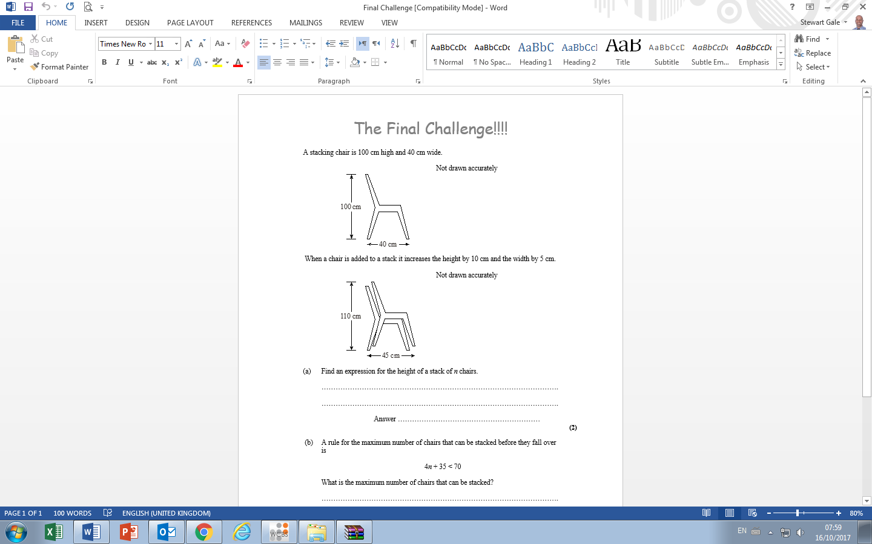
Maximum number of chairs before they fall over:
4n + 35 < 70
What is the maximum of chairs that can be stacked?
n < 8.75
n = 8

