Slide 1
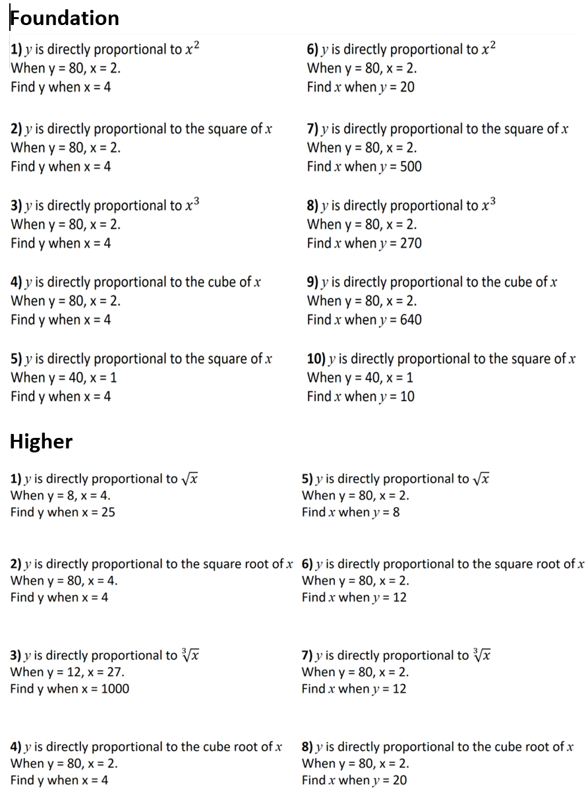

Slide 2
ANSWERS

Slide 3
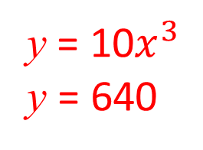
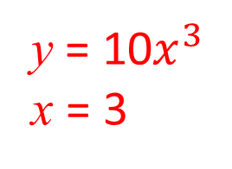
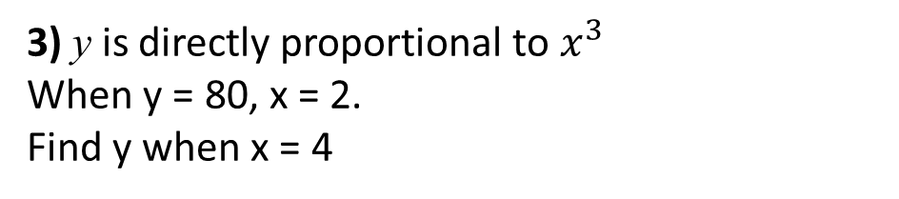
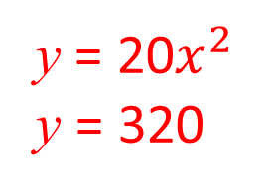
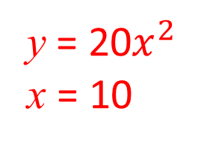
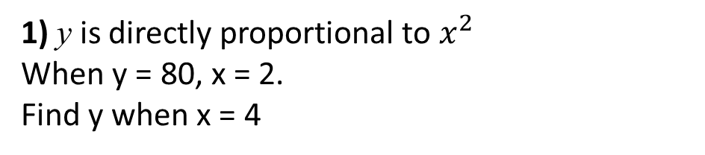
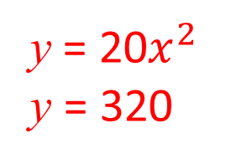
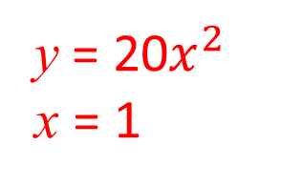
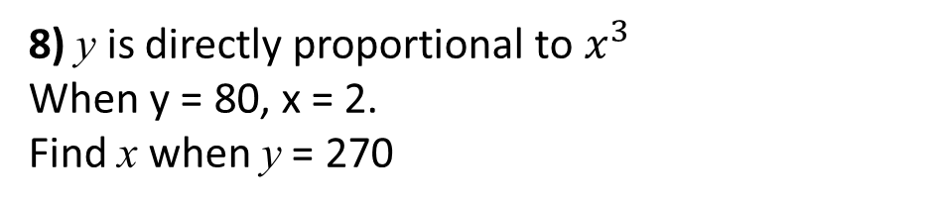
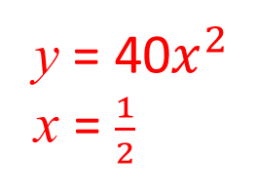
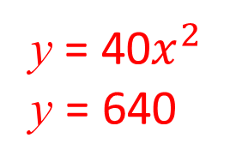
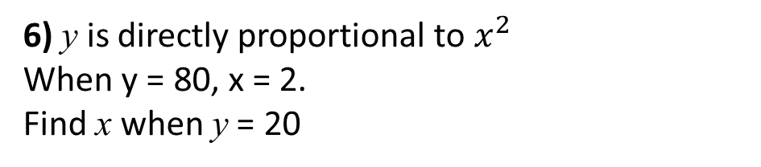
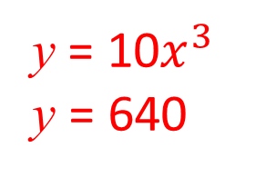
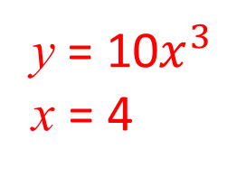
1) y is directly proportional to $x^{2}$
When y = 80, x = 2.
Find y when x = 4
6) y is directly proportional to $x^{2}$
When y = 80, x = 2.
Find x when y = 20
y = 20$x^{2}$
y = 320
y = 20$x^{2}$
x = 1
2) y is directly proportional to the square of x
When y = 80, x = 2.
Find y when x = 4
7) y is directly proportional to the square of x
When y = 80, x = 2.
Find x when y = 500
y = 20$x^{2}$
y = 320
y = 20$x^{2}$
x = 10
3) y is directly proportional to $x^{3}$
When y = 80, x = 2.
Find y when x = 4
8) y is directly proportional to $x^{3}$
When y = 80, x = 2.
Find x when y = 270
y = 10$x^{3}$
y = 640
y = 10$x^{3}$
x = 3
4) y is directly proportional to the cube of x
When y = 80, x = 2.
Find y when x = 4
9) y is directly proportional to the cube of x
When y = 80, x = 2.
Find x when y = 640
y = 10$x^{3}$
y = 640
y = 10$x^{3}$
x = 4
5) y is directly proportional to the square of x
When y = 40, x = 1
Find y when x = 4
10) y is directly proportional to the square of x
When y = 40, x = 1
Find x when y = 10
y = 40$x^{2}$
y = 640
y = 40$x^{2}$
x = $\frac{1}{2}$

Slide 4
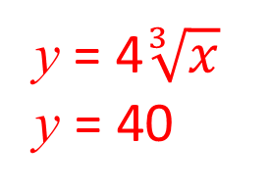
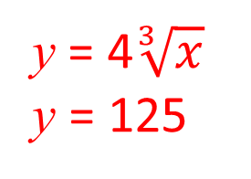
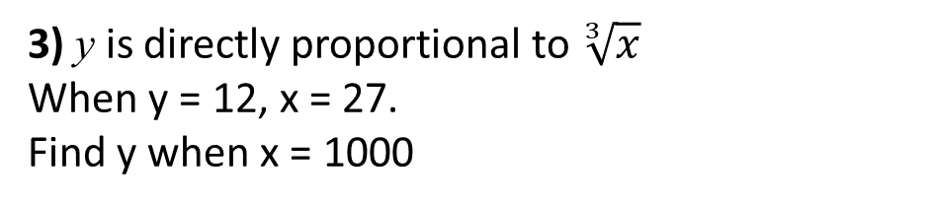
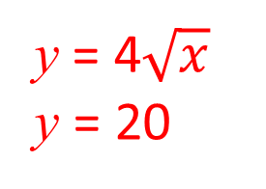
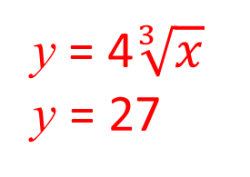
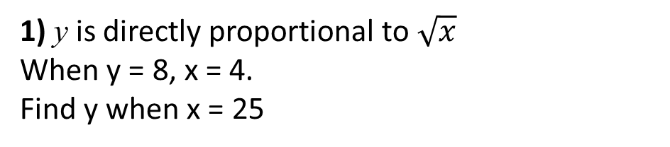
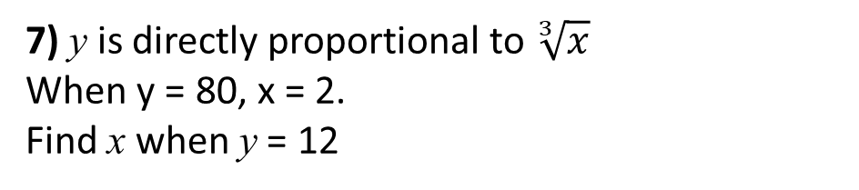
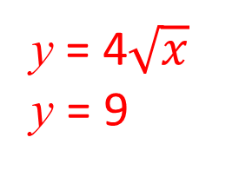
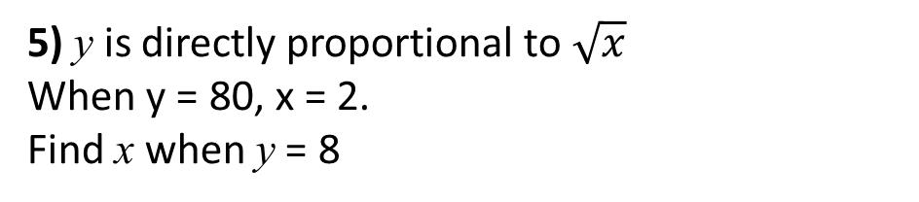
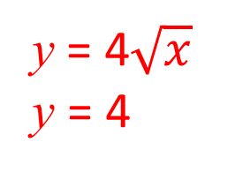

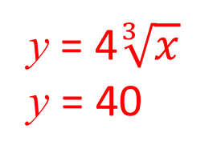
1) y is directly proportional to $\sqrt{x}$
When y = 8, x = 4.
Find y when x = 25
5) y is directly proportional to $\sqrt{x}$
When y = 80, x = 2.
Find x when y = 8
y = 4$\sqrt{x}$
y = 20
y = 4$\sqrt{x}$
y = 4
2) y is directly proportional to the square root of x
When y = 80, x = 4.
Find y when x = 4
6) y is directly proportional to the square root of x
When y = 80, x = 2.
Find x when y = 12
y = 4$\sqrt{x}$
y = 20
y = 4$\sqrt{x}$
y = 9
3) y is directly proportional to $\sqrt[3]{x}$
When y = 12, x = 27.
Find y when x = 1000
7) y is directly proportional to $\sqrt[3]{x}$
When y = 80, x = 2.
Find x when y = 12
y = 4$\sqrt[3]{x}$
y = 40
y = 4$\sqrt[3]{x}$
y = 27
4) y is directly proportional to the cube root of x
When y = 80, x = 2.
Find y when x = 4
8) y is directly proportional to the cube root of x
When y = 80, x = 2.
Find x when y = 20
y = 4$\sqrt[3]{x}$
y = 40
y = 4$\sqrt[3]{x}$
y = 125

