Slide 1
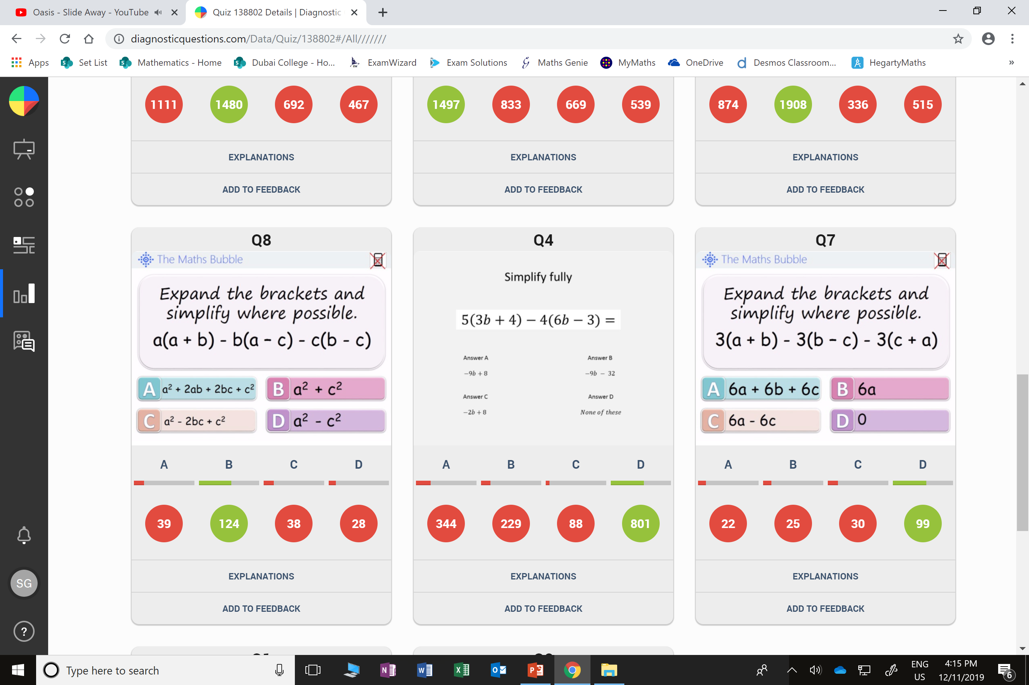
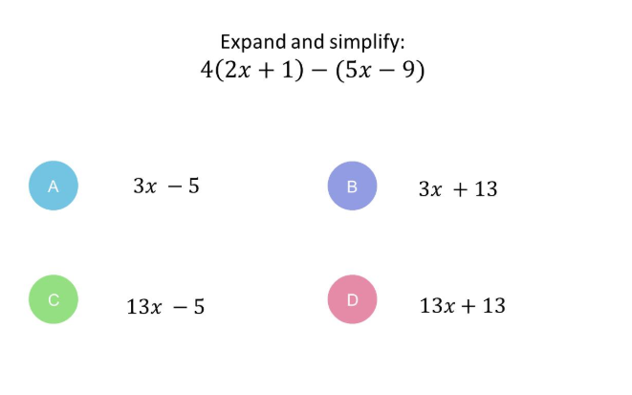
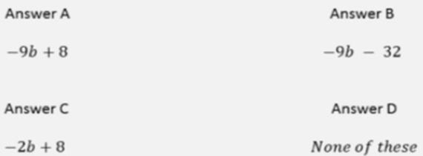
Which is the worst answered questions?
What was the most common
wrong answer?

Slide 2
Which question had the lowest percentage of
correct answers?

Slide 3
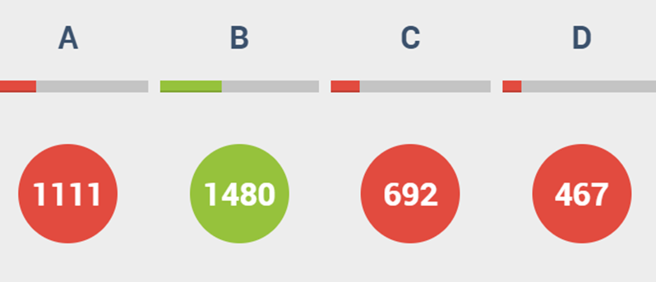
A
They did 4 – 9 instead of
4 + 9.
(-1 x -9 = 9)

Slide 4
A
They did 20 – 12 instead of
20 + 12.
(-4 x -3 = 12)

