Slide 1
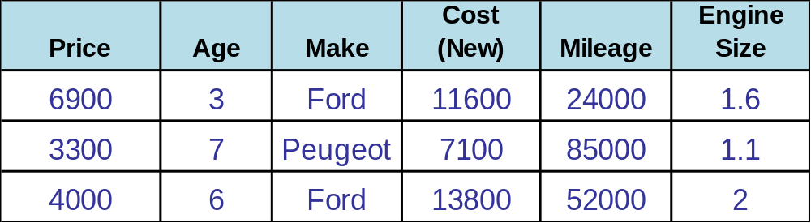
LO: Investigate the Second Hand Cars
If you were to buy a brand new car
as soon as you drive the car out of the garage you will loss
approximately 10 to 20% of its value.
Use the information given to investigate
the cost of second hand cars.

Slide 2
Produce a scatter graph for….
Price of a car as it does more Mileage?
Mileage of the car as it gets older (Age)?
Price of the car as it gets older (Age)?
Engine size and the Age?

Slide 3
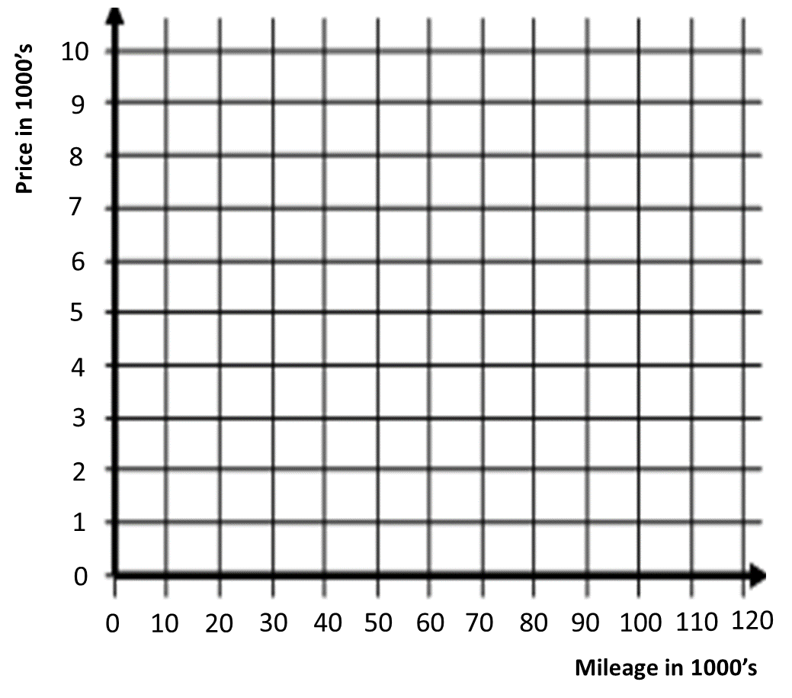
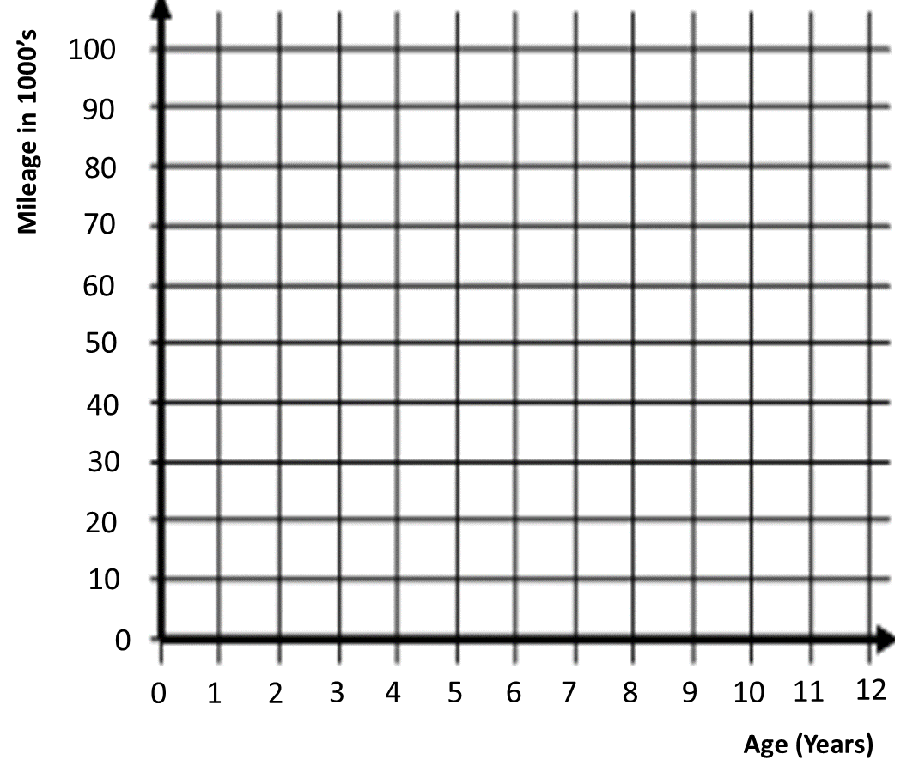
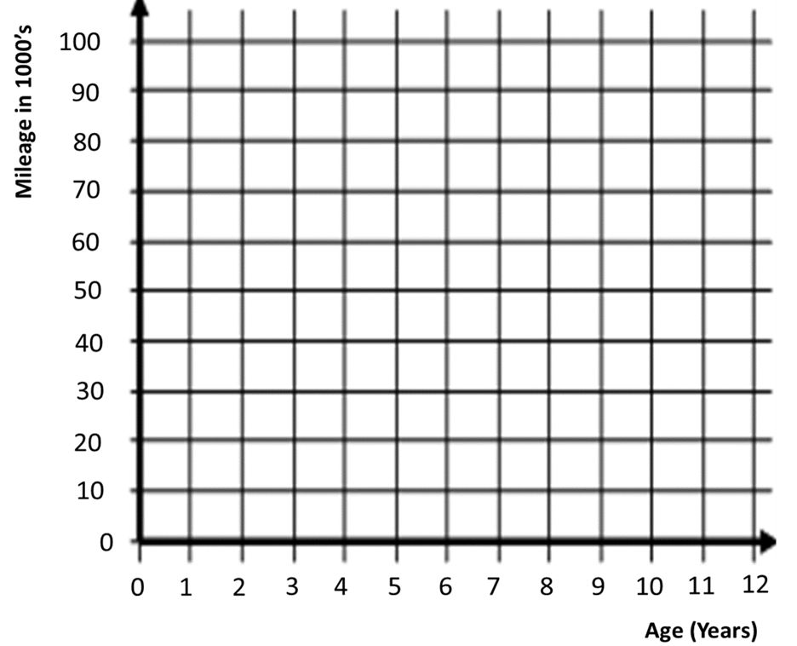
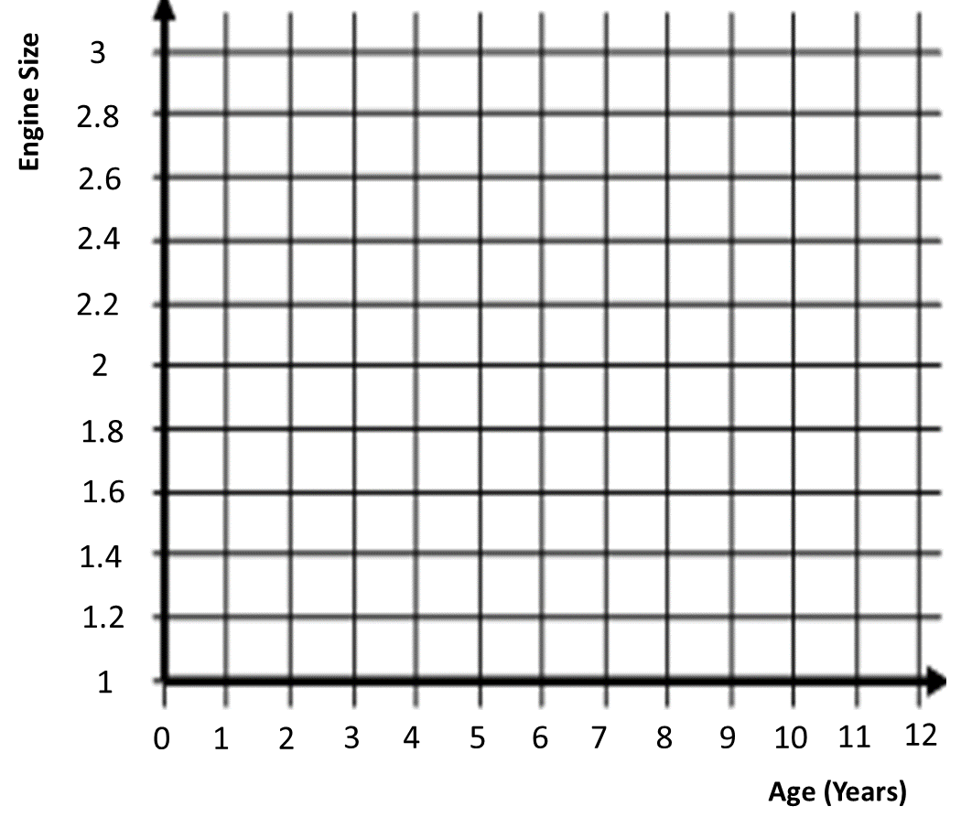
Price | Age | Make | Cost when new | Mileage | Engine Size
6500 | 3 | Fiat | 8700 | 24000 | 1.2
1500 | 9 | Vauxhall | 8700 | 82000 | 1.6
950 | 9 | Ford | 8500 | 102000 | 1.8
3000 | 7 | Vauxhall | 10400 | 63000 | 1.7
7500 | 1 | Vauxhall | 9800 | 8000 | 1.4
5600 | 4 | Ford | 11000 | 41000 | 1.6
5000 | 3 | Ford | 9900 | 34000 | 1.4
2600 | 7 | Rover | 12000 | 82000 | 1.6
1000 | 10 | Peugeot | 6200 | 119000 | 1.1
750 | 11 | Peugeot | 5100 | 96000 | 1
2900 | 8 | Ford | 17800 | 96000 | 2.9
5400 | 1 | Rover | 7400 | 11000 | 1.1
2700 | 5 | Fiat | 13000 | 51000 | 2

Slide 4
ANSWERS

Slide 5
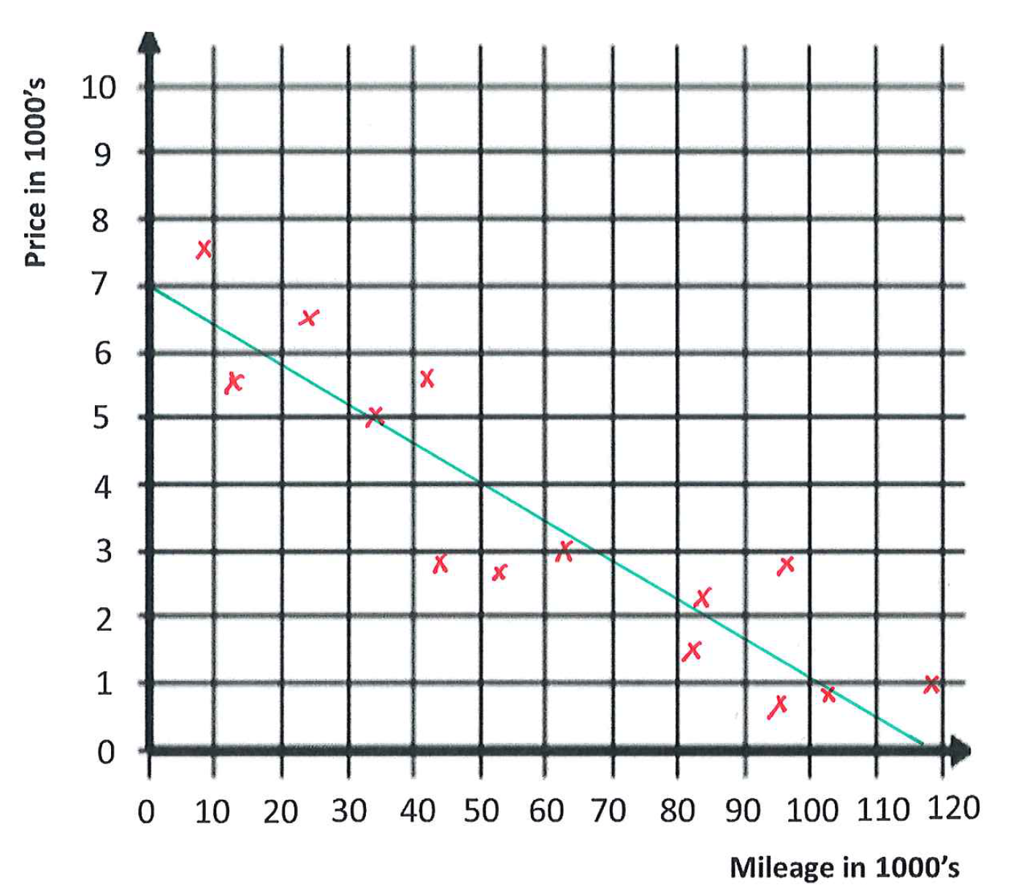

Slide 6
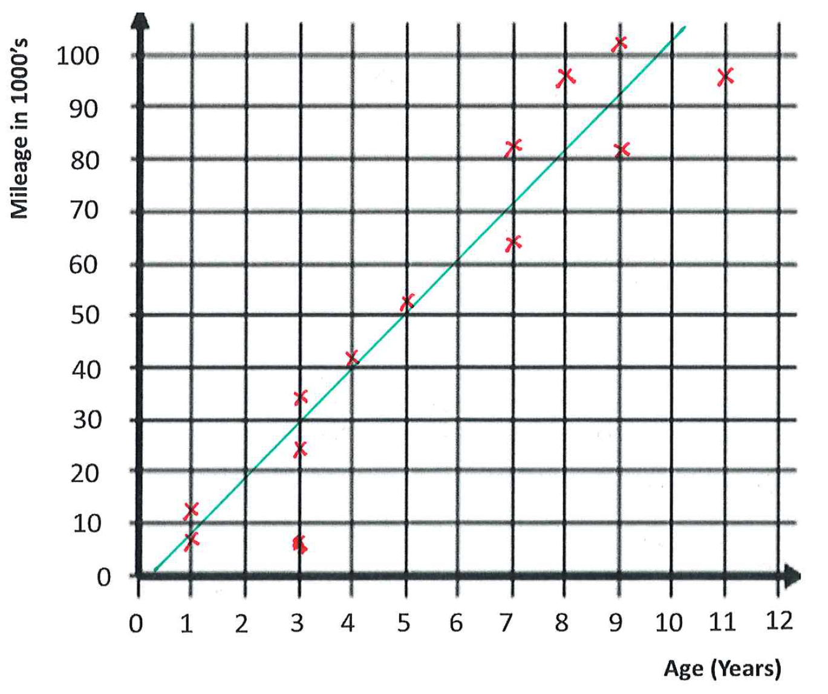
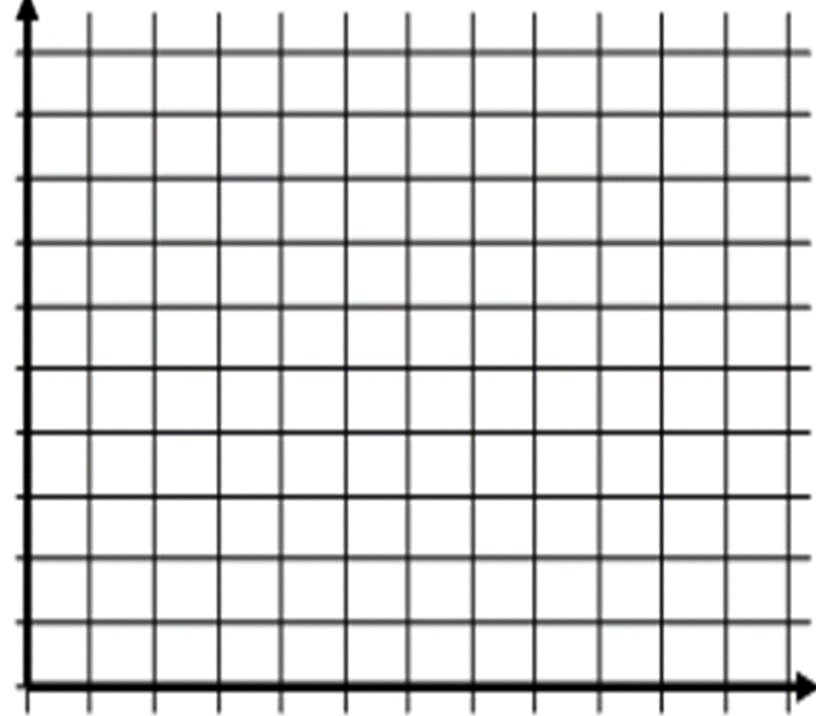
100
90
Mileage in 1000’s
80
70
60
50
40
30
20
10
0
0
1
2
3
4
5
6
7
8
9
10
11
12
Age (Years)

Slide 7
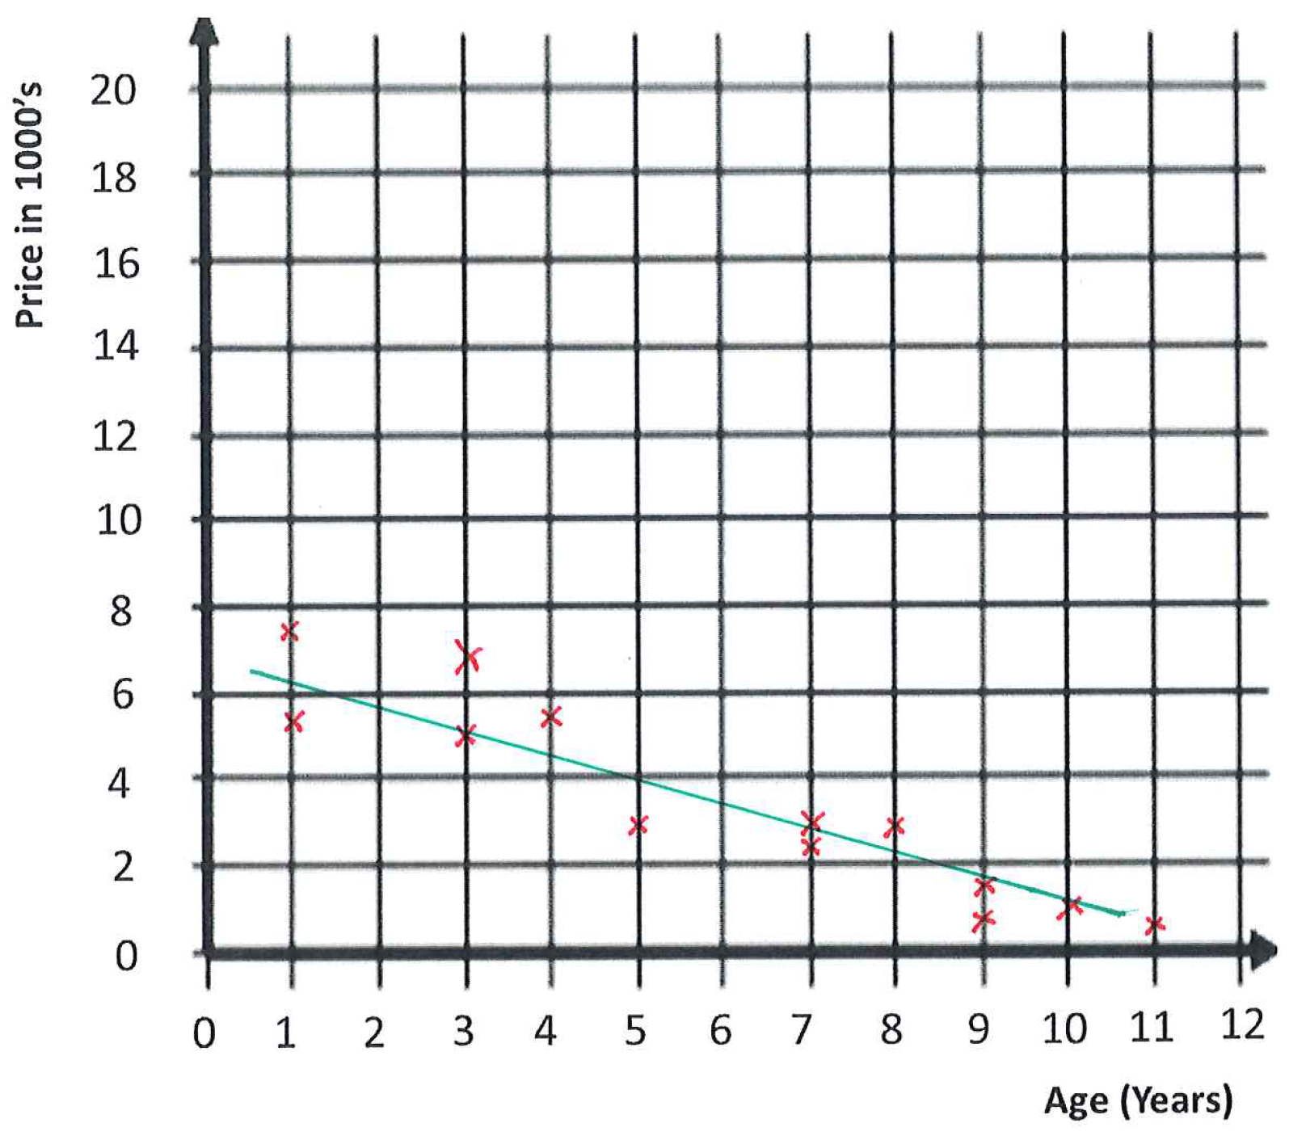
20
18
Price in 1000’s
16
14
12
10
8
6
4
2
0
0
1
2
3
4
5
6
7
8
9
10
11
12
Age (Years)

Slide 8
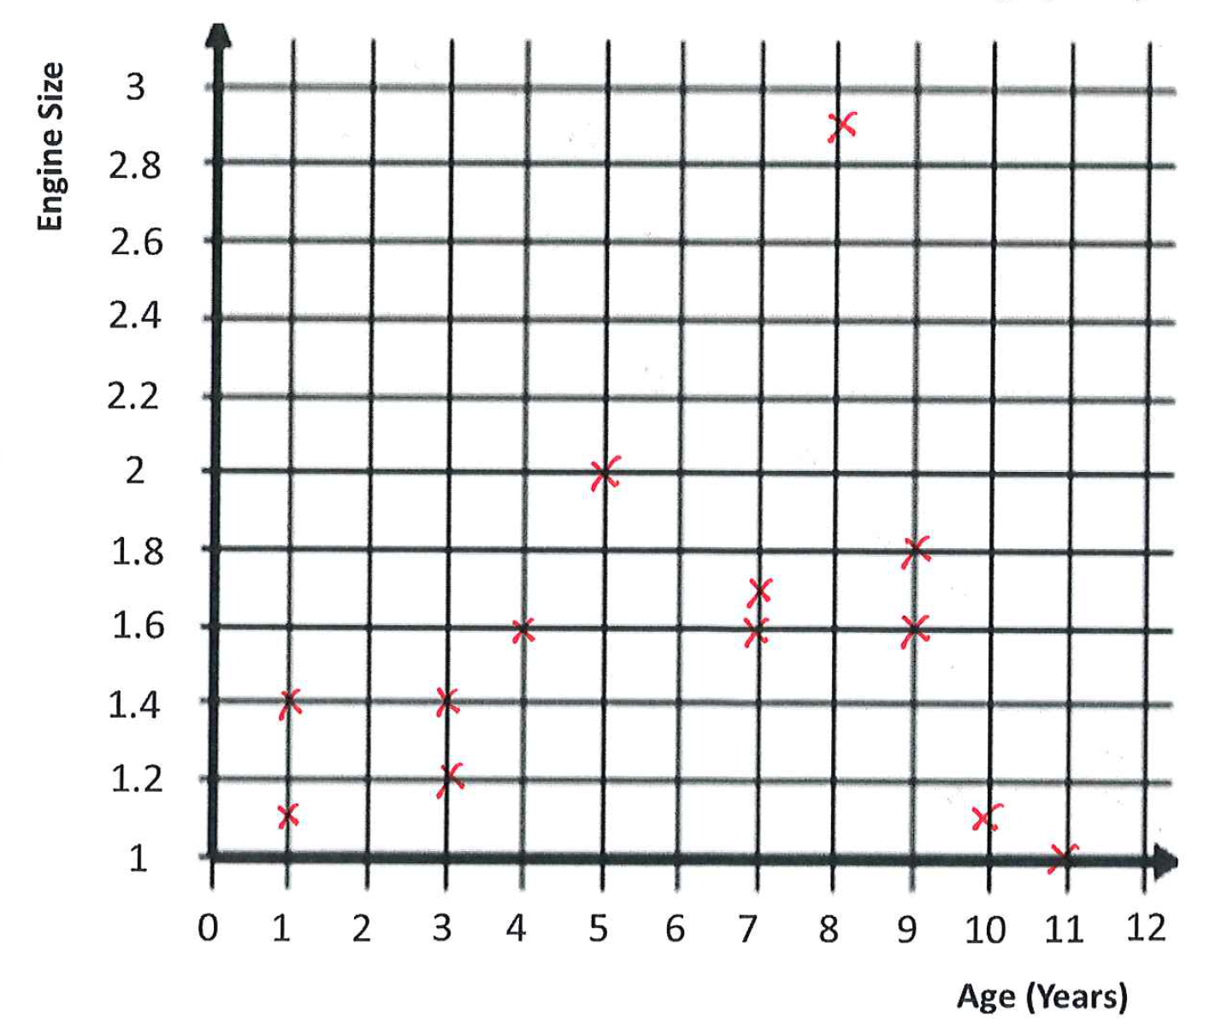
3
Engine Size
2.8
2.6
2.4
2.2
2
1.8
1.6
1.4
1.2
1
0
1
2
3
4
5
6
7
8
9
10
11
12
Age (Years)

