Slide 1
LO: Improper and Mixed fractions

Slide 2
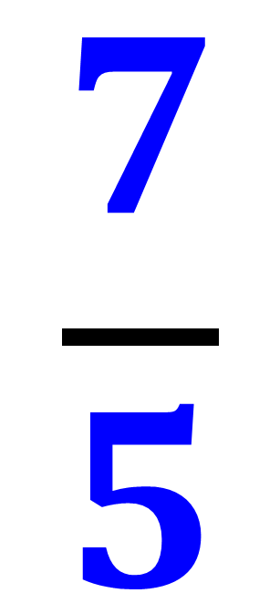
What makes an Improper fraction
an Improper fraction?
$$\frac{7}{5}$$
The numerator is bigger
than the denominator.

Slide 3
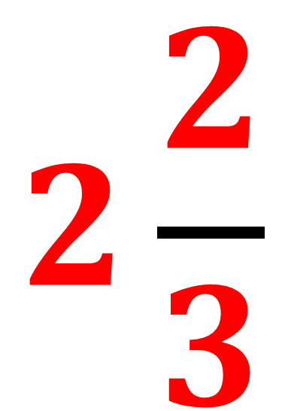
What makes an Mixed fraction
an Mixed fraction?
$$2\frac{2}{3}$$
There is a whole number and a fraction.

Slide 4
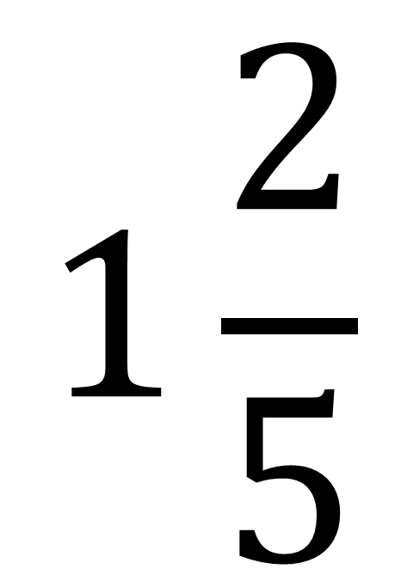
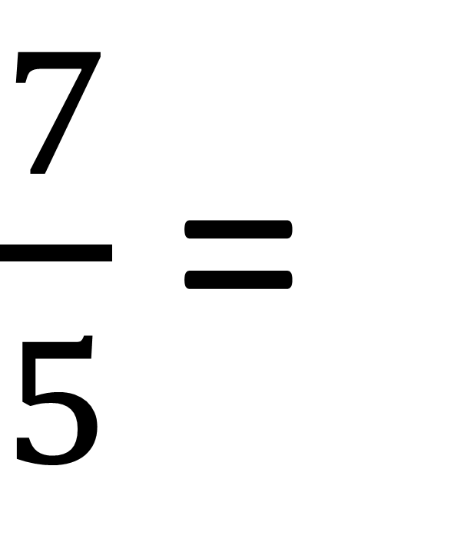
Converting a improper fraction
to mixed fraction.
$$1\frac{2}{5}$$
$\frac{7}{5}$ =
Remainder
Denominator stays the same
Whole Number

Slide 5
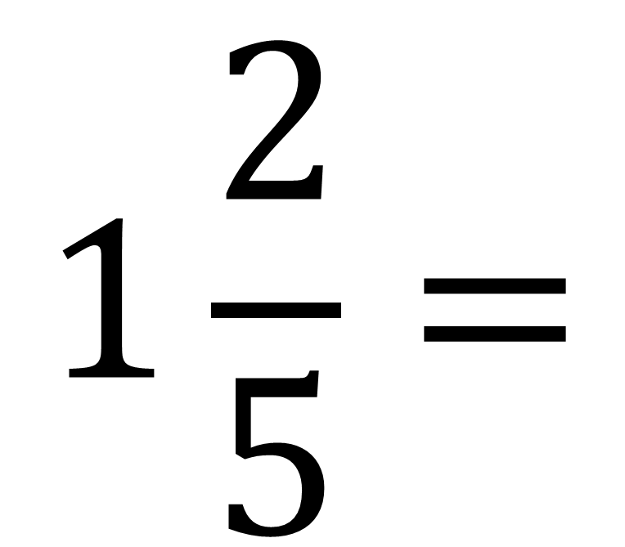
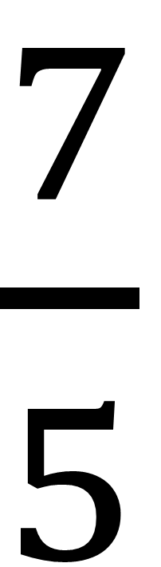
Converting a mixed fraction
to improper fraction.
Whole number Multiply Denominator
Add
Numerator
$$1\frac{2}{5}=$$
$\frac{7}{5}$
Denominator stays the same

Slide 6
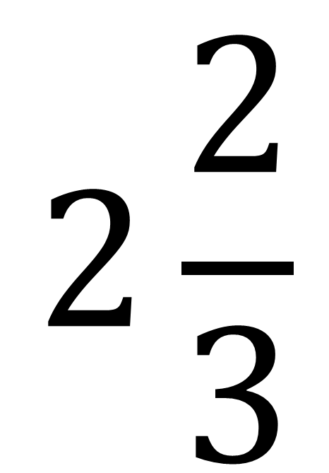
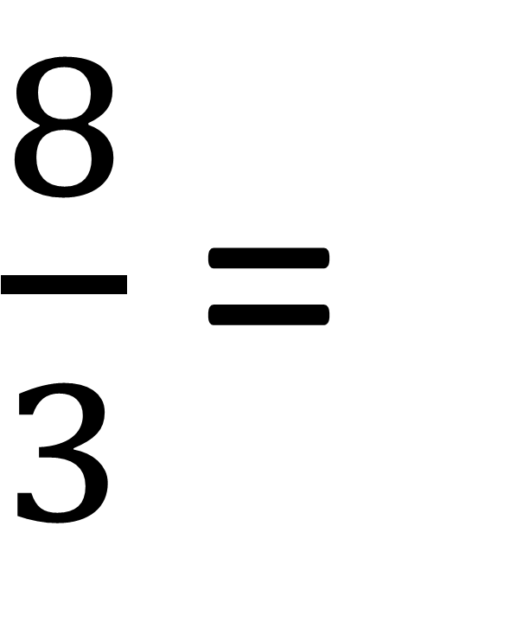
Converting a improper fraction
to mixed fraction.
$$2\frac{2}{3}$$
$\frac{8}{3}$ =

Slide 7
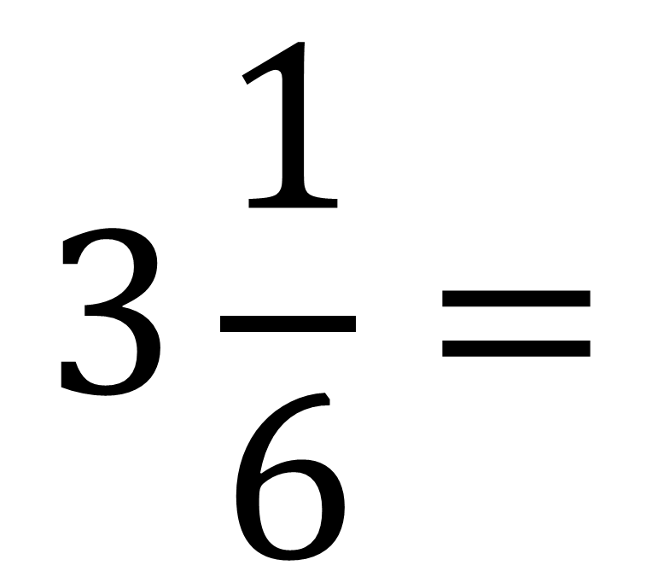
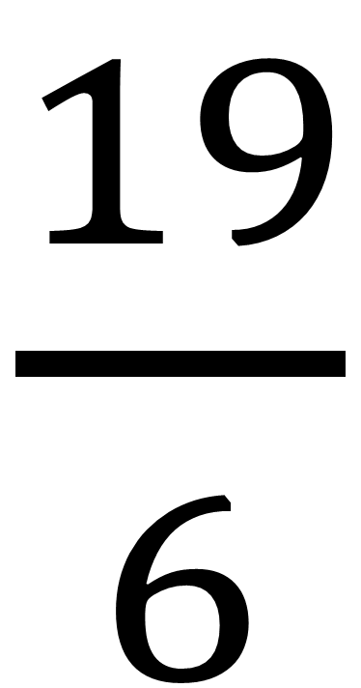
Converting a mixed fraction
to improper fraction.
$$3\frac{1}{6}=$$
$\frac{19}{6}$

Slide 8
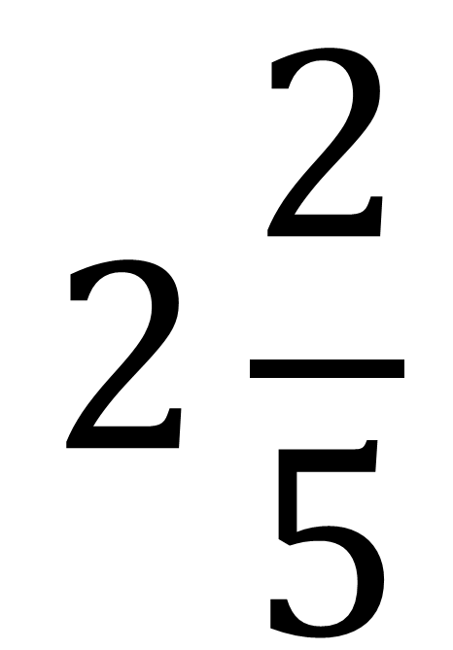
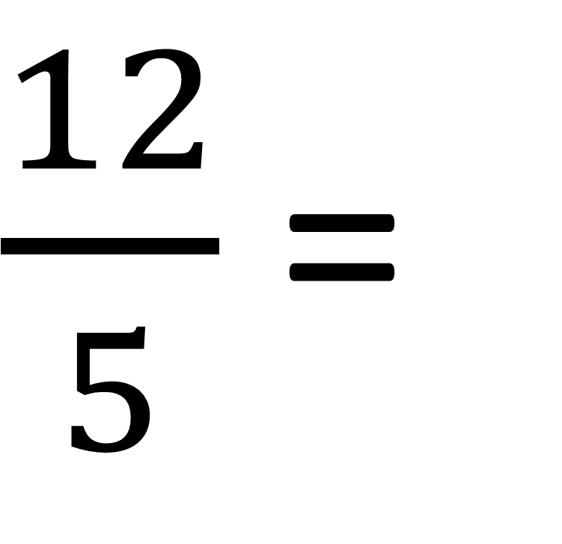
Converting a improper fraction
to mixed fraction.
$$2\frac{2}{5}$$
$\frac{12}{5}$ =

Slide 9
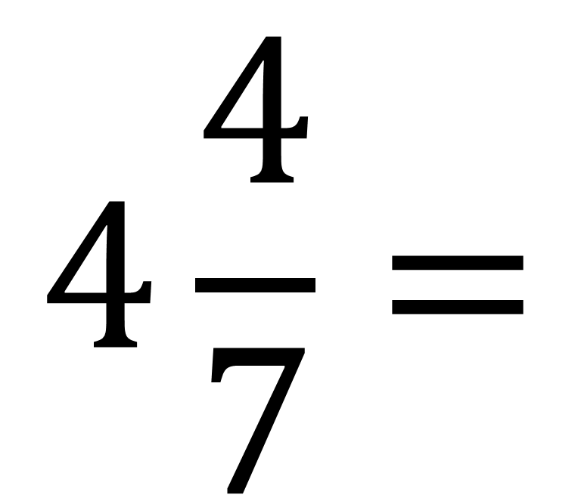
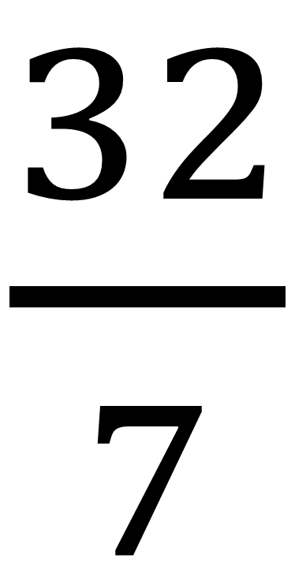
Converting a mixed fraction
to improper fraction.
$$4\frac{4}{7}=$$
$\frac{32}{7}$

