Slide 1
Constant Acceleration
SUVAT Vertical
Chapter 9
(Part 4 of 4)

Slide 2
Vertical Motion - Under Gravity
If there is no air resistance,
then the acceleration of objects under gravity, regardless of mass,
is constant.

Slide 3
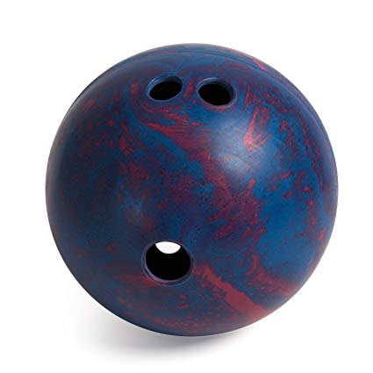
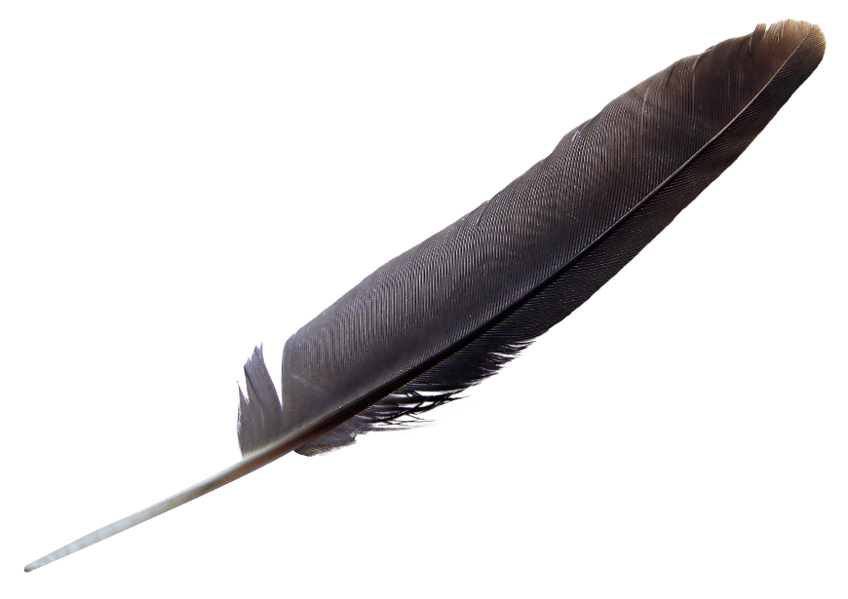
Which one would drop to the ground first?
https://www.youtube.com/watch?v=E43-CfukEgs

Slide 4
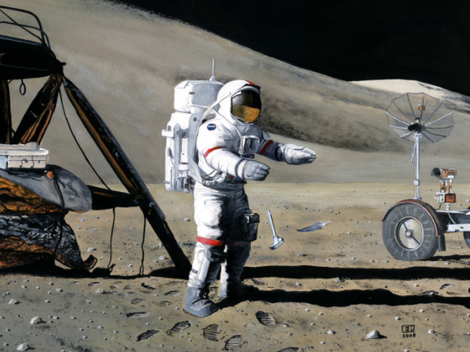

The downwards acceleration
under gravity is $g=9.8$ms⁻²

Slide 5

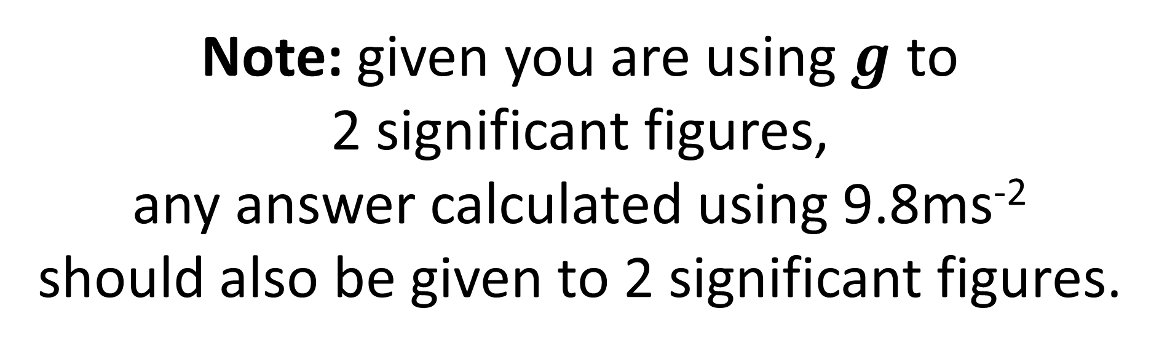
$g=9.8$ms⁻²
Note: given you are using $g$ to
2 significant figures,
any answer calculated using 9.8ms⁻²
should also be given to 2 significant figures.

Slide 6
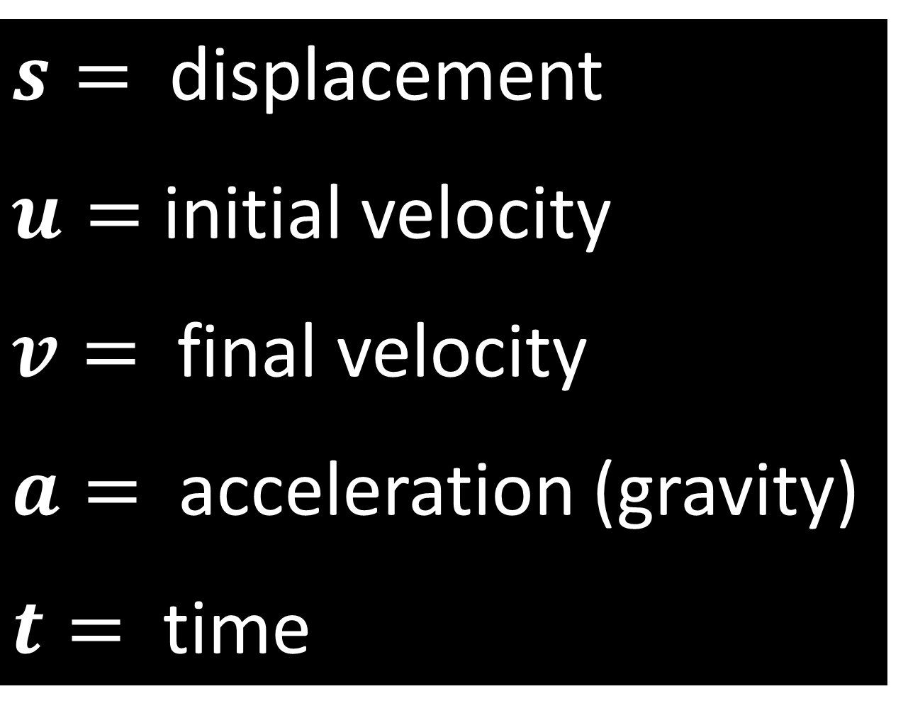
$s=$ displacement
$u=$ initial velocity
$v=$ final velocity
$a=$ acceleration (gravity)
$t=$ time

Slide 7




$$v=u+at$$
$$v^{2}=u^{2}+2as$$
$$s=\left(\frac{u+v}{2}\right)t$$
$$s=ut+\frac{1}{2}at^{2}$$

Slide 8
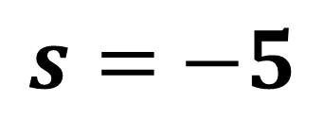

$$S$$
Displacement is the distance from your starting point to your current position.
Start
Finish
7m
2m
What is the displacement of the particle?
$s=$ $−5$

Slide 9


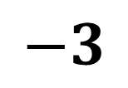


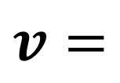

$$U$$
$$V$$
u is the velocity at the start of your calculations.
v is the velocity at the finish point of your calculations.
Start
5 ms⁻¹
$$u=$$
$$5$$
Finish
3 ms⁻¹
$$v=$$
$$−3$$

Slide 10




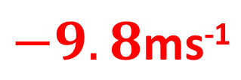


$$a$$
a is the acceleration/deceleration.
$$g=$$
$$−9.8\text{ms}\text{−1}$$
$$g=$$
$$−9.8\text{ms}\text{−1}$$

Slide 11
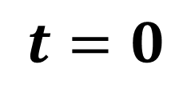

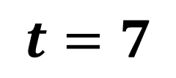
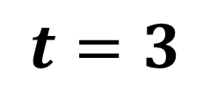
$$t$$
t time take to travel from one point to another.
$$t=3$$
$$t=7$$
$$t=0$$

Slide 12
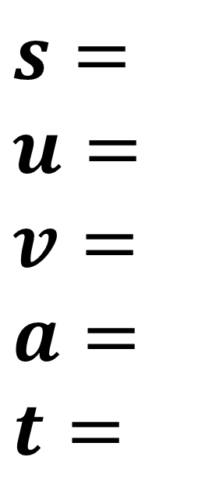
For each question write out SUVAT
and identify the information you know.
$s=$
$$u=$$
$$v=$$
$$a=$$
$$t=$$
Then identify which SUVAT equation
you can use that only gives you one unknown.

Slide 13
Vertical Motion – Maximum Height
0 ms⁻¹
0 ms⁻¹
What is the speed of the particle when is at its maximum height?
At maximum height the velocity will be zero.

Slide 14
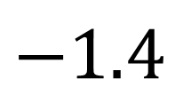
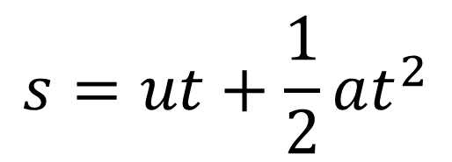

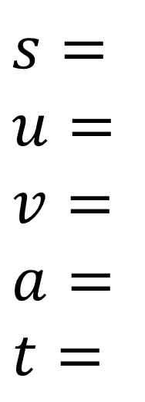

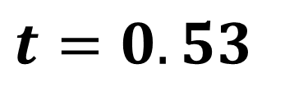
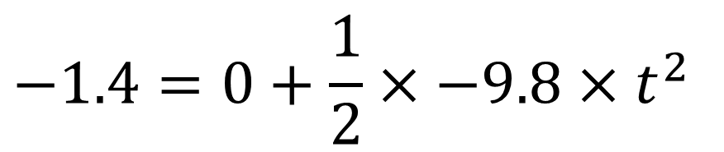
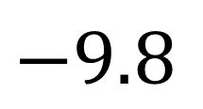
A book falls off the top shelf of a bookcase.
The shelf is 1.4 m above a wooden floor. Find:
the time the book takes to reach the floor,
the speed with which the book strikes the floor.
a)
Identify Values
Choose Equation
$$s=$$
$$u=$$
$$v= \\ a=$$
$$t=$$
$$−1.4$$
$$s=ut+\frac{1}{2}at^{2}$$
$$0$$
Substitute Values
$$−1.4=0+\frac{1}{2}×−9.8×t^{2}$$
$$−9.8$$
$$?$$
$$t=0.53$$

Slide 15
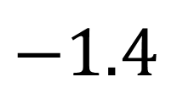
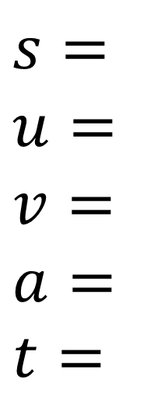

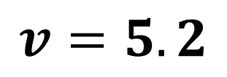
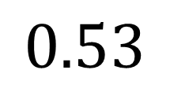
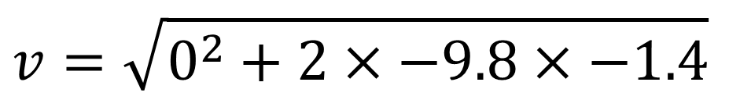
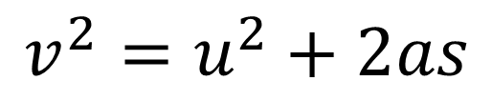
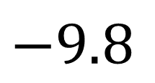
A book falls off the top shelf of a bookcase.
The shelf is 1.4 m above a wooden floor. Find:
the time the book takes to reach the floor,
the speed with which the book strikes the floor.
b)
Identify Values
Choose Equation
$$s=$$
$$u=$$
$$v= \\ a=$$
$$t=$$
$$−1.4$$
$$v^{2}=u^{2}+2as$$
$$0$$
Substitute Values
$$−9.8$$
$$v=\sqrt{0^{2}+2×−9.8×−1.4}$$
$$0.53$$
$$v=5.2$$

Slide 16
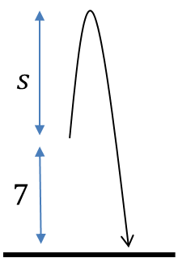
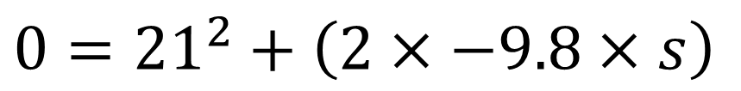
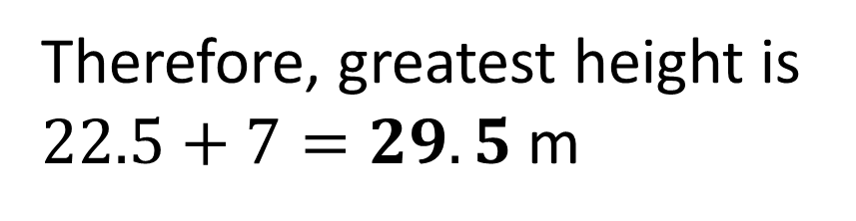
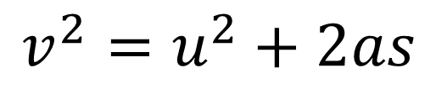
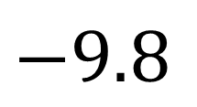
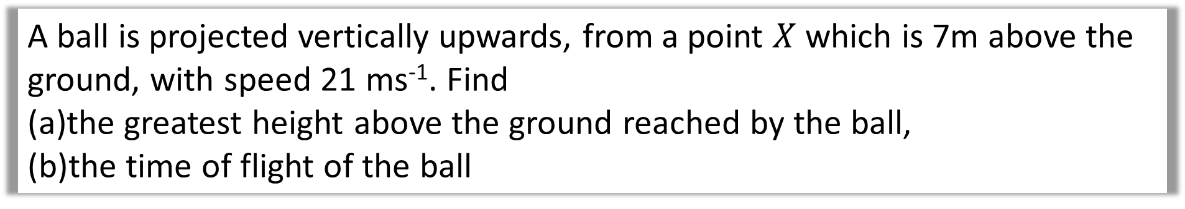
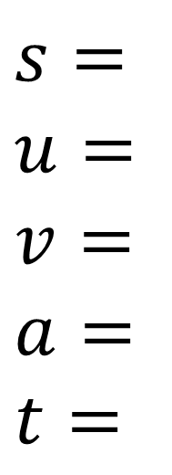

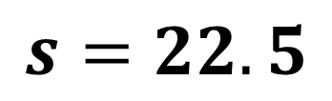


A ball is projected vertically upwards, from a point $X$ which is 7m above the ground, with speed 21 ms⁻¹. Find
the greatest height above the ground reached by the ball,
the time of flight of the ball
a)
Identify Values
Choose Equation
$$s=$$
$$u=$$
$$v= \\ a=$$
$$t=$$
$$?$$
$$v^{2}=u^{2}+2as$$
$$21$$
Substitute Values
$$0$$
$$0={21}^{2}+\left(2×−9.8×s\right)$$
$$−9.8$$
$$s=22.5$$
Therefore, greatest height is
$22.5+7=29.5$ m

Slide 17
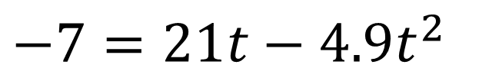
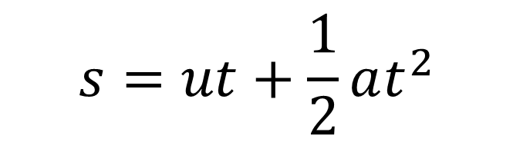
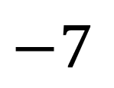
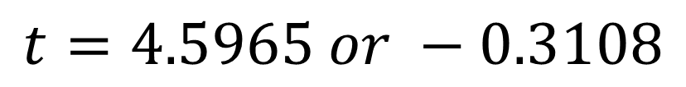
A ball is projected vertically upwards, from a point $X$ which is 7m above the ground, with speed 21 ms⁻¹. Find
the greatest height above the ground reached by the ball,
the time of flight of the ball
b)
Identify Values
Choose Equation
$$s=$$
$$u=$$
$$v= \\ a=$$
$$t=$$
$$s=ut+\frac{1}{2}at^{2}$$
$$−7$$
$$21$$
Substitute Values
$$−7=21t−4.9t^{2}$$
$$−9.8$$
$$t=4.5965 or −0.3108$$
Time of flight is 4.6 s (2sf)

Slide 18
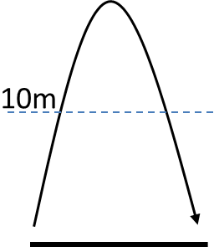

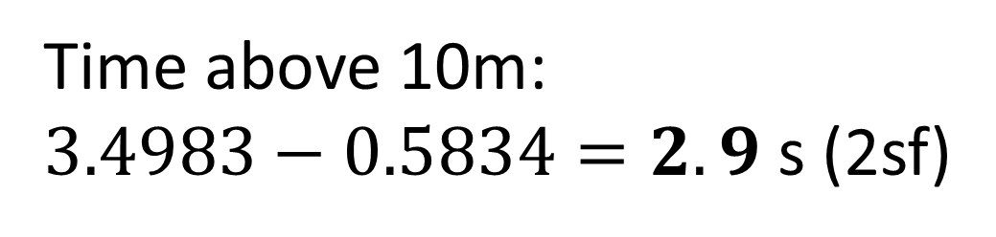
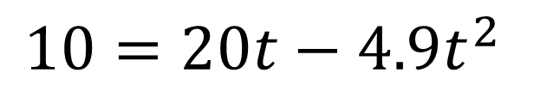
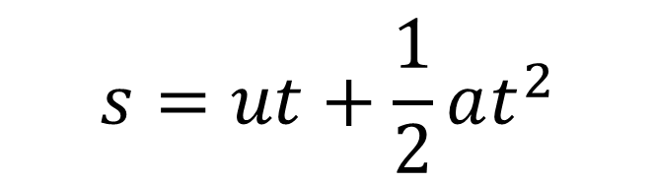
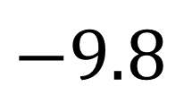
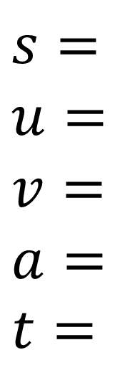
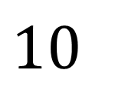
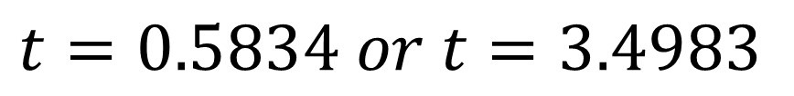

A ball is projected vertically upwards from ground level at a speed of 20 ms⁻¹. Determine the amount of time the ball is at least 10m above ground level.
Identify Values
Choose Equation
$$s=ut+\frac{1}{2}at^{2}$$
$$s=$$
$$u=$$
$$v= \\ a=$$
$$t=$$
$$10$$
$$20$$
Substitute Values
$$10=20t−4.9t^{2}$$
$$−9.8$$
$$t=0.5834 or t=3.4983$$
$$?$$
Time above 10m:
$3.4983−0.5834=2.9$ s (2sf)

Slide 19


Slide 20




















$$S_{A}$$
$$S_{B}$$
$${Distance}_{A}+{Distance}_{B}=50$$
Identify A Values
Identify B Values
$$s=$$
$$u=$$
$$v= \\ a=$$
$$t=$$
$$S_{A}$$
$$s=$$
$$u=$$
$$v= \\ a=$$
$$t=$$
$$S_{B}$$
$S_{A}$ will be a negative so it need to be made a positive as it is distance need not displacement.
$$2$$
$$20$$
$−(2T−\frac{1}{2}gT^{2})+$ $20T−\frac{1}{2}gT^{2}=50$
$$−9.8$$
$$−9.8$$
$−2T+\frac{1}{2}gT^{2}+$ $20T−\frac{1}{2}gT^{2}=50$
$$T$$
$$T$$
$$18T=50$$
Equation A
Equation B
$$S_{A}=2T−\frac{1}{2}gT^{2}$$
$$S_{B}=20T−\frac{1}{2}gT^{2}$$
$$T=2.78$$

