Slide 1
LO: Learning
about Pi

Slide 2
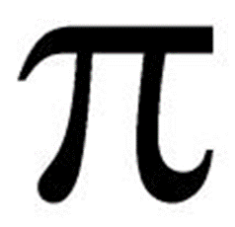

Pi (a letter in the Greek alphabet) it is one of the most ancient numbers known to man.
= 3.14159……

Slide 3
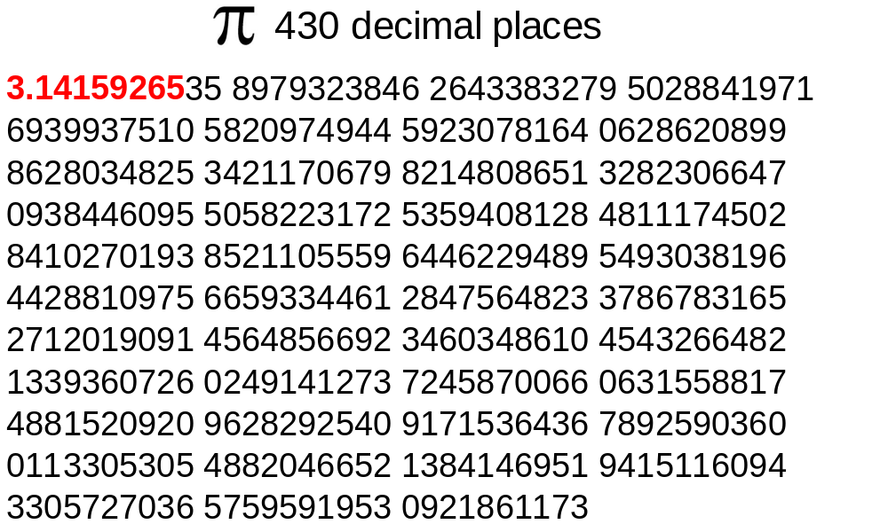

Slide 4

Around 250 BC a Greek mathematician called Archimedes found that pi is somewhere about 3.14
is a never ending number which never repeats.
is found by dividing the circumference of a circle by the diameter of the circle.

Slide 5
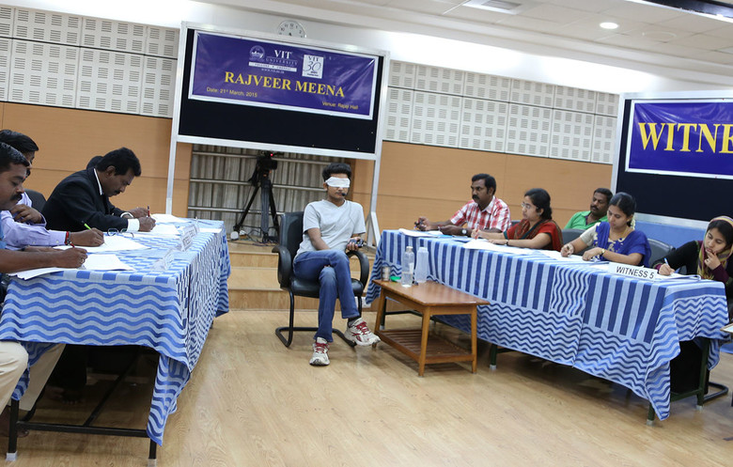
The top 3 world records for memorizing pi
World Rank | Name | Country | Digits | Date
1 | Rajveer Meena | India | 70000 | March 2015
2 | Chao Lu | China | 67890 | Nov-05
3 | Krishan Chahal | India | 43000 | Jun-06
The most decimal places of Pi memorised is 70,000, and was achieved by Rajveer Meena (India) at the VIT University, Vellore, India, on 21 March 2015.
Rajveer wore a blindfold throughout the entire recall, which took nearly 10 hours.

Slide 6
Over the last four thousand years, many people have tried to find out
an exact value for pi, and still our best guess is……
a bit more than 3!
Culture/Person | Approximate Time | Value Used
Babylonians | 2000 BC | 3.125
Egyptians | 2000 BC | 3.16045
China | 1200 BC | 3
Bible mentions it | 550 BC | 3
Archimedes | 250 BC | 3.1418
Hon Han Shu | 130 | 3.1622
Ptolemy | 150 | 3.14166

