Slide 1
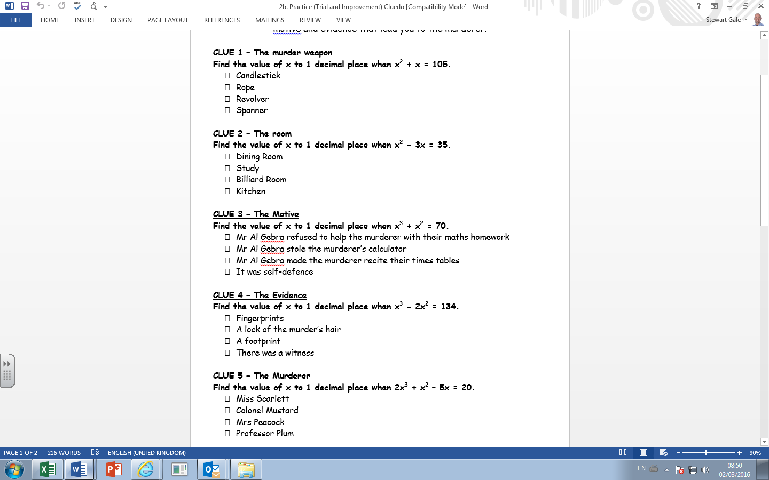
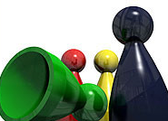

9.9 Spanner | 9.8 Revolver | 9.7 Rope | 9.6 Candlestick
7.4 Kitchen | 7.5 Billiard Room | 7.6 Study | 7.7 Dining Room
3.8 Mr Al Gebra made murderer recite times tables | 3.9 It was self-defence | 3.7 Mr Al Gebra stole the murderer’s calculator | 3.6 Mr Al Gebra refused to help the murderer with HW.
5.6 Witness | 5.7 Footprint | 5.8 Lock of hair | 5.9 Finger-prints
2.2 Professor Plum | 2.4 Mrs Peacock | 2.3 Colonel Mustard | 2.5 Miss Scarlett

Slide 2
ANSWERS

Slide 3
Who did it?
9.9 Spanner | 9.8 Revolver | 9.7 Rope | 9.6 Candlestick
7.4 Kitchen | 7.5 Billiard Room | 7.6 Study | 7.7 Dining Room
3.8 Mr Al Gebra made murderer recite times tables | 3.9 It was self-defence | 3.7 Mr Al Gebra stole the murderer’s calculator | 3.6 Mr Al Gebra refused to help the murderer with HW.
5.6 Witness | 5.7 Footprint | 5.8 Lock of hair | 5.9 Finger-prints
2.2 Professor Plum | 2.4 Mrs Peacock | 2.3 Colonel Mustard | 2.5 Miss Scarlett

