Slide 1
LO: Pythagoras
Applied Problems

Slide 2

If you want to use Pythagoras theorem
then you need to be on the
look out for right angle triangles.

Slide 3
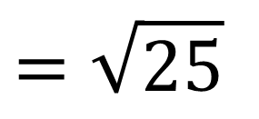
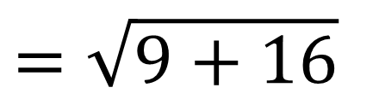
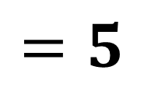
Find the length AB.
y
B
5
$$=\sqrt{9+16}$$
$$=\sqrt{25}$$
3
$$=5$$
A
2
4
x
3
7

Slide 4
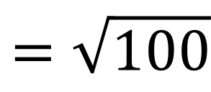
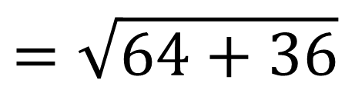
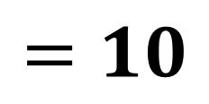
Find the length AB.
y
B
(10, 9)
$$=\sqrt{64+36}$$
6
$$=\sqrt{100}$$
A
(2, 3)
$$=10$$
8
x

Slide 5
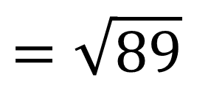
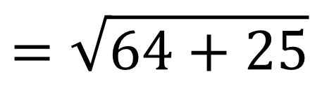
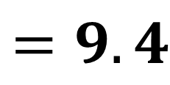
Find the length AB.
y
B
(12, 10)
$$=\sqrt{64+25}$$
5
$$=\sqrt{89}$$
A
$$=9.4$$
(4, 5)
8
x

Slide 6
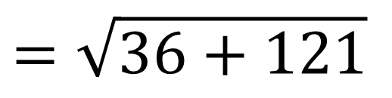
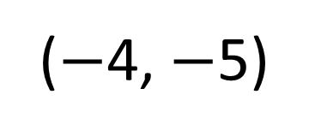
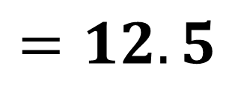
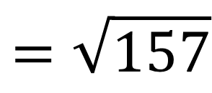
Find the length AB.
y
$$=\sqrt{36+121}$$
B
$$=\sqrt{157}$$
(2, 6)
$$=12.5$$
x
11
A
($−$4, $−$5)
6

Slide 7
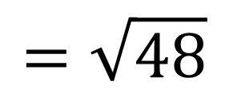
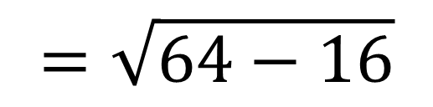
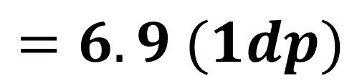
What is the height of the triangle?
8cm
8cm
8cm
4cm
$$=\sqrt{64−16}$$
$$=\sqrt{48}$$
8cm
$$=6.9 (1dp)$$

Slide 8
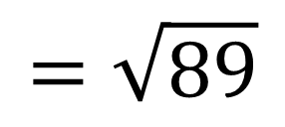
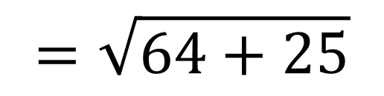
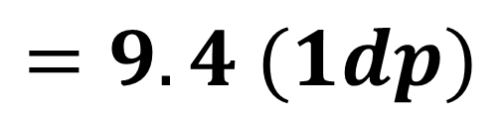
What is the length of the diagonal?
8cm
8cm
5cm
$$=\sqrt{64+25}$$
$$=\sqrt{89}$$
5cm
$$=9.4 (1dp)$$

Slide 9
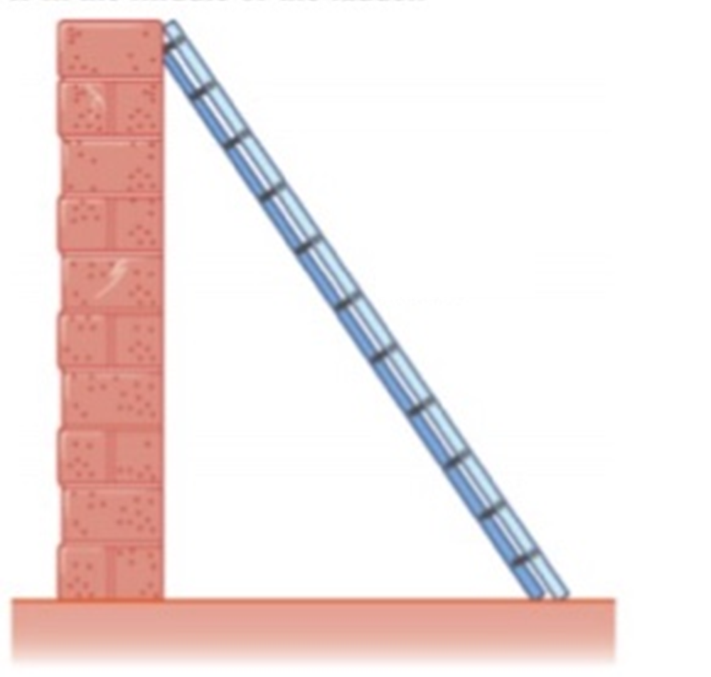
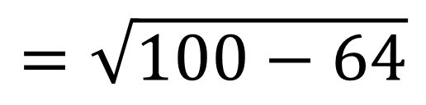
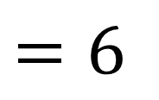
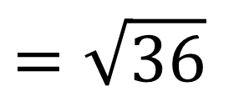
A ladder is 10 metres in length.
The ladder is 8 metres from the base of the wall.
What is the height from the ground to the
top of the ladder?
$$=\sqrt{100−64}$$
10cm
$$=\sqrt{36}$$
8cm
$$=6$$

