Slide 1
Integration
By parts
Chapter 11
(Part 5 of 12)

Slide 2
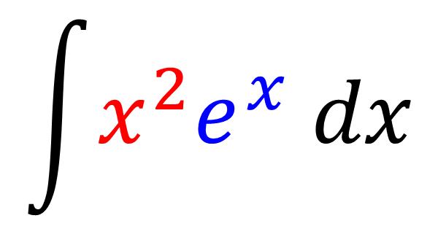
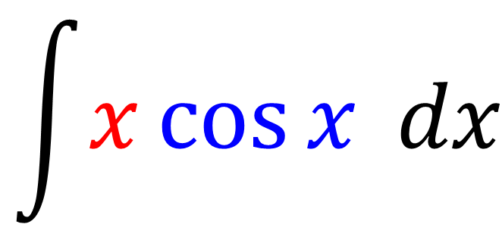
Integration by Parts
‘Integration by Parts’
when integrating
the product of two functions.
$$\int{x\cos{x} dx}$$
$$\int{x^{2}e^{x} dx}$$

Slide 3
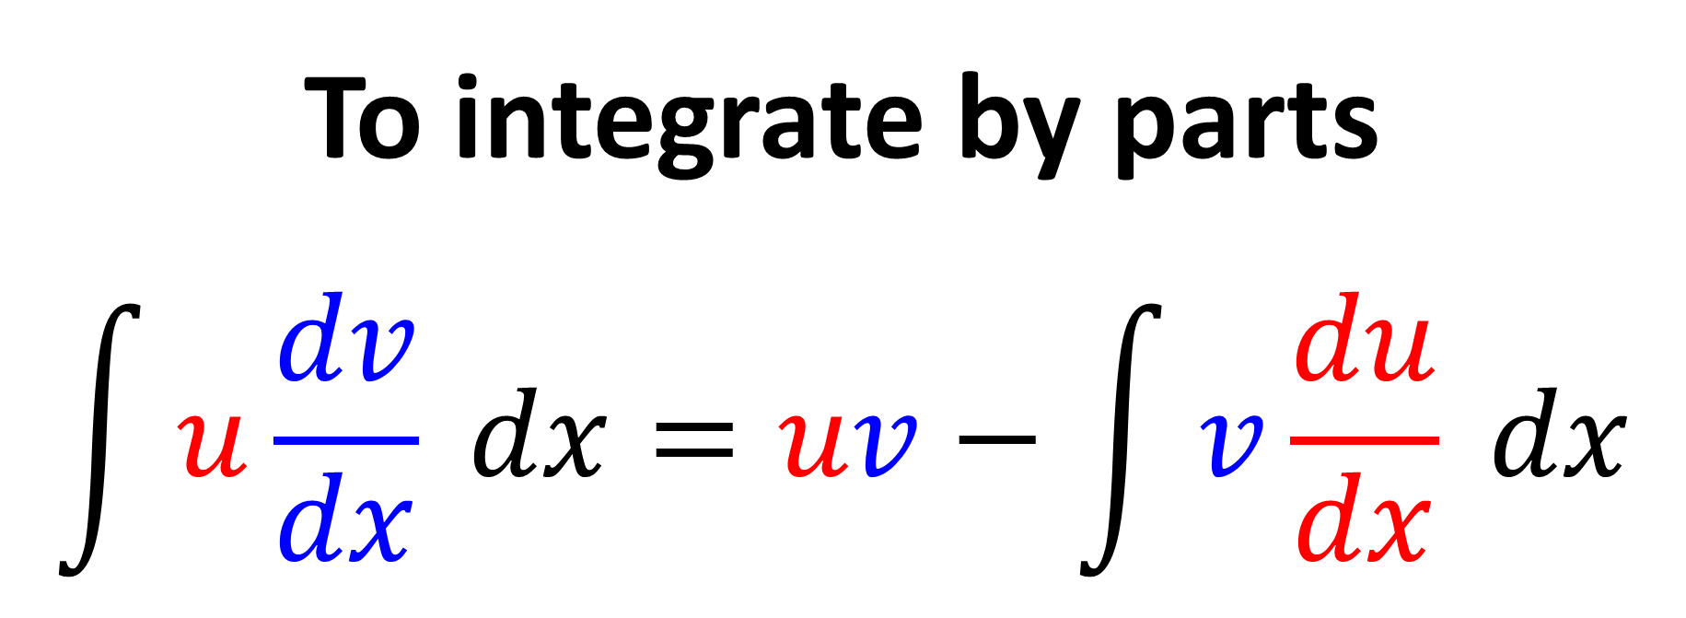
To integrate by parts
$$\int{u\frac{dv}{dx}} dx=uv−\int{v\frac{du}{dx} dx}$$
Given in the formula booklet

Slide 4
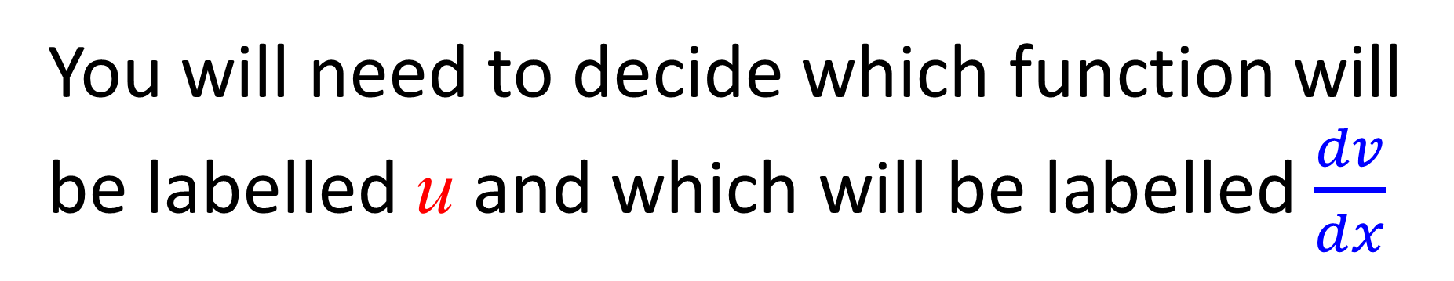
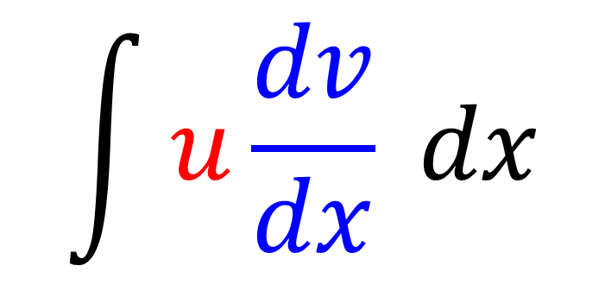
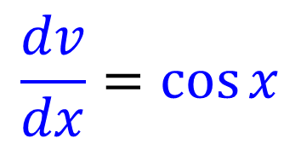
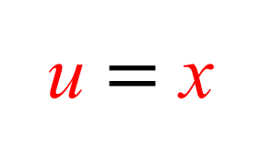
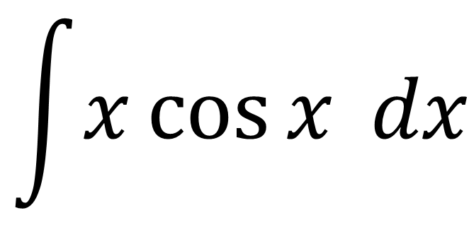
$$\int{u\frac{dv}{dx}} dx$$
You will need to decide which function will be labelled u and which will be labelled $\frac{dv}{dx}$
$$\int{x\cos{x} dx}$$
u $=$ x
$$\frac{dv}{dx}=\cos{x}$$

Slide 5
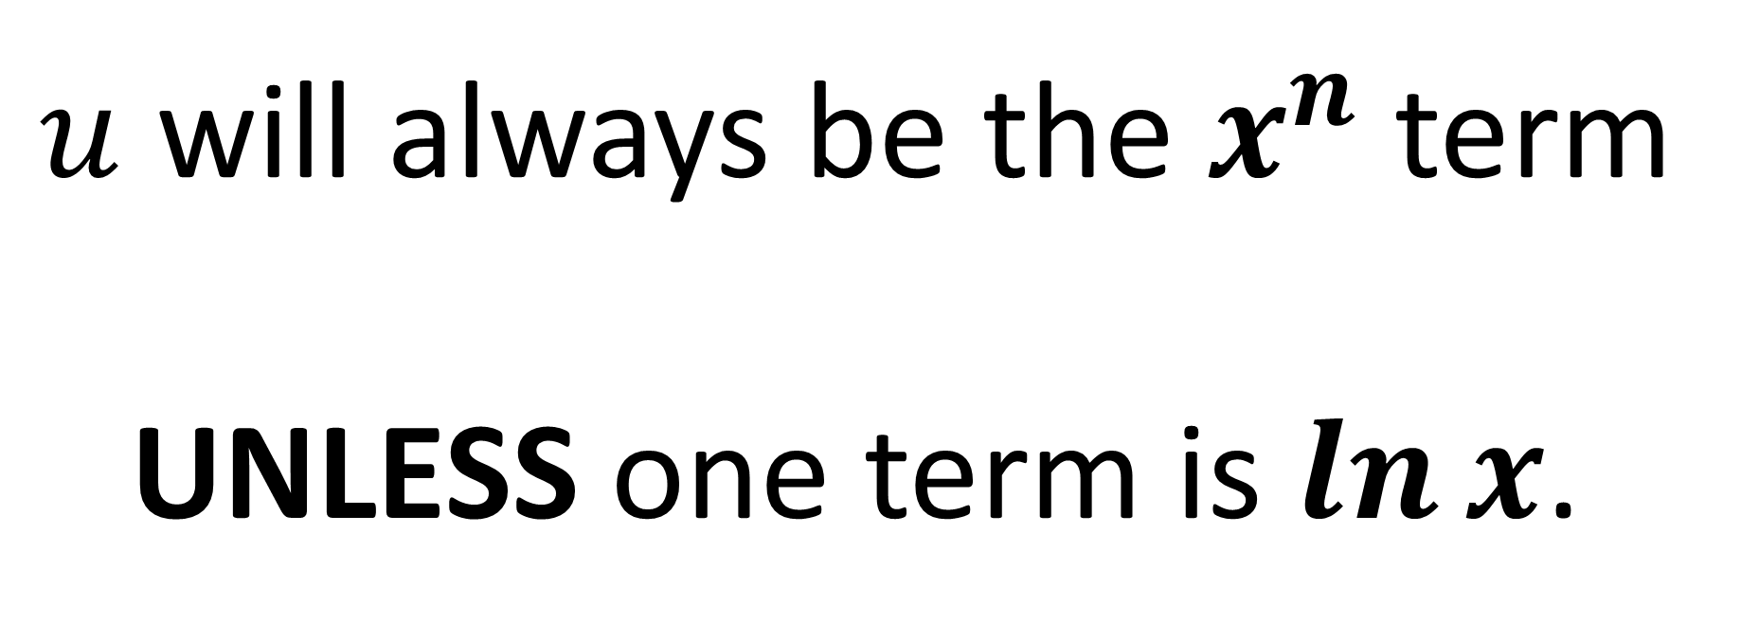
$u$ will always be the $x^{n}$ term
UNLESS one term is $\ln{x}$.

Slide 6
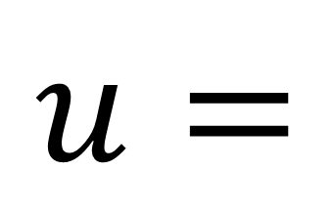
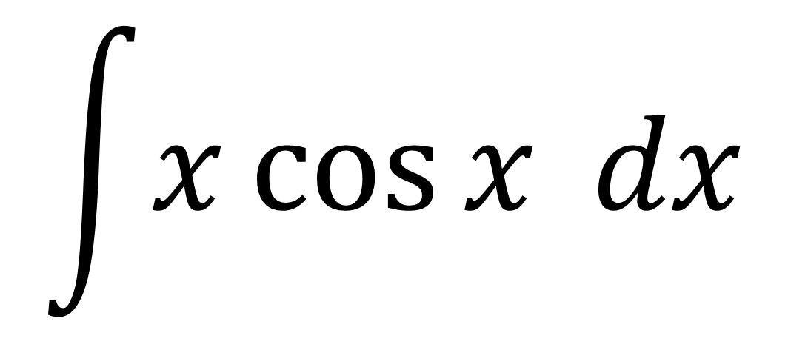


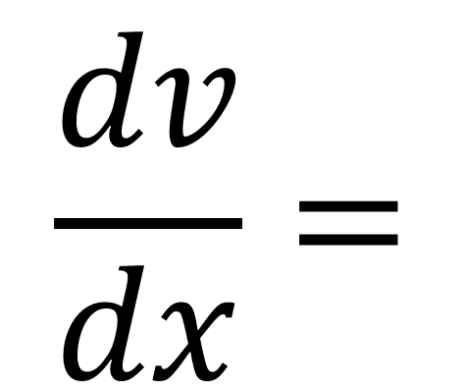
$$\int{x\cos{x} dx}$$
$$\frac{dv}{dx}=$$
$$u=$$
$$x$$
$$\cos{x}$$

Slide 7
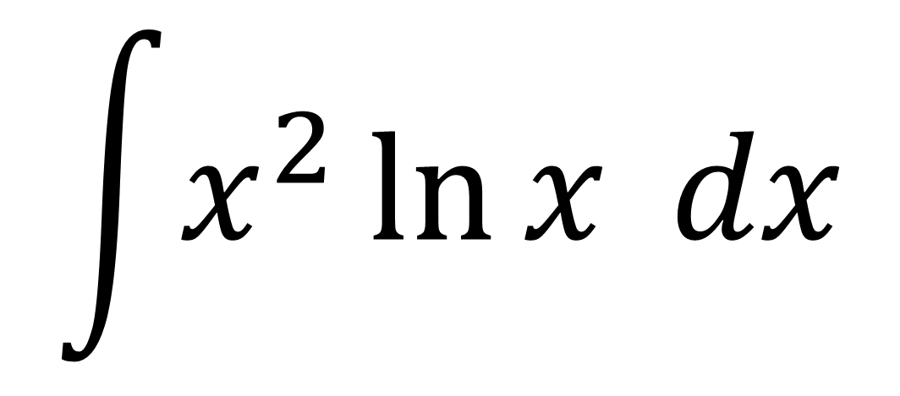
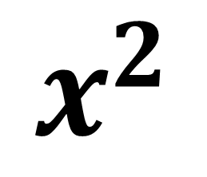
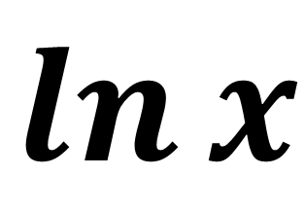
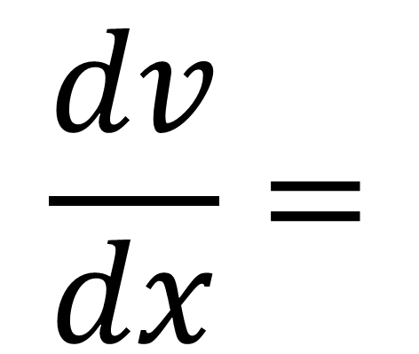
$$\int{x^{2}\ln{x} dx}$$
$$\frac{dv}{dx}=$$
$$u=$$
$$\ln{x}$$
$$x^{2}$$

Slide 8
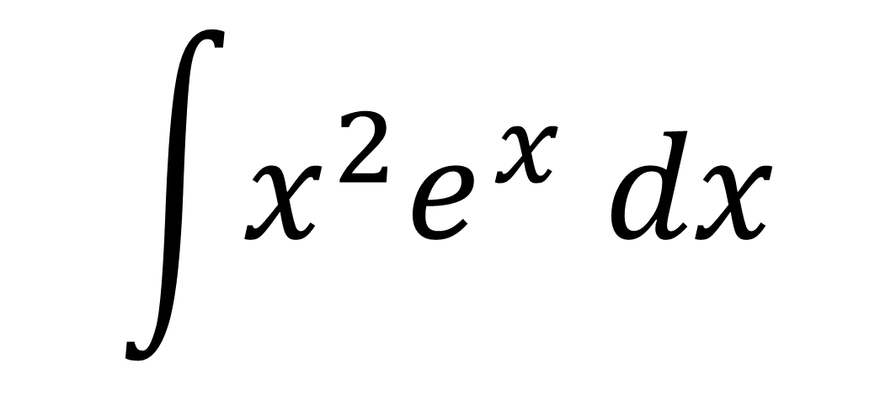
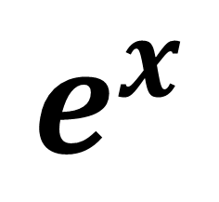
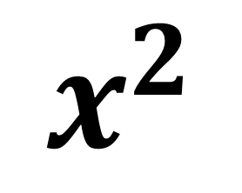
$$\int{x^{2}e^{x} dx}$$
$$\frac{dv}{dx}=$$
$$u=$$
$$x^{2}$$
$$e^{x}$$

Slide 9
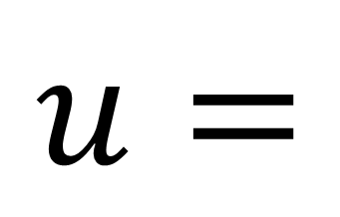
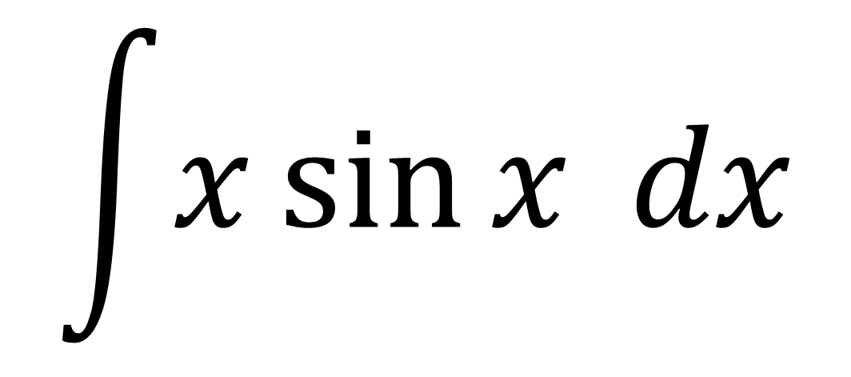


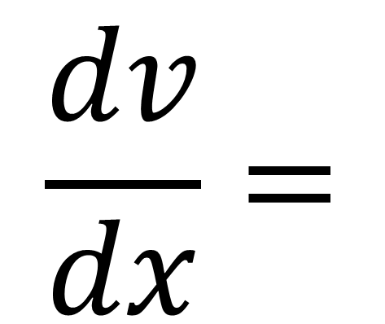
$$\int{x\sin{x} dx}$$
$$\frac{dv}{dx}=$$
$$u=$$
$$x$$
$$sin x$$

Slide 10
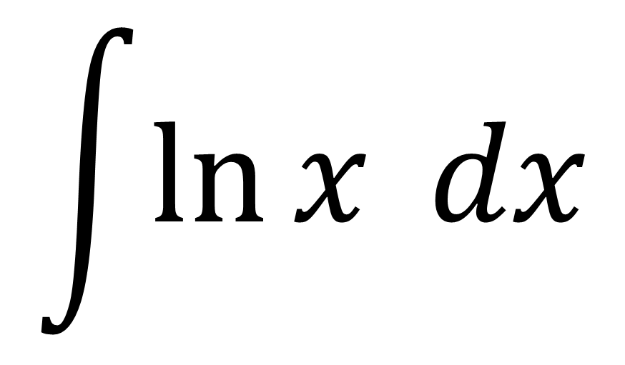

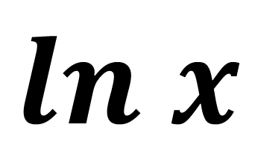
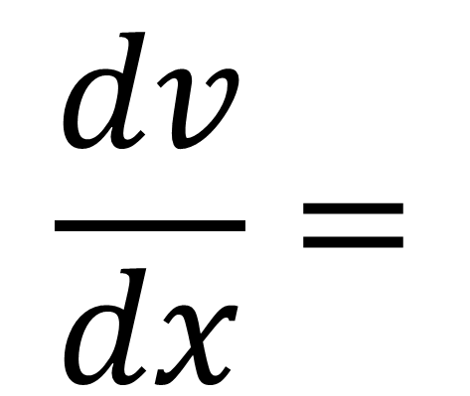
$$\int{\ln{x} dx}$$
Special Case
$$\frac{dv}{dx}=$$
$$u=$$
$$ln x$$
$$1$$

Slide 11
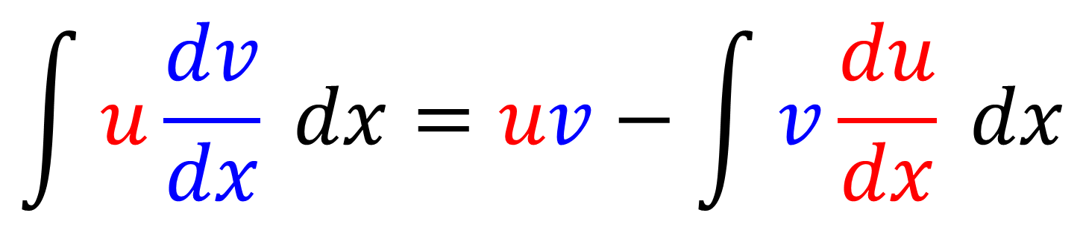
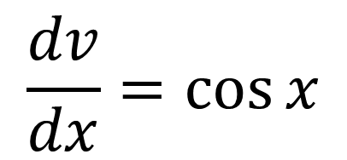

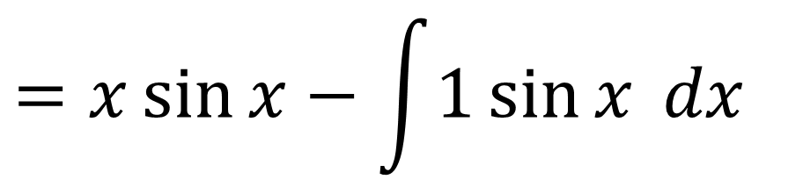
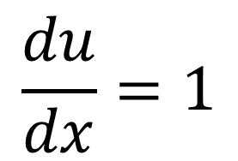
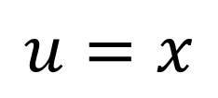
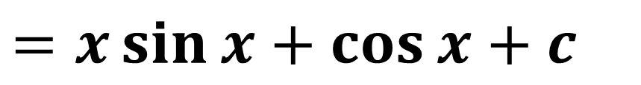
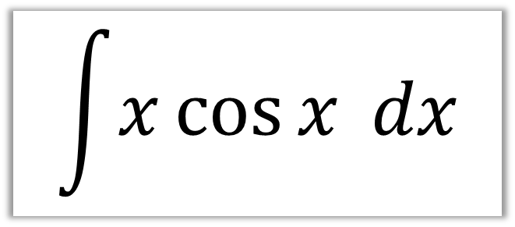
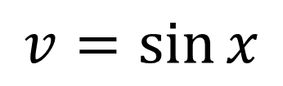
$$\int{x\cos{x} dx}$$
STEP 1: Assign labels
STEP 3: Write out formula
$$\frac{dv}{dx}=\cos{x}$$
$$=x\sin{x}−\int{1\sin{x} dx}$$
$$u=x$$
STEP 2: Find $\frac{du}{dx}$ and $v$
STEP 4: Integrate
$$\frac{du}{dx}=1$$
$$=x\sin{x}+\cos{x}+c$$
$$v=\sin{x}$$

Slide 12
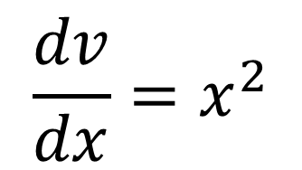
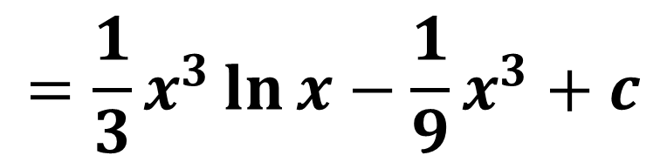


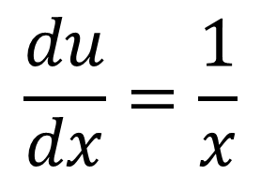
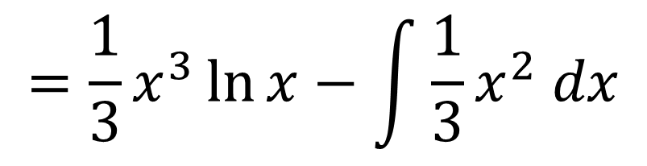
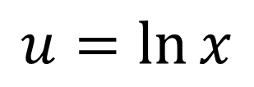
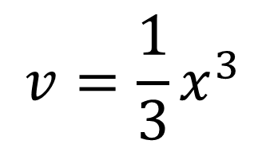
Find $\int{x^{2}\ln{x} dx}$
STEP 1: Assign labels
STEP 3: Write out formula
$$\frac{dv}{dx}=x^{2}$$
$$u=\ln{x}$$
$$=\frac{1}{3}x^{3}\ln{x}−\int{\frac{1}{3}x^{2} dx}$$
STEP 2: Find $\frac{du}{dx}$ and $v$
STEP 4: Integrate
$$\frac{du}{dx}=\frac{1}{x}$$
$$v=\frac{1}{3}x^{3}$$
$$=\frac{1}{3}x^{3}\ln{x}−\frac{1}{9}x^{3}+c$$

Slide 13
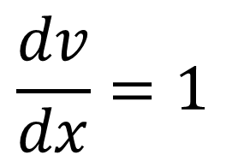
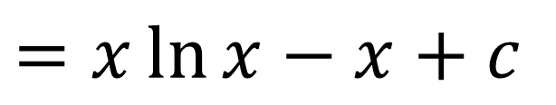


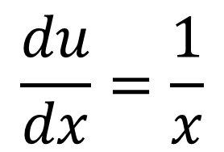
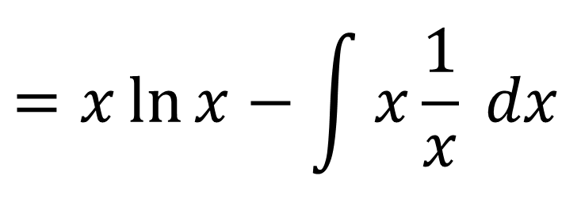
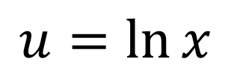
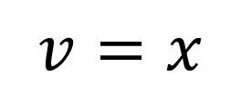
Find $\int{\ln{x} dx}$
Find $\int{1 ln{x} dx}$
STEP 1: Assign labels
STEP 3: Write out formula
$$\frac{dv}{dx}=1$$
$$=x\ln{x}−\int{x\frac{1}{x} dx}$$
$$u=\ln{x}$$
STEP 2: Find $\frac{du}{dx}$ and $v$
STEP 4: Integrate
$$\frac{du}{dx}=\frac{1}{x}$$
$$v=x$$
$$=x\ln{x}−x+c$$

Slide 14

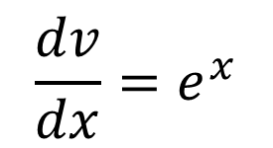


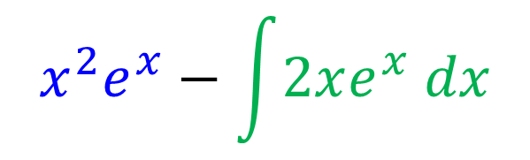
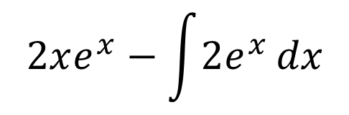


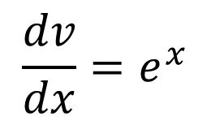
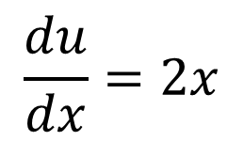







Integration by Parts Twice!
We have to apply IBP again for$\int{2xe^{x} dx}$
$$\frac{dv}{dx}=e^{x}$$
Find $\int{x^{2}e^{x} dx}$
STEP 4: Assign labels
$$u=2x$$
STEP 1: Assign labels
$$\frac{du}{dx}=2$$
$$\frac{dv}{dx}=e^{x}$$
STEP 5: Find $\frac{du}{dx}$ and $v$
$$v=e^{x}$$
$$u=x^{2}$$
STEP 2: Find $\frac{du}{dx}$ and $v$
$$2xe^{x}−\int{2e^{x}}dx$$
STEP 6: Write out formula
and integrate
$$\frac{du}{dx}=2x$$
$$v=e^{x}$$
$$=2xe^{x}−2e^{x}$$
STEP 7: Combine answers
STEP 3: Write out formula
$$x^{2}e^{x}−\left(2xe^{x}−2e^{x}\right)+c$$
$$x^{2}e^{x}−\int{2xe^{x} dx}$$
$$=x^{2}e^{x}−2xe^{x}+2e^{x}+c$$

Slide 15


Integration by Parts – Area Under a Graph
$$Area= {\left[uv−\int{v\frac{du}{dx}dx}\right]}_{a}^{b}$$

Slide 16









Find $\int_{1}^{2}{\ln{x}dx}$
leaving your answer in terms of natural logarithms.
STEP 1: Assign labels
STEP 3: Write out formula
$$x\ln{x}−\int{1 dx}$$
$$\frac{dv}{dx}=1$$
$$u=\ln{x}$$
STEP 4: Integrate
STEP 2: Find $\frac{du}{dx}$ and $v$
$${=\left[x\ln{x−x}\right]}_{1}^{2}$$
$$\frac{du}{dx}=\frac{1}{x}$$
STEP 5: Substitute Limits
$$v=x$$
$$=2\ln{2}−1$$

Slide 17











Find $\int_{0}^{\frac{π}{2}}{x\sin{x} dx}$
STEP 3: Write out formula
$$=−x\cos{x}−\int{−\cos{x} dx}$$
STEP 1: Assign labels
STEP 4: Integrate
$$\frac{dv}{dx}=\sin{x}$$
$$u=x$$
$$=−x\cos{x}+\sin{x}$$
STEP 5: Substitute Limits
STEP 2: Find $\frac{du}{dx}$ and $v$
$$={\left[−x\cos{x}+\sin{x}\right]}_{0}^{\frac{π}{2}}$$
$$\frac{du}{dx}=1$$
$$v=−\cos{x}$$
$$=\left(−\frac{π}{2}\cos{\frac{π}{2}}+\sin{\frac{π}{2}}\right)−\left(0+\sin{0}\right)=$$
$$1$$

