Slide 1
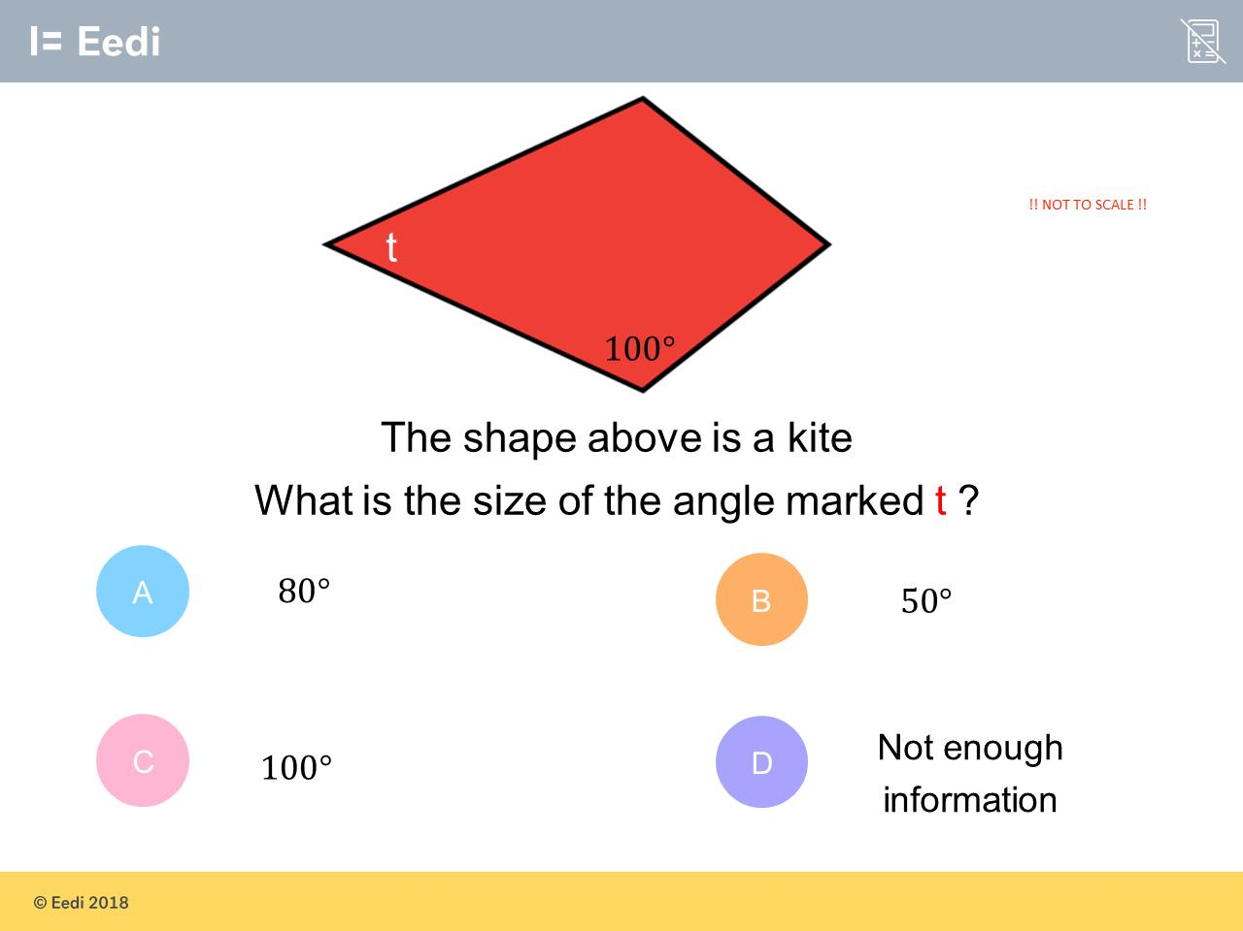
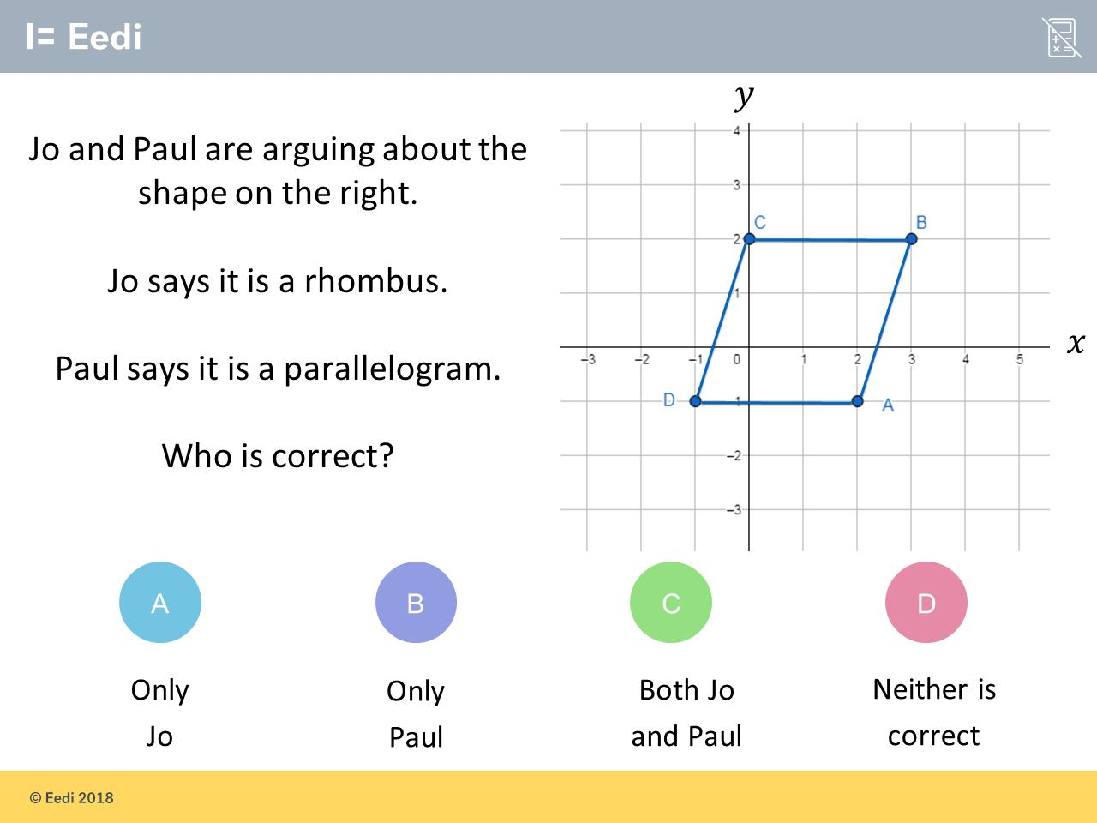
Worst answered question?
Most common wrong answer?

Slide 2
ANSWERS

Slide 3
Worst answered question?

Slide 4

A
The student may believe that the angles sum to 180.

Slide 5
C
The student may not be able to work out that the lengths
are different.

