Slide 1
Sequences and Series
Arithmetic Sequences
Chapter 3
(Part 1 of 8)

Slide 2
When you have a sequence
the first thing you should ask yourself is
‘what type of sequence do you have?’
Arithmetic Sequence
or
Geometric Sequence

Slide 3
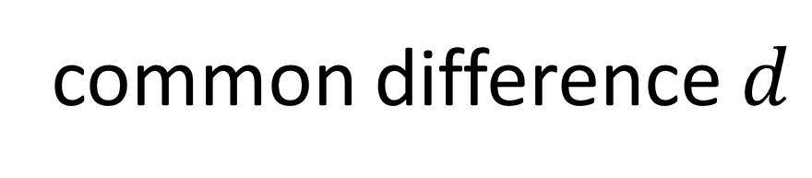
Arithmetic Sequence
common difference $d$
+3
+3
+3
2, 5, 8, 11, 14, …
An arithmetic sequence has
a common difference between terms.

Slide 4
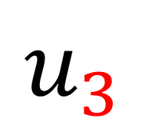
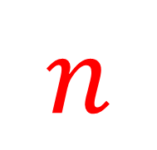

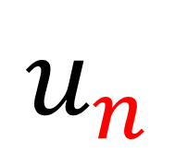
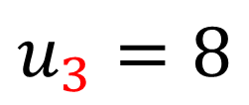
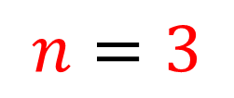
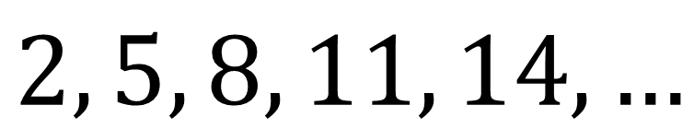
Notation
$$u_{n}$$
The $n$^{th} term.
$$n$$
The position of the term in the sequence.
$$u_{3}$$
The 3rd term.
$$u_{3}=8$$
$$n=3$$
$$2, 5, 8, 11, 14, …$$

Slide 5
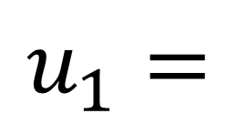
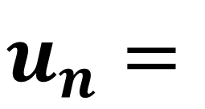
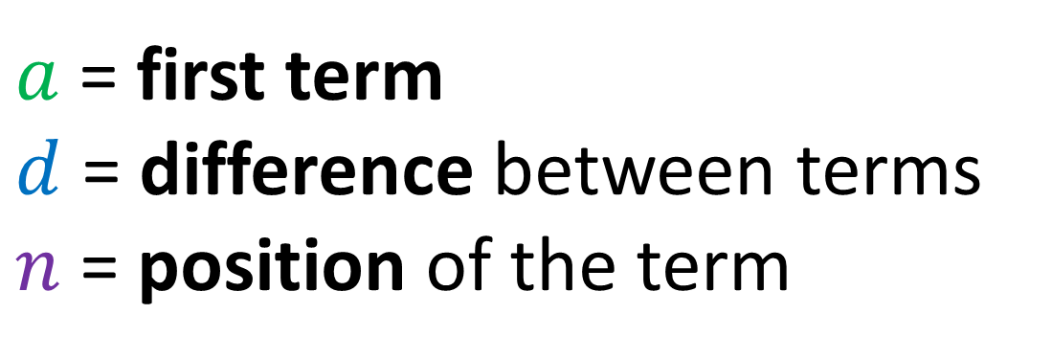
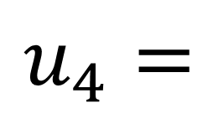
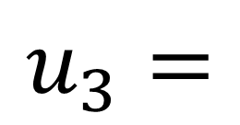
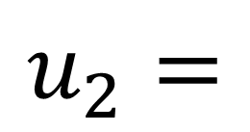
$a$ = first term
$d$ = difference between terms
$n$ = position of the term
$$u_{1}=$$
a
$$u_{2}=$$
a + 1d
$$u_{3}=$$
a + 2d
$$u_{4}=$$
a + 3d
$$u_{n}=$$
a + (n – 1)d

Slide 6
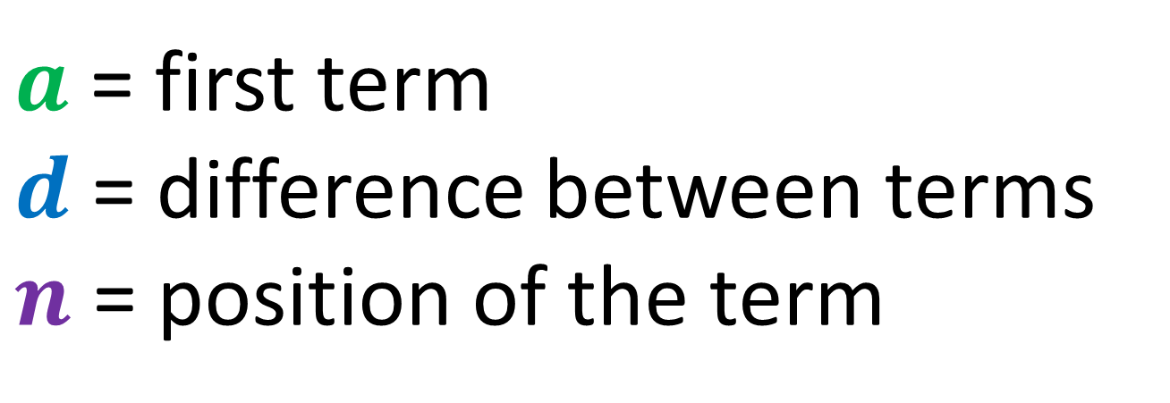


$n$^{th} term
$a$ = first term
$d$ = difference between terms
$n$ = position of the term
$n$^{th} term of arithmetic sequence
$$u_{n}=a+\left(n−1\right)d$$

Slide 7
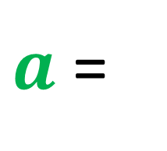

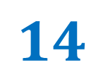
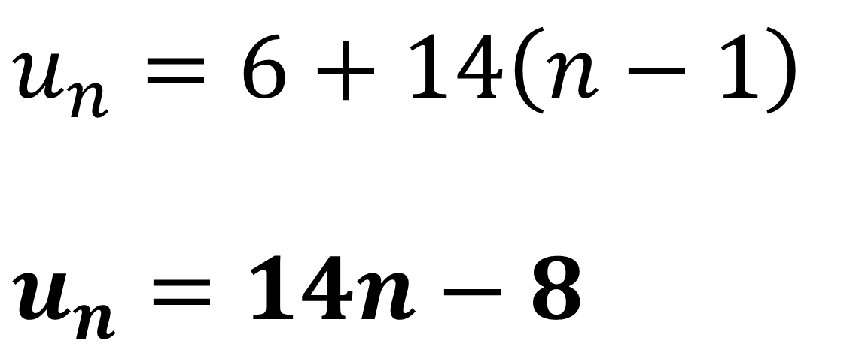

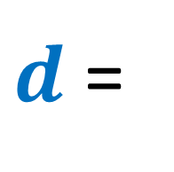
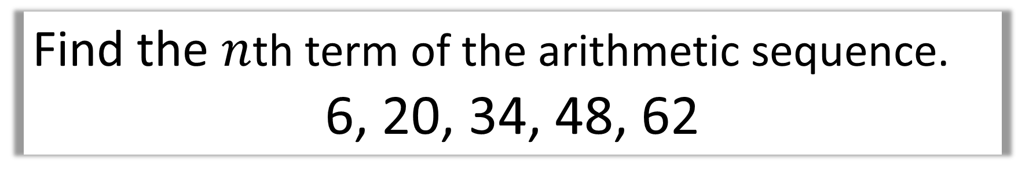
Find the $n$th term of the arithmetic sequence.
6, 20, 34, 48, 62
$$u_{n}=a+\left(n−1\right)d$$
$a$ =
$$6$$
$d$ =
$$14$$
$$u_{n}=6+14\left(n−1\right)$$
$$u_{n}=14n−8$$

Slide 8
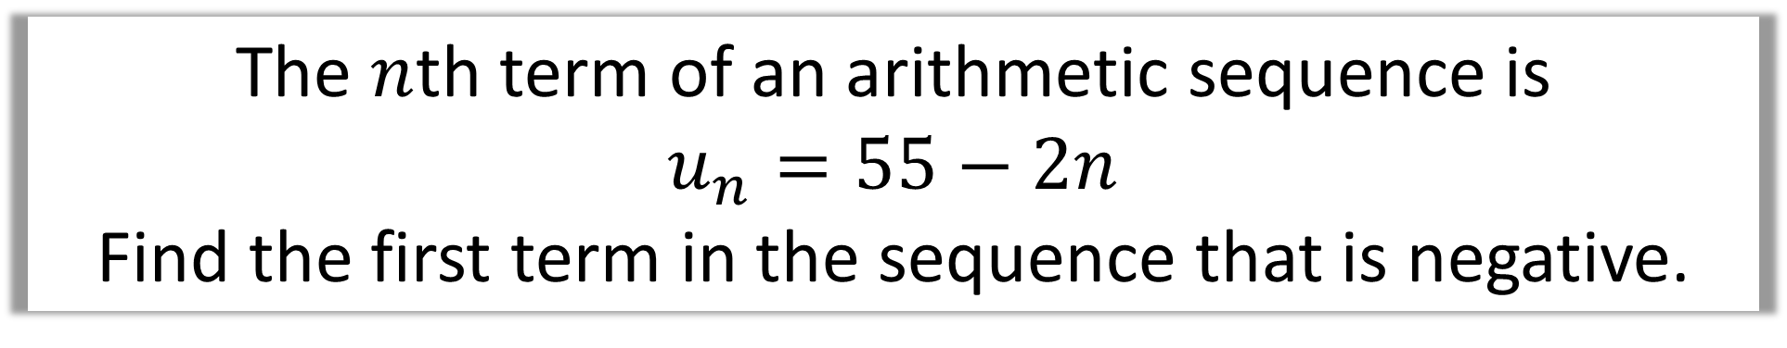
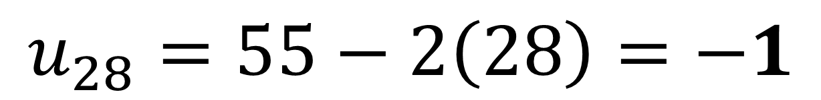
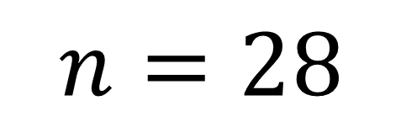
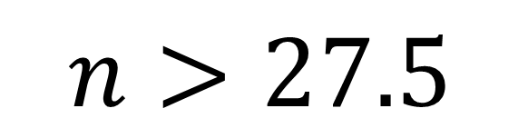
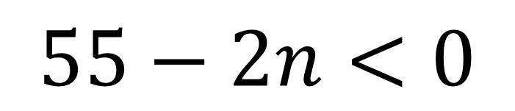
The $n$th term of an arithmetic sequence is
$$u_{n}=55−2n$$
Find the first term in the sequence that is negative.
$$55−2n<0$$
$$n>27.5$$
$$n=28$$
$$u_{28}=55−2\left(28\right)=−1$$

Slide 9
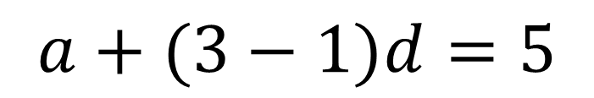
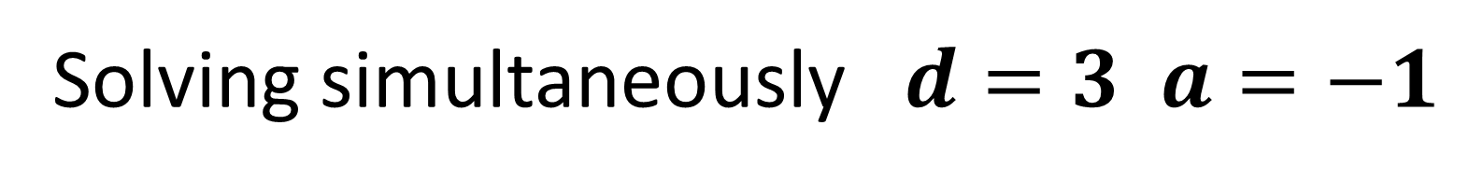
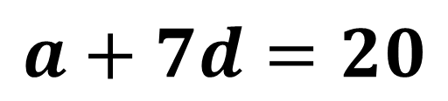
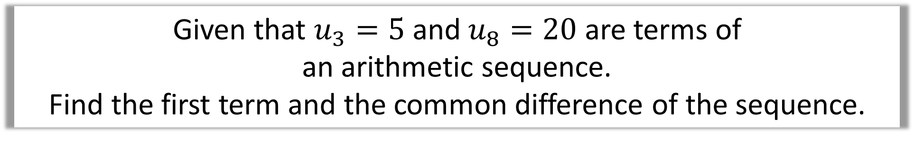
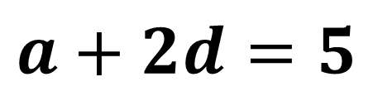
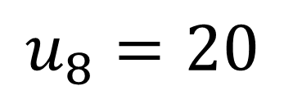

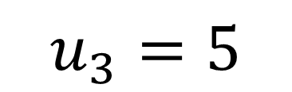
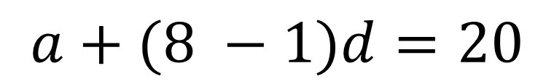
Given that $u_{3}=5$ and $u_{8}=20$ are terms of
an arithmetic sequence.
Find the first term and the common difference of the sequence.
$$u_{n}=a+\left(n−1\right)d$$
$$u_{3}=5$$
$$a+(3−1)d=5$$
$$a+2d=5$$
$$u_{8}=20$$
$$a+(8 −1)d=20$$
$$a+7d=20$$
Solving simultaneously $d=3 a=−1$

Slide 10
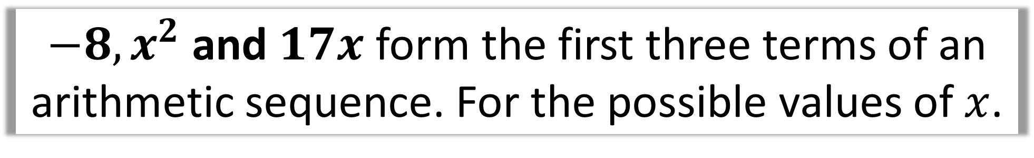
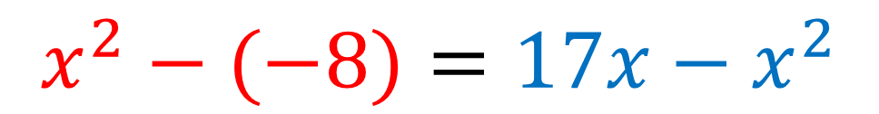
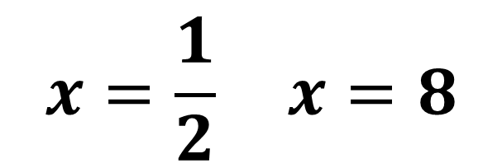
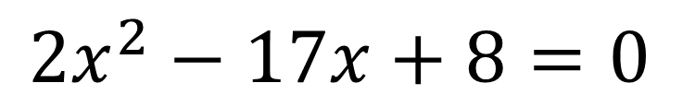
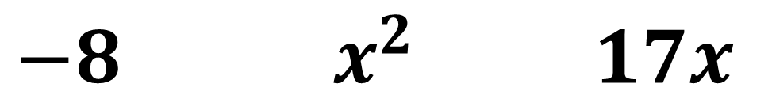
$−8, x^{2}$ and $17x$ form the first three terms of an arithmetic sequence. For the possible values of $x$.
$−8 { x}^{2}$ $17x$
1st
Difference
2nd
Difference
$$x^{2}−(−8)=17x−x^{2}$$
$$2x^{2}−17x+8=0$$
$$x=\frac{1}{2} x=8$$

Slide 11
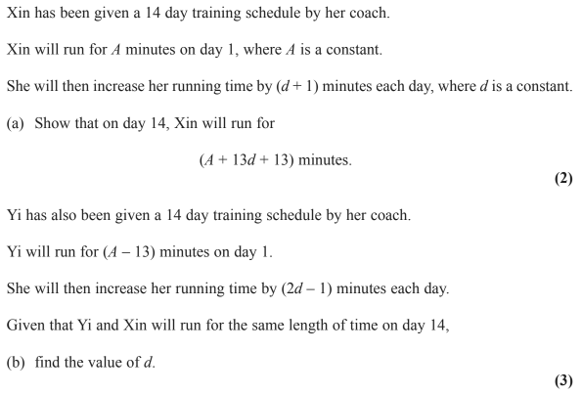

Slide 12
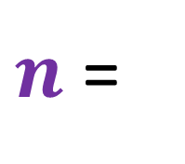
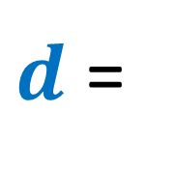
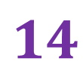
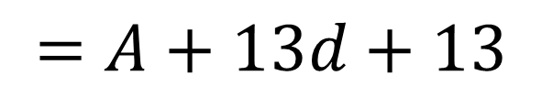
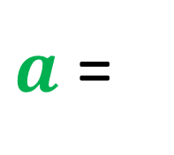
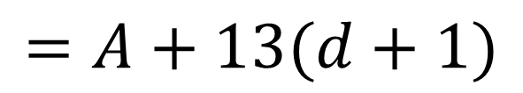
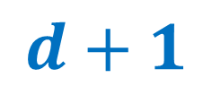
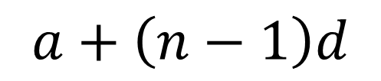

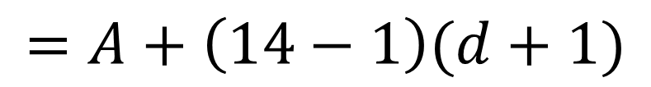
$a$ =
$$A$$
$d$ =
$$d+1$$
$n$ =
$$14$$
$$a+\left(n−1\right)d$$
$$=A+\left(14−1\right)(d+1)$$
$$=A+13(d+1)$$
$$=A+13d+13$$

Slide 13










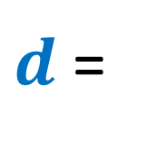


$a$ =
$$A−13$$
$d$ =
$$2d−1$$
$n$ =
$$14$$
$$A−13+\left(14 −1\right)(2d−1)$$
$$A+13d+13=A+26d−26$$
$$=A−13+13(2d−1)$$
$$39=13d$$
$$=A−13+26d−13$$
$$d=3$$
$$=A+26d−26$$

