Slide 1
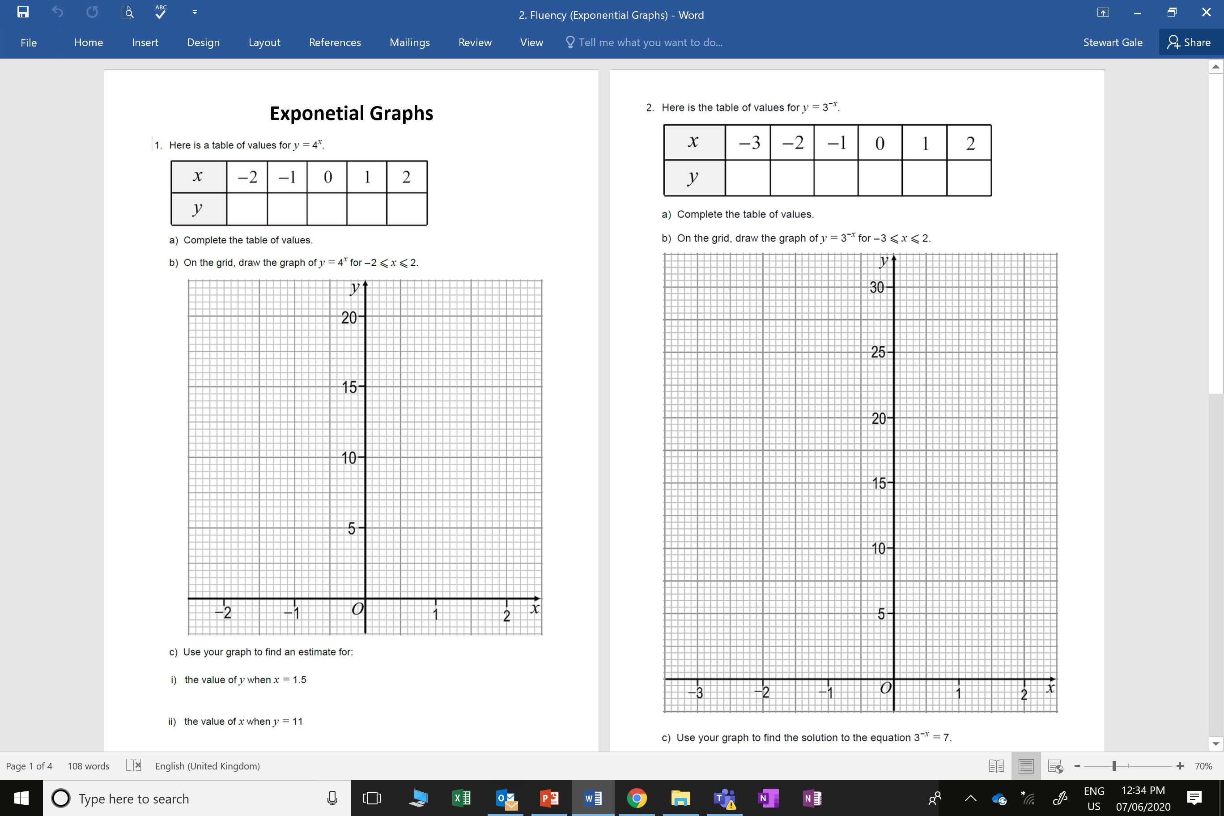

Slide 2
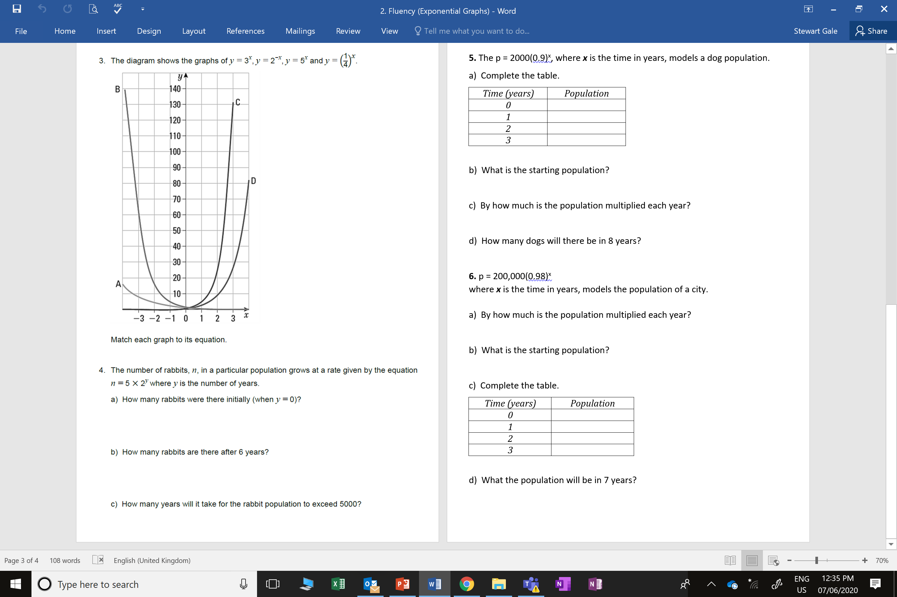

Slide 3
ANSWERS

Slide 4
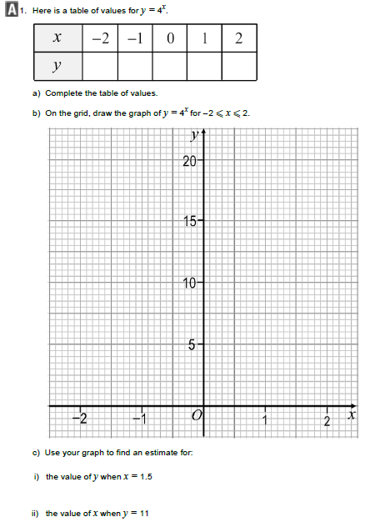
1/16
1/4
1
4
16
y = 8.5 +1
x = 1.6 +0.1

Slide 5
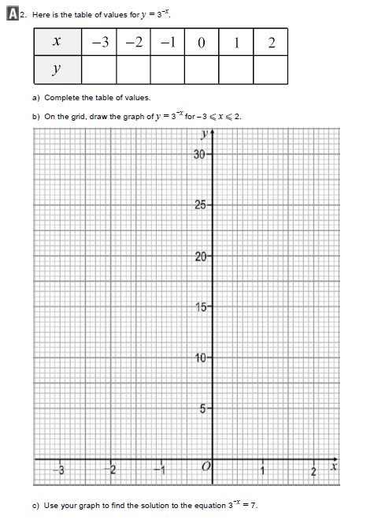
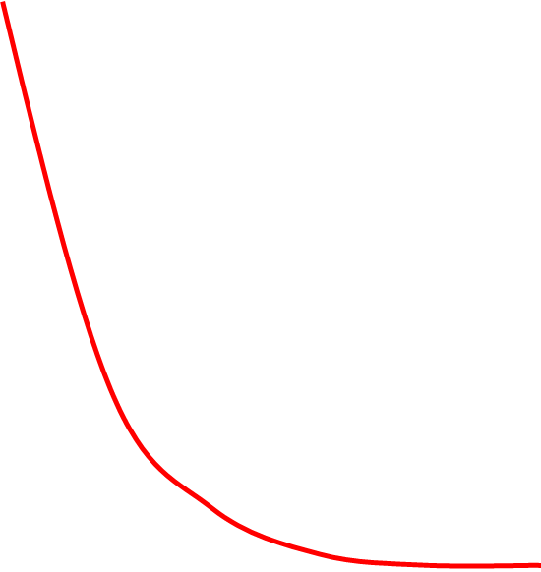
27
9
3
1
1/3
1/9
x = -1.8 +0.1

Slide 6
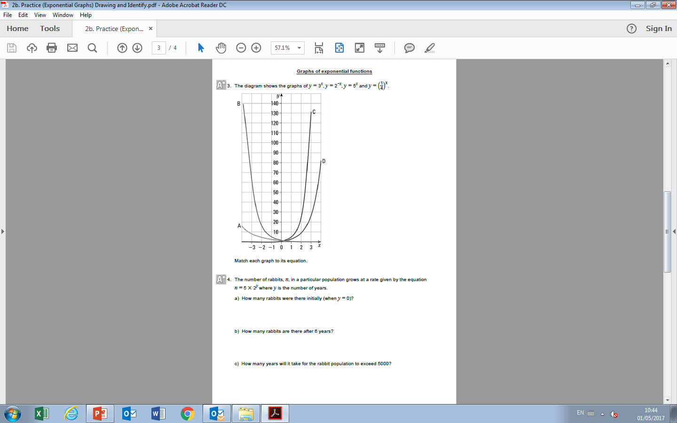
B: y = (1/4)^{X}
A: y = (2)^{-X}
D: y = (3)^{X}
C: y = (5)^{X}

Slide 7
5
320
5000 = 5(2^{Y})
2¹⁰ = 1024
2⁹ = 512
y = 10

Slide 8
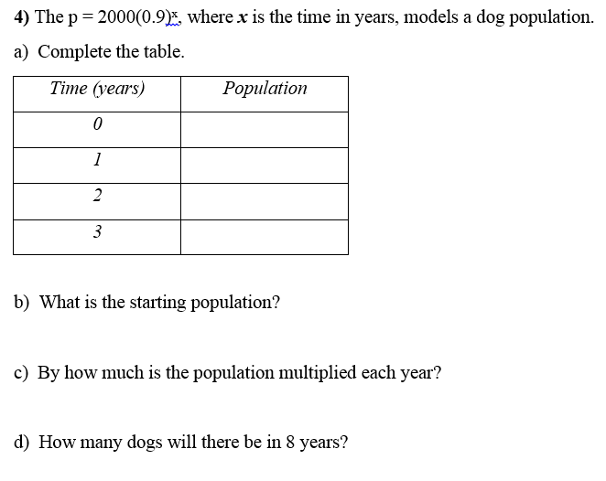
5.
2000
1800
1620
1458
2000
0.9
860

Slide 9
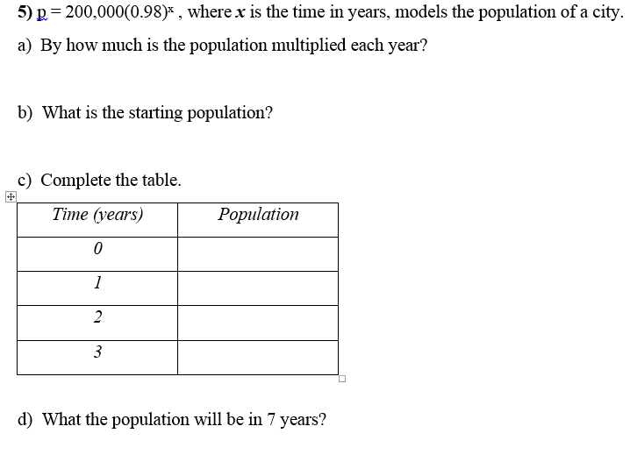
6.
0.98
2000000
200000
196000
192080
188238
173625

