Slide 1
Elastic Collisions in 1D
Loss of K.E.
Chapter 4
(Part 4 of 5)

Slide 2

Loss of Kinetic Energy
The Kinetic Energy of an object can be found if it’s speed is known using $\frac{1}{2}mv^{2}$

Slide 3
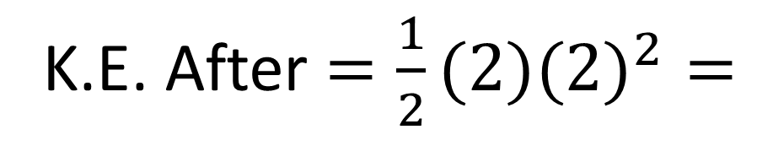
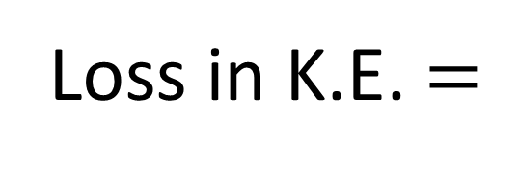
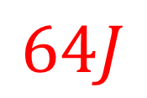

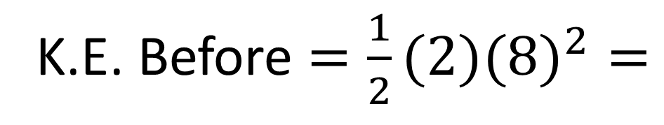
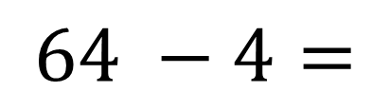
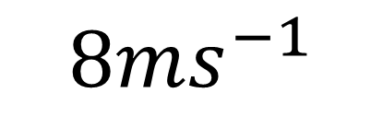
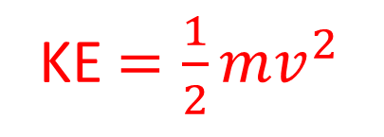
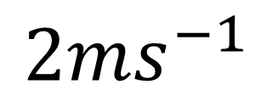

KE $=\frac{1}{2}mv^{2}$
$$8ms^{−1}$$
K.E. Before $=\frac{1}{2}(2)({8)}^{2}=$
$$64J$$
2kg
K.E. After $=\frac{1}{2}(2)({2)}^{2}=$
$$4J$$
$$2ms^{−1}$$
Loss in K.E. $=$
$$64 −4=$$
$$60J$$

Slide 4
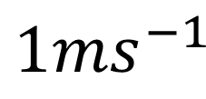
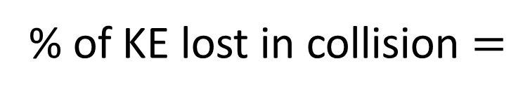
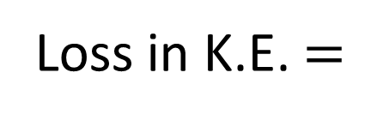
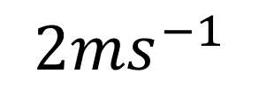

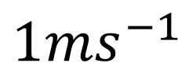
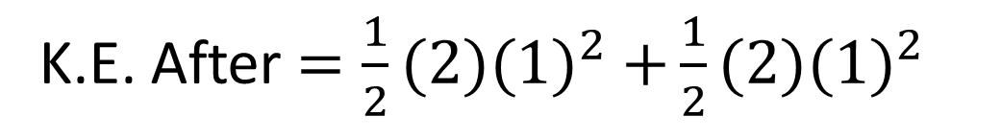


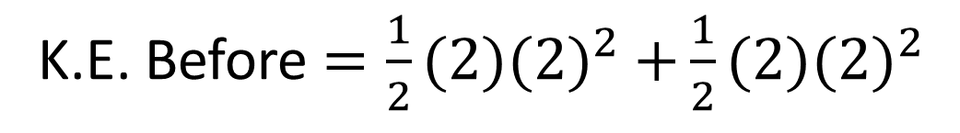
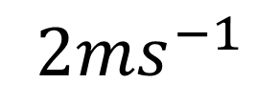

$$2ms^{−1}$$
$$2ms^{−1}$$
K.E. Before $=\frac{1}{2}(2)({2)}^{2}$ $+\frac{1}{2}(2)({2)}^{2}$
2kg
2kg
$$=8J$$
K.E. After $=\frac{1}{2}(2)({1)}^{2}$ $+\frac{1}{2}(2)({1)}^{2}$
$$1ms^{−1}$$
$$1ms^{−1}$$
$$=2J$$
Loss in K.E. $=$
$$6J$$
% of KE lost in collision $=$
$$75\%$$

Slide 5
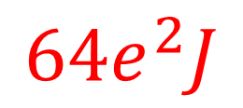
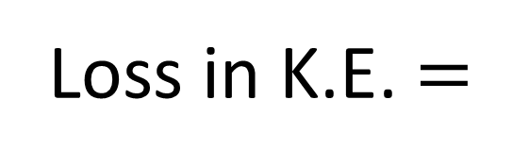
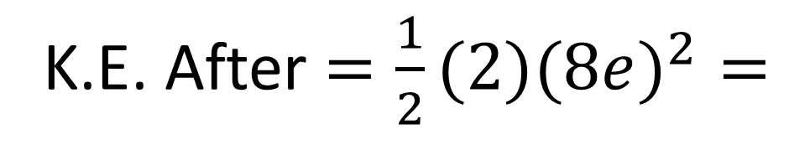
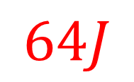
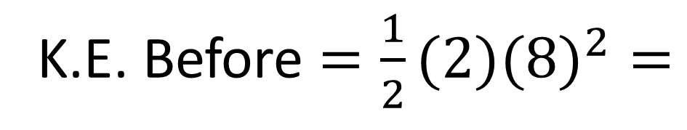

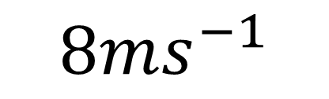
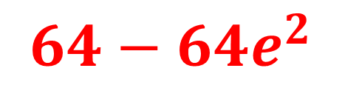
$$8ms^{−1}$$
K.E. Before $=\frac{1}{2}(2)({8)}^{2}=$
$$64J$$
2kg
$e$
K.E. After $=\frac{1}{2}(2)({8e)}^{2}=$
$${64e}^{2}J$$
8e
Loss in K.E. $=$
$$64−{64e}^{2}$$

Slide 6
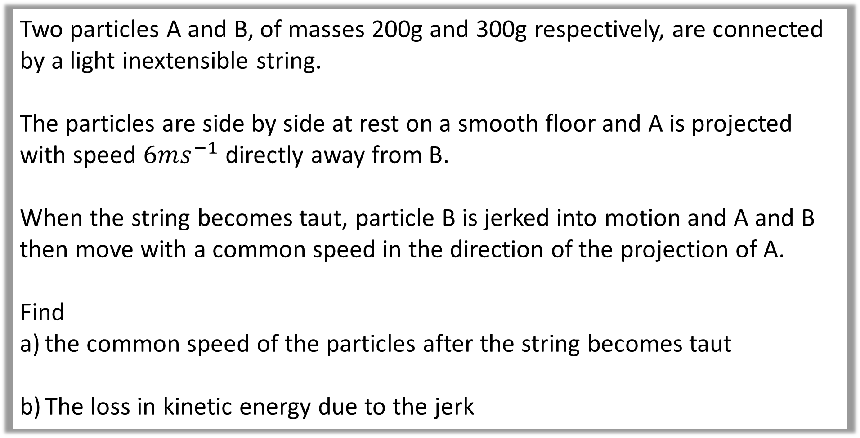
Question A
Two particles A and B, of masses 200g and 300g respectively, are connected by a light inextensible string.
The particles are side by side at rest on a smooth floor and A is projected with speed $6ms^{−1}$ directly away from B.
When the string becomes taut, particle B is jerked into motion and A and B then move with a common speed in the direction of the projection of A.
Find
the common speed of the particles after the string becomes taut
The loss in kinetic energy due to the jerk

Slide 7

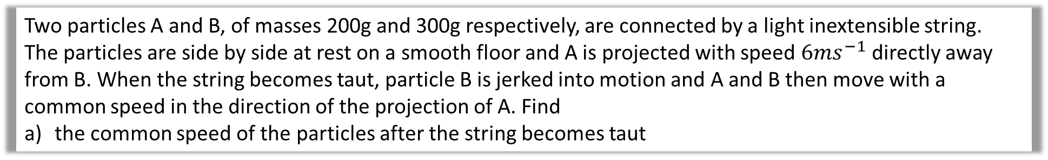






Two particles A and B, of masses 200g and 300g respectively, are connected by a light inextensible string.
The particles are side by side at rest on a smooth floor and A is projected with speed $6ms^{−1}$ directly away from B. When the string becomes taut, particle B is jerked into motion and A and B then move with a common speed in the direction of the projection of A. Find
the common speed of the particles after the string becomes taut
a.
$$6$$
$$0$$
$$6\left(0.2\right)+0\left(0.3\right)=0.2v+0.3v$$
0.2
0.3
$$1.2=0.5v$$
$$v$$
$$v$$
$$v=2.4$$

Slide 8
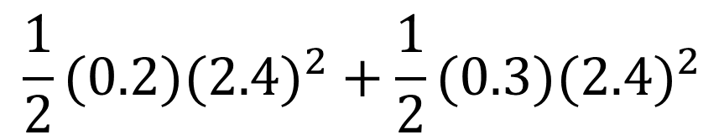

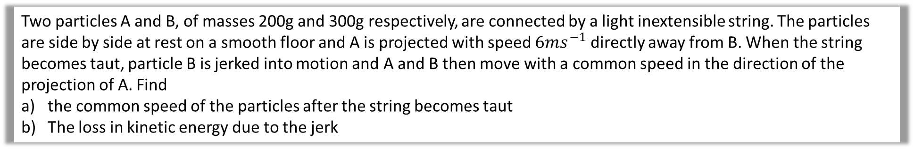
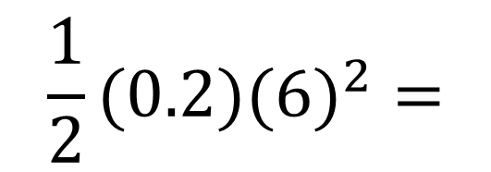
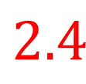
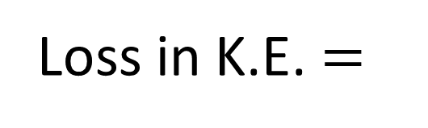


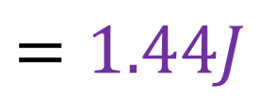

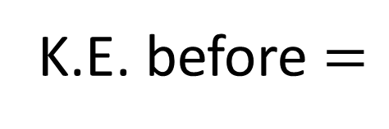
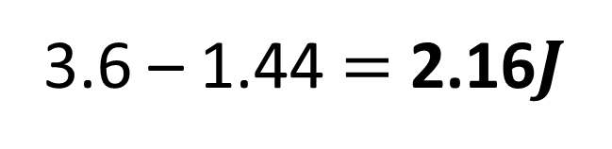

Two particles A and B, of masses 200g and 300g respectively, are connected by a light inextensible string. The particles are side by side at rest on a smooth floor and A is projected with speed $6ms^{−1}$ directly away from B. When the string becomes taut, particle B is jerked into motion and A and B then move with a common speed in the direction of the projection of A. Find
the common speed of the particles after the string becomes taut
The loss in kinetic energy due to the jerk
b.
$$\frac{1}{2}(0.2)({6)}^{2}=$$
K.E. before $=$
$$3.6J$$
$$6$$
$$0$$
$$\frac{1}{2}(0.2)({2.4)}^{2}+\frac{1}{2}(0.3)({2.4)}^{2}$$
0.2
0.3
K.E. after $=$
$$=1.44J$$
$$2.4$$
$$2.4$$
Loss in K.E. $=$
3.6 – 1.44 $=$ 2.16$J$

