Slide 1
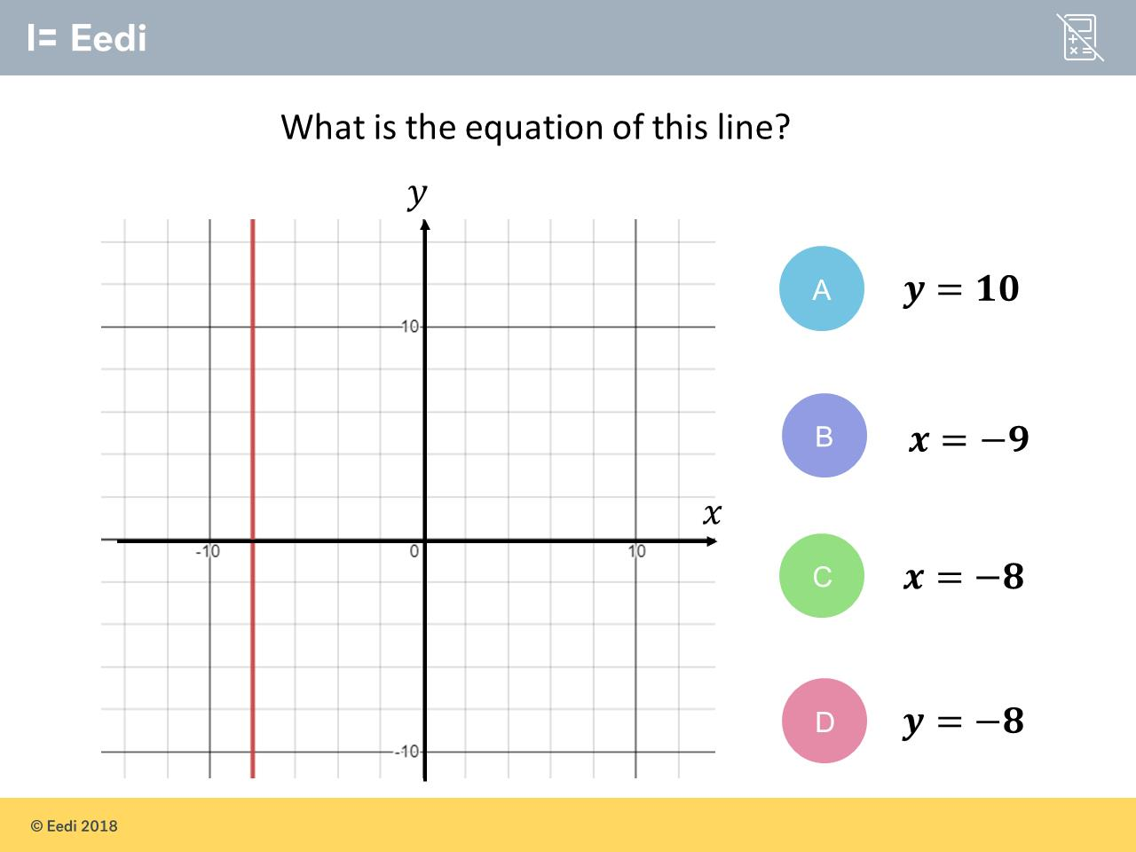
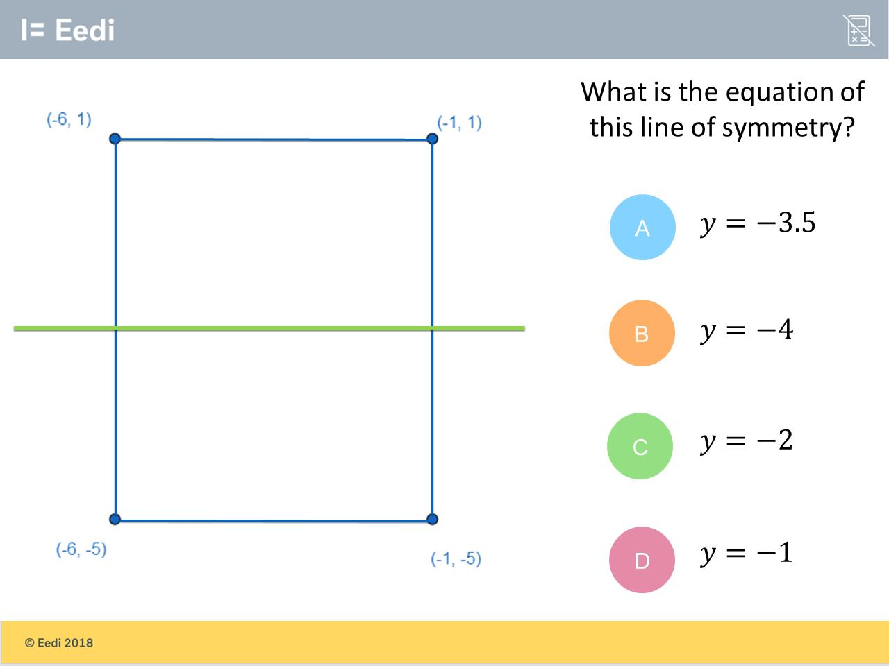
(-6, 1)
(-1, 1)
(-6, -5)
(-1, 5)
Worst answered question?
Most common wrong answer?

Slide 2
ANSWERS

Slide 3
Worst answered question?

Slide 4
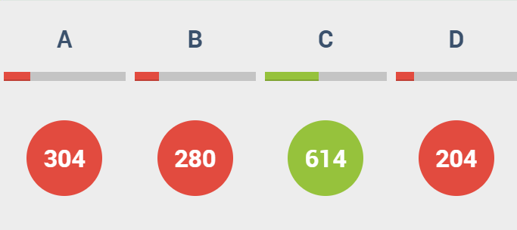
(-6, 1)
(-1, 1)
A
The student appears to have worked out the vertical line of symmetry.
(-6, -5)
(-1, 5)

Slide 5
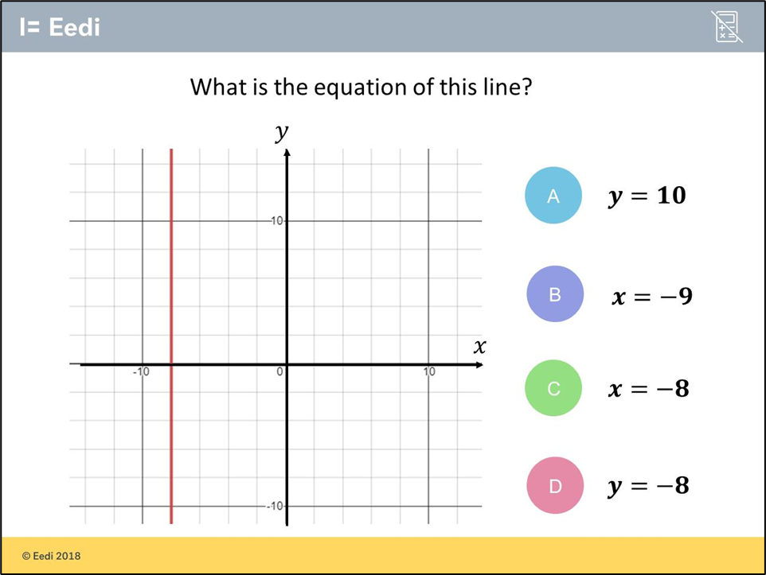
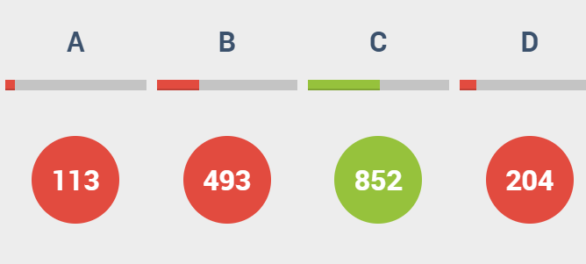
B
They did not check the scale of the x axis.

