Slide 1
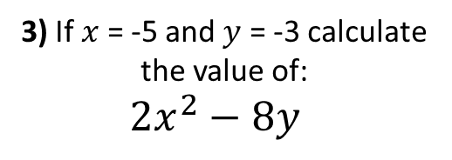
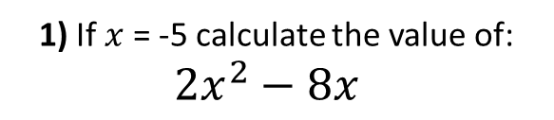
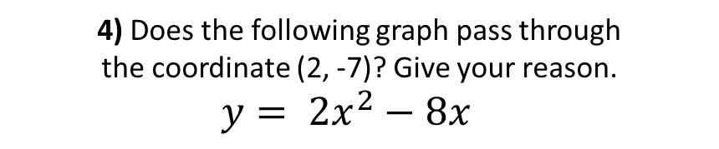
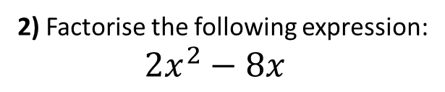
1) If $x$ = -5 calculate the value of:
${2x}^{2}−8x$
2) Factorise the following expression:
${2x}^{2}−8x$
3) If $x$ = -5 and $y$ = -3 calculate the value of:
${2x}^{2}−8y$
4) Does the following graph pass through
the coordinate (2, -7)? Give your reason.
$$y= {2x}^{2}−8x$$

Slide 2
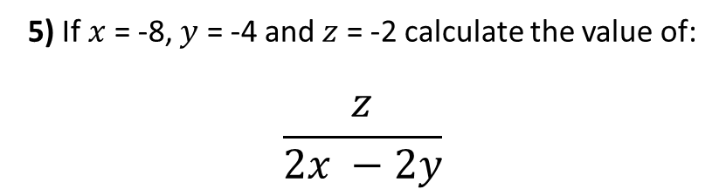
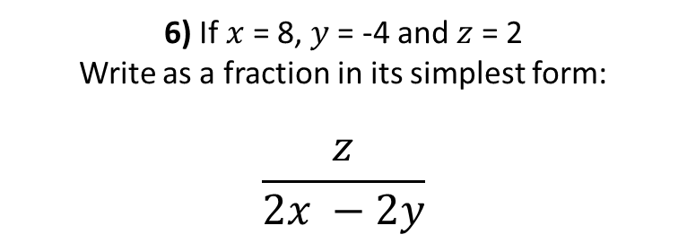
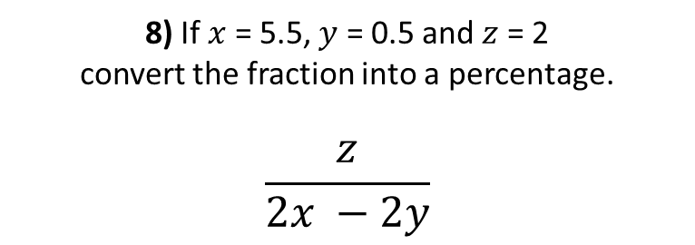
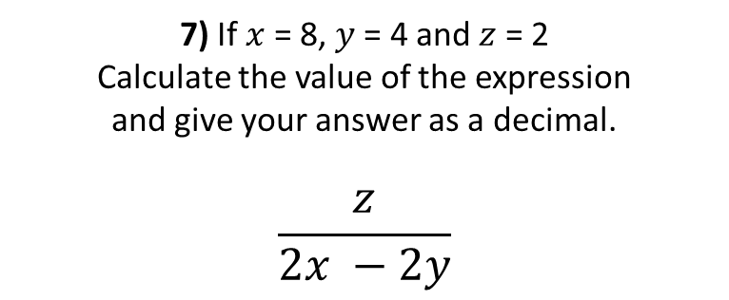
5) If $x$ = -8, $y$ = -4 and $z$ = -2 calculate the value of:
$$\frac{z}{2x −2y}$$
6) If $x$ = 8, $y$ = -4 and $z$ = 2
Write as a fraction in its simplest form:
$$\frac{z}{2x −2y}$$
7) If $x$ = 8, $y$ = 4 and $z$ = 2
Calculate the value of the expression
and give your answer as a decimal.
$$\frac{z}{2x −2y}$$
8) If $x$ = 5.5, $y$ = 0.5 and $z$ = 2
convert the fraction into a percentage.
$$\frac{z}{2x −2y}$$

Slide 3
ANSWERS

Slide 4
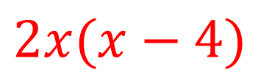
1) If $x$ = -5 calculate the value of:
${2x}^{2}−8x$
2) Factorise the following expression:
${2x}^{2}−8x$
50 + 40 = 90
$$2x(x−4)$$
3) If $x$ = -5 and $y$ = -3 calculate the value of:
${2x}^{2}−8y$
4) Does the following graph pass through
the coordinate (2, -7)? Give your reason.
$$y= {2x}^{2}−8x$$
y = 2(2)² – 8(2)
50 + 24 = 74
y = 8 – 16
-8 ≠ -7
so does not pass
through (2,-7)
y = -8

Slide 5
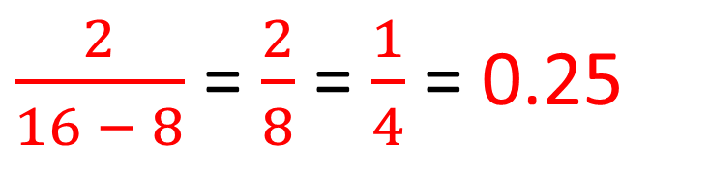
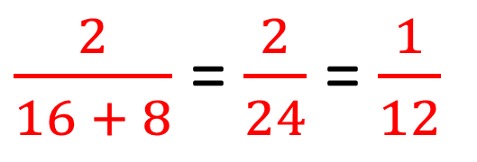
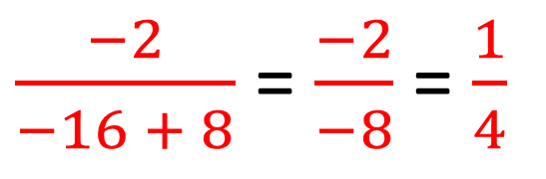
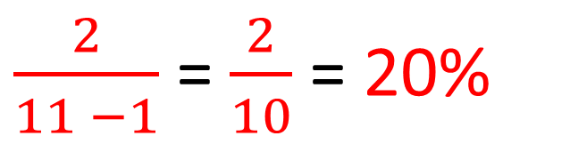
5) If $x$ = -8, $y$ = -4 and $z$ = -2 calculate the value of:
$$\frac{z}{2x −2y}$$
6) If $x$ = 8, $y$ = -4 and $z$ = 2
Write as a fraction in its simplest form:
$$\frac{z}{2x −2y}$$
$\frac{−2}{−16 + 8}$ = $\frac{−2}{−8}$ = $\frac{1}{4}$
$\frac{2}{16 + 8}$ = $\frac{2}{24}$ = $\frac{1}{12}$
7) If $x$ = 8, $y$ = 4 and $z$ = 2
Calculate the value of the expression
and give your answer as a decimal.
$$\frac{z}{2x −2y}$$
8) If $x$ = 5.5, $y$ = 0.5 and $z$ = 2
convert the fraction into a percentage.
$$\frac{z}{2x −2y}$$
$\frac{2}{11 −1}$ = $\frac{2}{10}$ = 20%
$\frac{2}{16 − 8}$ = $\frac{2}{8}$ = $\frac{1}{4}$ = 0.25

