Slide 1
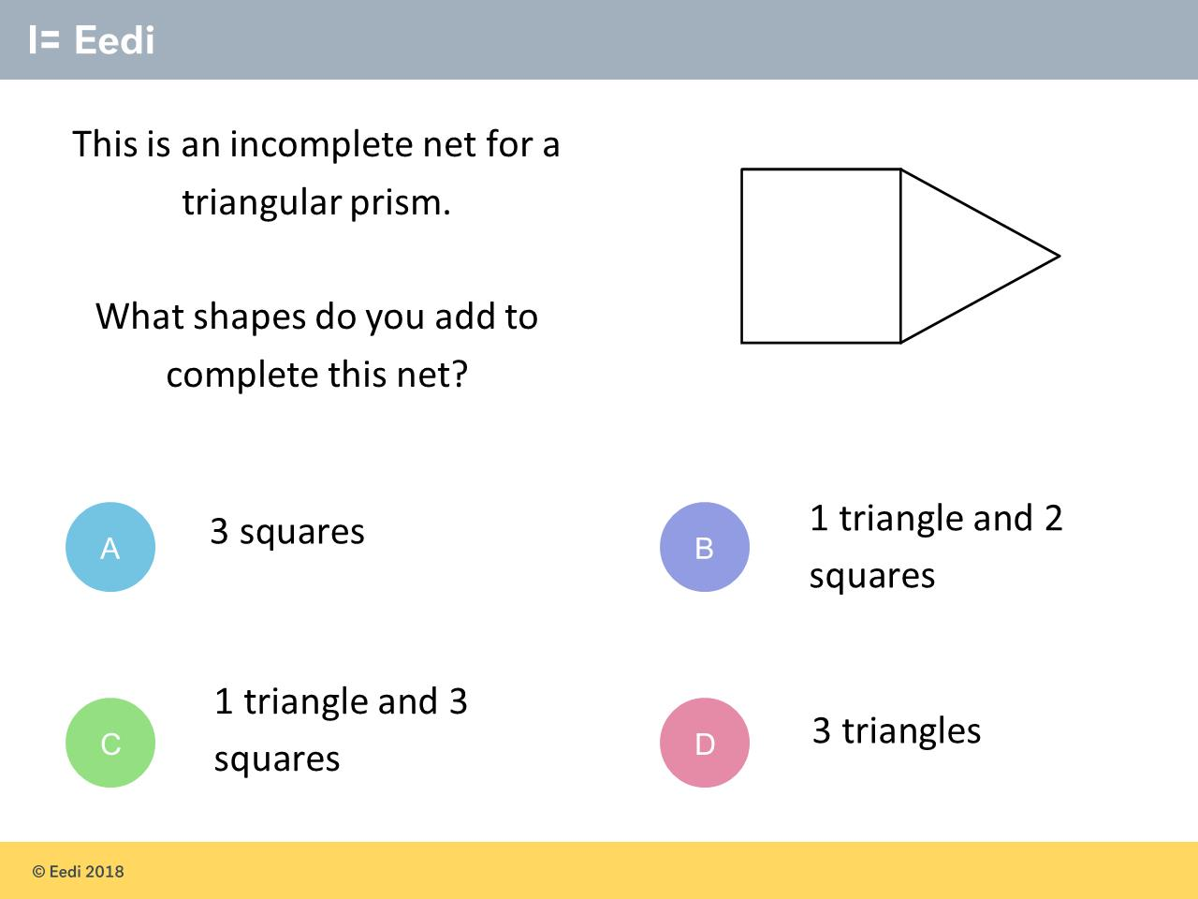
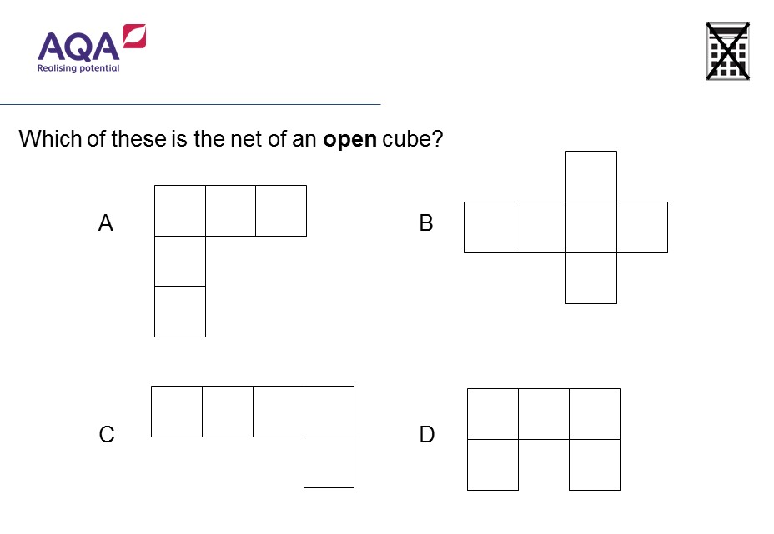
Worst answered question?
Most common wrong answer?

Slide 2
ANSWERS

Slide 3
Worst answered question?

Slide 4
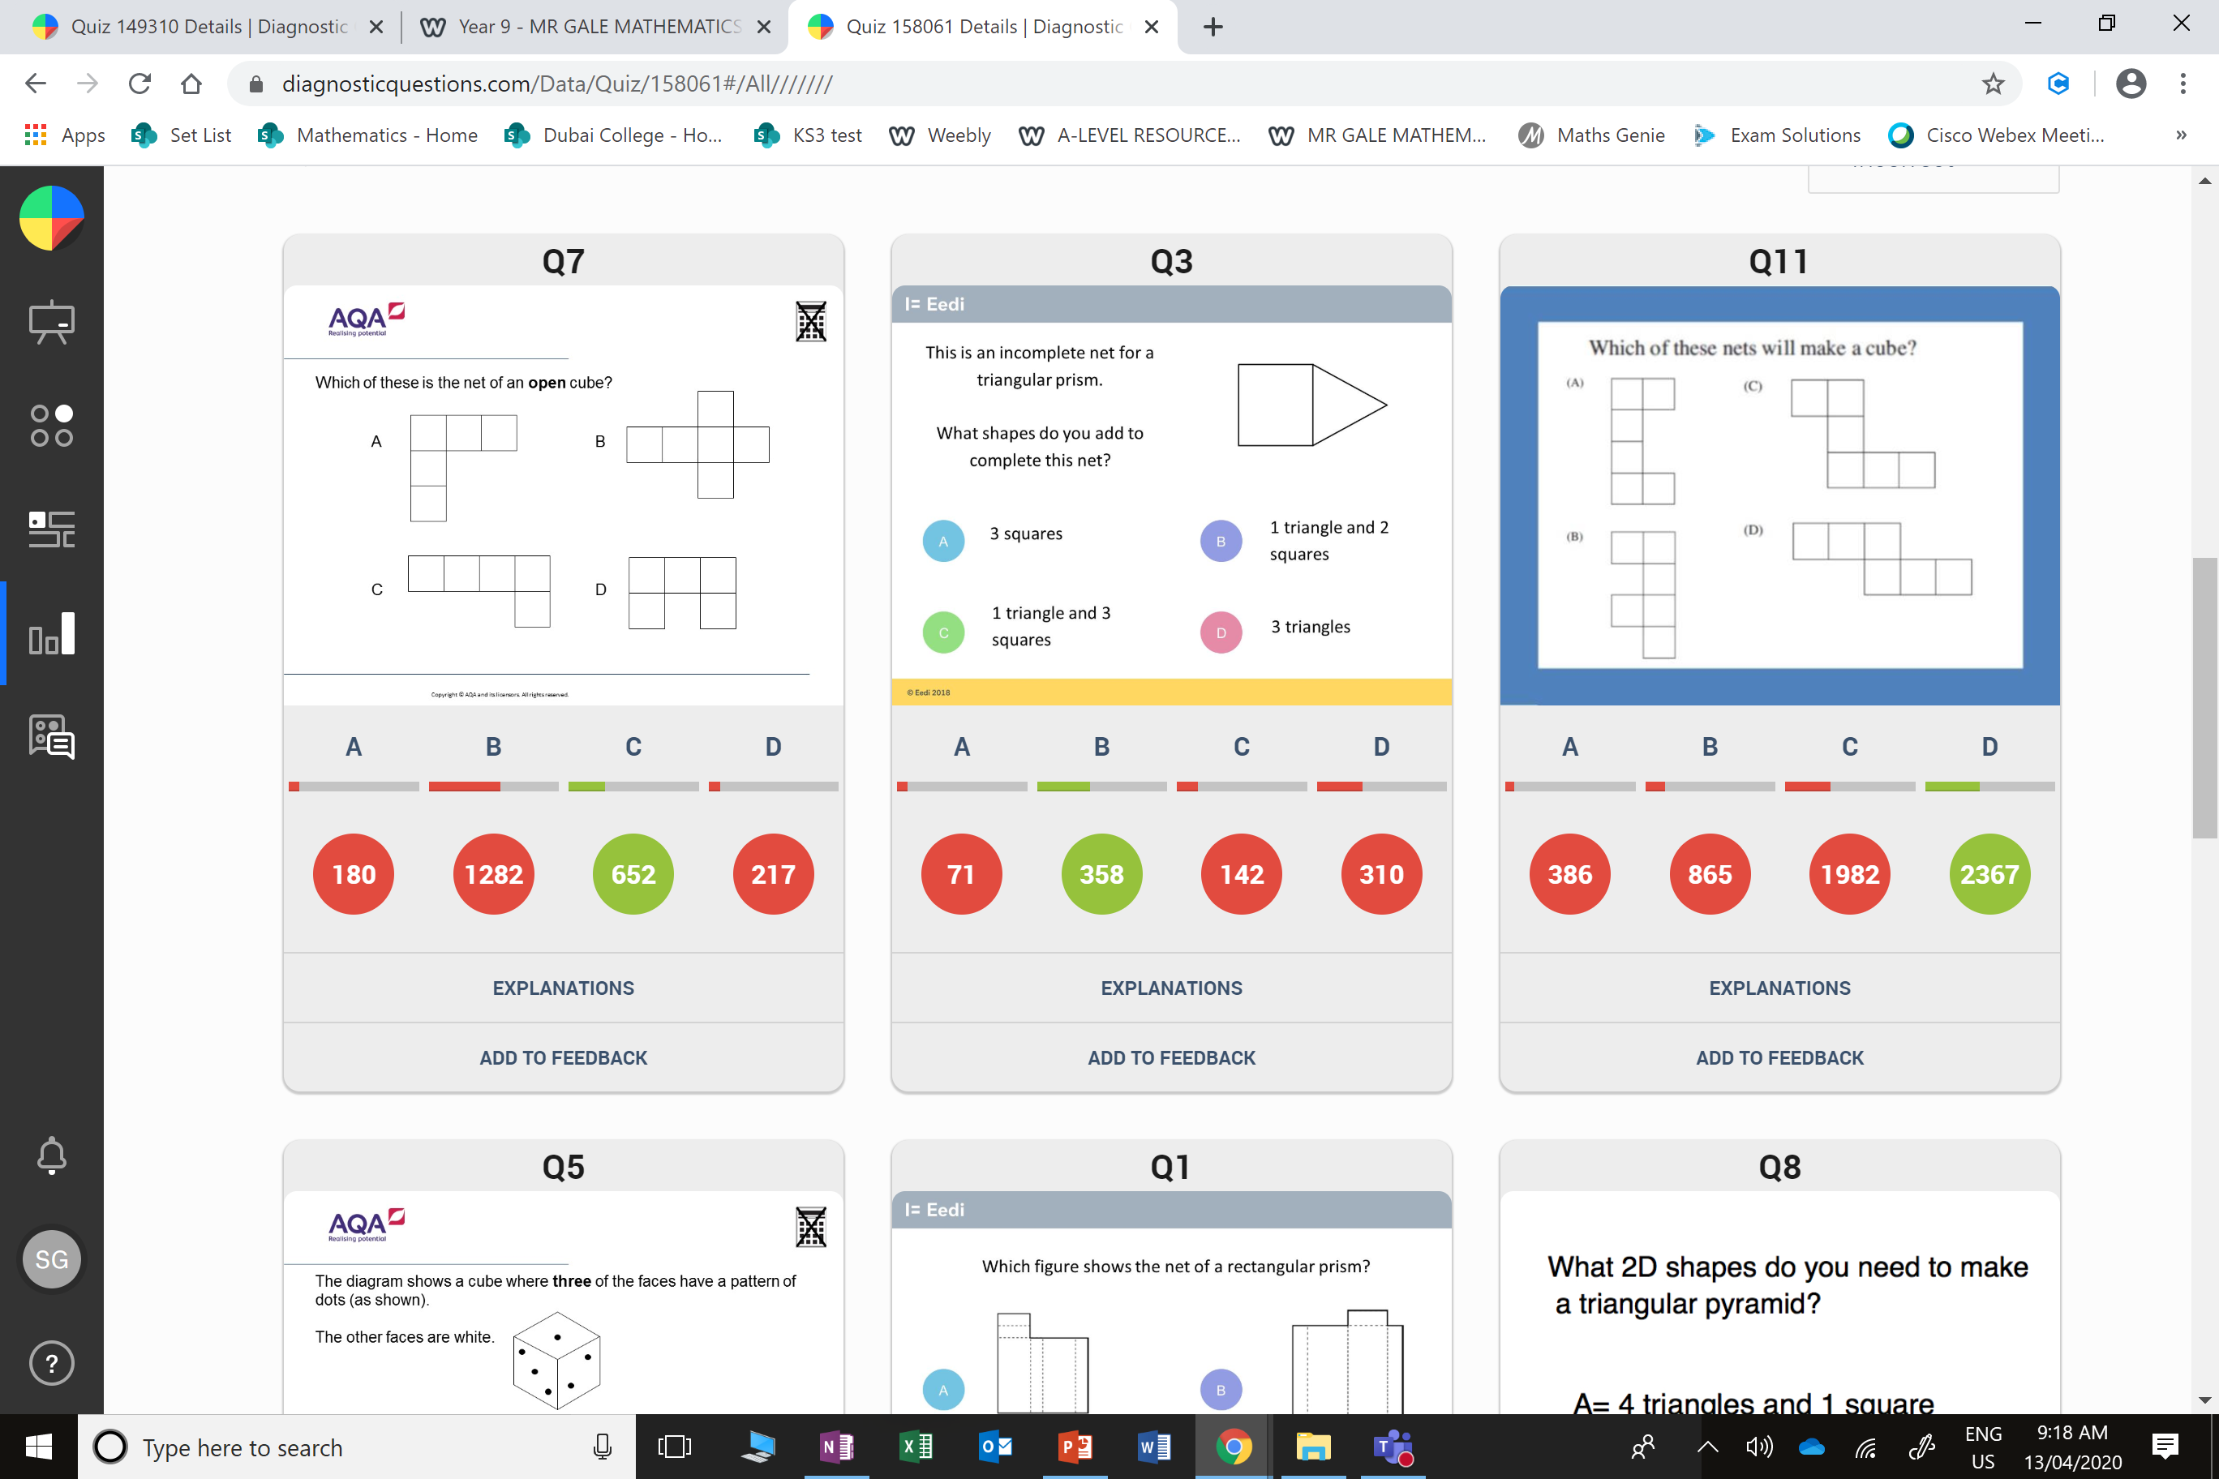
B
It makes a cube
but it is closed.

Slide 5
D
They made a square based pyramid.

