Slide 1

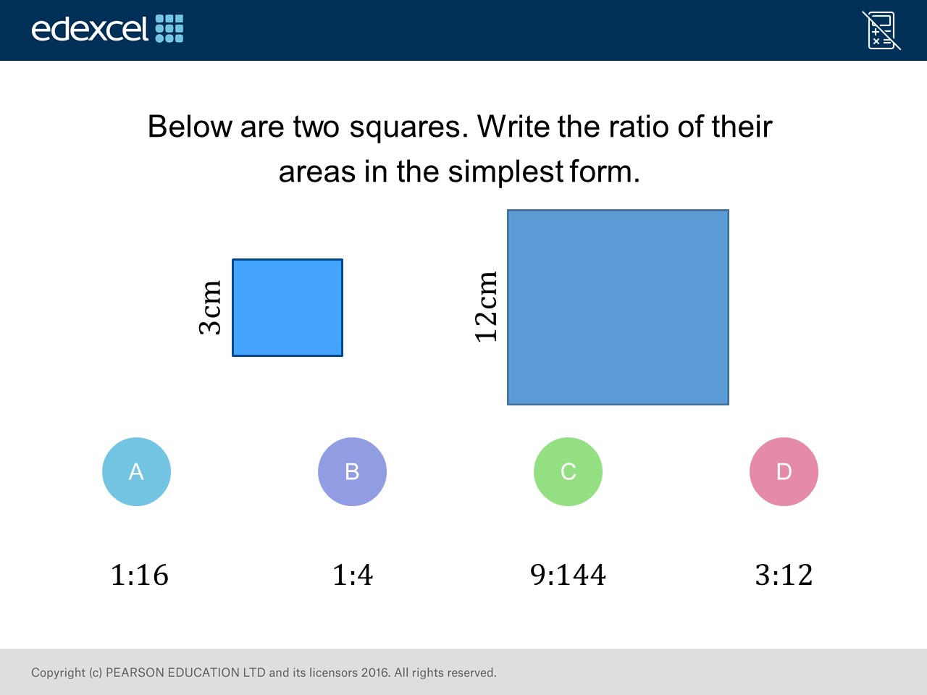
Worst answered question?
Most common wrong answer?

Slide 2
ANSWERS

Slide 3
Worst answered question?

Slide 4

B
They did the ratio of the sides
and not the area.

Slide 5
D
They did not convert them into the same units.

