Slide 1
LO: 3D Trigonometry

Slide 2

You need to be good at looking out for right angle triangles.

Slide 6
Identify angle
ECG
B
C
x
A
D
F
G
E
H

Slide 7
Identify angle
GEH
B
C
A
D
F
G
x
E
H

Slide 8
Identify angle
EDH
B
C
A
D
x
F
G
E
H

Slide 9

Identify angle
CEG
B
C
A
D
F
G
$$x$$
E
H

Slide 10

Identify the angle
between CE and plane EFGH
B
C
A
D
F
G
$$x$$
E
H

Slide 11
What side do the triangles share?
B
C
A
D
EG
F
G
E
H

Slide 12
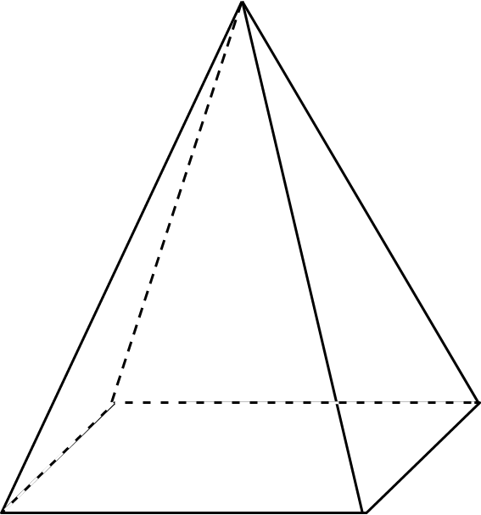
E
Identify angle
ECA
x
D
A
B

Slide 13
Identify angle
BCA
E
C
D
x
A
B

Slide 14
E
Identify angle
EAB
C
D
x
A
B

Slide 15
Identify the angle that AE and Plane ABCD make.
E
C
D
x
A
B

Slide 16
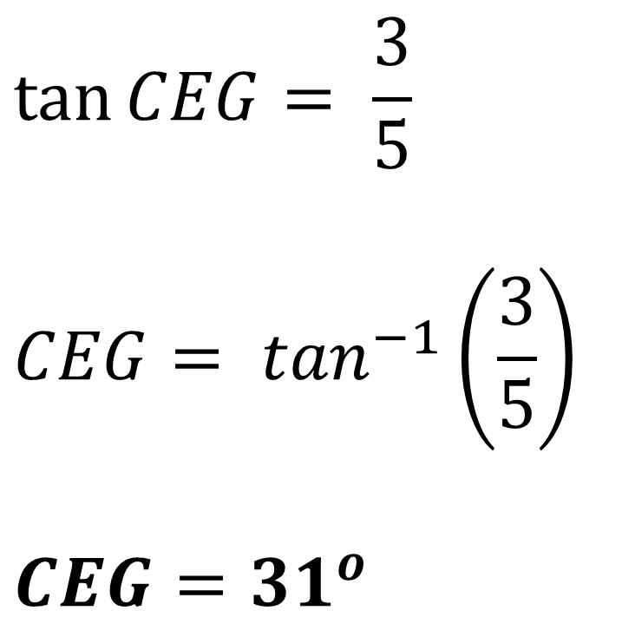
Calculate angle CEG.
B
$$\tan{CEG}= \frac{3}{5}$$
$$CEG= \tan^{−1}\left(\frac{3}{5}\right)$$
$$CEG={31}^{o}$$
C
A
D
3cm
F
G
5cm
E
H

Slide 17
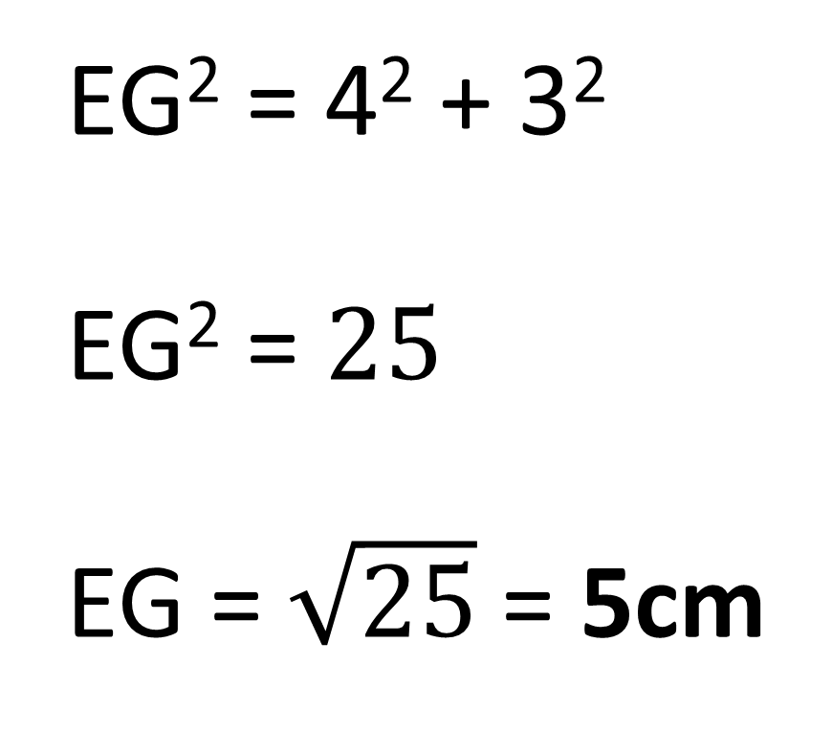
Calculate length EG.
B
EG² = 4² + 3²
EG² = $25$
EG = $\sqrt{25}$ = 5cm
C
A
D
F
G
3cm
E
H
4cm

Slide 18
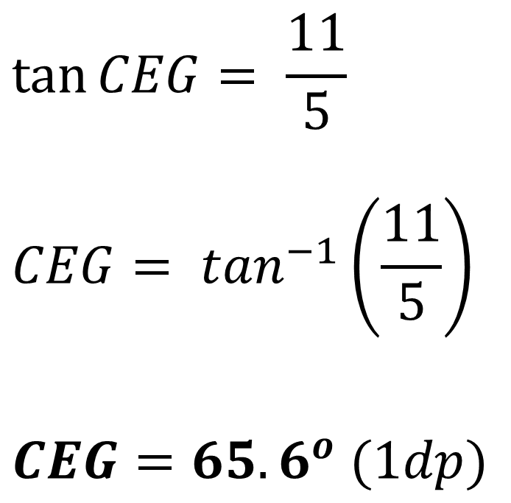
Calculate the size of the angle
between CE and Plane EFGH
B
C
$$\tan{CEG}= \frac{11}{5}$$
$$CEG= \tan^{−1}\left(\frac{11}{5}\right)$$
$$CEG={65.6}^{o} (1dp)$$
C
A
D
11cm
11cm
F
G
3cm
E
5cm
G
E
4cm
H

Slide 19
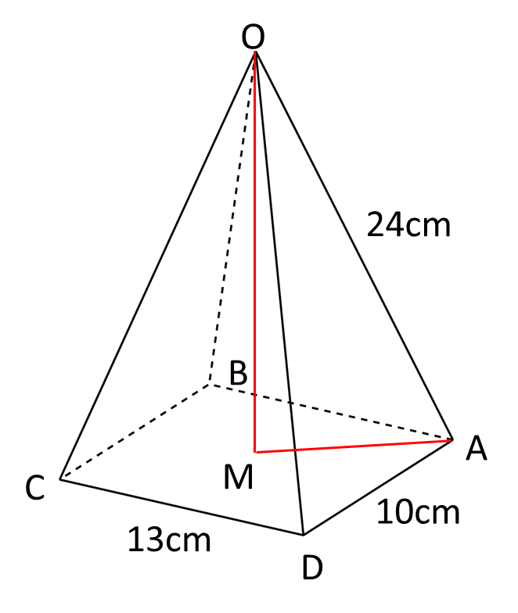
Calculate the angle that OA makes with
the plane ABCD.

Slide 20
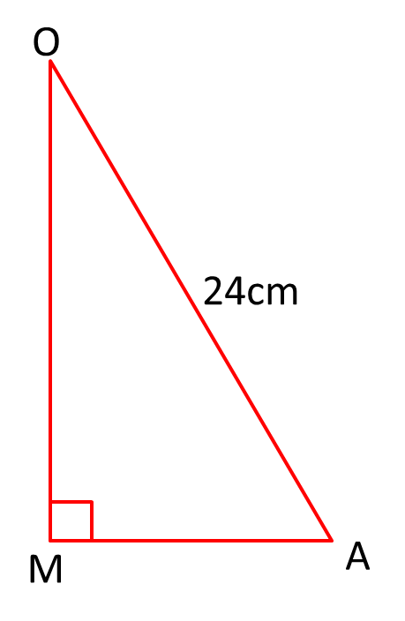
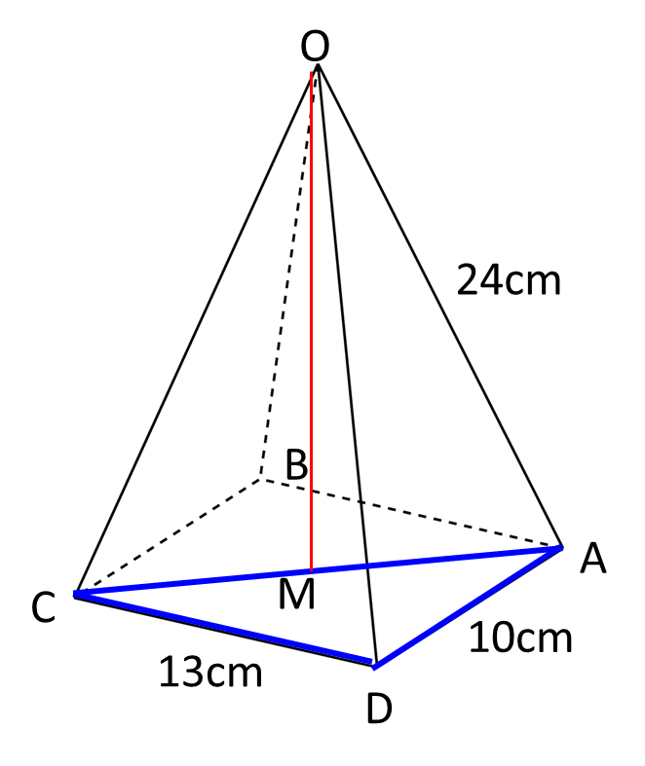
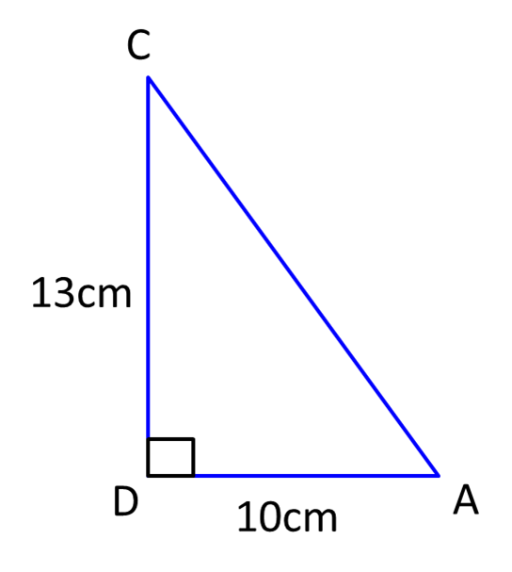
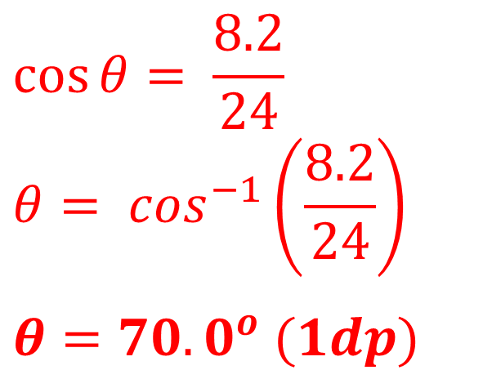
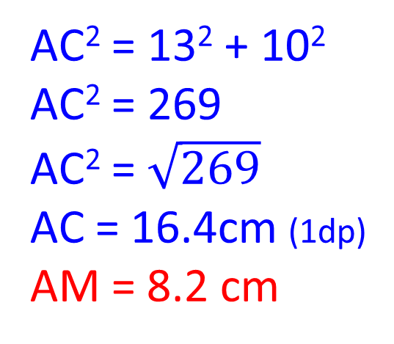
Calculate the angle that OA makes with the plane ABCD.
AC² = 13² + 10²
AC² = 269
AC² = $\sqrt{269}$
AC = 16.4cm (1dp)
AM = 8.2 cm
8.2
$$\cos{θ}= \frac{8.2}{24}$$
$$θ= \cos^{−1}\left(\frac{8.2}{24}\right)$$
$$θ={70.0}^{o} (1dp)$$

