Slide 1
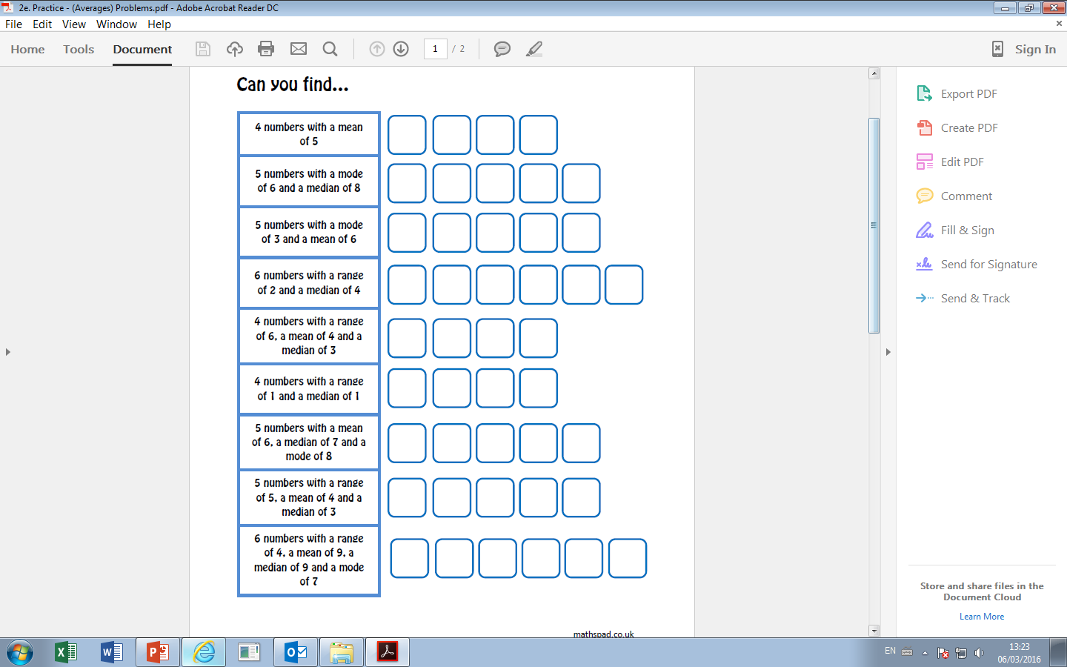

Slide 2
ANSWERS

Slide 3
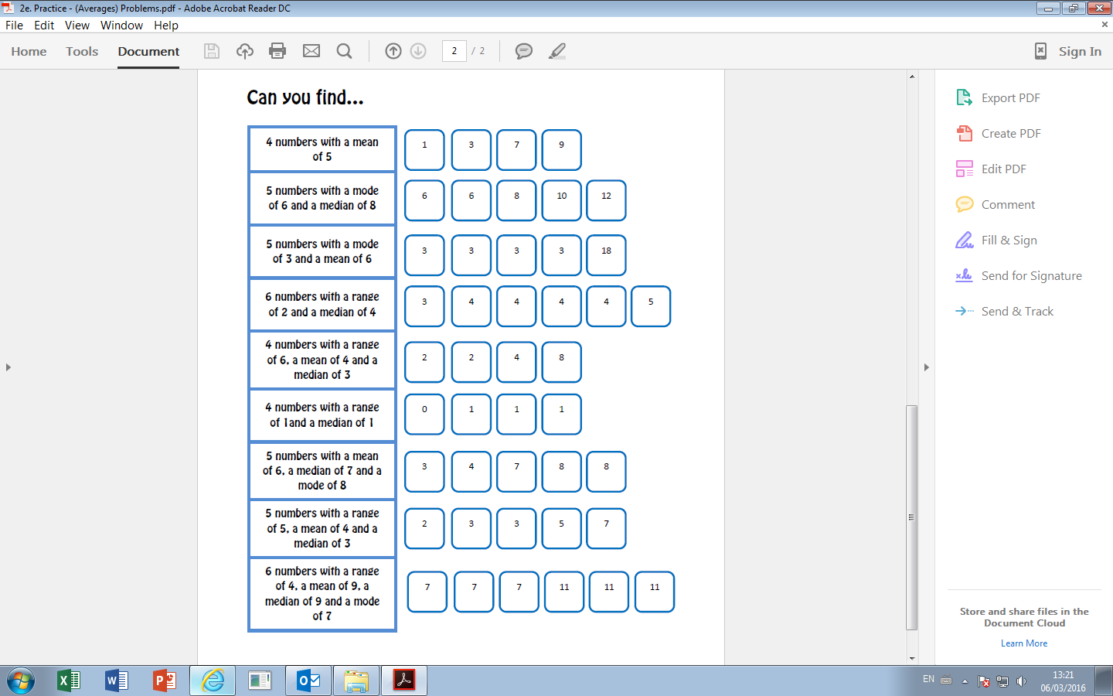
Total must be 20
Middle number is 8 and two 6’s
Total must be 30. Minimum of two 3’s
Big – Small = 2. Middle two numbers add to 8
Big – Small = 6. Total must be 16. Middle two numbers add to 6
Big – Small = 1. Middle two numbers add to 2.
Total must be 30. Middle is 7. Two 8’s.
Big – Small = 5. Total must be 20. Middle is 3.
Impossible!

