Slide 1
Bar chart Bingo
Draw a 3x3 grid in your book and choose 9 boxes from the grid below.
104 | 5 | Ireland | Norway
55 | 10 | boys | nations
apple | Molly | 3.5 | 85
15 | same | telephone | 30
broccoli | 9 | 3 | 25

Slide 2
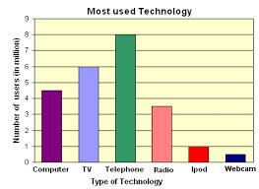
What type of technology is used the most?
Telephone

Slide 3
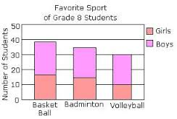
How many students were asked in total?
104

Slide 4
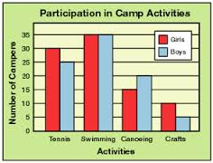
How many boy campers are there altogether?
85

Slide 5
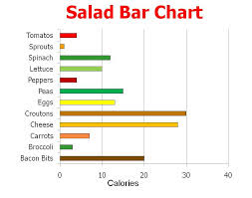
What item has the second lowest calories?
broccoli

Slide 6
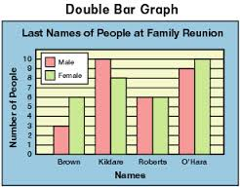
How many people have the last name “Brown”?
9

Slide 7
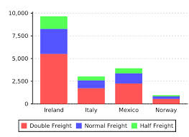
Which country has the most normal freight?
Ireland

Slide 8
What is the highest amount of calories?
30

Slide 9
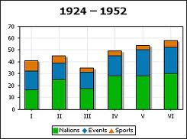
Is there more nations,events or sports?
nations

Slide 10
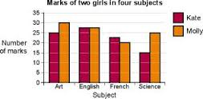
Who has better marks overall?
Molly

Slide 11
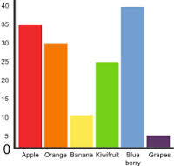
How many more blueberries are there than kiwifruit?
15

Slide 12
Are the sports in III roughly the same, less than or more than in V?
same

Slide 13
How many more girls like badminton than volleyball?
5

Slide 14
How many million use the radio?
3.5

Slide 15
How many more males have the last name O’Hara compared to Roberts?
3

Slide 16
What fruit is the second most popular?
apple

Slide 17
Which country has the least half freight?
Norway

Slide 18
How many more marks in science did Molly get compared to Kate?
10

Slide 19
Which gender are there least of?
boys

Slide 20
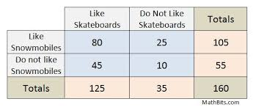
What is the total who do not like snowmobiles?
55

Slide 21
How many like snowmobiles but
do not like skateboards?
25

