Slide 1
LO: Velocity Time Graphs
(Non-Linear)

Slide 2
What word would you use to describe the rate of change of distance and time?
Velocity or Speed

Slide 3
What word would you use to describe the rate of change of velocity and time?
Acceleration

Slide 4

Do cars travel at
constant speeds?
Sometimes

Slide 5
The velocity time graphs shows the journey of car.
Velocity
Time
What is strange about this graph?
They are all linear lines

Slide 6
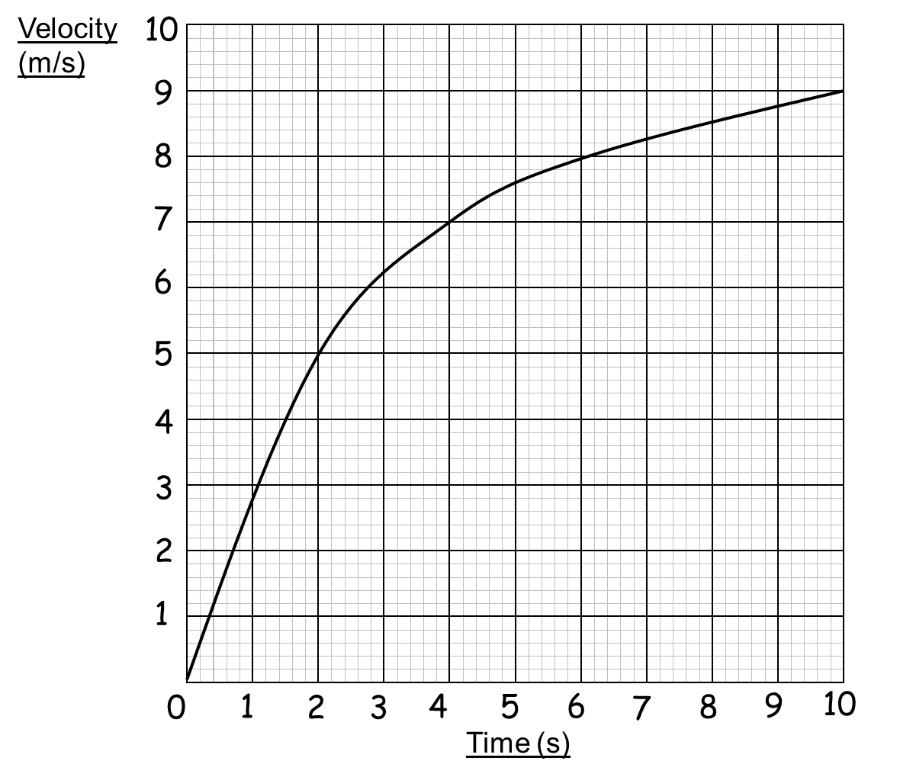
The velocity time graphs shows the journey of car.
Velocity (m/s)
Describe the journey.
Time (Seconds)

Slide 7
From velocity graphs
you are able to find:
Acceleration
Distance Travelled

Slide 8
Acceleration/Deceleration

Slide 9
What is the acceleration of this car?
Velocity (m/s)
It depends on the time as acceleration is constantly changing.
Time (Seconds)

Slide 10
Measuring Acceleration.
Velocity (m/s)
Find the gradient of
a tangent at the time you want to know the acceleration.
Time (Seconds)

Slide 11
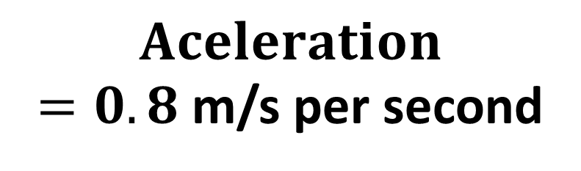
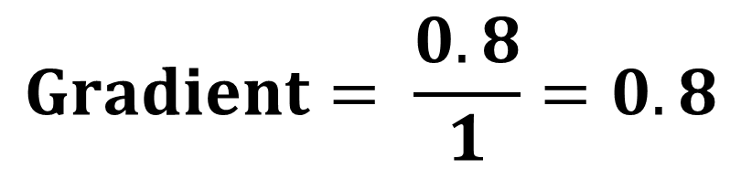
0.8
What is the acceleration of the car at 4 seconds?
1
Velocity (m/s)
$$Gradient= \frac{0.8}{1}=0.8$$
$$Aceleration$$
$=0.8$ m/s per second
Time (Seconds)

Slide 12
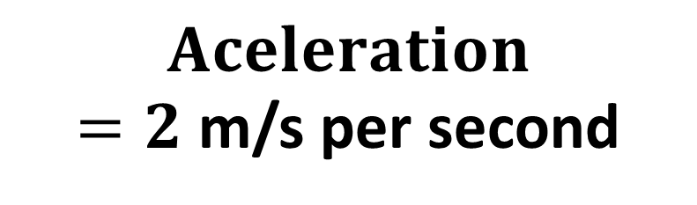
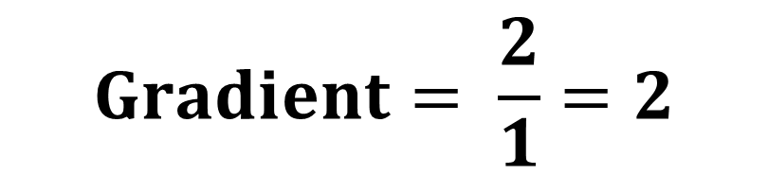
What is the acceleration of the car at 2 seconds?
2
Velocity (m/s)
1
$$Gradient= \frac{2}{1}=2$$
$$Aceleration$$
$=2$ m/s per second
Time (Seconds)

Slide 13
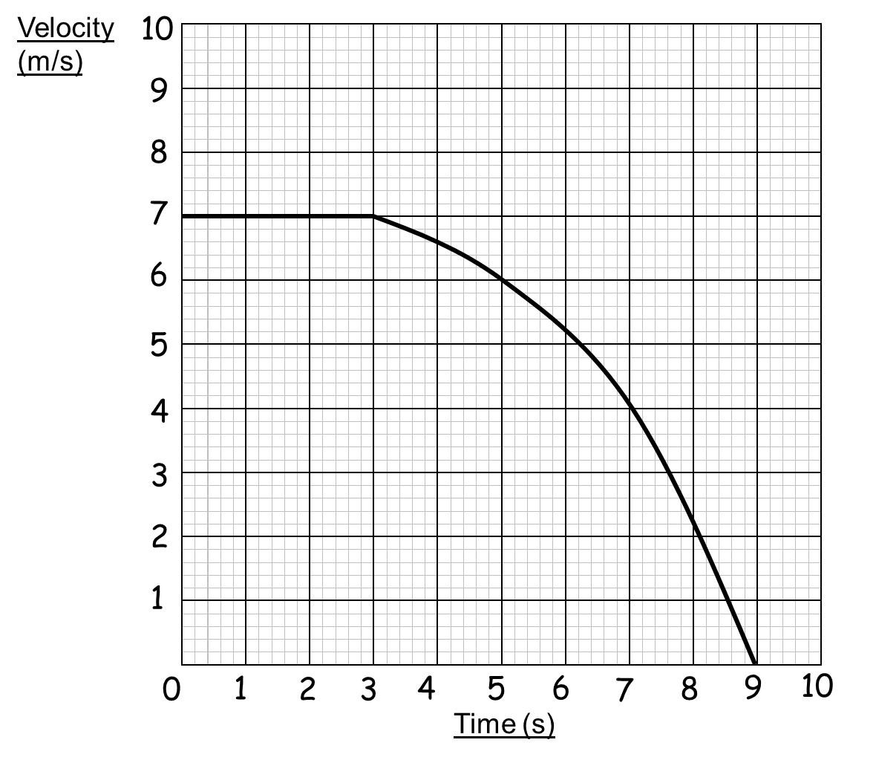
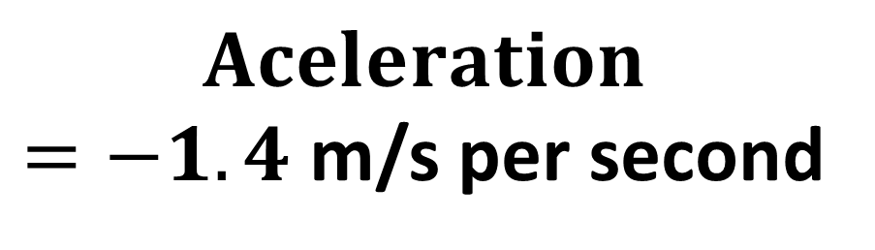
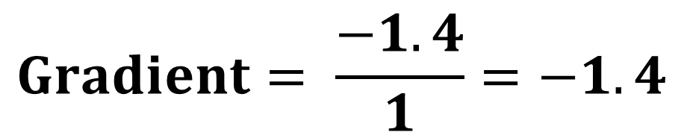
What is the deceleration of the car at 7 seconds?
Distance (m/s)
1
$$Gradient= \frac{−1.4}{1}=−1.4$$
-1.4
$$Aceleration$$
$=−1.4$ m/s per second
Time (Seconds)

Slide 14
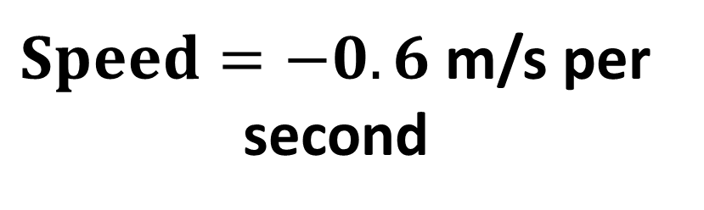
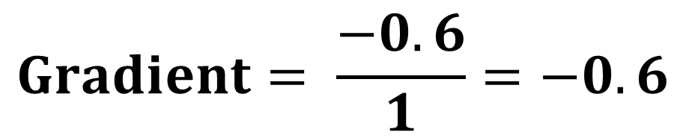
What is the speed
of the car at 7 seconds?
1
-0.6
Distance (m/s)
$$Gradient= \frac{−0.6}{1}=−0.6$$
$Speed=−0.6$ m/s per second
Time (Seconds)

Slide 15
Acceleration over a period of time.
Identify the two times
then draw a straight line.
Velocity (m/s)
Then find the
gradient of the line.
Time (Seconds)

Slide 16
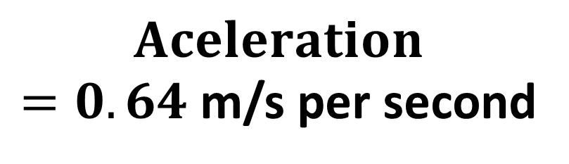

What is the acceleration between
2 and 7 seconds?
3.2
Velocity (m/s)
5
$$Gradient= \frac{3.2}{5}=0.64$$
$$Aceleration$$
$=0.64$ m/s per second
Time (Seconds)

Slide 17
Distance Travelled

Slide 18
How can you work out the distance travelled from a velocity-time graph?
Velocity
Time
From the area under the graph.

Slide 19
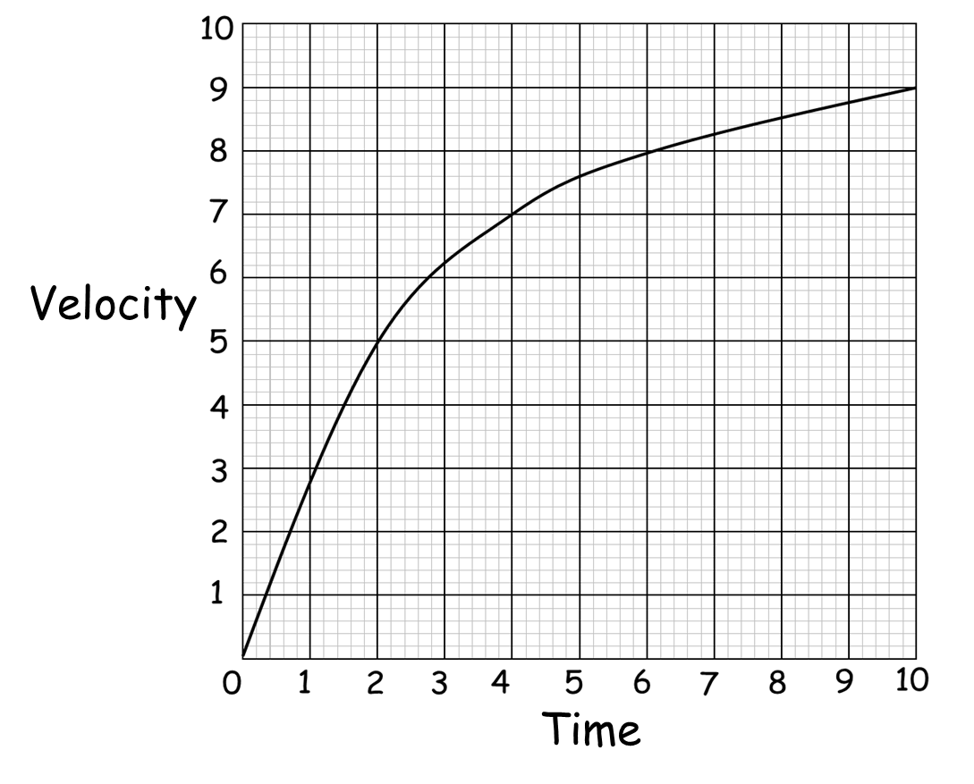
How can you find the area under a graph
if it is a curve?
You will have to estimate using various shapes.

Slide 20
Is a triangle a good option
for this curve?
NO

Slide 21
Is a one rectangle a good option
for this curve?
NO

Slide 22
Are two rectangles a good option
for this curve?
NO

Slide 23
Are 5 rectangles a good option
for this curve?
The more the better

Slide 24
Is 4 trapeziums and a triangle
the best option for this curve?
YES
Velocity
Time

Slide 25
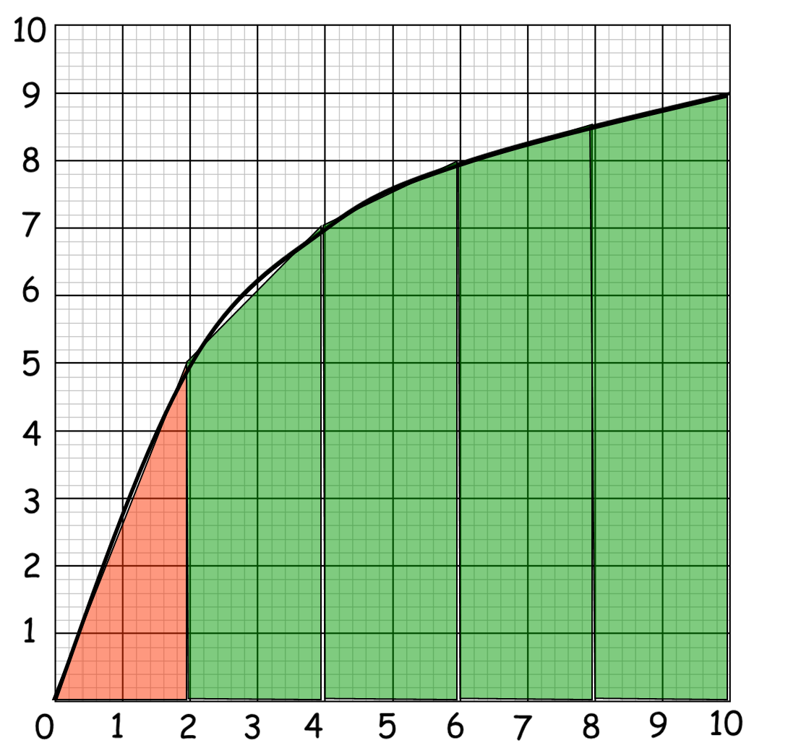
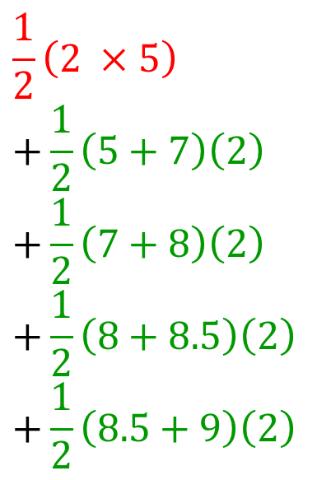
Estimate the distance travelled in these 10 seconds.
Use 5 strips of equal widths.
$$\frac{1}{2}\left(2 ×5\right)$$
$$+\frac{1}{2}\left(5+7\right)\left(2\right)$$
$$+\frac{1}{2}\left(7+8\right)\left(2\right)$$
$$+\frac{1}{2}\left(8+8.5\right)\left(2\right)$$
$$+\frac{1}{2}\left(8.5+9\right)\left(2\right)$$
Velocity (m/s)
Area = 5 + 12 + 15 + 16.5 + 17.5
Area = 66 units²
Distance = 66m
Time (Sec)

Slide 26
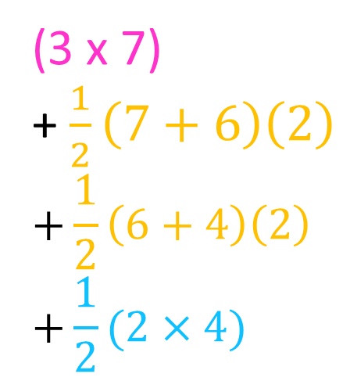
Estimate for the distance travelled these
nine seconds using only 4 strips.
(3 x 7)
+ $\frac{1}{2}\left(7+6\right)\left(2\right)$
$$+\frac{1}{2}\left(6+4\right)\left(2\right)$$
$$+\frac{1}{2}(2×4)$$
Area = 21 + 13 + 10 + 4
Area = 48 units²
Distance = 48m

Slide 27
Overestimate or Underestimate?
Velocity
Underestimate
Time

Slide 28
Overestimate or Underestimate?
Underestimate

Slide 29
Overestimate or Underestimate?
Over estimate

