Slide 1
Problem solving
Multiplication
Algebra pyramid
Perimeter 1
Angles in triangles 1
Cube numbers
Linear equation 1
Perimeter 2
Angles in triangles 2
Prime numbers
Linear equation 2
Perimeter 3
Angles in triangles 3
Prime numbers 2
Linear equation 3
Perimeter 4
Angles in triangles 4
Factors
Simultaneous equations 1
Area rules 1
Angles in polygons 1
Multiples 1
Simultaneous equations 2
Area rules 2
Angles in polygons 2
Multiples 2
Simultaneous equations 3
Overlapping squares
Index laws
Equivalent ratios
Gradient
Overlapping circles
Fractions 3
Percentage of amount
Being systematic
Visualisation 1
Fractions 4
Fractions 1
Linear equation 4
Visualisation 2
Percentage change
Logic
Fractions 2
Constructions
Pie charts

Slide 2
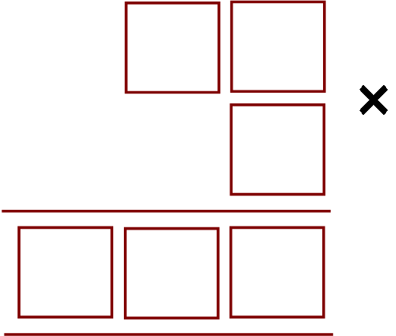


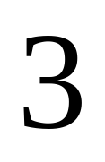

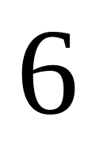


Use the digits 1 to 6, once only, in the six boxes to make the multiplication sum correct
How many ways can this be done?
Can you be sure?

Slide 3





Can you complete this cross-number?
Across
Down
1
2
1. A cube
1. One less than a cube
3. A cube
3
The only two-digit cubes are 3³ = 27 and 4³ = 64
So either
1
2
Or
1
2
3
3
1 Down is one less than a cube so must be 26
Hence 3 Across must be 64

Slide 4
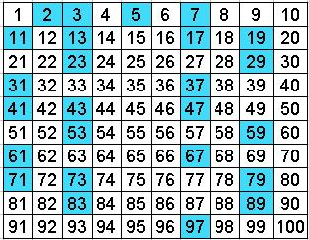
The sum of three different prime numbers is 40.
What is the difference between the two larger primes?
2 must be one of the numbers, as all other primes are odd and there must be exactly two odd numbers to give an even total.
So the other two primes add up to 38
The only pair that fits is 7 and 31
Their difference is 24

Slide 5
Only one choice of the digit d gives prime numbers when you read across and down in the diagram below.
Which digit is d?
5
1
d
3
7
A 5
B 6
C 7
Hint: consider the test for divisibility by 3
Vertically, 5 + 7 = 12 so d cannot be 6
Horizontally, 1 + 3 = 4 so d cannot be 5
Which leaves d = 7

Slide 6
















A census taker approaches a house and asks the woman who answers the door
"How many children do you have, and what are their ages?"
Woman: "I have three children, the product of their ages are 36, the sum of their ages are equal to the address of the house next door."
The census taker walks next door, comes back and says "I need more information."
The woman replies "I have to go, my oldest child is sleeping upstairs."
Census taker: "Thank you, I now have everything I need."
What are the ages of each of the three children?
The possible ages, based on their product being 36:
Product
Sum
Looking at the house number next door is only inconclusive if the number is 13, as there are two combinations with this sum
As the woman has an oldest child, they must be the 2, 2 and 9 combination!

Slide 7
What is the largest multiple you can make using the digits below?
You don’t have to use each digit and can use each one at most once
2
3
4
5
Multiple of 2
Multiple of 3
Multiple of 6
Number must be even
Digits must sum to a multiple of 3
Must be a multiple of 2 and 3
5432
Don’t use the 2 as this is the smallest value you can remove to obtain a multiple of 3
534
543
What are the smallest and largest multiples of 4 you can make using all the digits below?
Last 2 digits must be divisible by 4
4
5
6
7
8
Smallest
45768
Largest
87564

Slide 8
Beth, Carol and George love reading their favourite bedtime story together.
They take it in turns to read a page, always in the order Beth, then Carol, then George.
All twenty pages of the story are read on each occasion.
One evening, Beth is staying at Grandma’s house but Carol and George still read the same story and take it in turns to read a page with Carol reading the first page.
In total, how many pages are read by the person who usually reads that page?
Carol normally reads the 2nd, 5th, 8th, … pages but on this occasion reads every odd page. These coincide on the 5th, 11th, 17th pages.
George normally reads the 3rd, 6th, 9th, … pages but on this occasion reads every even page. These coincide on the 6th, 12th, 18th pages.
This gives a total of 6 pages read by the usual person

Slide 9

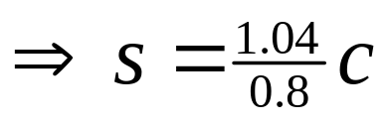
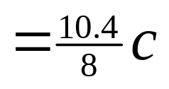

In a sale, an item is reduced by 20% and as a result makes only a 4% profit on the cost to the shop-keeper.
What percentage profit would the shop-keeper have made if the item had sold at full price?
c = cost price
s = selling price
You know that
i.e. 30% profit

Slide 10
A swimming club has junior, senior and veteran members.
The ratio of juniors to seniors is 3:2
The ratio of seniors to veterans is 5:2
Which of the following could be the total number of members in the club?
A 30 B 35 C 48 D 58 E 60
J : S : V
3 : 2
x 5
15 : 10 : 4
x 2
5 : 2
Which total could be shared in the ratio 15 : 10 : 4?
Only 58

Slide 11
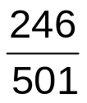

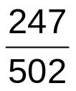
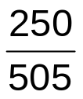
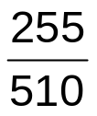

After playing 500 games, my success rate at Angry Birds is 49%.
Assuming I win every game from now on, how many extra games do I need to play in order that my success rate increases to 50%?
(a) 1 (b) 2 (c) 5 (d) 10 (e) 50
1% of 500 is 5, so 49% is 245 games won so far
If I win 1 more, this gives
If I win 2 more, this gives
If I win 5 more, this gives
If I win 10 more, this gives
I must play 10 more times

Slide 12
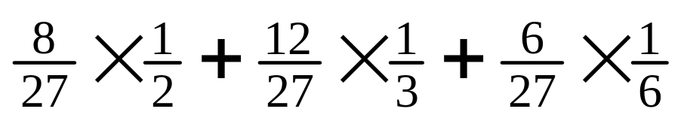
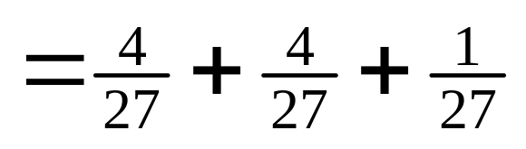
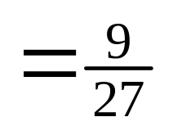
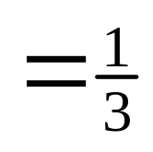
A cube with 3cm sides is painted red on the outside.
The cube is then split into cubes with 1cm sides.
What fraction of the total surface area of the new cubes is red?
3 sides painted = 8
2 sides painted = 1 x 12 = 12
1 side painted = 1 x 6 = 6
No sides painted = 1
Total = 27

Slide 13

The numbers 2, 3, 4, 5, 6, 7, 8 are to be placed, one per square, in the diagram shown such that the four numbers in the horizontal row and the four numbers in the vertical column add up to 21.
Which number should replace x?
Total in all squares = 2+3+4+5+6+7+8 = 35
Total of row + column = 42
But this is the total on all squares + x
So x = 7

Slide 14
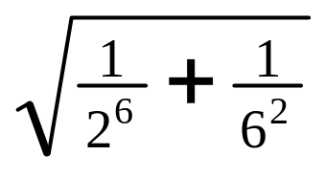
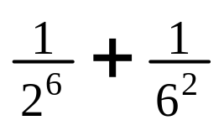
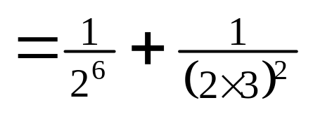
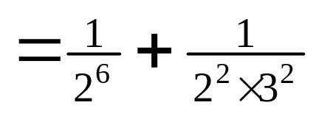
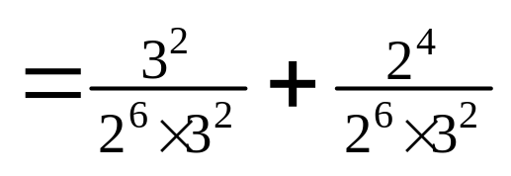
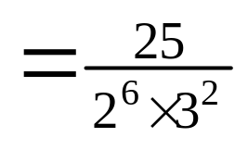
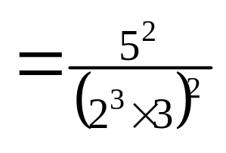
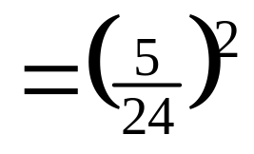
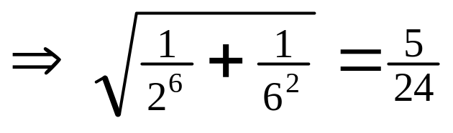
What is the value of

Slide 15













In this number pyramid, the two numbers below are a block are added to give its value.
Find the value of x

Slide 16










John, Paul, George and Ringo have their 12th, 14th, 15th and 15th birthdays today.
How many years will it be till their combined age reaches 100?
If n years pass, their ages will be:
John:
Paul:
George:
Ringo:
Total:
Now solve the equation
In 11 years time

Slide 17








Three-quarters of the area of the rectangle has been shaded.
What is the value of x?
Unshaded areas
So rectangle area
But rectangle area = 6 x 8 = 48

Slide 18


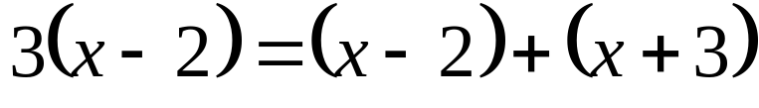


Q is an enlargement of P, scale factor 3, from centre O.
Find the value of x
O
P
Q

Slide 19










Peter has three times as many sisters as brothers.
His sister Louise has twice as many sisters as brothers.
How many children are there in the family?
Let b = number of boys
and g = number of girls
‘Peter has three times as many sisters as brothers’
‘Louise has twice as many sisters as brothers’
Sub in (2)
There are 4 + 9 = 13 children

Slide 20






Wobbly weights
Weighing the baby at the clinic was a problem
The baby would not keep still and caused the scales to wobble
So I held the baby and stood on the scales while the nurse read off 78 kg
Then the nurse held the baby while I read off 69 kg
Finally I held the nurse while the baby read off 137 kg
What is the combined weight of all three?
Weight of parent = p
Weight of nurse = n
Weight of baby = b
A 142 kg
B 147 kg
C 206 kg
D 215 kg
E 284 kg

Slide 21











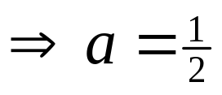

I write down three positive numbers a, b and c
The product of a and b is 2.
The product of b and c is 24.
The product of c and a is 3.
What is the sum of all three numbers?
Comparing with equation (1)
Comparing with equation (2)
Comparing with equation (3)
So sum is 10½

Slide 22
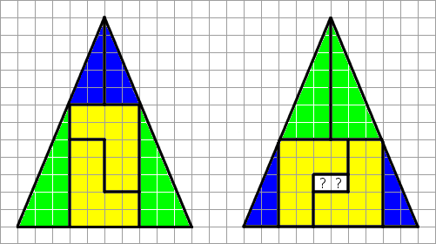


The two shapes are made up of the same pieces.
Where did the hole come from?
Hence the shapes are different (and neither is a triangle!)

Slide 23





















The interior angles of a triangle are (5x+3y)º, (3x+20)º and (10y+30)º where x and y are whole numbers.
What is the value of x+y?
(a) 15 (b) 14 (c) 13 (d) 12 (e) 11
Summing angles gives
But the angles in a triangle sum to 180º
Hence
To understand the effect of the different values offered for x+y, factorise to obtain
Trying the different options:
which is possible
which is not a whole number
which is not a whole number
which is not a whole number
which is not a whole number
The only answer giving whole numbers is (a) 15

Slide 24



There are six more girls than boys in Miss Spelling’s class of 24 pupils.
What is the ratio of girls to boys in this class?
(a) 5:3 (b) 4:1 (c) 3:1 (d) 1:4 (e) 3:5
Number of boys = x
Number of girls = x + 6
Total pupils = 2x + 6
But total = 24
9 boys
15 girls
Ratio girls to boys = 15:9
= 5:3

Slide 25
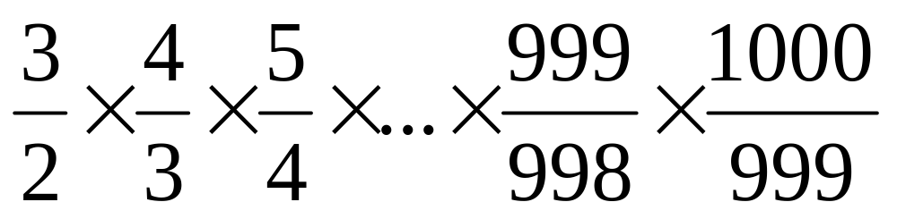
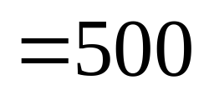
What is the value of the expression

Slide 26
The shape shown is made up of three rectangles, each measuring 3cm by 1cm.
What is the perimeter of the shape?
Perimeter of rectangles = 3 x 8 = 24
Meeting edges = 2 x (3 + 1) = 8
16cm

Slide 27
Each side of an isosceles triangle is a whole number of cm. Its perimeter is 20cm.
How many possibilities are there for the length of its sides?
1, 1, 18
2, 2, 16
3, 3, 14
Not possible
4, 4, 12
5, 5, 10
6, 6, 8
The equal sides must have a total length which is greater than the length of the third side
7, 7, 6
8, 8, 4
9, 9, 2
There are 4 possibilities

Slide 28







The parallelogram shown in the diagram has been divided into nine smaller parallelograms. The perimeters, in cm, of four of the smaller parallelograms are shown. The perimeter of WXYZ is 21cm.
What is the perimeter of the shaded parallelogram?
W
X
4
11
5
8
Z
Y
Total perimeter for given shapes
Perimeter of WXYZ
Perimeter of shaded shape
So perimeter of shaded shape

Slide 29
A 3 x 8 rectangle is cut into two pieces along the dotted line shown.
The two pieces are then rearranged to form a right-angled triangle.
What is the perimeter of the triangle formed?
Perimeter = 24cm
10cm
6cm
3cm
8cm

Slide 30




Which shape’s area is different to the others?
A
C
B
D
E
Hard to tell – come back to it!
As the others are all definitely 3, this must be the odd one out!
Can you work out D’s area?

Slide 31











The area of JGK is 20cm²
Can you find the areas of every other shape?
A
B
C
D
ADHK is a square, length 12 cm
AB = BC = CD = AE
BE is parallel to CF
EI is parallel to FJ
GE is parallel to AD
F
E
G
H
I
J
K

Slide 32
Three identical squares overlap as shown.
The areas of the overlapping sections are 2cm², 5cm² and 8cm².
The areas of the non-overlapping parts of the squares are 117cm².
What are the lengths of the sides of the squares?
Total area = non-overlapping
+ 2 x overlapping
= 117 + 2 x (2 + 5 + 8)
= 147cm²
Each square = 49cm²
Side of each square = 7cm

Slide 33
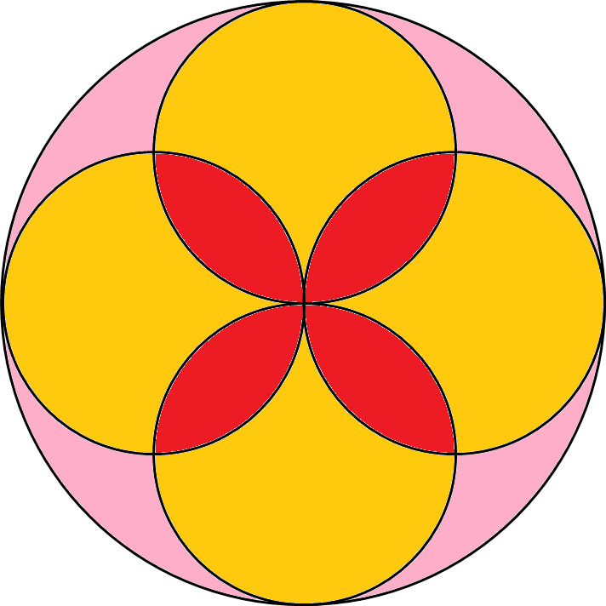


Prove that the red areas and the pink areas are the same
If radius of small circles = r
large circle
= small circles
So overlap = remainder
ie red = pink

Slide 34
Imagine two identical isosceles triangles.
Put sides of equal length together.
Describe the resulting shape. Is it the only possibility?
Rhombus
Kite
Parallelogram
If the isosceles triangles were right-angled…
Isosceles triangle
Square

Slide 35
A solid square-based pyramid has all of its corners cut off, as shown.
How many edges does the resulting shape have?
8 + 4 + 4 x 3 = 24

Slide 36
The diagram shows two equilateral triangles.
Find the size of angle x
x
60º
80º
80º
x = 40º
60º
60º
75º
45º
55º
65º

Slide 37
In this triangle, the internal bisectors of the angles at Q and R meet at S.
What is the size of angle QSR?
P
PQR + PRQ = 140º
40º
so SQR + SRQ = 70º
S
then QSR = 110º
Q
R

Slide 38
What is the sum of the six marked angles?
Five points make 5 x 360 = 1800º
Two triangles make 2 x 180 = 360º
1440º

Slide 39
What is the sum of the marked angles now?!
Four triangles make 720º
Quadrilateral makes 360º
360º

Slide 40
The diagram a regular pentagon and a regular hexagon which overlap.
Find the size of angle x
60º
x
36º
x = 84º

Slide 41



A pupil has three tiles.
One is a regular octagon, one is a regular hexagon, and one is a square.
The side length of each tile is the same.
The pupil says the hexagon will fit exactly like this.
Why is the pupil wrong?
Interior angle of square = 90º
Interior angle of hexagon = 120º
Interior angle of octagon = 135º
90 + 120 + 135 = 345º
Diagram not drawn accurately
As the total angle is less than 360º, the shapes will not meet exactly at a point

Slide 42
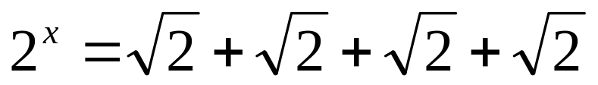
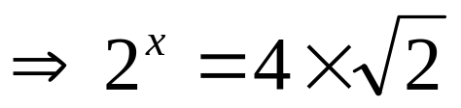
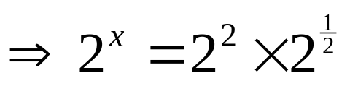
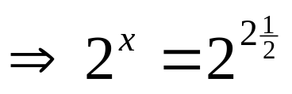
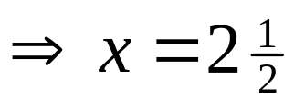
Solve

Slide 43



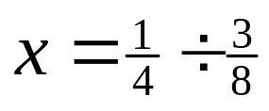
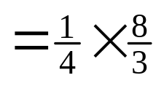


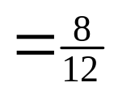
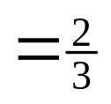

The diagram shows a square with side length 1, divided into four rectangles whose areas are equal.
What is the length labelled x?

Slide 44

Only one of these triangles can actually be made. Which is it?
Not possible – triangle can’t be isosceles with these angles
Not possible – must be that the longer the side, the bigger the angle opposite
25º
A
3cm
20º
B
4cm
4cm
25º
110º
130º
30º
3cm
C
5cm
8cm
7cm
30º
Not possible – Pythagoras’ theorem doesn’t hold
D
2cm
6cm
E
6cm
3cm
60º
Hard to tell – come back to it!
3cm
As the others are all impossible, so
this one must be (in fact it is half an equilateral triangle with 6cm sides!)
Not possible – the longest side must be less than the sum of the other two

Slide 45








What frequencies for green, red, blue and yellow could create these pie charts?
a
b
c
If frequency of green = n
 | green | red | blue | yellow
frequencies?

