Slide 1
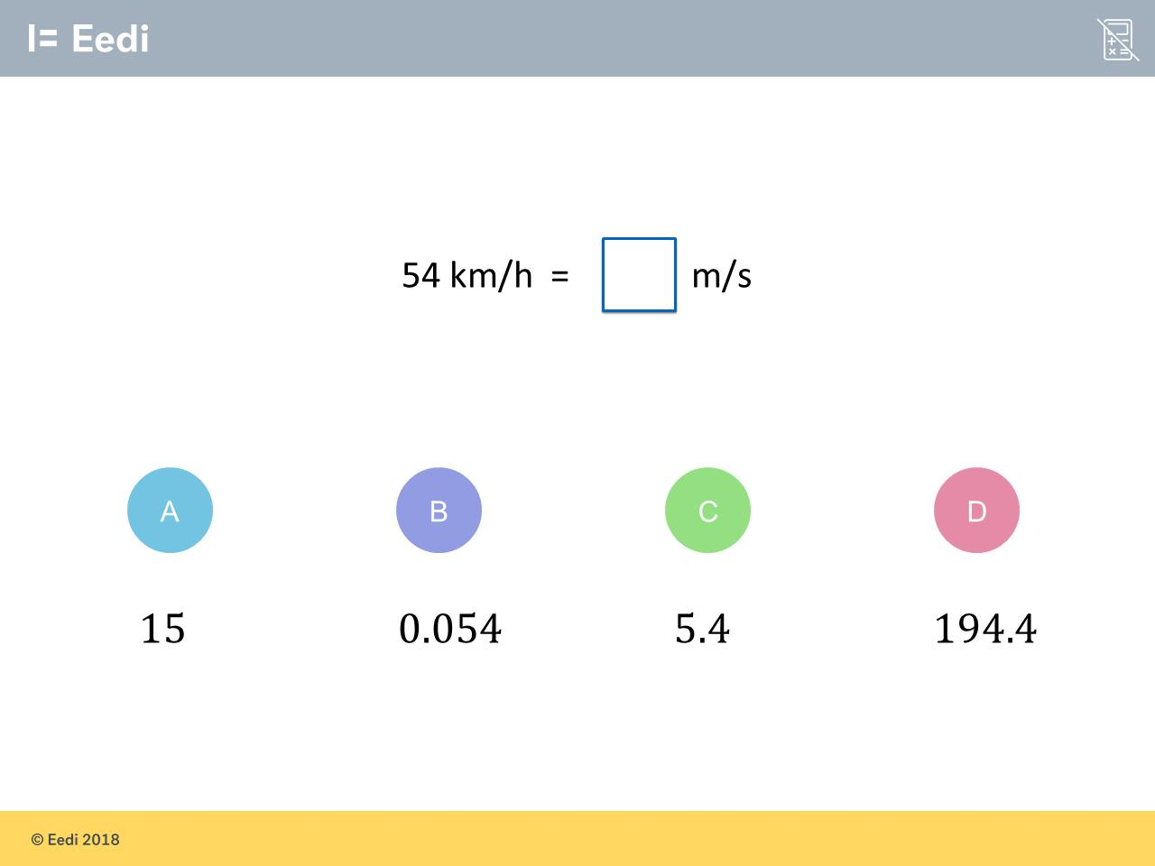
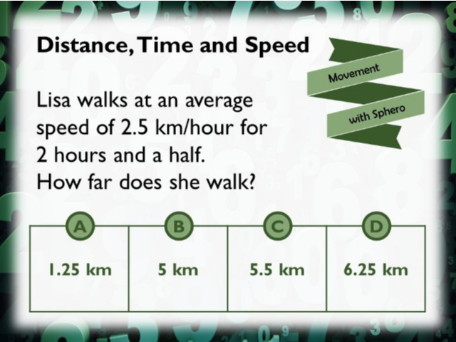
Worst answered question?
Most common wrong answer?

Slide 2
ANSWERS

Slide 3
Worst answered question?

Slide 4
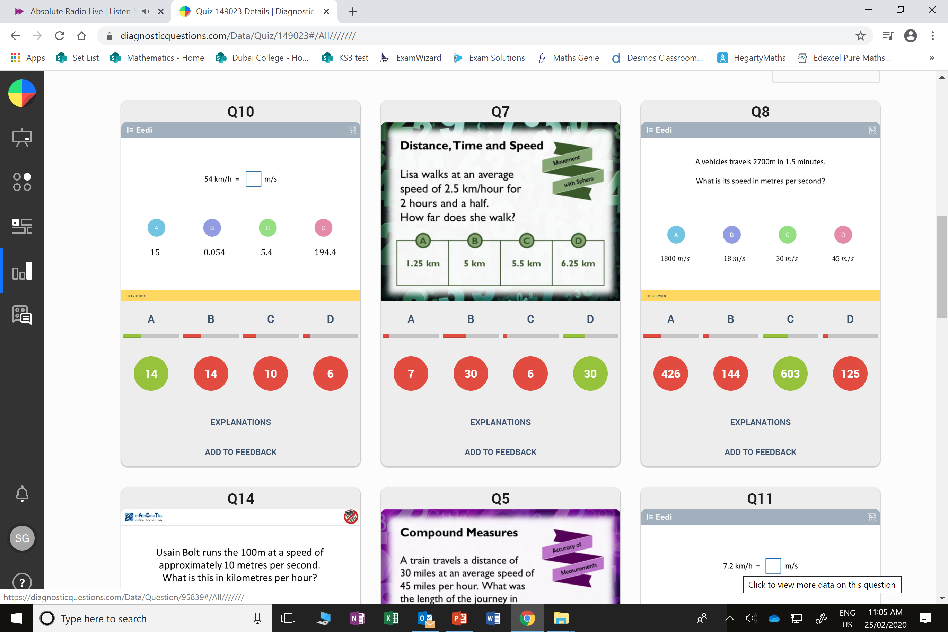
B
The student may not have noticed it is metres per SECOND.

Slide 5
B
They double rather than half 2.5

