Slide 1
Work, Energy and Power
Power
Chapter 2
(Part 3 of 3)

Slide 2

Power is
the rate of doing work.
Units: Watts ($Js^{−1}$)

Slide 3
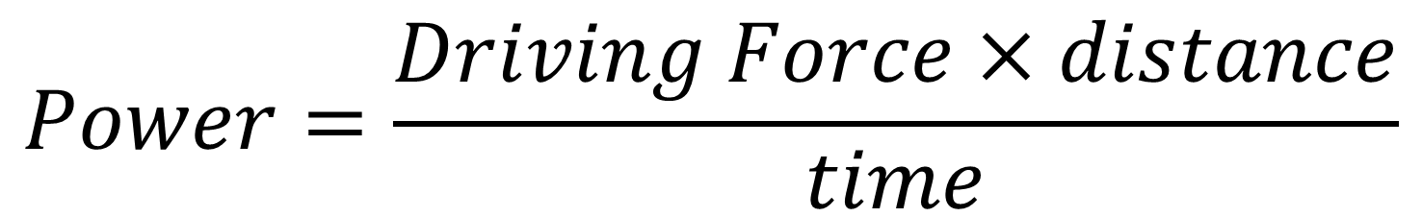
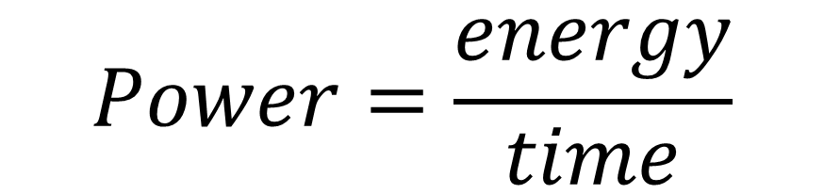
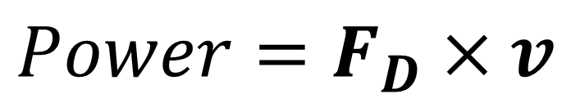
Power - Formula
$$Power=\frac{energy}{time}$$
$$Power=\frac{Driving Force×distance}{time}$$
$$Power=Driving Force × velocity$$
$$Power=F_{D}×v$$
Note: Force and Velocity
directions must be consistent.

Slide 4
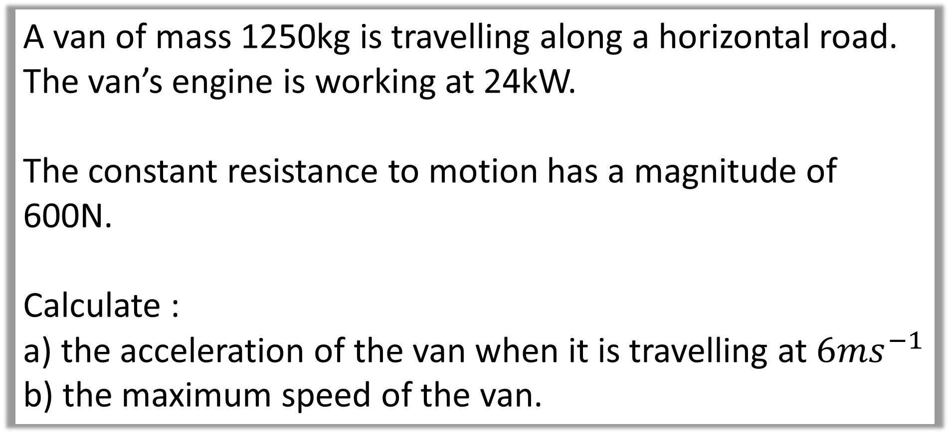
Example A: Acceleration and Max Speed
A van of mass 1250kg is travelling along a horizontal road.
The van’s engine is working at 24kW.
The constant resistance to motion has a magnitude of 600N.
Calculate :
the acceleration of the van when it is travelling at $6ms^{−1}$
the maximum speed of the van.

Slide 5
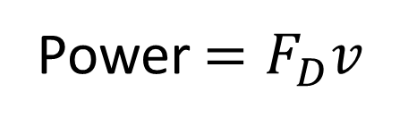


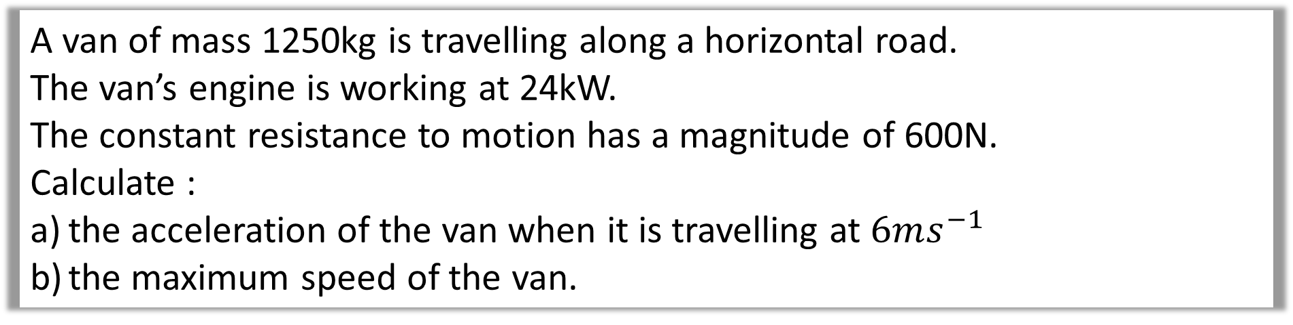
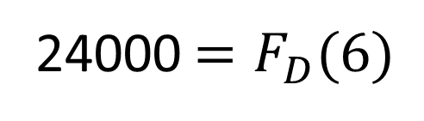




A van of mass 1250kg is travelling along a horizontal road.
The van’s engine is working at 24kW.
The constant resistance to motion has a magnitude of 600N.
Calculate :
the acceleration of the van when it is travelling at $6ms^{−1}$
the maximum speed of the van.
a)
Power $=F_{D}v$
$$F_{R}=ma$$
$$6ms^{−1}$$
24000 $=F_{D}(6)$
$$4000−600=1250a$$
600
1250
$$F_{D}$$
$$F_{D}=4000$$
$$a=2.72ms^{−2}$$

Slide 6
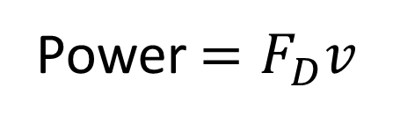

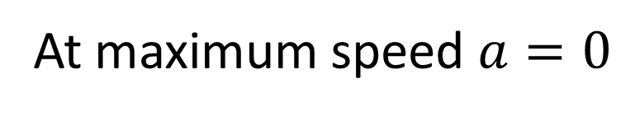
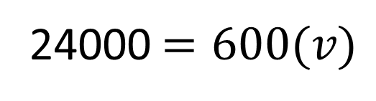



A van of mass 1250kg is travelling along a horizontal road.
The van’s engine is working at 24kW.
The constant resistance to motion has a magnitude of 600N.
Calculate :
the acceleration of the van when it is travelling at $6ms^{−1}$
the maximum speed of the van.
b)
At maximum speed $a=0$
Power $=F_{D}v$
$$F_{R}=ma$$
24000 $=600(v)$
$$F_{D}−600=1250(0)$$
$$v=40 ms^{−1}$$
$$F_{D}=600$$

Slide 7
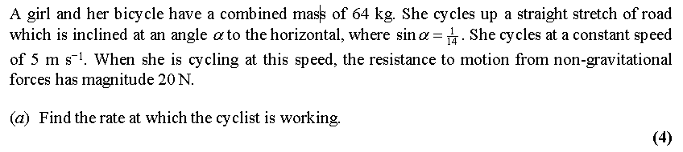
Example B: Exam Question

Slide 8
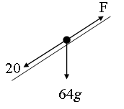
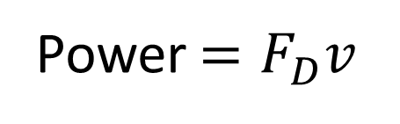




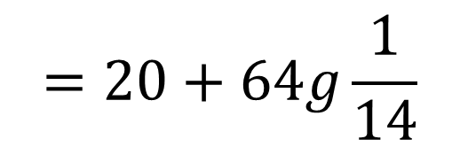
$$F_{D}=20+64g\sin{α}$$
Power $=F_{D}v$
$$=20+64g\frac{1}{14}$$
$=64.8(5)$
$$=324 W$$
$$=64.8 N$$

