Slide 1
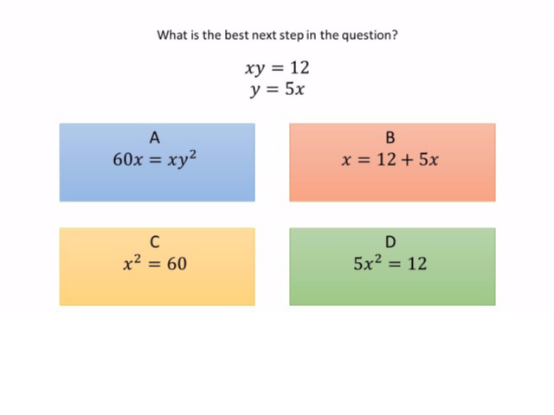
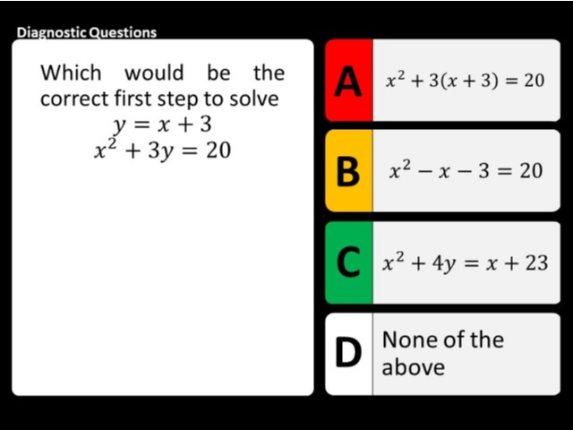
Worst answered question?
Most common wrong answer?

Slide 2
ANSWERS

Slide 3
Worst answered question?

Slide 4
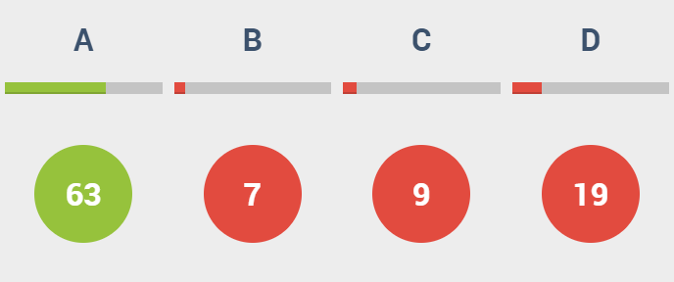
D
They do not know how to do substitution.

Slide 5
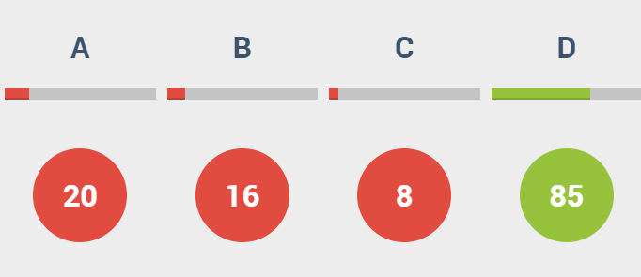
A
They multiplied the two equation together.

