Slide 1
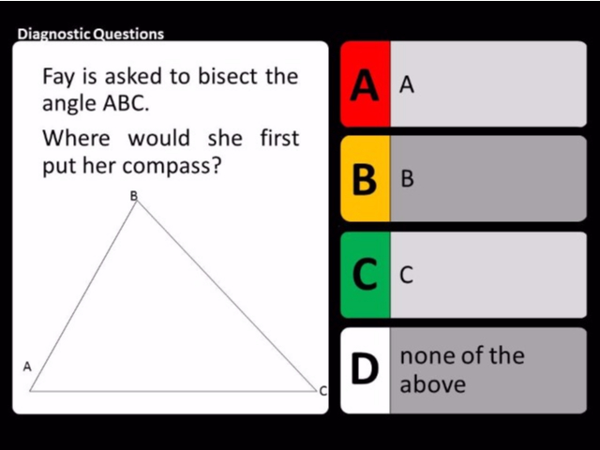
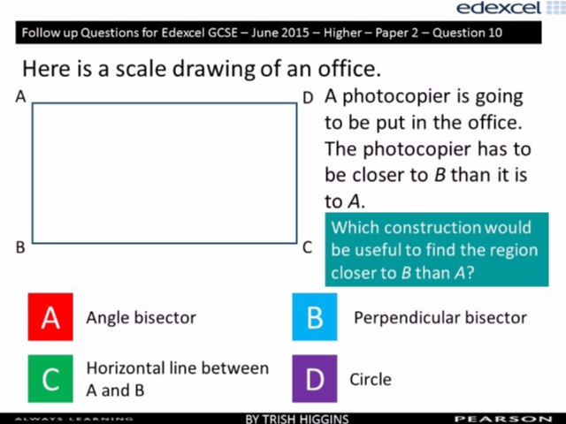
Worst answered question?
Most common wrong answer?

Slide 2
ANSWERS

Slide 3
Worst answered question?
Most common wrong answer?

Slide 4
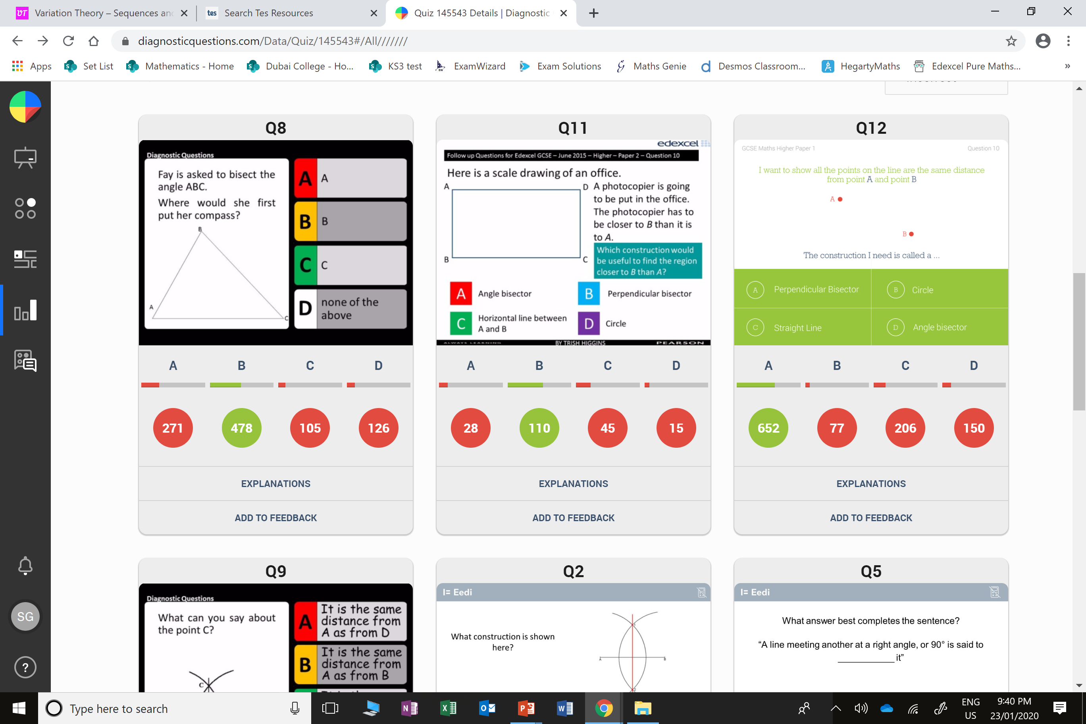
A
They just used the first letter.

Slide 5
C
This option does not state it should be
in the middle.

