Slide 1
LO: Reverse Percentages

Slide 2
What multiplier would you use to....
INCREASE by 10%
1.1
0.10
1.9
0.9

Slide 3
What multiplier would you use to....
INCREASE by 20%
0.2
1.2
0.02
1.02

Slide 4
What multiplier would you use to....
INCREASE by 65%
16.5
0.165
1.65
0.65

Slide 5
What multiplier would you use to....
INCREASE by 2%
0.02
1.2
0.2
1.02

Slide 6
What multiplier would you use to....
DECREASE by 20%
1.2
0.8
0.20
0.02

Slide 7
What multiplier would you use to....
DECREASE by 15%
0.15
1.15
0.85
0.75

Slide 8
What multiplier would you use to....
DECREASE by 5%
0.95
0.05
0.095
1.05

Slide 9
Reverse percentages is when you
what to find the original price
after it has been
increased or decreased.
There are two methods
you could chose from.

Slide 10
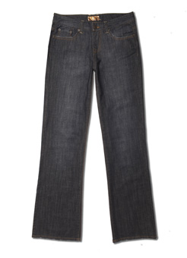
10% off Original Price
Sale Price £45
What was the original price?
£50

Slide 11
10% off Original Price
Sale Price £45
What was the original price?
Method 1
Method 2
45 ÷ 0.90
£45 = 90%
£0.5 = 1%
£50 = 100%
= £50

Slide 12
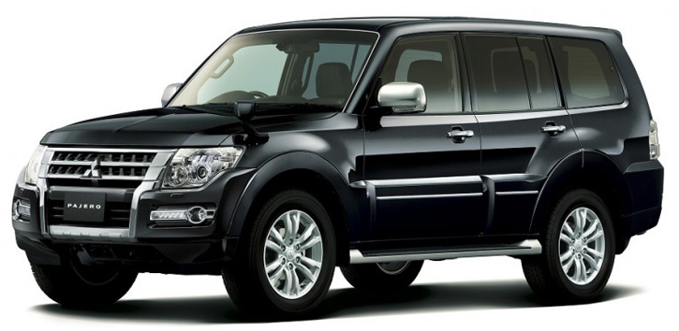
2015
Original Price
Depreciates
by 20%
2019
Current Price
40,000dhs
50,000dhs

Slide 13
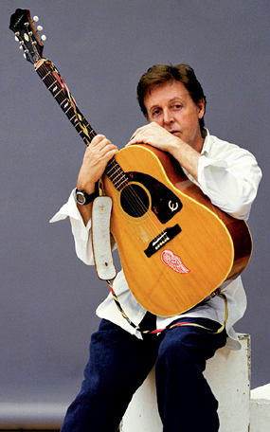
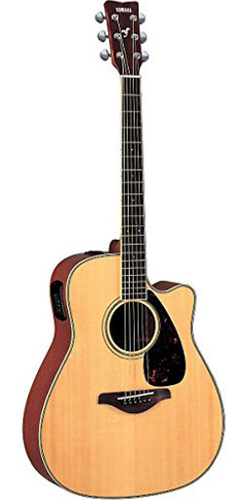
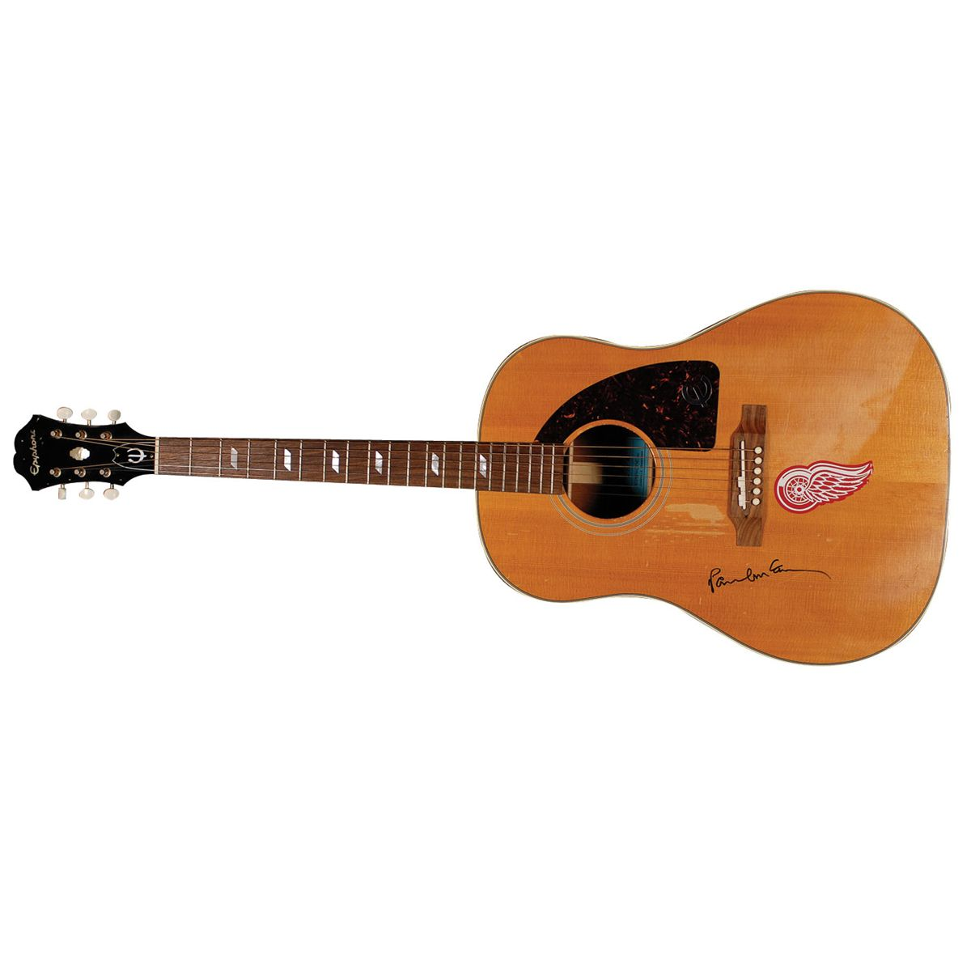
Original Price
Increase by 80%
Current Price £900
£500

Slide 14

Original Price
132 ÷ 1.1 = 120 dhs
Percentage Increase 10%
New Price 132 dhs

Slide 15
Original Price
58.8 ÷ 1.05 = 56 dhs
Percentage Increase 5%
New Price 58.80 dhs

Slide 16
Original Price
39.90 ÷ 0.95 = 42 dhs
Percentage Decrease 5%
New Price 39.90 dhs

Slide 17
Original Price
7.8 ÷ 0.65 = 12 dhs
Percentage Decrease 35%
New Price 7.80 dhs

