Slide 1

Junior Challenge 2
BRONZE

Slide 2
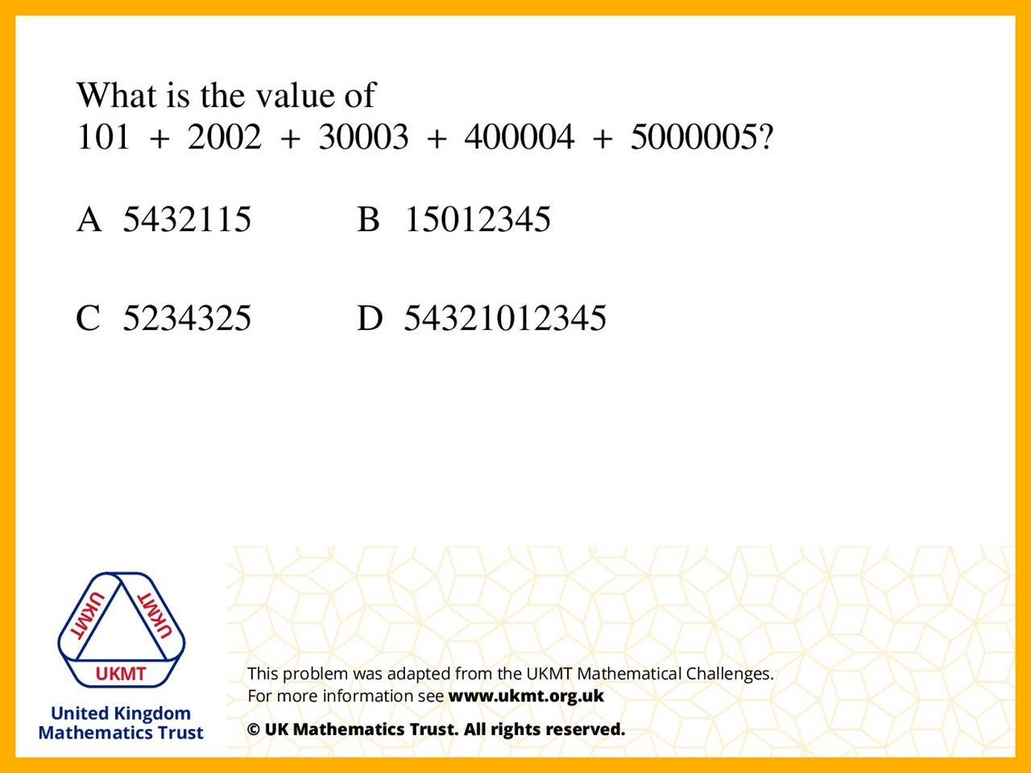
Q1.
Because if you add all the units you get 15,
And the tens total is zero plus the carry over of 1. So the first two numbers will be 15

Slide 3
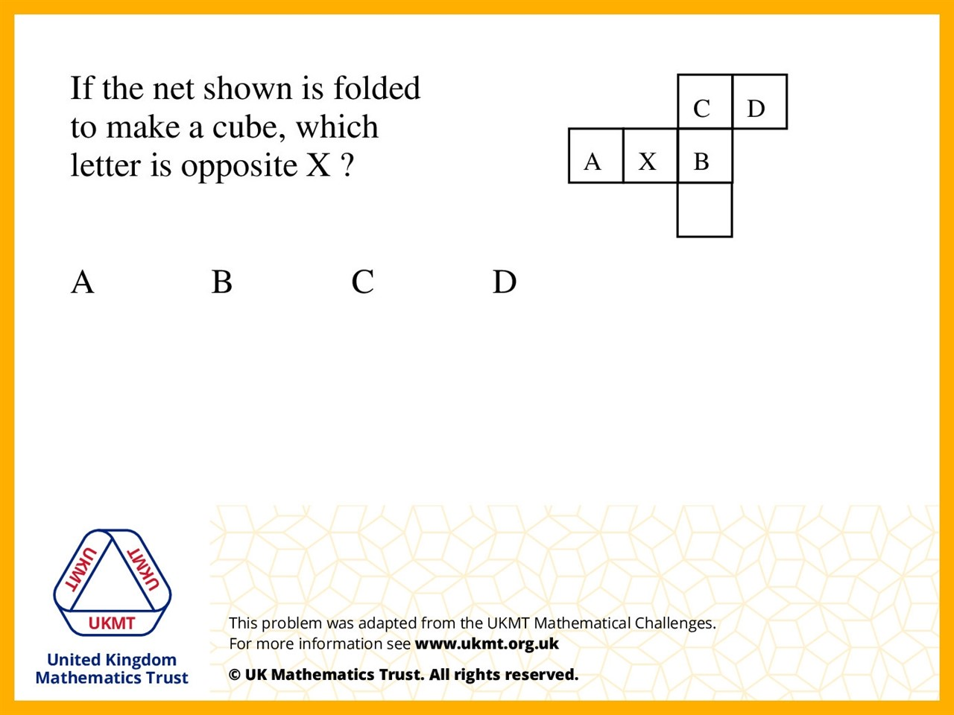
Q2.
Take B as the base, X is the left hand side
and D would be on the right hand side.
(C would be the front, A would be the top and the blank face would be the back.)

Slide 4
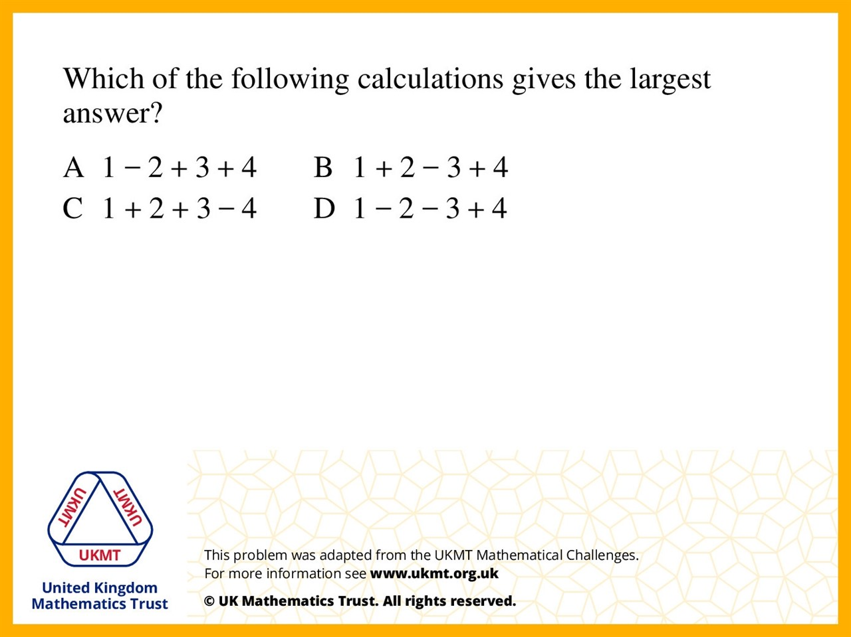
Q3.
A = 6
B = 4
C = 2
D = 0

Slide 5
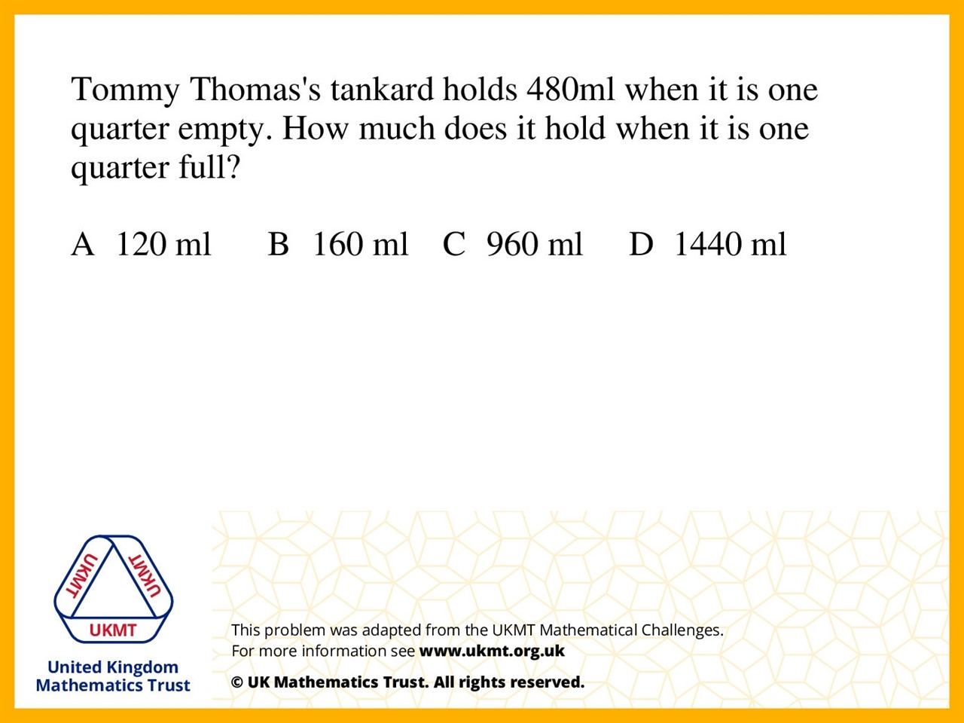
Q4.
Because 480ml is 3 quarters,
so 160ml so 1 quarter.
160 times 4 is 640.

Slide 6
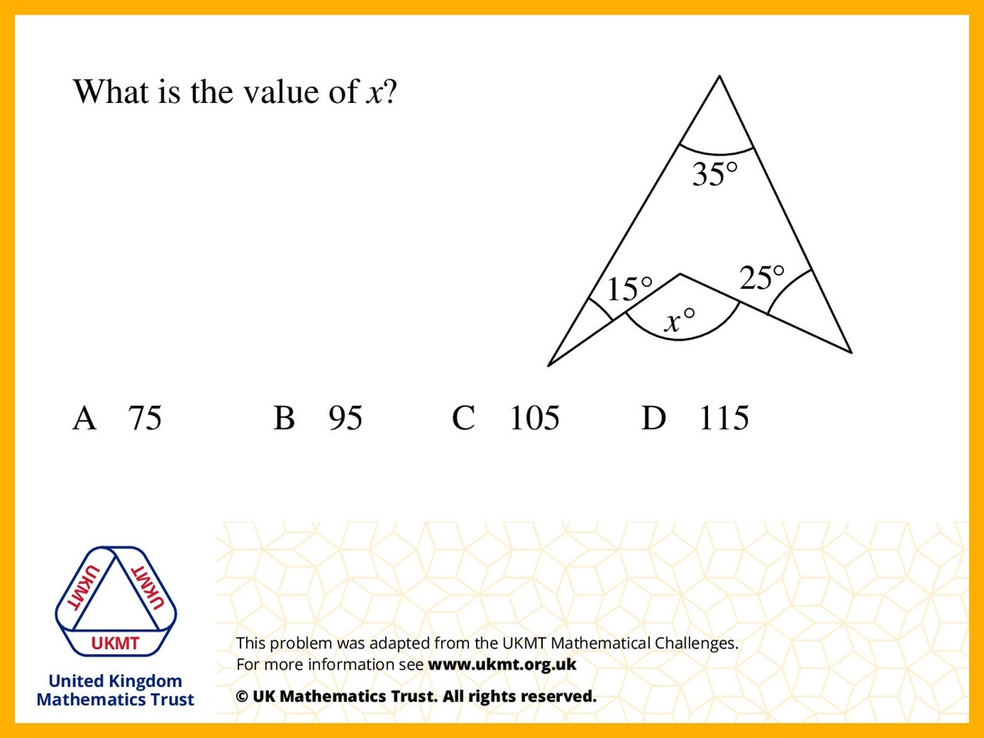
Q5.
Quadrilaterals Total Interior Angles = 360˚
360 – 35 – 25 – 15 = 285˚
Angles in a circle = 360˚ so 360 – 285 = 75˚

