Slide 1
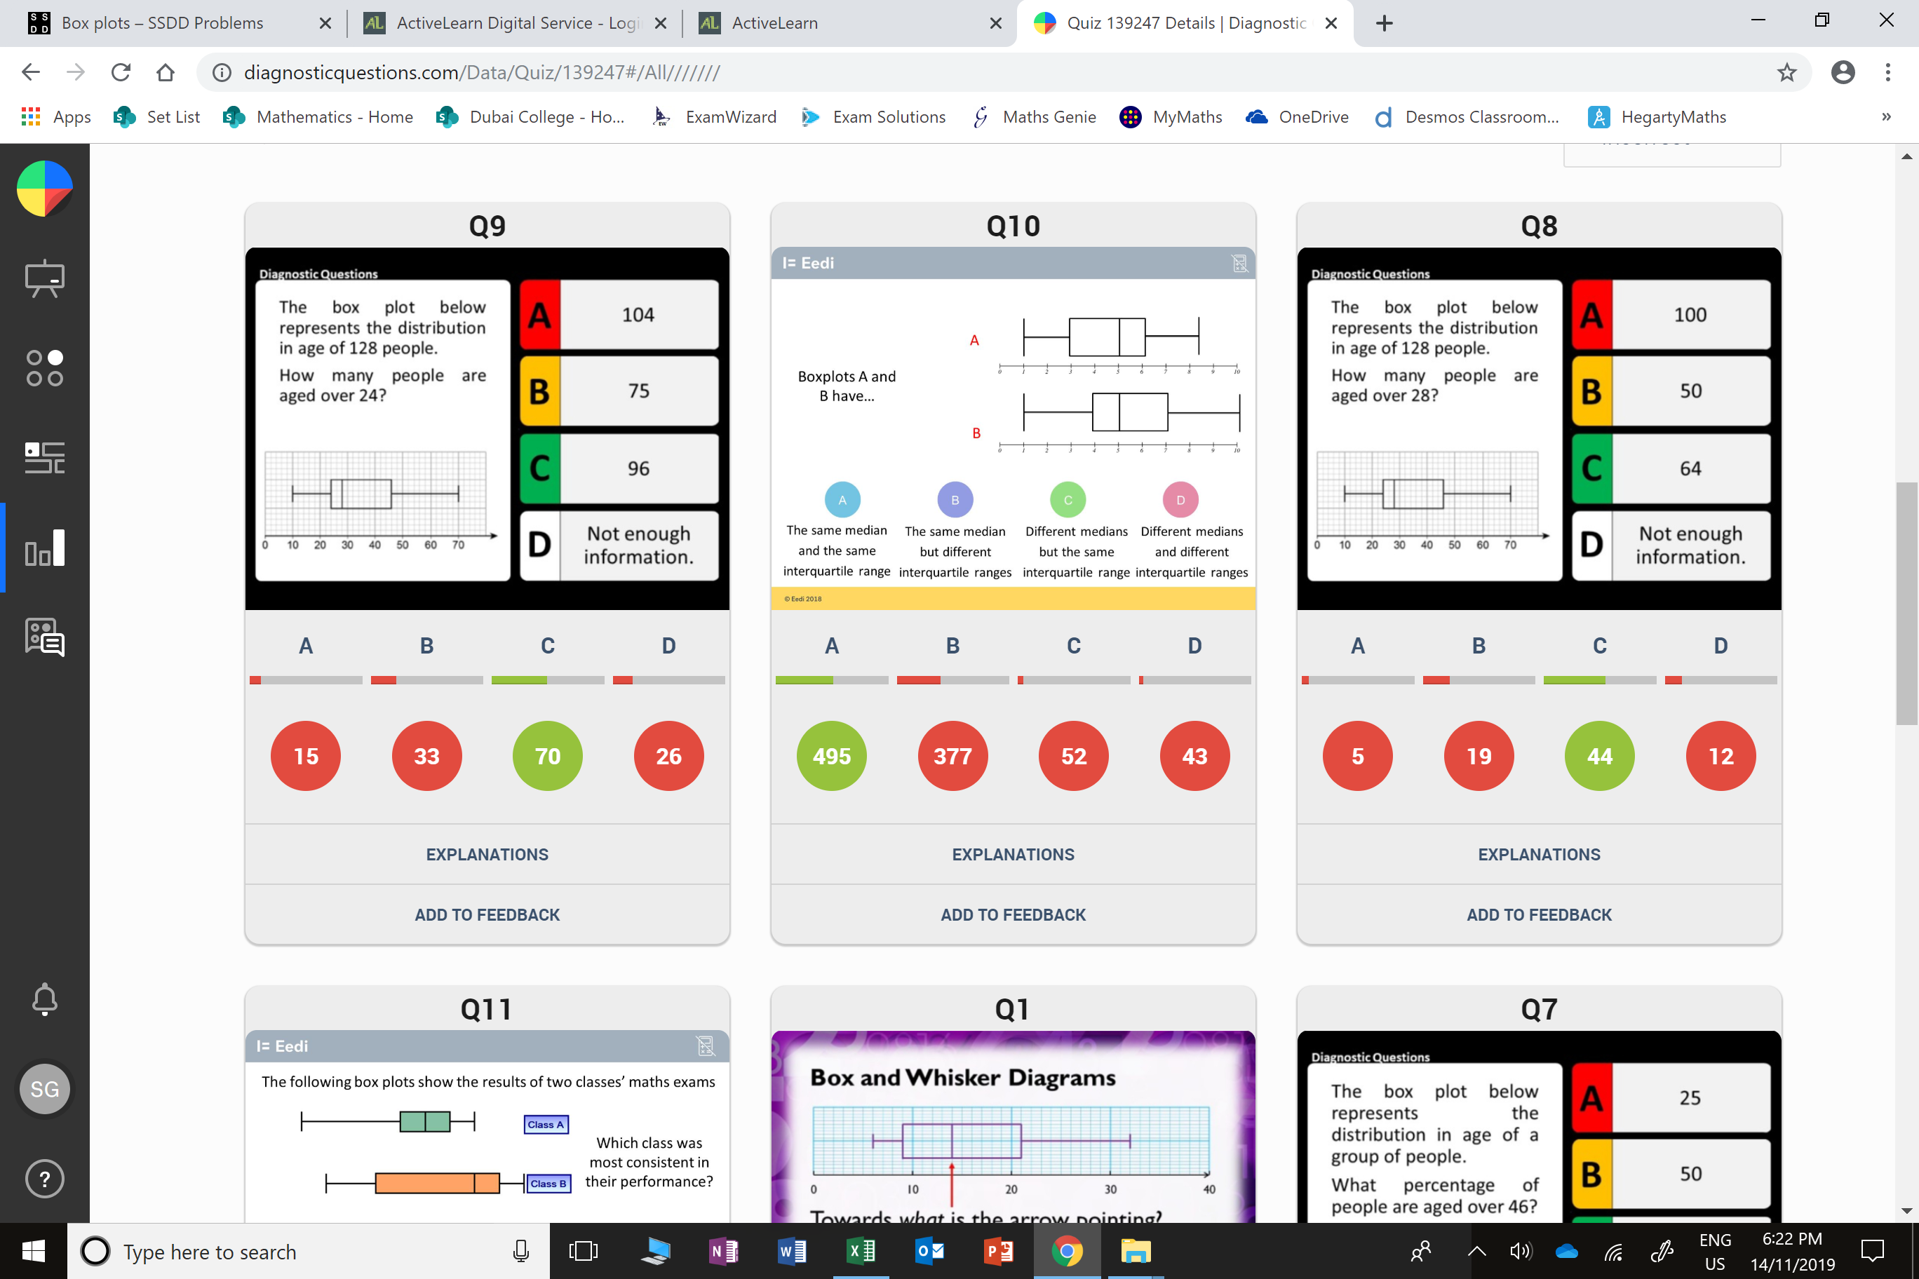
Which question had the lowest percentage of
correct answers?
For each question, what was the most common
wrong answer?

Slide 2
ANSWERS

Slide 3
Which question had the lowest percentage of
correct answers?

Slide 4
B
75% are over 24.
They needed
the number of people not %

Slide 5
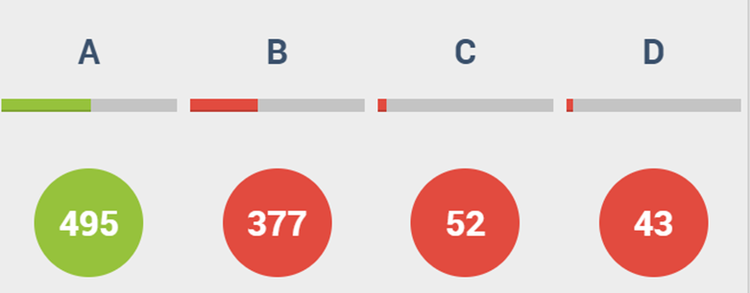
B
The student may be confusing the interquartile ranges and the ranges.

