Slide 1
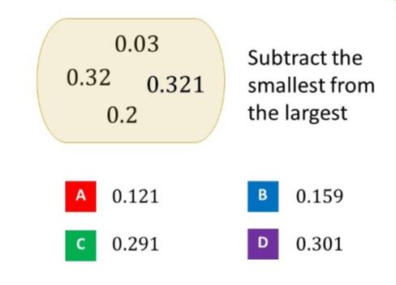
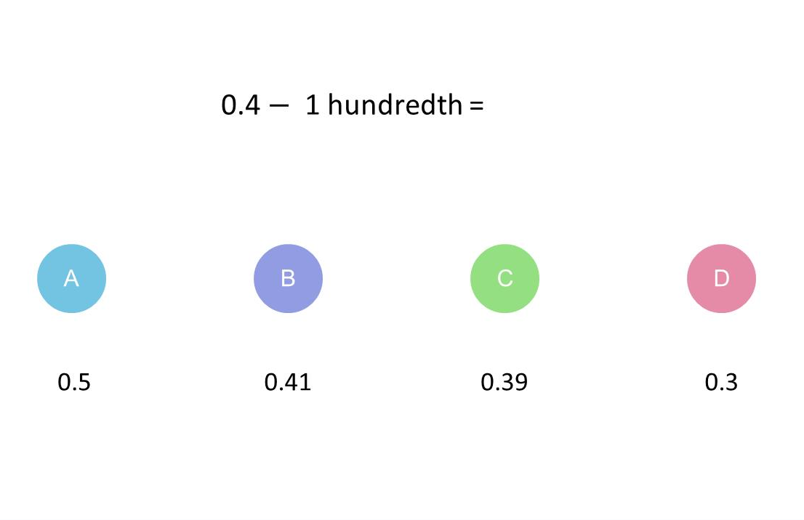
Worst answered question?
Most common wrong answer?

Slide 2
ANSWERS

Slide 3
Worst answered question?

Slide 4
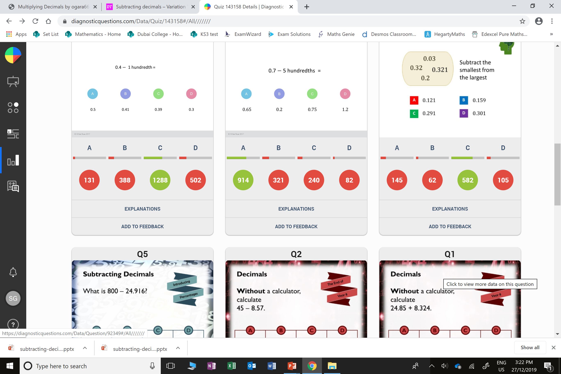
D
They took away 0.1 instead of 0.01

Slide 5
A
They thought 0.2 was the smallest number

