Slide 1
LO: Direct
Proportion

Slide 2
Two sets of values are directly proportional if they have a common multiplier.
x ∝ y

Slide 3
Directly Proportional or Not ?
x | 2 | 3 | 4 | 5 | 6
x2
x2
x2
x2
x2
y | 4 | 6 | 8 | 10 | 12
Directly Proportional

Slide 4
Directly Proportional or Not ?
x | 2 | 3 | 4 | 5 | 6
x2
x2
x2
x2
x3
y | 4 | 6 | 8 | 10 | 18
NOT

Slide 5
Directly Proportional or Not ?
x | 2 | 5 | 8 | 12 | 15
x3
x4
x3
x3
x3
y | 6 | 20 | 24 | 36 | 45
NOT

Slide 6
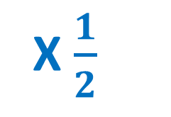
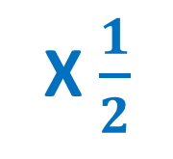
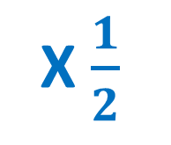
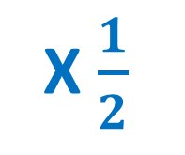
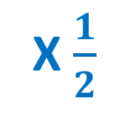
Directly Proportional or Not ?
x | 4 | 8 | 12 | 16 | 20
X$\frac{1}{2}$
X$\frac{1}{2}$
X$\frac{1}{2}$
X$\frac{1}{2}$
X$\frac{1}{2}$
y | 2 | 4 | 6 | 8 | 10
Directly Proportional

Slide 7
Directly Proportional or Not ?
x
0
1
2
3
4
y
0
50
100
150
200
x 50
x 50
x 50
x 50
x 50
Directly Proportion

Slide 8
Directly Proportional or Not ?
x
0
1
2
3
4
y
5
7
14
21
28
???
x 7
x 7
x 7
x 7
NOT

Slide 9
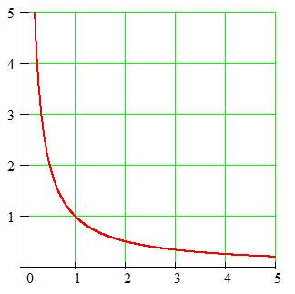
Directly Proportional or Not ?
y
NOT
x

Slide 10
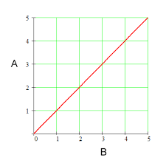
Directly Proportional or Not ?
y
Directly Proportion
x

Slide 11
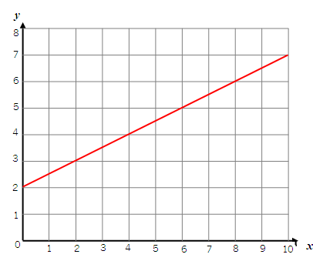
Directly Proportional or Not ?
y
NOT
x

Slide 12
c ∝ b
c | b
0 | 0
1 | 50
2 | 100
3 | 150
5
250

Slide 13
g ∝ h
g | h
0 | 0
1 | 5
5 | 25
9 | 45
 | 20
4

Slide 14
y ∝ x
Write a formula connection y and x given they are
directly proportional.
x | y
0 | 0
1 | 6
2 | 12
3 | 18
4 | 24
y = 6x

Slide 15
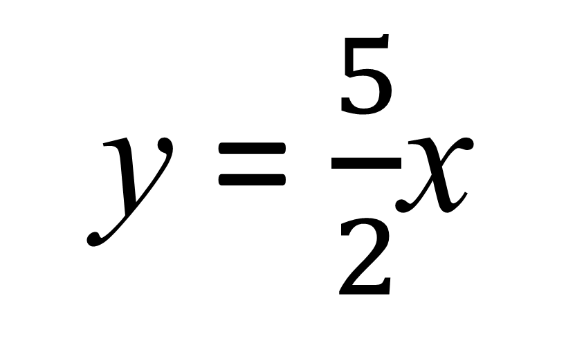
y ∝ x
Write a formula for
y in terms of x
given they are
directly proportional.
x | y
0 | 0
2 | 5
4 | 10
6 | 15
8 | 20
y = $\frac{5}{2}$x

Slide 16
y and x are directly proportional.
Find a formula for y in terms of x.
Given that when x = 6, y = 18
x | y
6 | 18
x 3
y = 3x

Slide 17
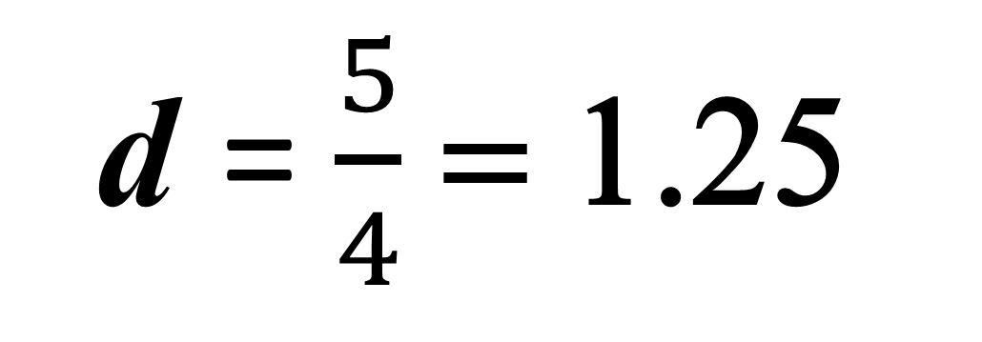
d and t are directly proportional
i) Find a formula for t in terms of d. Given that d = 2 when t = 8
ii) Work out the value of t when d = 10
iii) Work out the value of d when t = 5
t = 4d
d | t
2 | 8
t = 40
d = $\frac{5}{4}$ = 1.25

