Slide 1

Diagnostic Assessment .Delta 1
Unit 10
Sequences
Horizontal and Vertical Lines
Plotting Linear Graphs

Slide 2
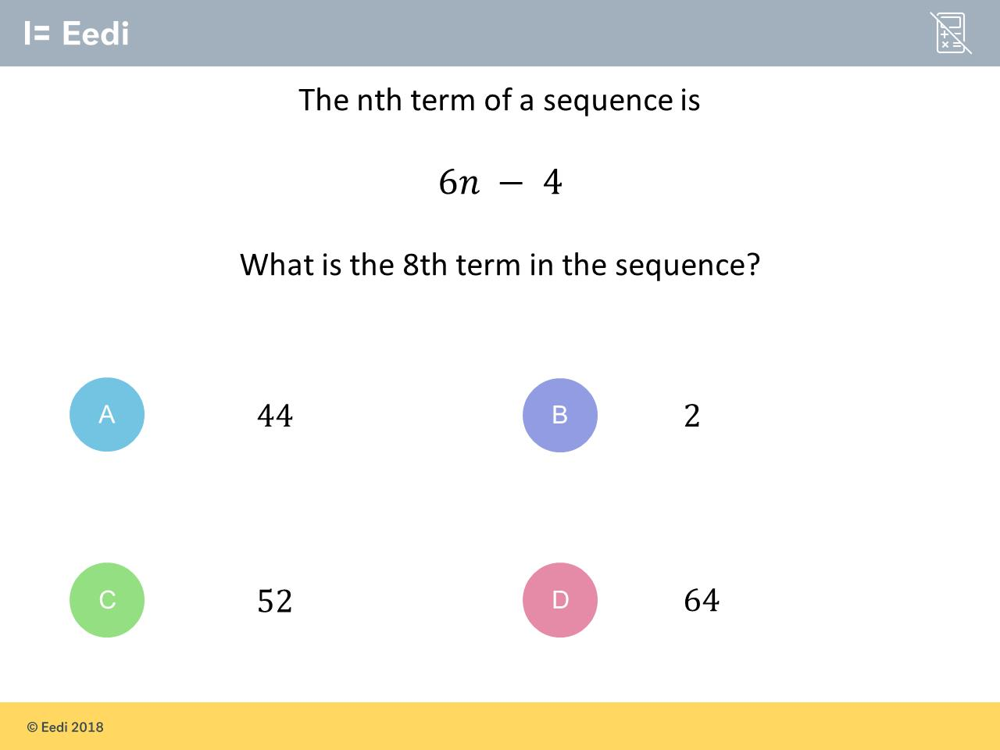
Question 1 – Sequences

Slide 3
Answer 1 – Sequences
CORRECT ANSWER | CORRECT EXPLANATION
44 | We substitute n = 8 into the expression to get 6 × 8 - 4 = 48 - 4 = 44.
COMMON MISTAKES | WHAT MIGHT BE YOUR MISTAKE
2 | The student has found which term would have the value 8.
52 | The student has added the second term, rather than subtracting.
64 | The student has not multiplied the first term correctly, and has just replace n with the digit 8.

Slide 4
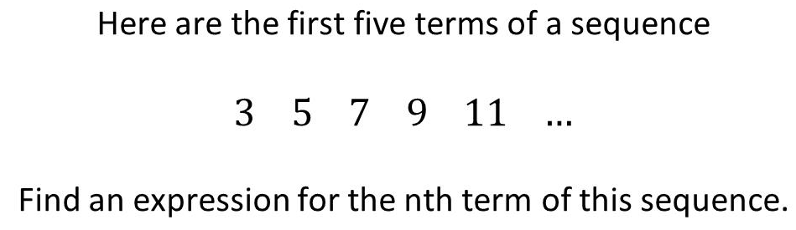
Question 2 – Sequences

Slide 5
Answer 2 – Sequences
CORRECT ANSWER | CORRECT EXPLANATION
2n + 1 | The difference between terms is 2, so the first part is 2n. We can adjust by noticing that 2 + 1 = 3 for the first term. This means the expression is 2n + 1.
COMMON MISTAKES | WHAT MIGHT BE YOUR MISTAKE
2n | The student has found the first part correctly, but not adjusted.
Double and add 1 | The student has written the rule in words, but not an expression.
n + 2 | The student has given the term-to-term rule.

Slide 6
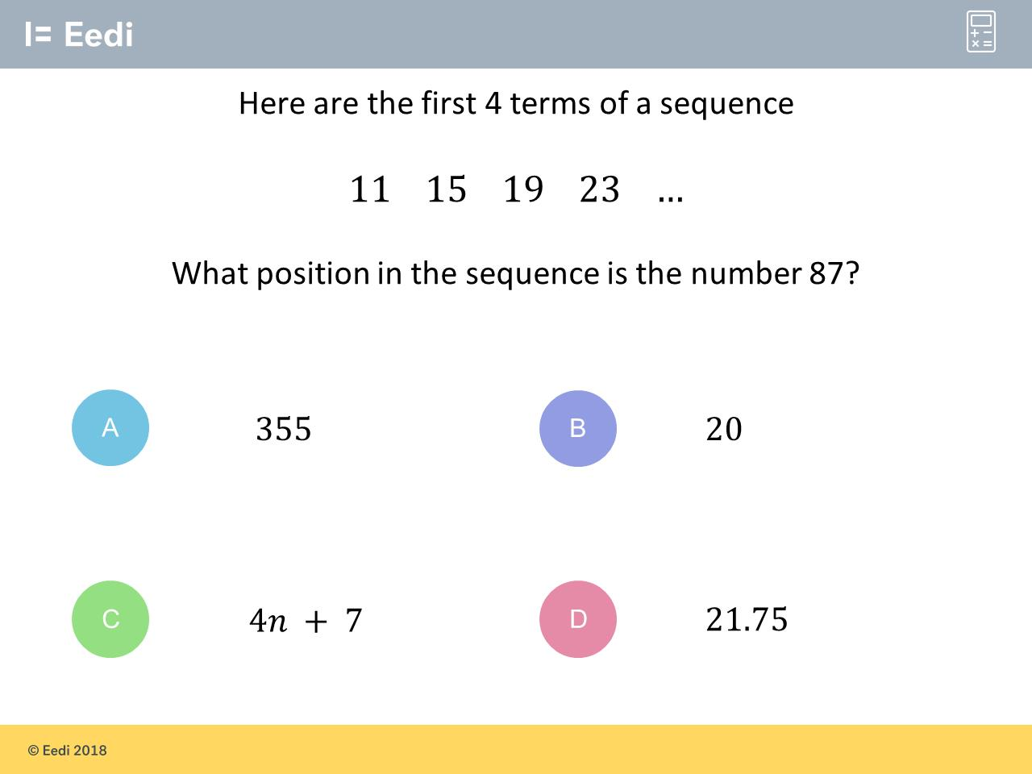
Question 3 – Sequences

Slide 7
Answer 3 – Sequences
CORRECT ANSWER | CORRECT EXPLANATION
20 | The nth term expression is 4n + 7, so we need to solve 4n + 7 = 87. This has solution n = 20.
COMMON MISTAKES | WHAT MIGHT BE YOUR MISTAKE
355 | The student has found the 87th term.
4n + 7 | The student has given the nth term rule, but not answered the question.
21.75 | The student has divided 87 by 4.

Slide 8
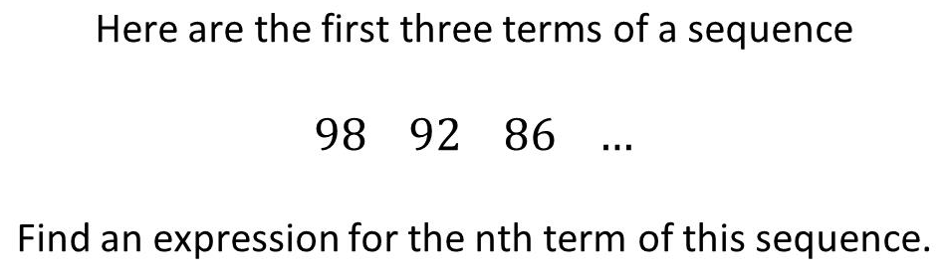
Question 4 – Sequences

Slide 9
Answer 4 – Sequences
CORRECT ANSWER | CORRECT EXPLANATION
-6n + 104 | The difference between terms is -6, which is the first part. Then we adjust by noticing that -6 + 104 = 98 for the first term, so the full expression is -6n + 104.
COMMON MISTAKES | WHAT MIGHT BE YOUR MISTAKE
-6n + 92 | The student has miscalculated the add on.
-6n | The student has found the common difference only.
6n + 92 | The student has not noticed that the sequence is decreasing.

Slide 10
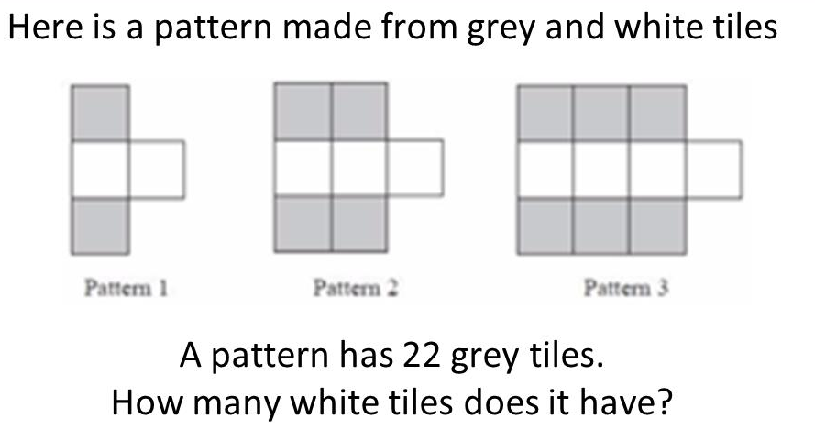
Question 5 – Sequences

Slide 11
Answer 5 – Sequences
CORRECT ANSWER | CORRECT EXPLANATION
12 | Each pattern has n + 1 white tiles and 2n grey tiles. If the pattern has 22 grey tiles, we must be on Pattern 11, so there are 11 + 1 = 12 white tiles.
COMMON MISTAKES | WHAT MIGHT BE YOUR MISTAKE
7 | The student has found the Pattern that has 22 tiles in total.
44 | The student has found the number of grey tiles in pattern 22.
22 | The student has simply repeated the number from the question.

Slide 12
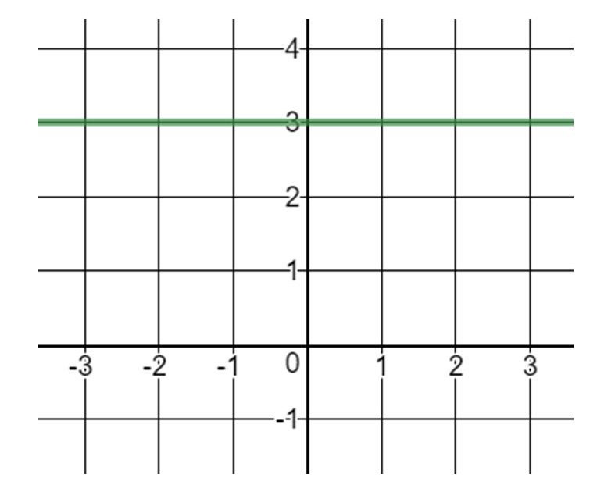
Question 6 – Vertical and Horizontal Lines
What is the equation of the line?

Slide 13
Answer 6 – Vertical and Horizontal Lines
What is the equation of the line?
CORRECT ANSWER | CORRECT EXPLANATION
30 | In 𝑦 = m𝑥 + c the intercept is 3 and the m is 0 giving 𝑦 = 3. Alternatively the 𝑦 coordinate of every point on the line is 3 hence 𝑦 = 𝑥
COMMON MISTAKES | WHAT MIGHT BE YOUR MISTAKE
20 | The student has seen that it passes through 3 and has inserted this into the 𝑦 = m𝑥 + c formula but in the m position rather than the c
0 | The student may think that it is 𝑥 = 3 as the line is in the same direction as the 𝑥 axis.
10 | The student may think that as it goes through 3 on the 𝑦 axis they need to put the 3 with the 𝑦, hence 𝑥 = 3𝑦

Slide 14
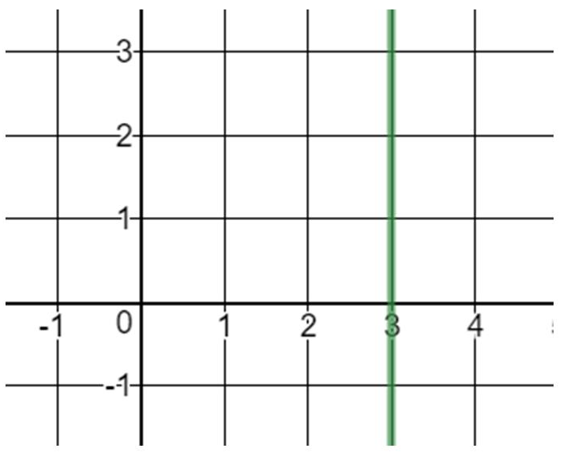
Question 7 – Vertical and Horizontal Lines
What is the equation of the line?

Slide 15
Answer 7 – Vertical and Horizontal Lines
What is the equation of the line?
CORRECT ANSWER | CORRECT EXPLANATION
x = 3 | This is a horizontal line that goes through 3 on the x-axis, so the equation is x = 3.
COMMON MISTAKES | WHAT MIGHT BE YOUR MISTAKE
x = 3y | The student may believe that we always need a y in the equation.
y = 3x | The student has mixed up vertical and horizontal lines.
y = 3 | The student has mixed up vertical and horizontal line, and has included an extra x term.

Slide 16
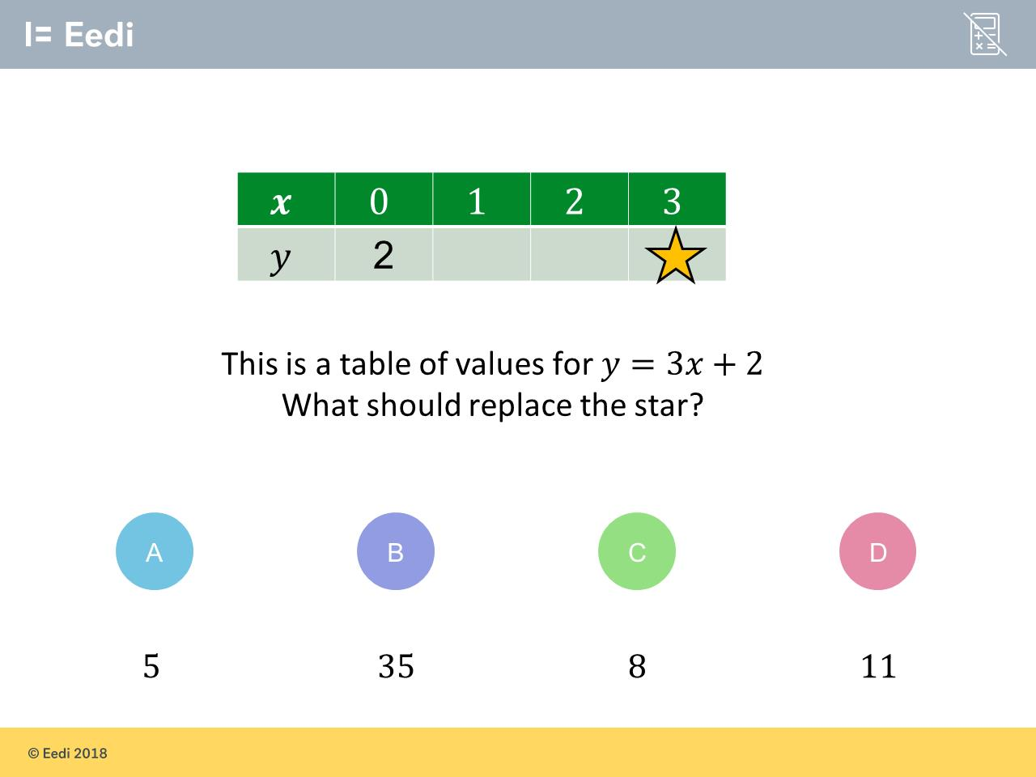
Question 8 – Plotting Linear Graphs

Slide 17
Answer 8 – Plotting Linear Graphs
CORRECT ANSWER | CORRECT EXPLANATION
11 | Substituting x = 3 into y = 3x + 2 gives y = 3 × 3 + 2 = 9 + 2 = 11.
COMMON MISTAKES | WHAT MIGHT BE YOUR MISTAKE
5 | The student may have counted up 3 spaces in the table.
35 | The student may have written 3x as 33.
8 | The student has added 3, rather than multiplying.

Slide 18
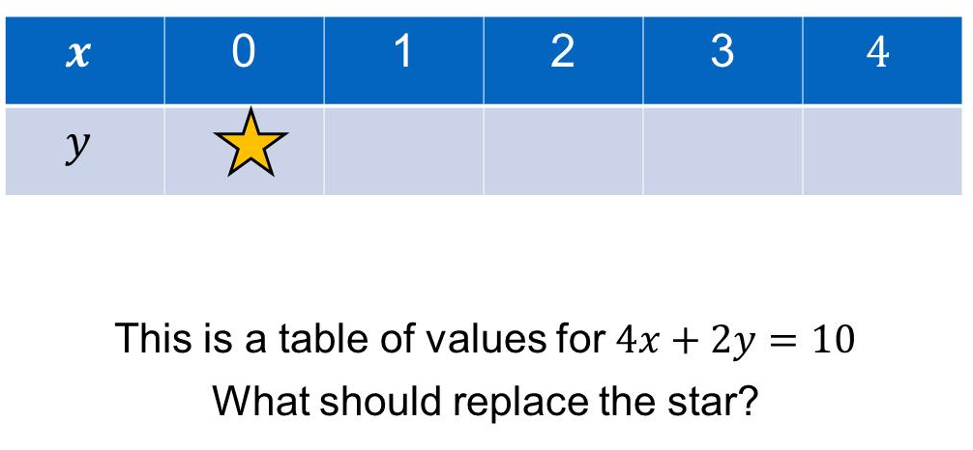
Question 9 – Plotting Linear Graphs

Slide 19
Answer 9 – Plotting Linear Graphs
CORRECT ANSWER | CORRECT EXPLANATION
5 | Substituting in x = 0 gives 4 × 0 + 2y = 10, and so 2y = 10. Dividing by 2 gives y = 5.
COMMON MISTAKES | WHAT MIGHT BE YOUR MISTAKE
20 | The student has multiplied, rather than dividing, when solving for y.
3 | The student may have added 4 and 0, rather than multiplying.
1.5 | The student has tried to solve for y = 0, but has made an error dividing.

Slide 20
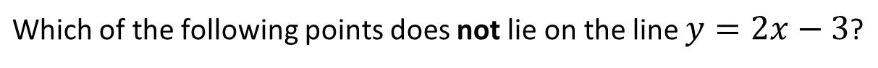
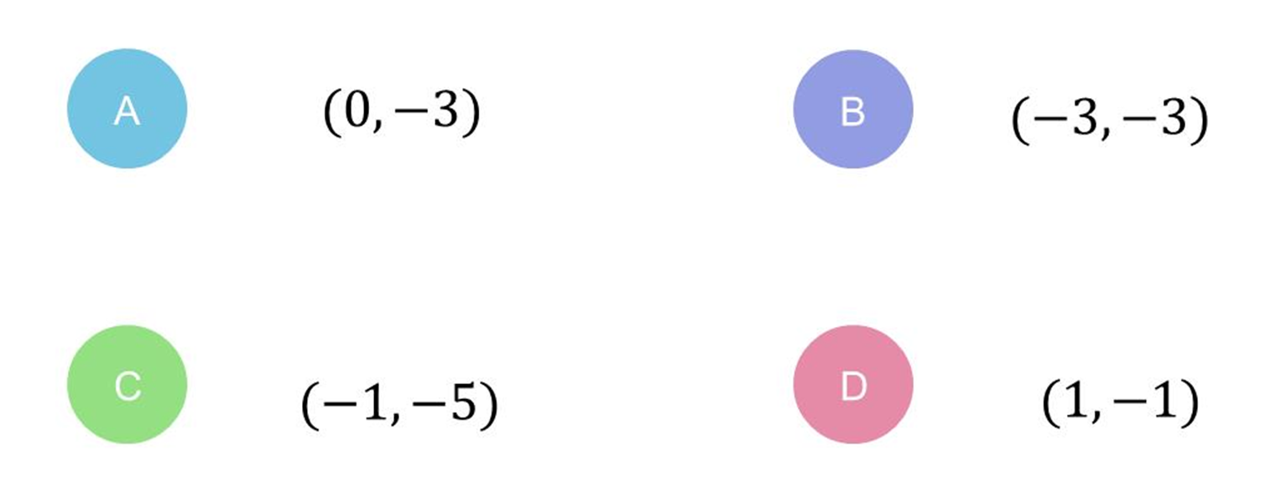
Question 10 – Plotting Linear Graphs

Slide 21
Answer 10 – Plotting Linear Graphs
CORRECT ANSWER | CORRECT EXPLANATION
(-3, -3) | Substituting x = -3 into the equation gives y = 2 × -3 -3 = -6 - 3 = -9, not -3.
COMMON MISTAKES | WHAT MIGHT BE YOUR MISTAKE
(0, -3) | The student has picked a point that is on the line.
(-1, -5) | The student has picked a point that is on the line.
(1, -1) | The student has picked a point that is on the line.

