Slide 1
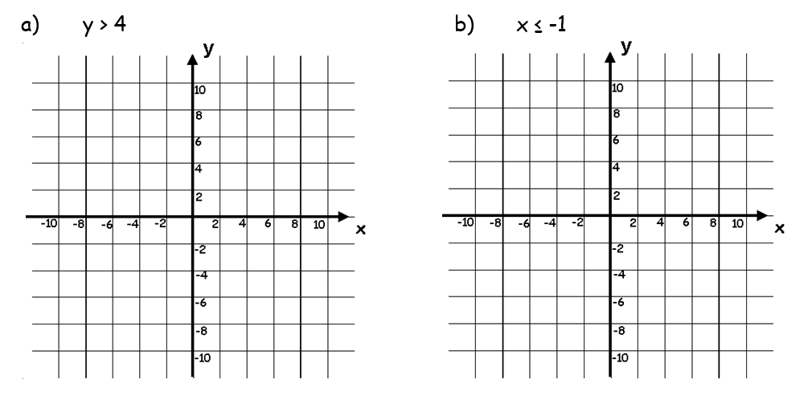

Slide 2
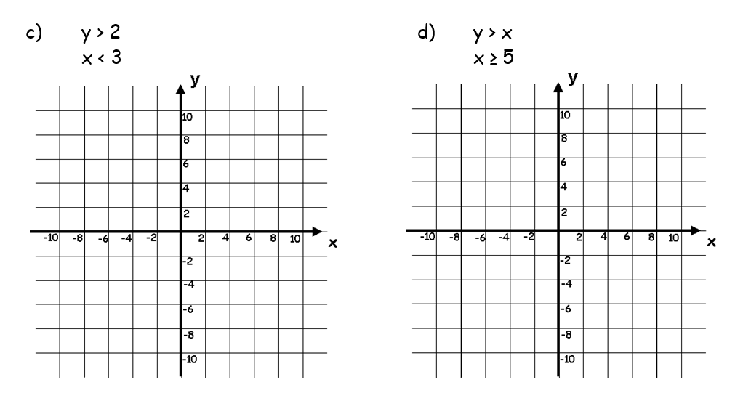

Slide 3
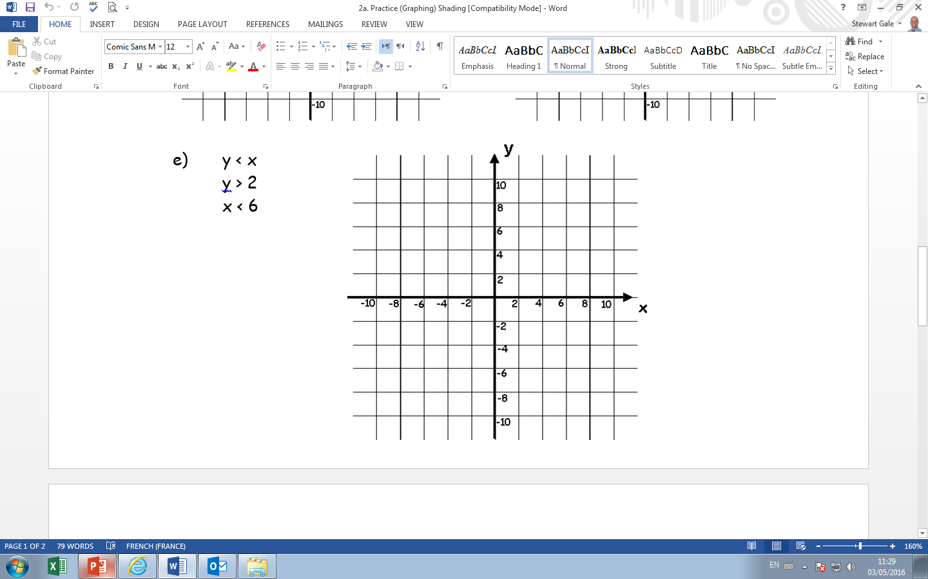

Slide 4
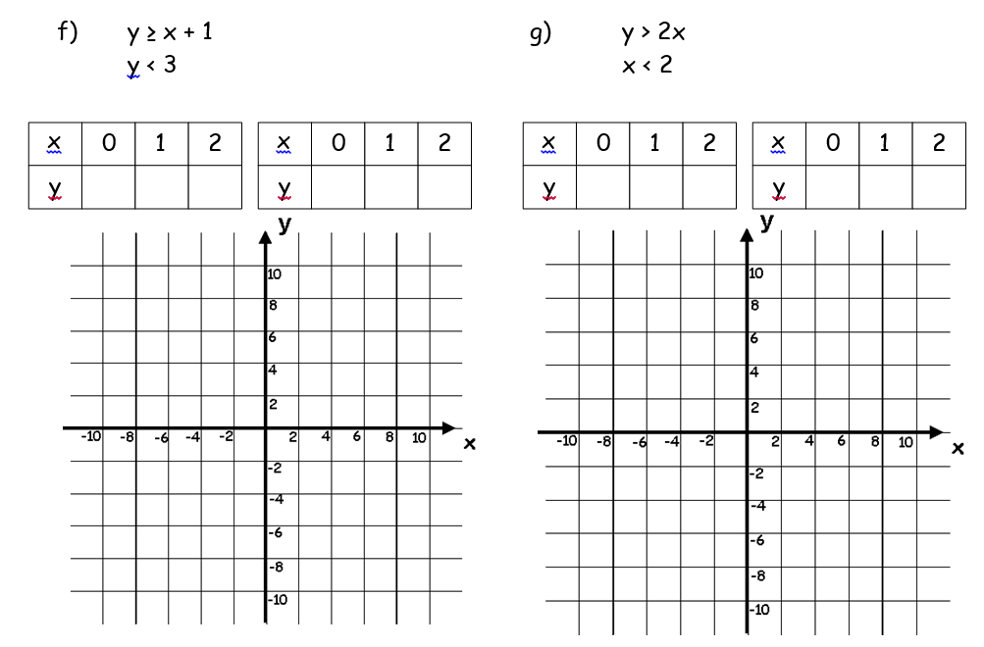
y < 2x
x > 2
1
1
1
1
1
1

Slide 5
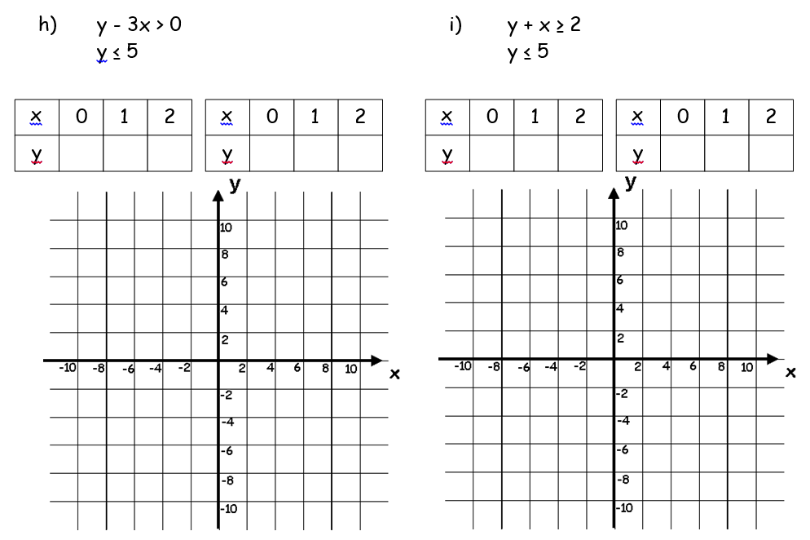
1
2
3

Slide 6
ANSWERS

Slide 8
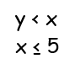

Slide 10
y < 2x
x > 2
1
2
3
1
1
1
0
2
4
1
1
1

Slide 11
0
3
6
1
2
3
2
1
0

