Slide 1
Normal Distribution
Introduction
Chapter 3
(Part 1 of 7)

Slide 2
Binomial Distribution looks at the probability
of an event happening, when discrete data.
31%
31%
16%
16%
3%
3%
0
1
2
3
4
5

Slide 3
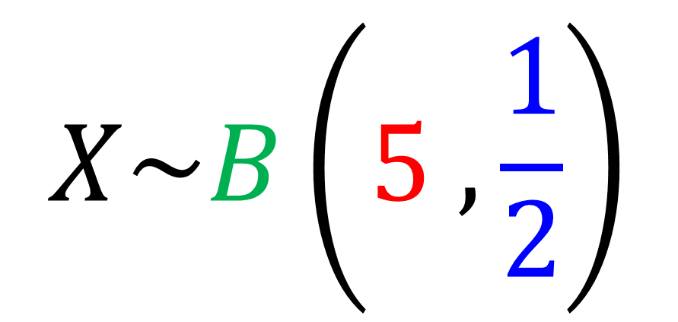
Binomial Distribution notation:
$$X\sim B\left(5 ,\frac{1}{2}\right)$$
Binomial Distribution
Number of Trials
Probability of success

Slide 4
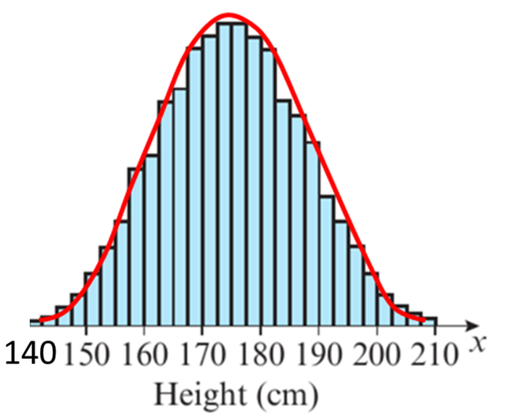
Normal Distribution looks at the probability
of an event happening, when continuous data.

Slide 5
Normal Distribution - Modelling
The normal distribution can be
used to model many
naturally occurring characteristics, such as:
Height of people within a population
Weight of tigers in a jungle
Errors in scientific measurements
Size variation in manufactured objects

Slide 6
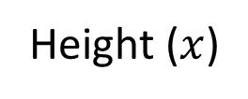
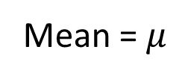
Normal Distribution - Characteristics
Probability
Density
Mean = $μ$
Height ($x$)
Normal distribution key features:
only uses continuous data
is symmetrical about the mean
has total area under the graph of 1 (100%)

Slide 7
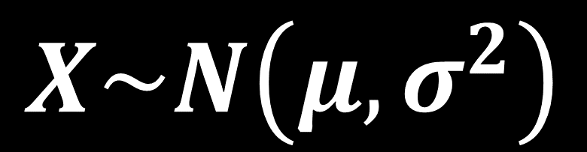
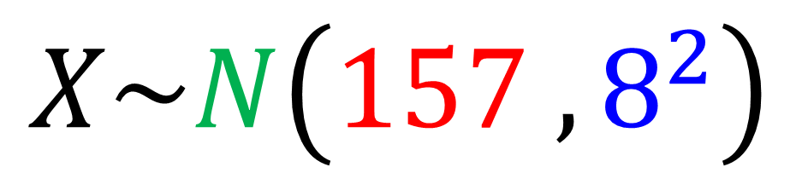
Normal Distribution Notation
$$X\sim N\left(μ,σ^{2}\right)$$
$$X\sim N\left(157 ,8^{2}\right)$$
Normal Distribution
Mean
Variance (SD = 8)

Slide 8
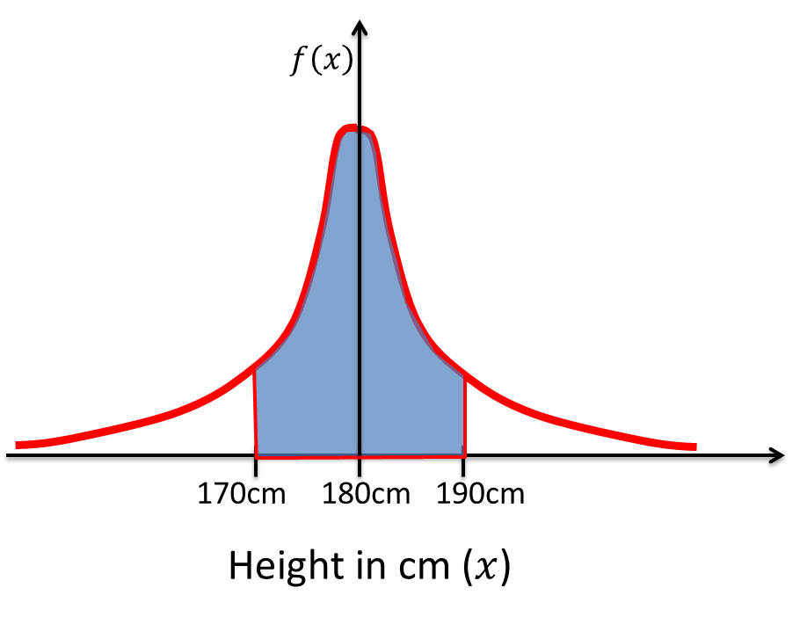

Normal Distribution - Probability Density
Probability of an event occurring is
represented by the area under the graph.
$$P\left(170<X<190\right)$$

Slide 9
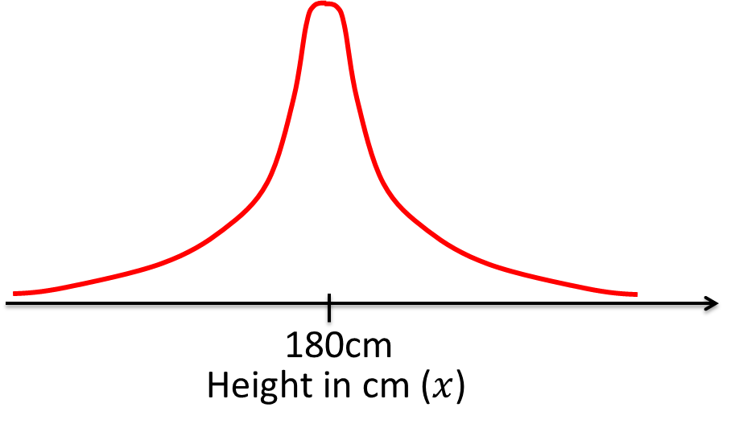


5$σ$
5$σ$
Values more than 5 standard deviations
from the mean have probabilities
close to 0 or equal to zero.

Slide 10
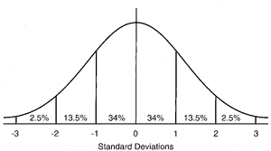

Normal Distribution – 68, 95, 99.7 Rule
≈ 𝟗𝟗.𝟕% of data is within three standard deviations of the mean.
≈ 95% of data is within two standard deviations from the mean.
≈ 68% of data is within one standard deviations from the mean.
For practical purposes we consider all data to lie within $μ±5σ$

