Slide 1
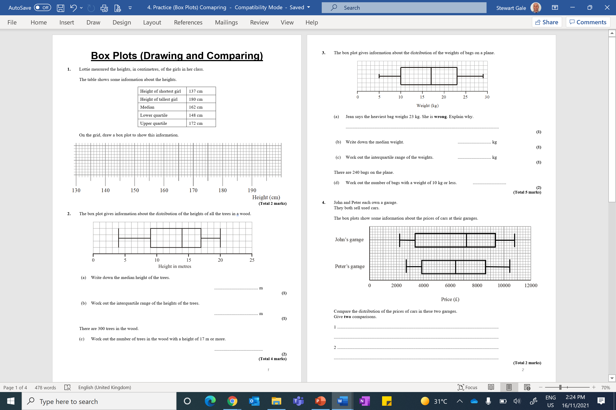

Slide 2
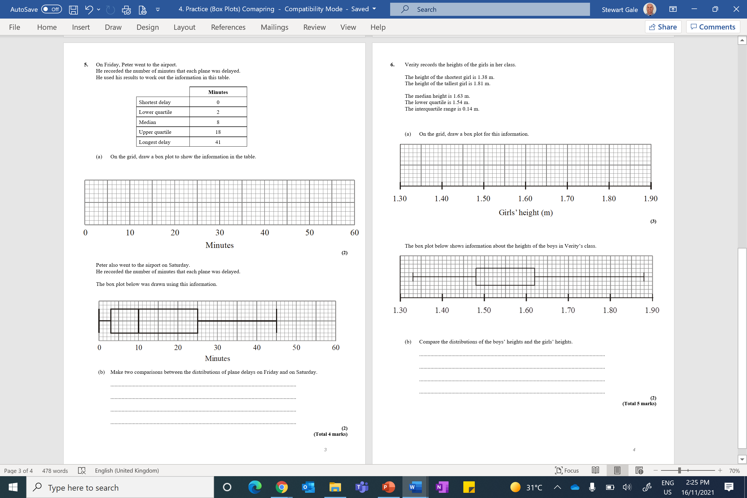

Slide 3
ANSWERS

Slide 4
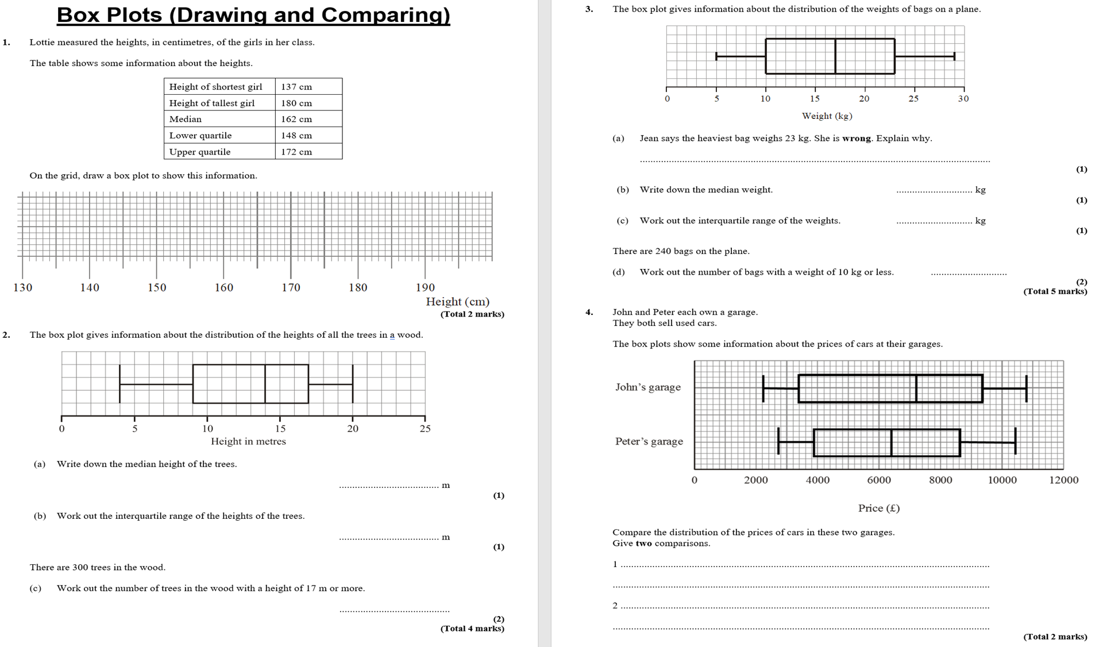

Slide 5
14
8
¼ x 300 = 75

Slide 6
Heaviest bag is 29kg
17
23 – 10 = 13
¼ x 240 = 60

Slide 7
B1 for a comparison of a specific value,
e.g. John’s median is greater than Peter’s median
B1 for a comparison of spread,
e.g. John’s range is wider than Peter’s range

Slide 8
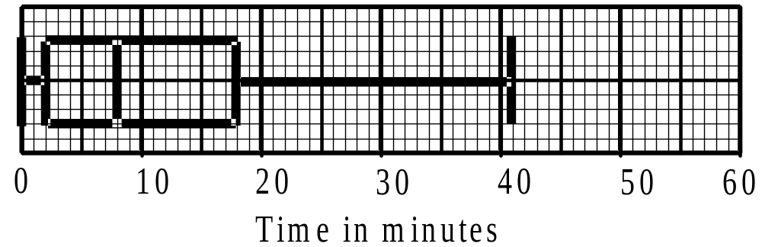
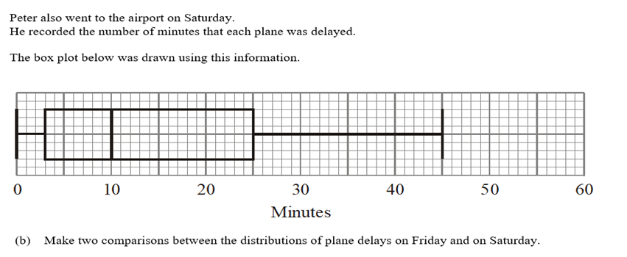
B2 for two comparisons with at least one on spread
B1 for one comparison of spread or one comparison of values

Slide 9
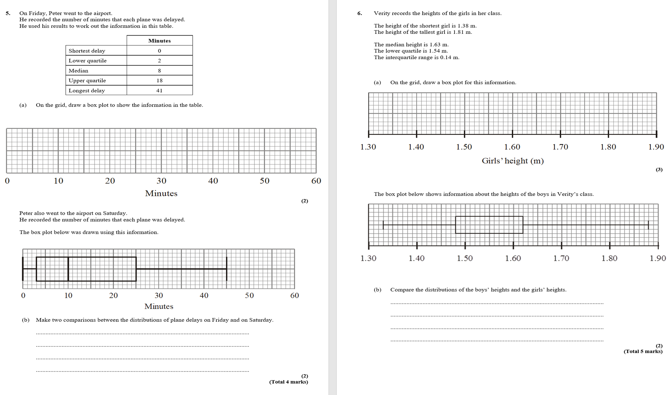
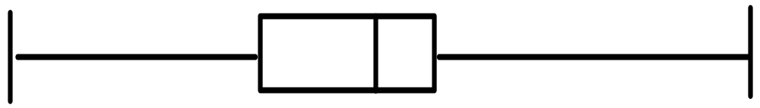
Markings at 1.38, 1.54, 1.63, 1.68, 1.81
B1 for comparison of a specific value
e.g. Tallest boy is taller than the tallest girl; girls median greater than boys median
B1 for comparison of spread
e.g. the range of the boys heights is greater than the range of the girls heights;
interquartile range is the same

