Slide 1
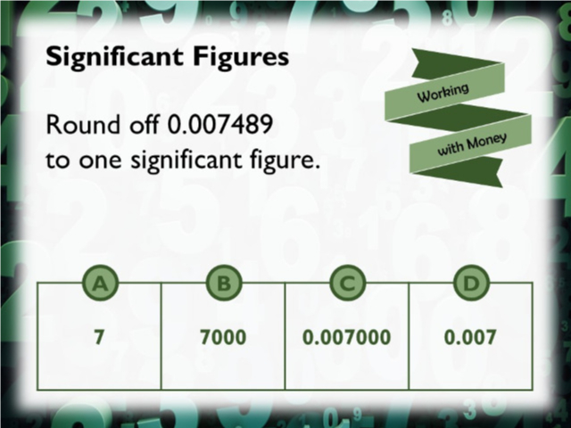
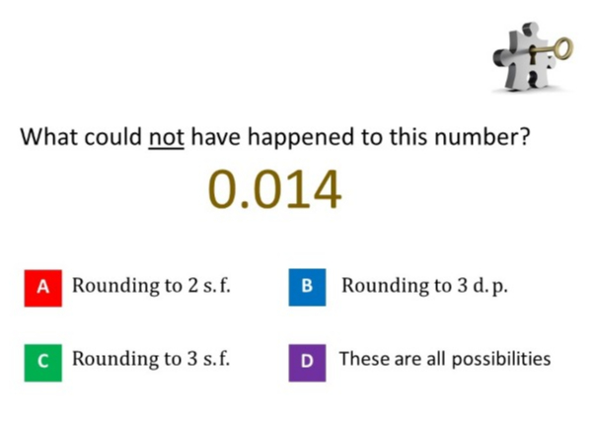
Worst answered question?
Most common wrong answer?

Slide 2
ANSWERS

Slide 3
Worst answered question?

Slide 4

D
There are
3 numbers after the decimal point so they think they can all be done.

Slide 5

C
They did not need the
extra zeros.

