Slide 1
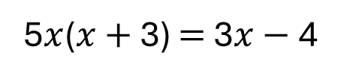
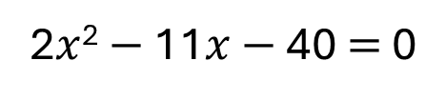
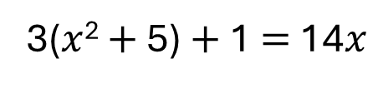
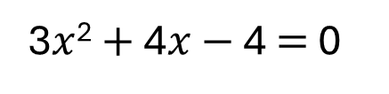
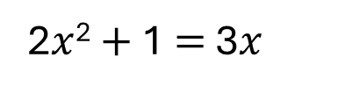
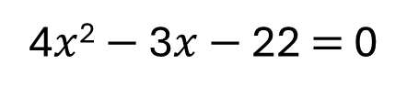
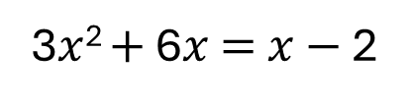
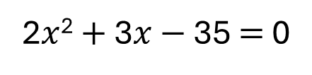
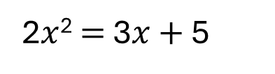
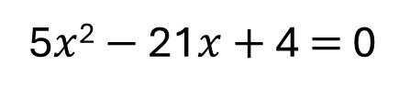
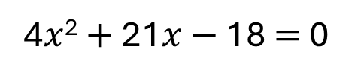
Solve the following quadratic equation by factorising into two brackets.
Q1
Q2
[a]
5$x$² $−$ 21$x$ $+$ 4 $=$ 0
[a]
2$x$² $=$ 3$x$ $+$ 5
[b]
2$x$² $+$ 3$x$ $−$ 35 $=$ 0
[b]
3$x$² $+$ 6$x$ $=$ $x$ $−$ 2
[c]
4$x$² $−$ 3$x$ $−$ 22 $=$ 0
[c]
2$x$² $+$ 1 $=$ 3$x$
[d]
3$x$² $+$ 4$x$ $−$ 4 $=$ 0
[d]
3($x$² $+$ 5) $+$ 1 $=$ 14$x$
[e]
2$x$² $−$ 11$x$ $−$ 40 $=$ 0
[e]
5$x$($x$ $+$ 3) $=$ 3$x$ $−$ 4
[f]
4$x$² $+$ 21$x$ $−$ 18 $=$ 0

Slide 2
ANSWERS

Slide 3
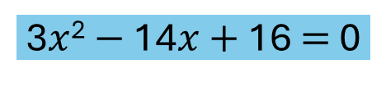
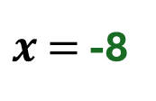
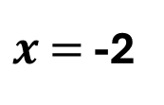
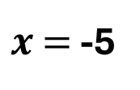

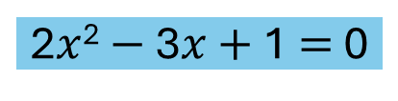
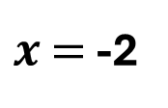
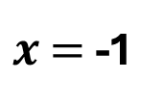

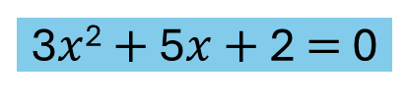
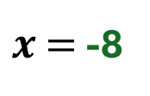
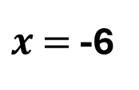
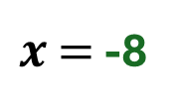

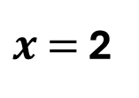

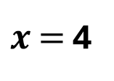
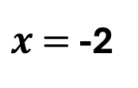

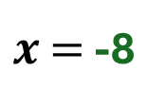
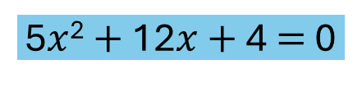


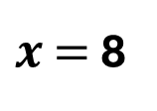

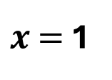
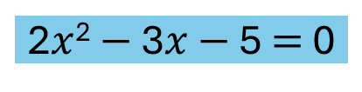
Solve the following quadratic equation by factorising into two brackets.
Q1
Q2
$x$ $=$ -8
$x$ $=$ 4
[a]
5$x$² $−$ 21$x$ $+$ 4 $=$ 0
1
[a]
2$x$² $=$ 3$x$ $+$ 5
$x$ $=$ -1
$x$ $=$ -8
5
5
2$x$² $−$ 3$x$ $−$ 5 $=$ 0
2
$x$ $=$ -8
$x$ $=$ -5
[b]
2$x$² $+$ 3$x$ $−$ 35 $=$ 0
7
[b]
3$x$² $+$ 6$x$ $=$ $x$ $−$ 2
$x$ $=$ -8
$x$ $=$ -1
2
-2
$x$ $=$ -2
$x$ $=$ -8
3$x$² $+$ 5$x$ $+$ 2 $=$ 0
3
[c]
4$x$² $−$ 3$x$ $−$ 22 $=$ 0
11
4
[c]
2$x$² $+$ 1 $=$ 3$x$
$x$ $=$ -8
$x$ $=$ 1
1
$x$ $=$ -2
$x$ $=$ -8
[d]
3$x$² $+$ 4$x$ $−$ 4 $=$ 0
2
2$x$² $−$ 3$x$ $+$ 1 $=$ 0
2
3
[d]
3($x$² $+$ 5) $+$ 1 $=$ 14$x$
$x$ $=$ -8
$x$ $=$ 2
8
$x$ $=$ -8
$x$ $=$ 8
-5
3$x$² $−$ 14$x$ $+$ 16 $=$ 0
3
[e]
2$x$² $−$ 11$x$ $−$ 40 $=$ 0
2
[e]
5$x$($x$ $+$ 3) $=$ 3$x$ $−$ 4
$x$ $=$ -8
$x$ $=$ -2
$x$ $=$ -6
$x$ $=$ -8
-2
3
[f]
4$x$² $+$ 21$x$ $−$ 18 $=$ 0
5$x$² $+$ 12$x$ $+$ 4 $=$ 0
5
4

