Slide 1
Vectors
3D Vectors
Chapter 12
(Part 2 of 6)

Slide 2
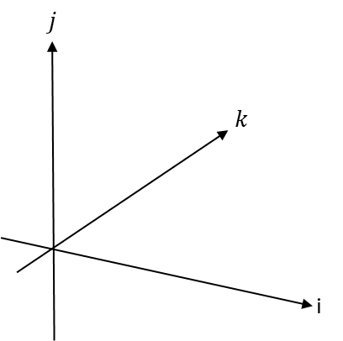
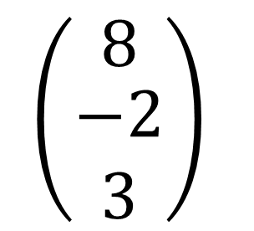
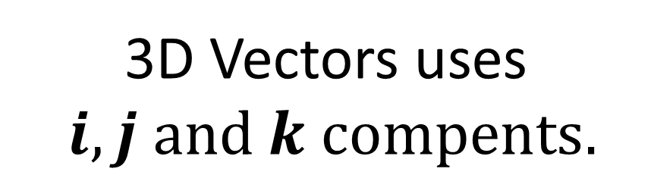
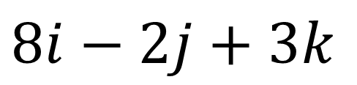
3D Vectors
3D Vectors uses
$i, j and k compents.$
$8i−2j+3k$
$$\left(\begin{matrix}8 \\ \begin{aligned}−2 \\ 3\end{aligned}\end{matrix}\right)$$

Slide 3
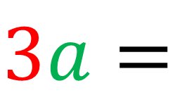
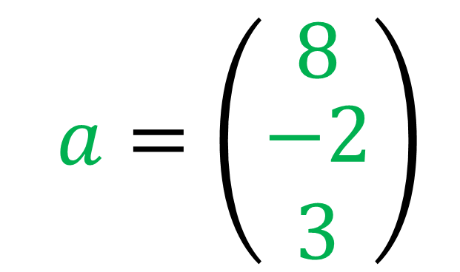
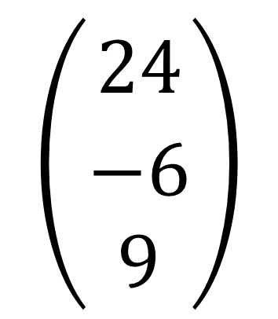
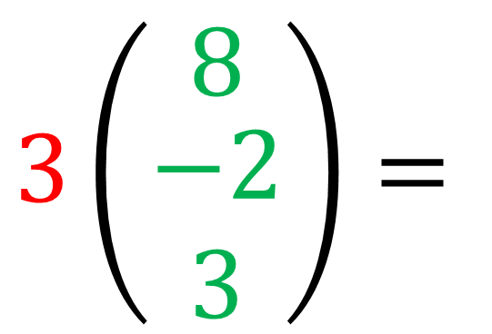
3D Vectors Calculations
$a=\left(\begin{matrix}8 \\ \begin{aligned}−2 \\ 3\end{aligned}\end{matrix}\right)$
$$\left(\begin{aligned}24 \\ \begin{matrix} \\ \begin{aligned}−6 \\ 9\end{aligned}\end{matrix}\end{aligned}\right)$$
$3\left(\begin{matrix}8 \\ \begin{aligned}−2 \\ 3\end{aligned}\end{matrix}\right)=$
$3a=$

Slide 4
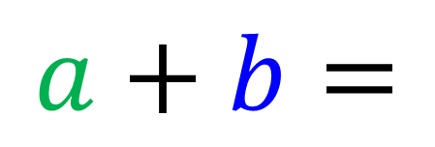

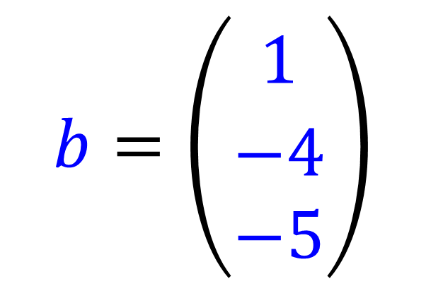
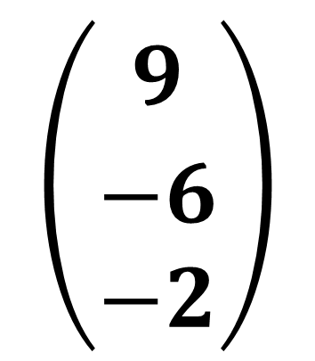
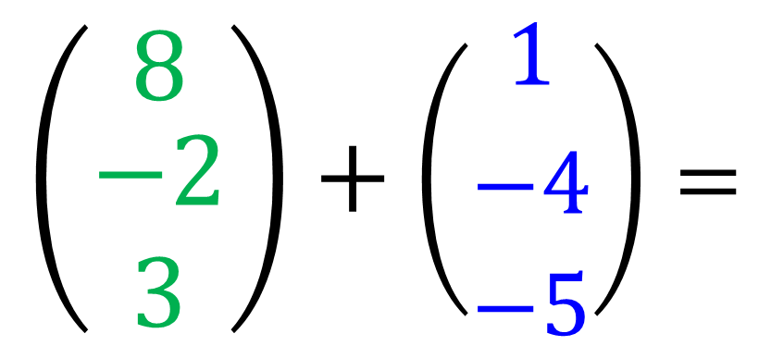
3D Vectors Calculations
$a=\left(\begin{matrix}8 \\ \begin{aligned}−2 \\ 3\end{aligned}\end{matrix}\right)$
$$b=\left(\begin{aligned}1 \\ \begin{matrix} \\ \begin{aligned}−4 \\ −5\end{aligned}\end{matrix}\end{aligned}\right)$$
$$\left(\begin{matrix}8 \\ \begin{aligned}−2 \\ 3\end{aligned}\end{matrix}\right)+\left(\begin{aligned}1 \\ \begin{matrix} \\ \begin{aligned}−4 \\ −5\end{aligned}\end{matrix}\end{aligned}\right)=$$
$$\left(\begin{aligned}9 \\ \begin{matrix} \\ \begin{aligned}−6 \\ −2\end{aligned}\end{matrix}\end{aligned}\right)$$
$a+b=$

Slide 5
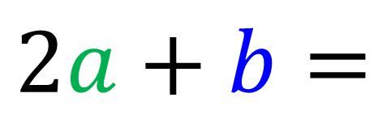
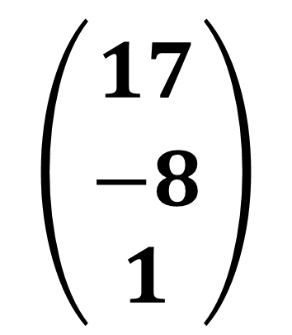
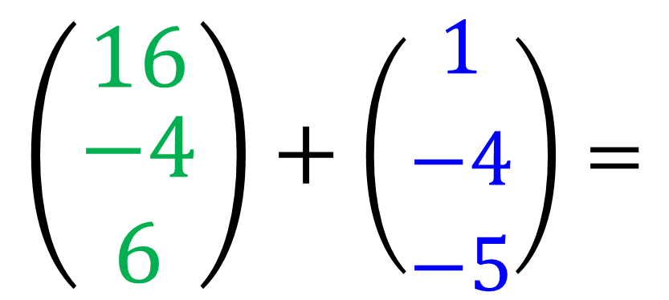
3D Vectors Calculations
$a=\left(\begin{matrix}8 \\ \begin{aligned}−2 \\ 3\end{aligned}\end{matrix}\right)$
$$b=\left(\begin{aligned}1 \\ \begin{matrix} \\ \begin{aligned}−4 \\ −5\end{aligned}\end{matrix}\end{aligned}\right)$$
$$\left(\begin{matrix}16 \\ \begin{aligned}−4 \\ 6\end{aligned}\end{matrix}\right)+\left(\begin{aligned}1 \\ \begin{matrix} \\ \begin{aligned}−4 \\ −5\end{aligned}\end{matrix}\end{aligned}\right)=$$
$$\left(\begin{aligned}17 \\ \begin{matrix} \\ \begin{aligned}−8 \\ 1\end{aligned}\end{matrix}\end{aligned}\right)$$
$2a+b=$

Slide 6
Vectors and Parallel
Two vectors are parallel if
one is a multiple of the other.

Slide 7
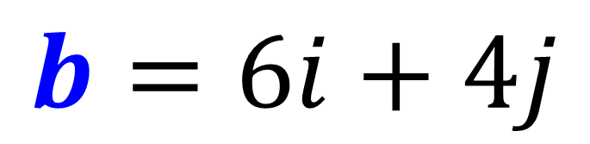
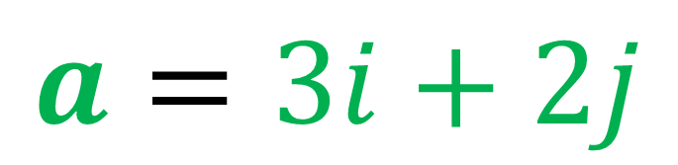
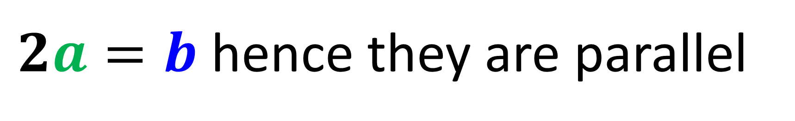
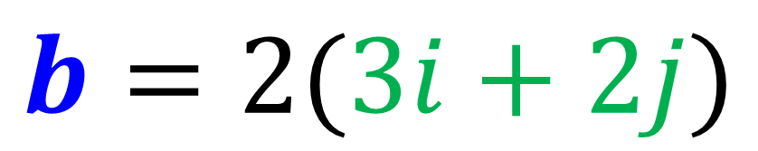

Vectors and Parallel
Show that vectors $a$ and $b$ are parallel.
$a=3i+2j$
$b=6i+4j$
$b=2(3i+2j)$
$2a=b$ hence they are parallel

Slide 8

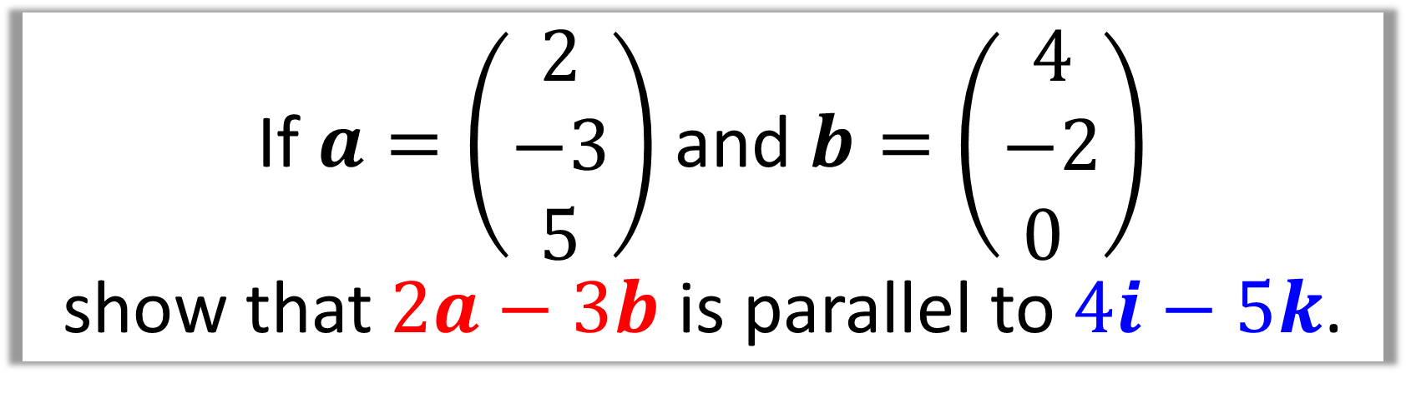
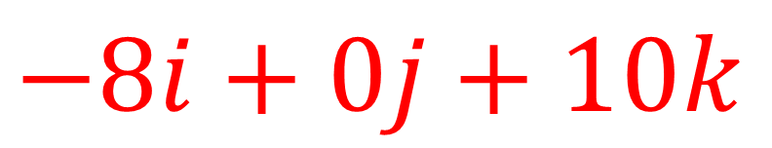

If $a=\left(\begin{matrix}2 \\ −3 \\ 5\end{matrix}\right)$ and $b=\left(\begin{matrix}4 \\ −2 \\ 0 \end{matrix}\right)$
show that $2a−3b$ is parallel to $4i−5k$.
$$2a−3b=$$
$−8i+0j+10k$
$−8i+0j+10k=2(−4i+0j+5k)$
$2a−3b$ is a multiple of $4i−5k$hence parallel

