Slide 1
LO: Simplify
Algebraic Fractions

Slide 2
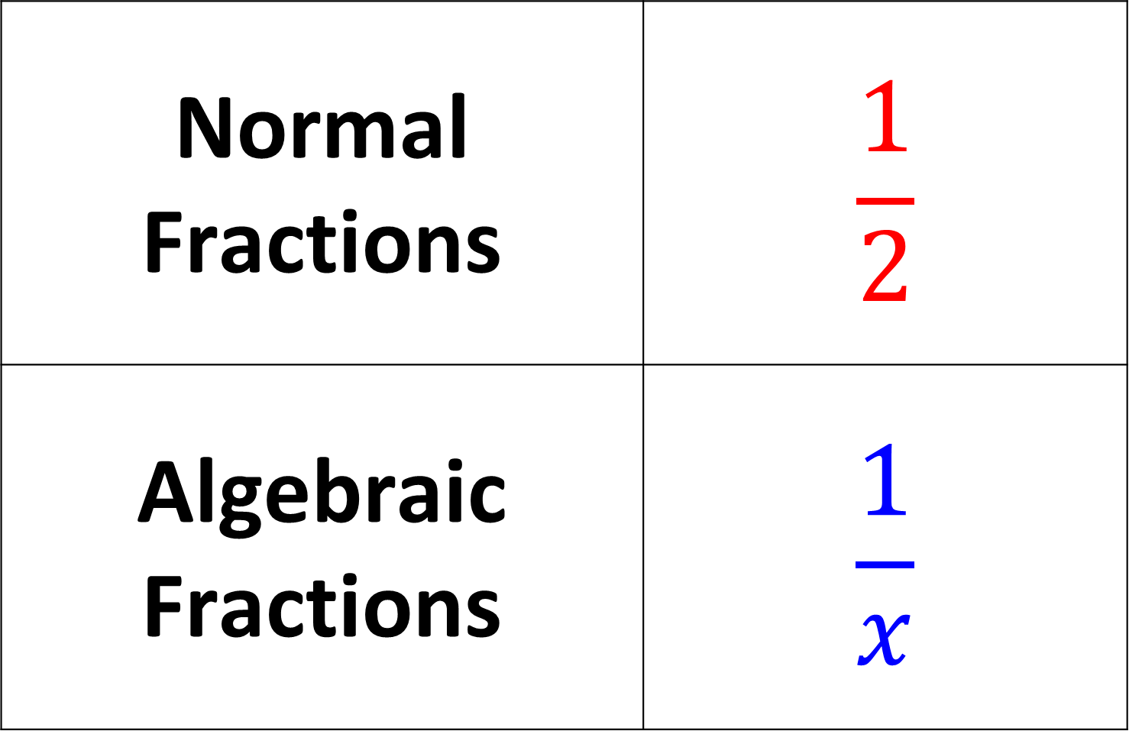
Normal Fractions | $$\frac{1}{2}$$
Algebraic Fractions | $$\frac{1}{x}$$

Slide 3

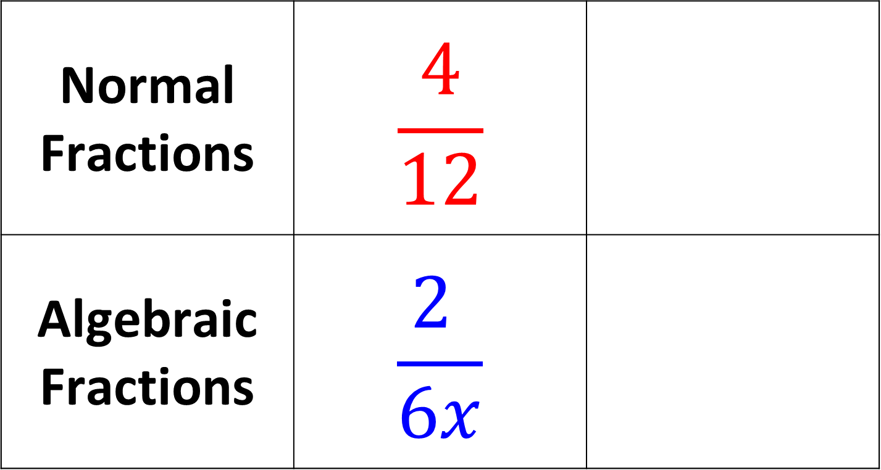

Simplify each fraction
Normal Fractions | $$\frac{4}{12}$$
Algebraic Fractions | $$\frac{2 }{6x}$$
$$\frac{1}{3}$$
$$\frac{1 }{3x}$$

Slide 4

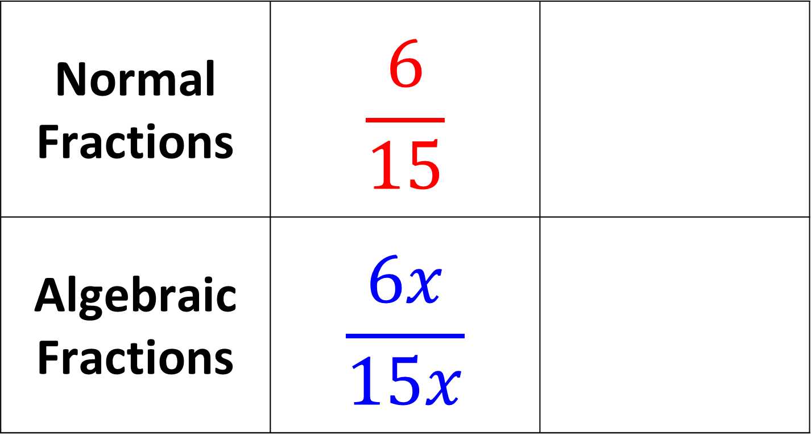

Simplify each fraction
Normal Fractions | $$\frac{6}{15}$$
Algebraic Fractions | $$\frac{6x}{15x}$$
$$\frac{2}{5}$$
$$\frac{2}{5}$$

Slide 5



Simplify each fraction
Normal Fractions | $$\frac{4}{12}$$
Algebraic Fractions | $$\frac{2 }{6x}$$
$$\frac{1}{3}$$
$$\frac{1 }{3x}$$

Slide 6
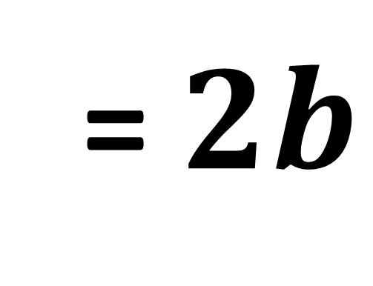
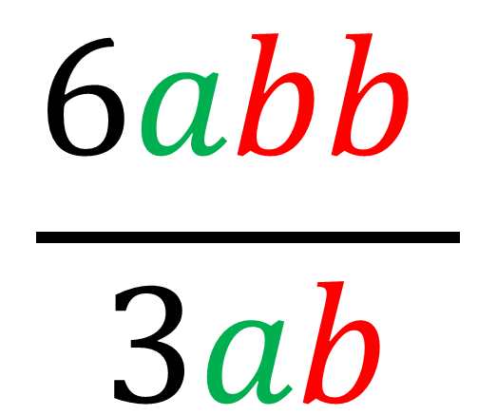
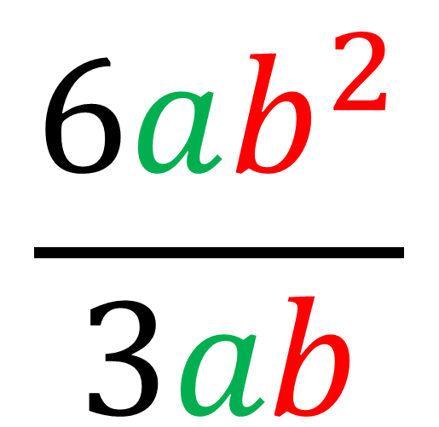
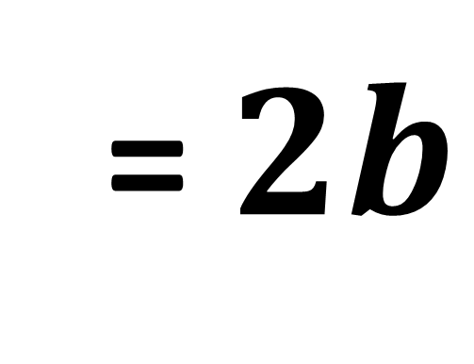
Simplify
Simplify
$$\frac{6ab^{2}}{3ab}$$
$$\frac{6abb }{3ab}$$
= $2b$
= $2b$

Slide 7
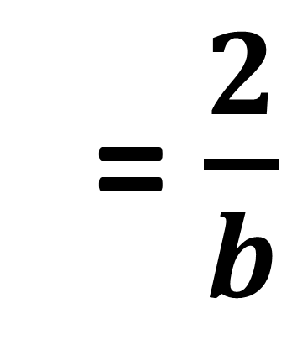
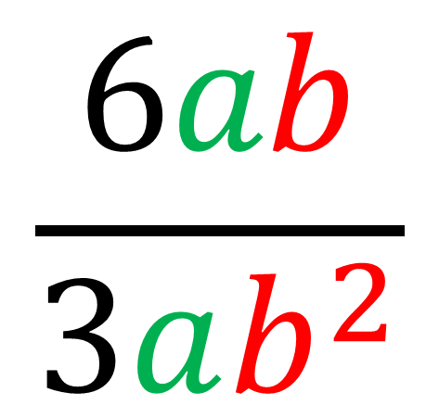
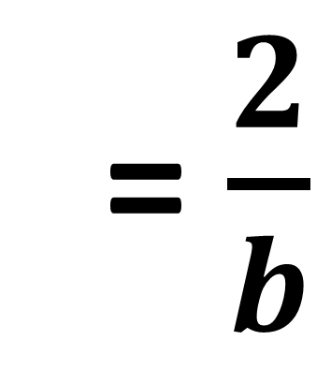
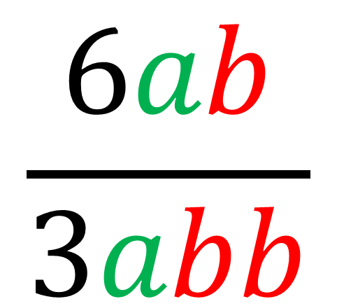
Simplify
Simplify
$$\frac{6ab}{3abb}$$
$$\frac{6ab}{3ab^{2}}$$
= $\frac{2}{b}$
= $\frac{2}{b}$

Slide 8
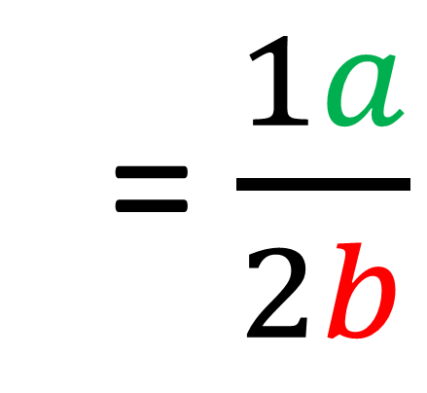
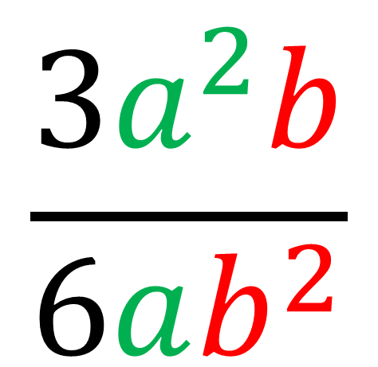
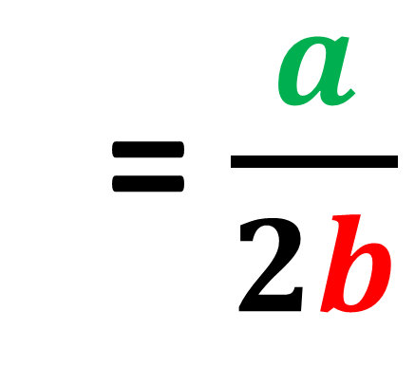
$$\frac{3a^{2}b}{6ab^{2}}$$
Simplify
= $\frac{1a}{2b}$
= $\frac{a}{2b}$

Slide 9
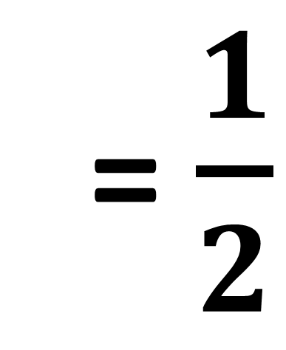
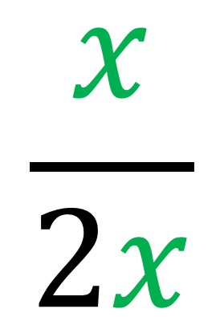
$$\frac{x}{2x}$$
Simplify
= $\frac{1}{2}$

Slide 10
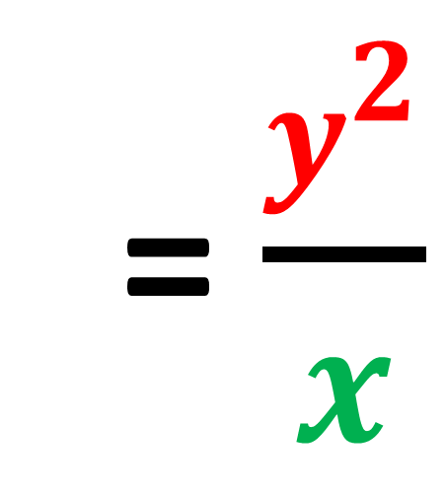
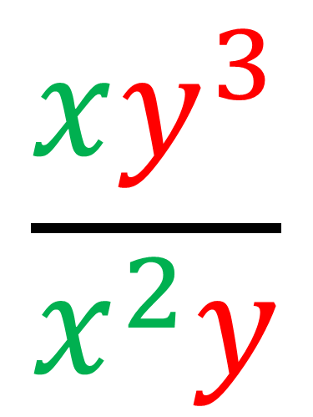
$$\frac{xy^{3}}{x^{2}y}$$
Simplify
= $\frac{y^{2}}{x}$

Slide 11
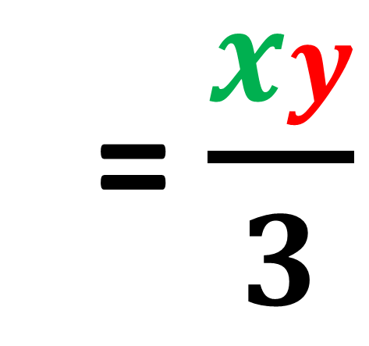
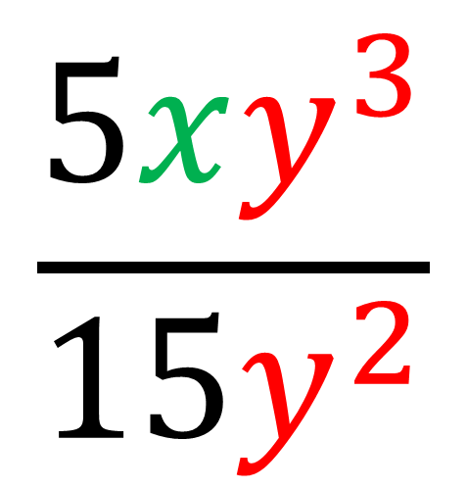
$$\frac{5xy^{3}}{{15y}^{2}}$$
Simplify
= $\frac{xy}{3}$

Slide 12
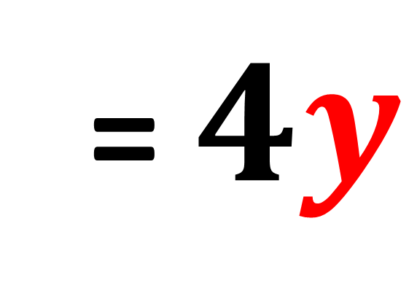
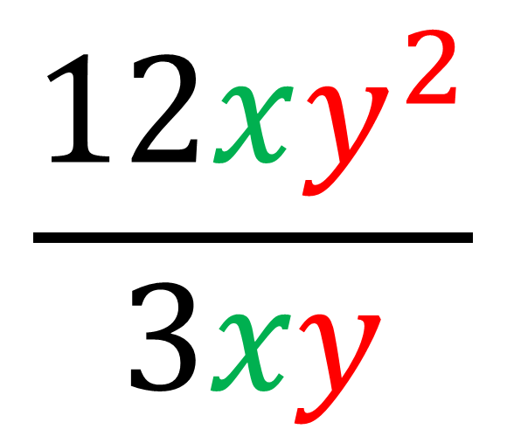
$$\frac{12xy^{2}}{3xy}$$
Simplify
= $4y$

