Slide 1
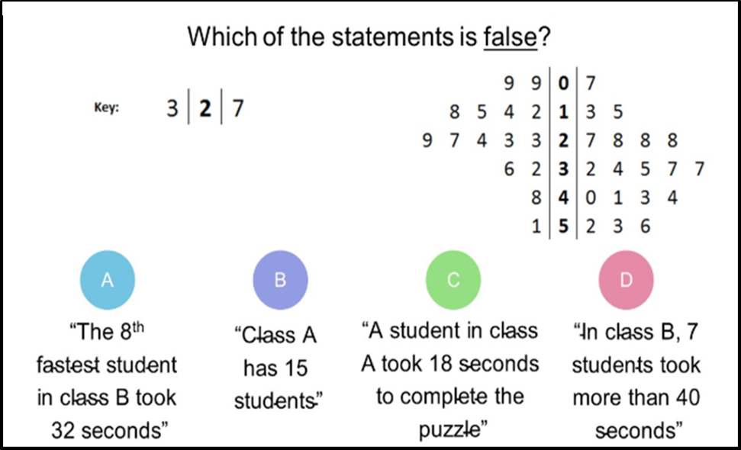
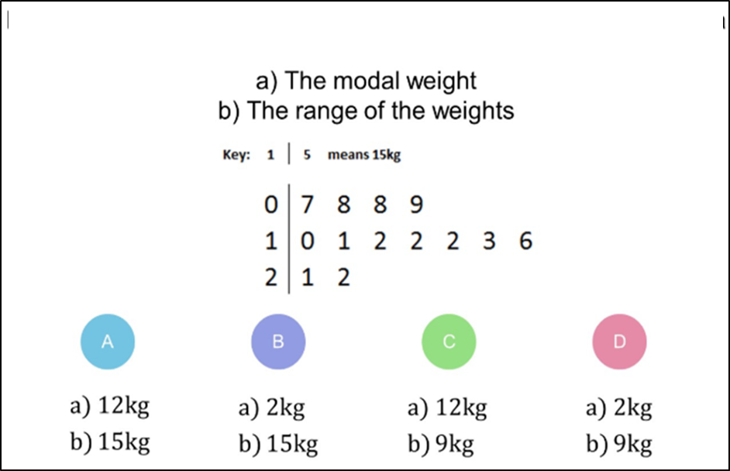
Class A
Class B
Which question had the lowest percentage of
correct answers?
For each question, what was the most common
wrong answer?

Slide 2
ANSWERS

Slide 3

Which question had the lowest percentage of
correct answers?

Slide 4
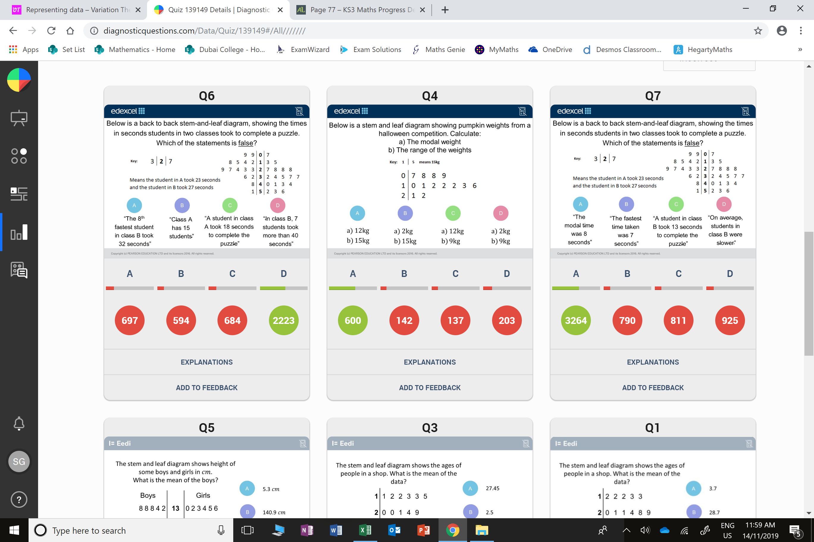
Class A
Class B
A
Student gave a true statement.

Slide 5
D
They have ignored the stem.

