Slide 1
Data Collection
Random Sampling
Chapter 1
(Part 1 of 4)

Slide 2
Populations
With reference to data,
What is meant by the population?
A population is all data you have.

Slide 3
Samples
With reference to the population,
What is meant by a sample?
A sample is a selection of
your population.

Slide 4
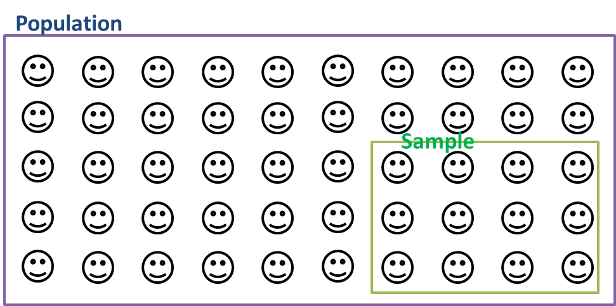
The sample should represent the population.

Slide 5
What is a Sample Frame?
Sampling frame is the source material that the sample was drawn from.

Slide 6
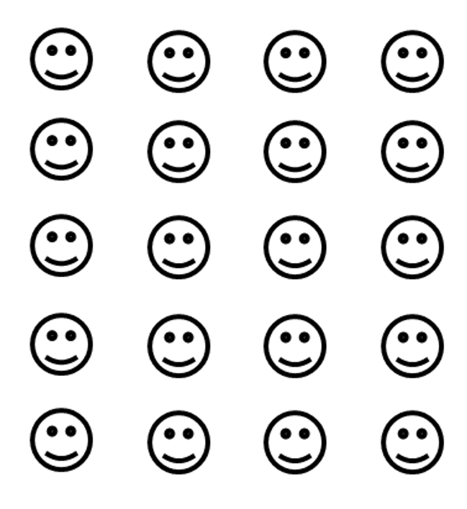
Population: University Students
Sampling frame: Directory of students at the university.

Slide 7
What is a sample unit?
A sample unit is an individual piece of data.

Slide 8
Population: University students
Sample Unit: One university student
Sampling Unit

Slide 9
What is a census?
Data collected from
the entire population
is known as a census.

Slide 10
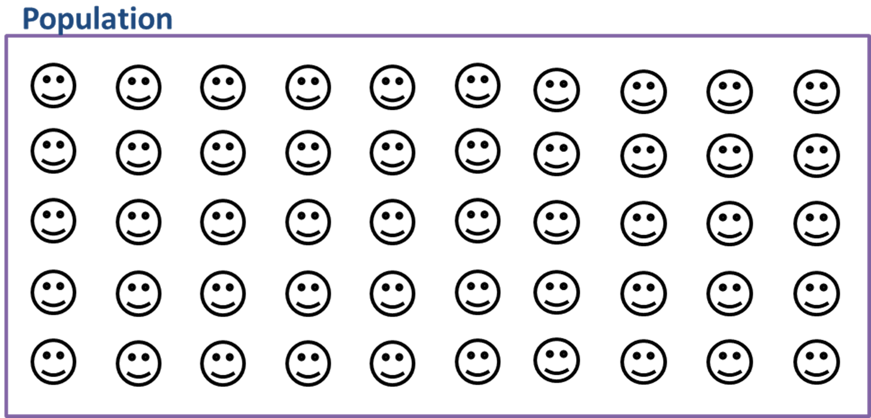
Census

Slide 11
 | Advantages | Disadvantages
Census | Accurate results | Time Consuming
 |  | Expensive
Accurate Results
Time Consuming
Expensive
 | Advantages | Disadvantages
Sample | Cheaper | May not be accurate
 | Quicker | Small sub-groups may not be represented
Cheaper
May not be accurate
Small sub-groups may not be represented
Quicker

Slide 12
Sampling – Different Types
Type
Simple Random Sampling
Random Sampling
Systematic Sampling
Stratified Sampling
Quota Sampling
Non-Random
Opportunity Sampling

Slide 13
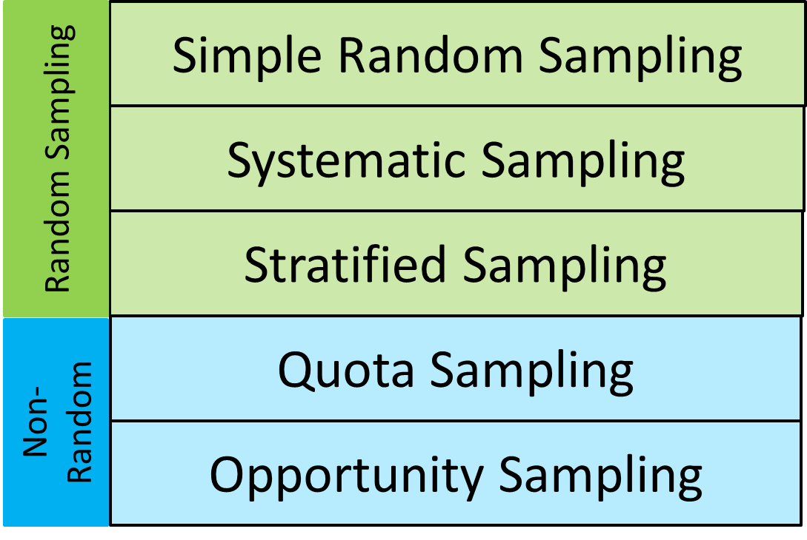
D
C The researchers select members of the population at a regular interval – for example, by selecting every 15th person on a list of the population.
C
E
B
D The researcher randomly selects a subset of participants from a population. Each member of the population has an equal chance of being selected.
A
A The researcher selects participants based on their availability.
E The researcher samples specific proportions of individuals from various subpopulations (strata) in the larger population—is meant to ensure that the subjects selected will be representative of the population of interest.
B Sampling method that relies on the non-random selection of a predetermined number or proportion of sample units.

Slide 14
Simple Random Sampling
The most important thing
when doing a random sample
is to make sure every piece of data has an equal chance of being picked.

Slide 15

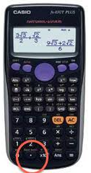
Simple Random Sampling
Names/numbers out of a hat
Random number generator

Slide 16
 | Advantages | Disadvantages
Simple Random Sampling
Bias free | Time consuming
Easy and Cheap | Sampling frame needed
Data has an equal chance of being selected

Slide 17
Systematic Sampling
Data is chosen at regular intervals from an ordered list.

Slide 18
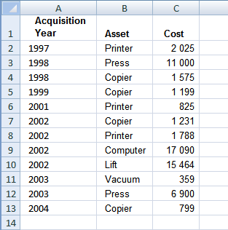
Systematic Sampling
Every 3rd
piece of data will be chosen.

Slide 19
 | Advantages | Disadvantages
Systematic Sampling | Simple and quick to use | Sampling frame needed
 | Suitable for large sample | Introduces bias if sample frame not random
 | Data has a equal chance of being selected
Simple and quick to use | Sampling frame needed
Suitable for large sample | Introduces bias if sample frame not random
Data has an equal chance of being selected

Slide 20
Stratified Sampling
Population is divided into distinct groups known as ‘strata’.
The sample size of each strata is respresetive of the population.

Slide 21
Stratified Sampling
School Population
Year 7
Year 8
Year 9
Year 10

Slide 22
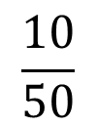

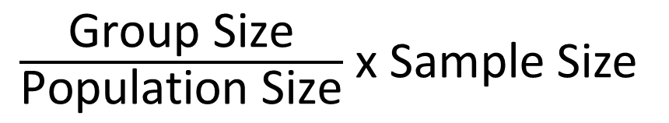


Stratified Sampling
Population
$\frac{\text{Group} \text{Size}}{\text{Population} \text{Size}}$ x Sample Size
$$\frac{20}{50}$$
$$\frac{10}{50}$$
$$\frac{15}{50}$$
$$\frac{5}{50}$$

Slide 23
 | Advantages | Disadvantages
Stratified Sampling | Simple to use | Population must be in distinct strata
 | Each strata gets represented | Can introduce bias
Simple to use | Population must be in distinct strata
Each strata gets represented | Can introduce bias

Slide 24
There are 64 girls and 56 boys in a school.
Explain briefly how you could take a random sample
of 15 student using a simple random sample.
Allocate each student a number from 1 to 120
Use a random number generator to select 15 different numbers from 1 to 120.
These student become the sample.

Slide 25
A company's employer directory
contains 50,000 names.
A researcher wishes to select a systematic sample
of 100 names from the directory.
Explain how the researcher should
obtain such a sample.
Number the employers from 1 to 50,000.
Select a starting position using a random number generator from 1 to 500.
Select every 500th person.

Slide 26


A school has 15 KS4 classes and a sixth form. In each KS4 class there are 30 students.
In the sixth form there are 150 students.
There are equal numbers of boys and girls in each KS4 class.
There are equal numbers of boys and girls in the sixth form.
The head teacher wishes to obtain the opinions of the students about school uniforms.
Explain how the head teacher would take a stratified sample of size 40.
Total Student = 15 x 30 + 150 = 600
KS4 $=\frac{450}{600}$ x 40 = 30 KS4 Students
6th Form $=\frac{150}{600}$ x 40 = 10 sixth form
Number the girls 1 to 225 and use a random number generator to select 20 girls.
Number the girls 1 to 75 and use a random number generator to select 5 girls.
Number the boys 1 to 225 and use a random number generator to select 20 boy.
Number the boys 1 to 75 and use a random number generator to select 5 boys.

