Slide 1
LO: Translating Shapes

Slide 2
Translation is the movement of an object by sliding a shape.

Slide 3
Can you name famous board games that use translations?

Slide 4
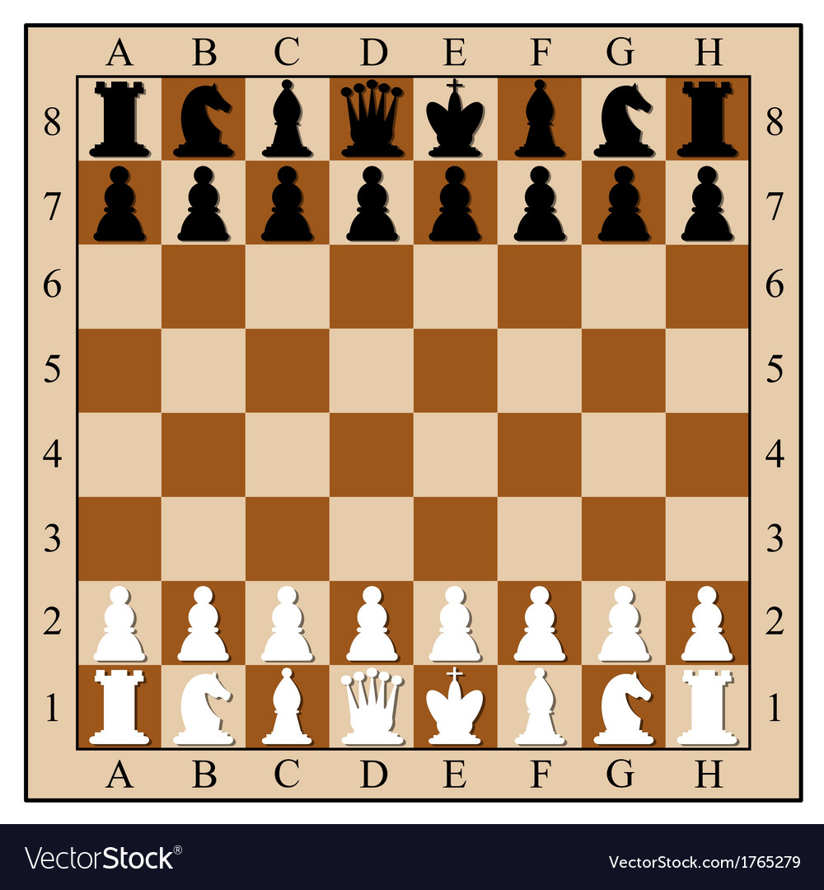

Slide 5
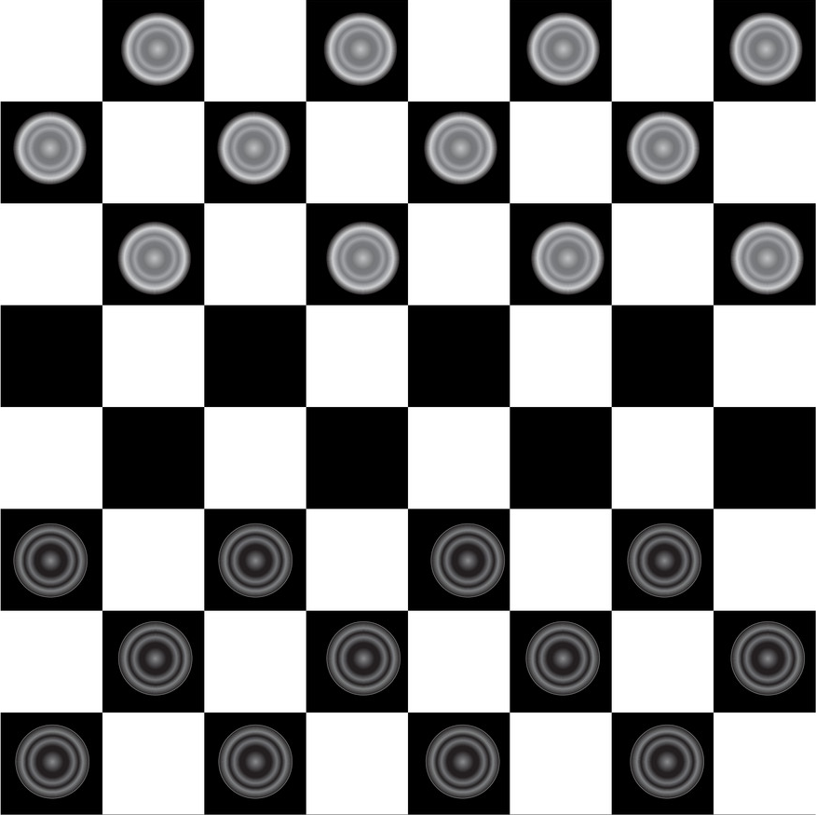

Slide 6
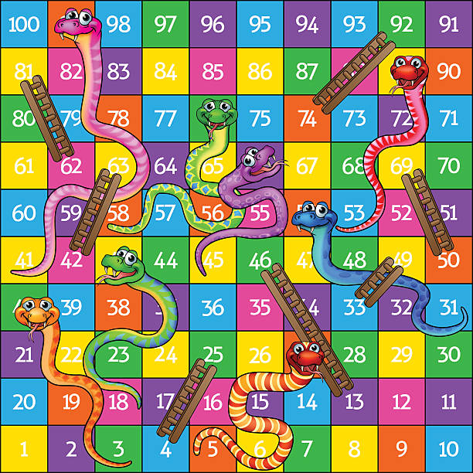

Slide 7
How would you describe the translation to move the counter from the start position to the finish?
Finish
3 Right
2 Up
Start

Slide 8
How would you describe the translation to move the counter from the start position to the finish?
Start
3 Left
2 Down
Finish

Slide 9
Column Vectors
3 Right
2 Up
Finish
( | )
3
2
Start

Slide 10
Column Vectors
( | )
-3
-2
Start
Finish

Slide 11
Column Vectors
( | )
2
1
Finish
Start

Slide 12
Column Vectors
( | )
-3
0
Finish
Start

Slide 13
Column Vectors
( | )
Finish
0
2
Start

Slide 14
Describe the translation to map A to B.
B
A
A
A
A
A
A
A
object
object
object
object
object
object
object
A
C
C
C
C
C
C
C
B
B
B
B
B
B
B
Column Vector
 | ( | 5 | )
 |  | 2

Slide 15
Describe the translation to map B to A.
B
A
A
A
A
A
A
A
object
object
object
object
object
object
object
A
C
C
C
C
C
C
C
B
B
B
B
B
B
B
Column Vector
 | ( | -5 | )
 |  | -2

Slide 16
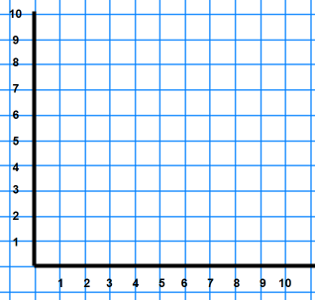
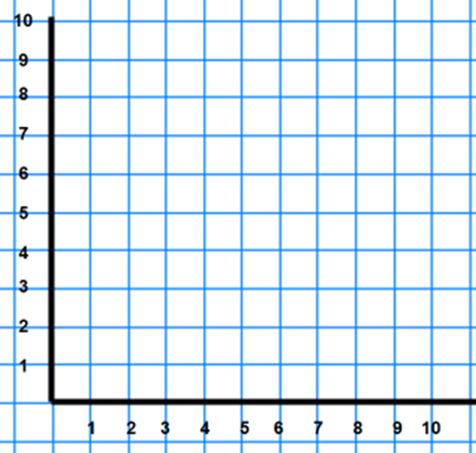
Translations on a Co-ordinate Grids
Which is a translation and why?
OR

Slide 17
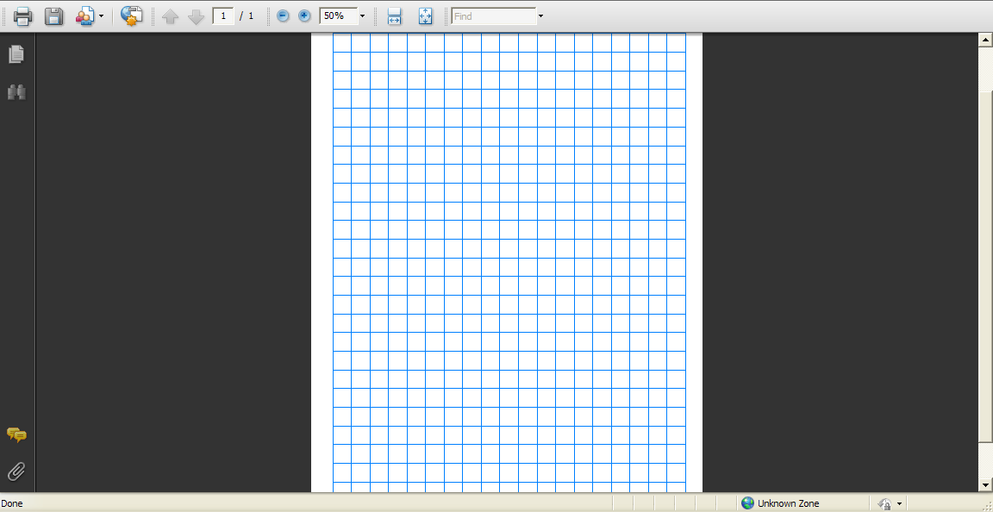
10
right 4 squares
9
Column Vector
 | ( | 4 | )
 |  | 0
8
7
6
5
4
3
2
1
1
2
3
4
5
6
7
8
9
10

Slide 18
10
9
8
Column Vector
 | ( | 0 | )
 |  | 5
7
6
5
4
3
2
1
1
2
3
4
5
6
7
8
9
10

Slide 19
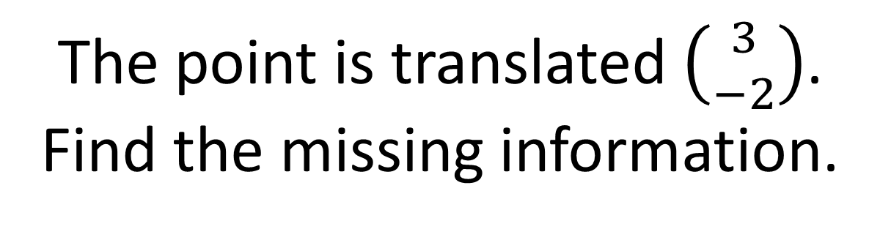
The point is translated $\left({3 \atop −2}\right)$.
Find the missing information.
Point | Object (Start) | Image (Finish)
A | (5,6)
B |  | (1,4)
C | (3,-2)
D |  | (3,2)
(8,4)
(-2,6)
(6,-4)
(0,4)

Slide 20

Describe translations
by using Column Vectors
-
+
+
-

