Slide 1
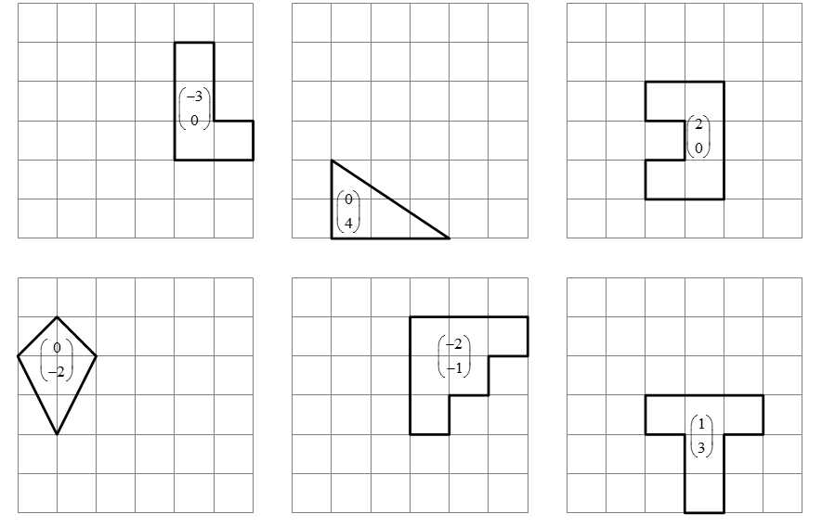

Slide 2
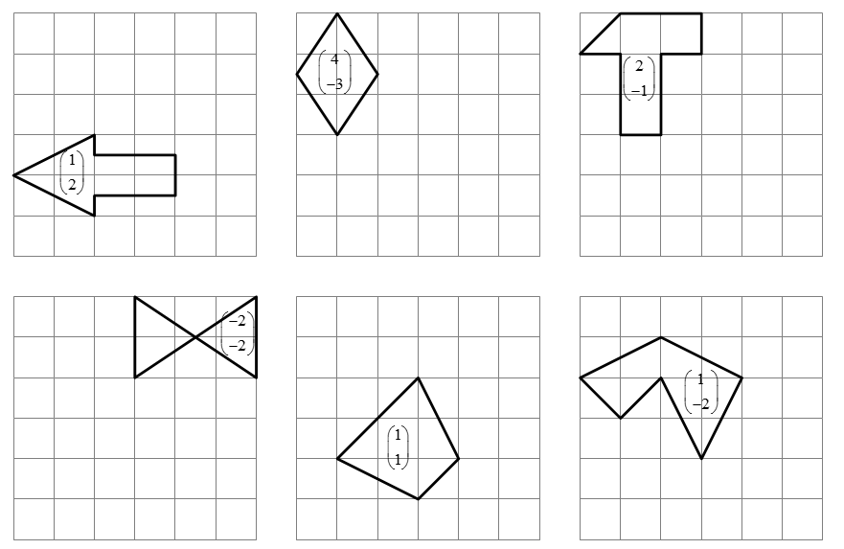

Slide 3
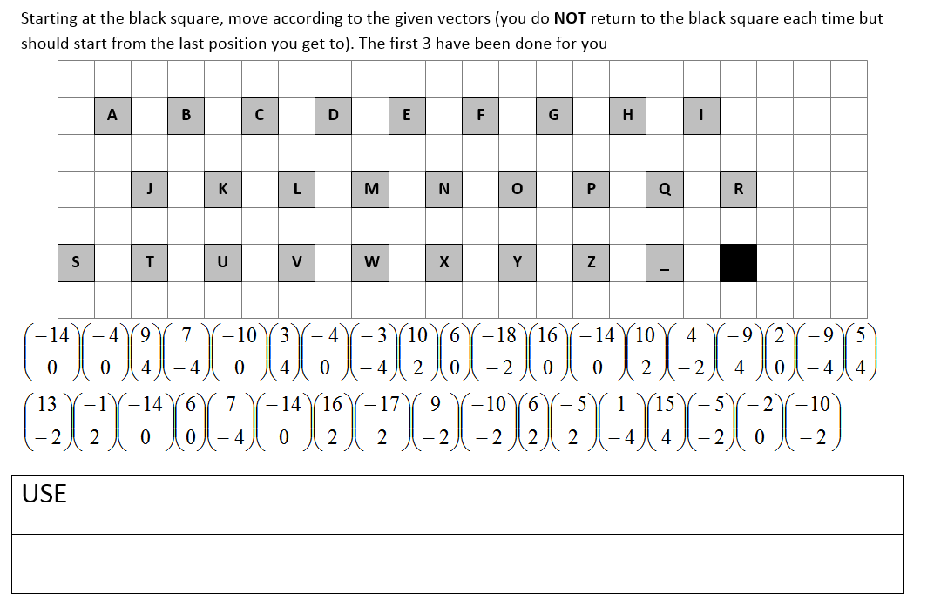

Slide 4
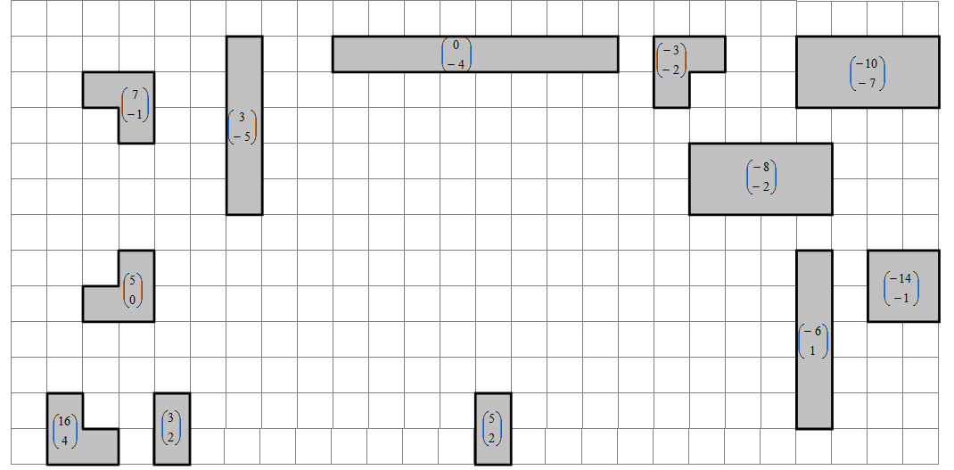

Slide 5
ANSWERS

Slide 8
-VECTORS-TO-DESCRIBE-TRANSLATIONS

