Slide 1
LO: Constructing
Triangles

Slide 2
Is the following triangle ‘unique’
or can x be different values?
Different Values
x
70°
6 cm

Slide 3
Is the following triangle ‘unique’
or can x be different values?
x
5 cm
Unique
70°
6 cm

Slide 4
Is the following triangle ‘unique’
or can x be different values?
5 cm
Different Values
x
4 cm

Slide 5
Is the following triangle ‘unique’
or can x be different values?
5 cm
3.2 cm
x
Unique
4 cm

Slide 6
Is the following triangle ‘unique’
or can x be different values?
Different Values
x
4 cm
6 cm

Slide 7
Is the following triangle a ‘unique’
or can x be different values?
x
4 cm
Unique
70°
6 cm

Slide 8
Is the following triangle ‘unique’
or can x be different values?
x
Different Values
115°
10 cm

Slide 9
Is the following triangle ‘unique’
or can x be different values?
x
Unique
115°
35°
10 cm

Slide 10
Is the following triangle ‘unique’
or can x be different values?
x
Different Values
5 cm
40°
6 cm

Slide 11
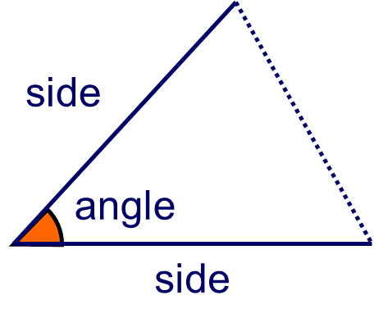
To construct ‘unique’ triangles
you need the following information:
Side Angle Side (SAS)

Slide 12
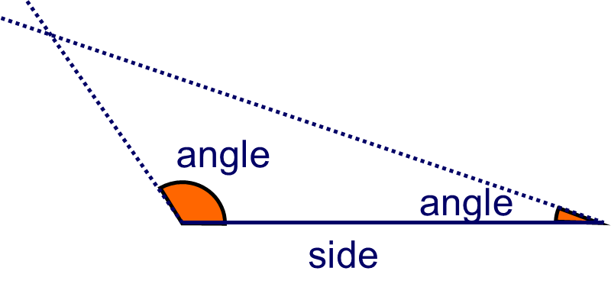
Angle Side Angle (ASA)

Slide 13
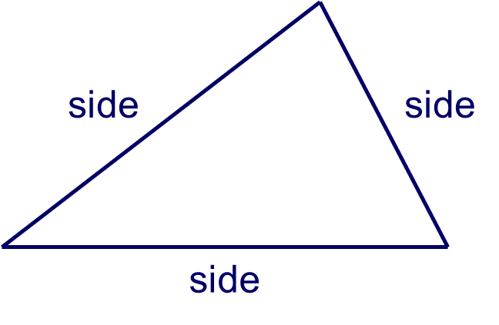
Side Side Side (SSS)

Slide 14
To construct ‘one off’ triangles
you need the following information:
Side Angle Side (SAS)
Angle Side Angle (ASA)
Side Side Side (SSS)

Slide 15
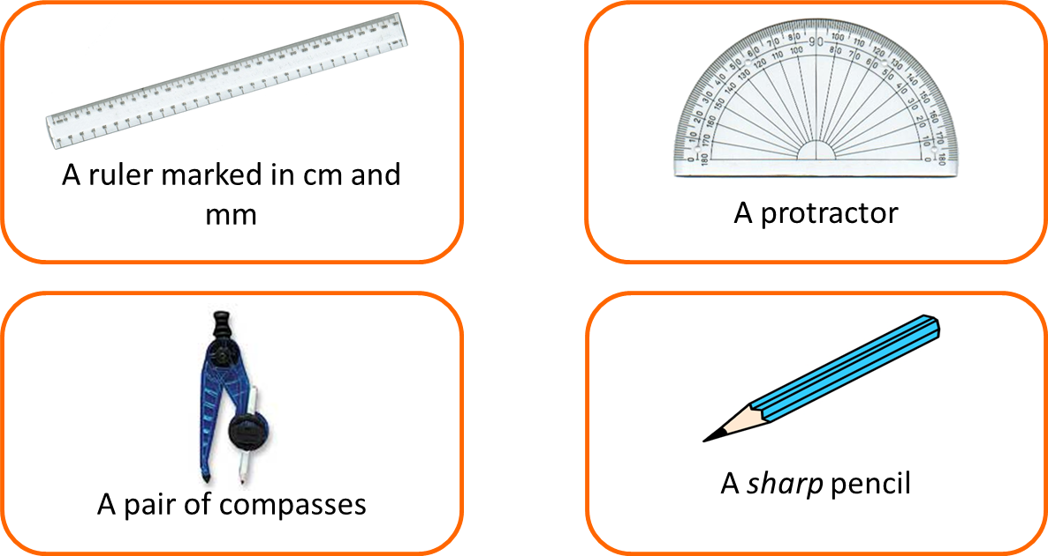

You need the follow equipment:

Slide 16

Constructing a SAS triangle

Slide 17

Constructing a ASA triangle
Notes:
Ask pupils how we could check that this triangle has been constructed correctly.
Establish that we could measure angle C to verify that it measures 30°.
Remind pupils that construction lines should not be rubbed out.

Slide 18
Constructing a SSS triangle

