Slide 1
LO: Transformation of
Trigonometric Graphs

Slide 2
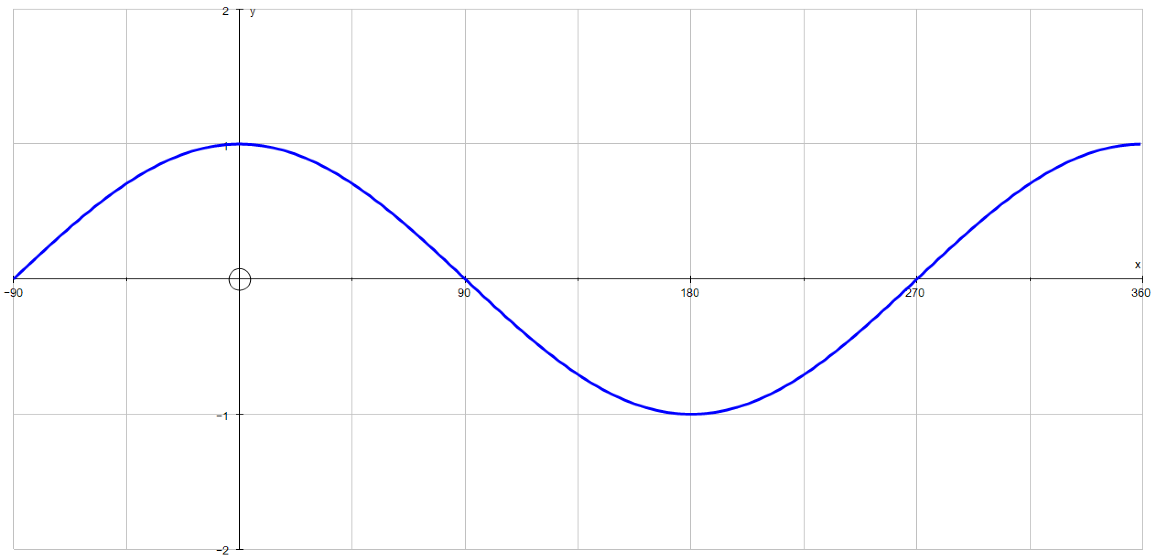
What is the equation that produces
the following graph?

Slide 3
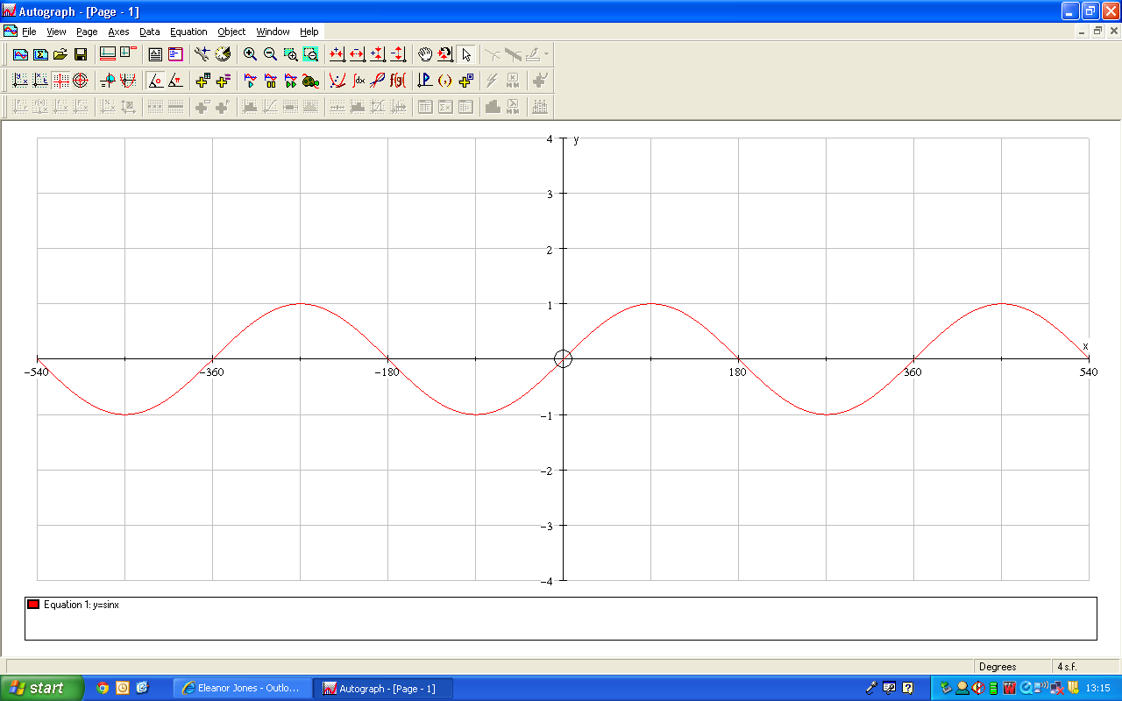
What is the equation that produces
the following graph?

Slide 4
What effect does the values of a and b have on the graphs?
y = a sin bx
y = a cos bx

Slide 5
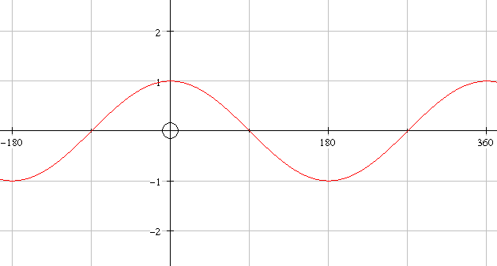

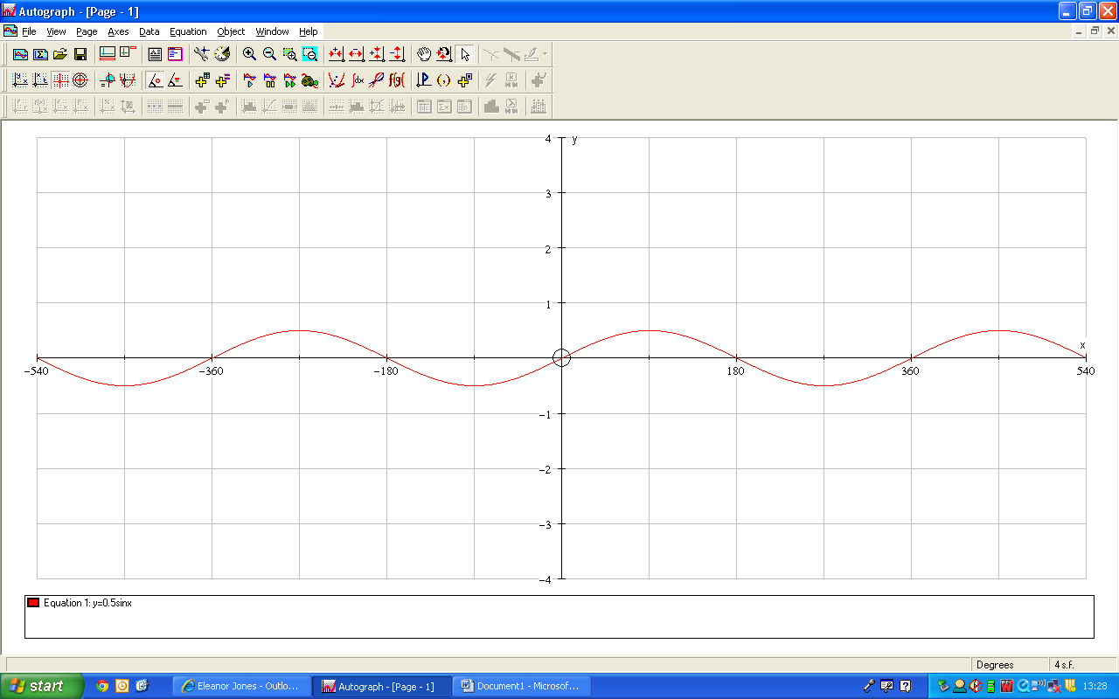

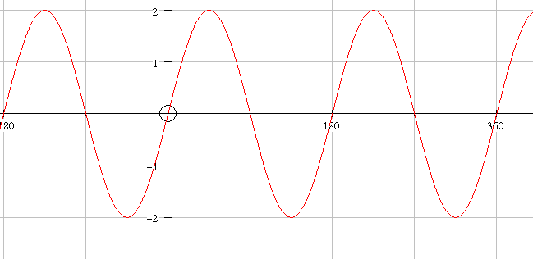

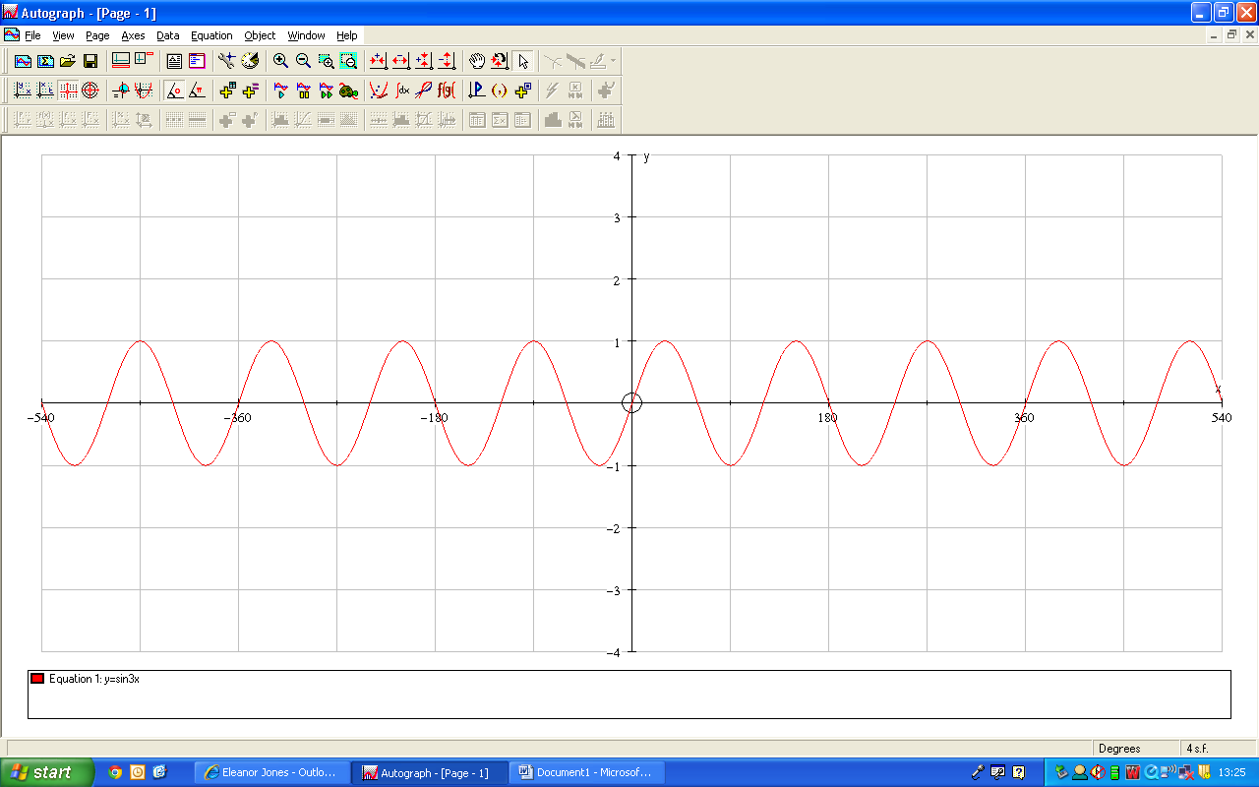
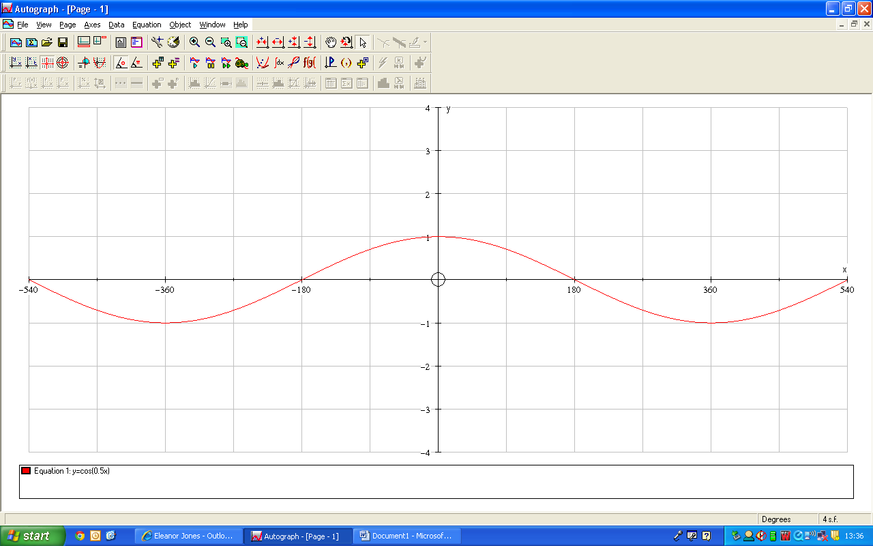

Use geogebra graphing website to see if you can plot the following graphs.
https://www.geogebra.org/graphing?lang=en

Slide 6
y = cos x

Slide 7
y = 2 cos x

Slide 8
y = sin 3x

Slide 9
y = cos 4x

Slide 10
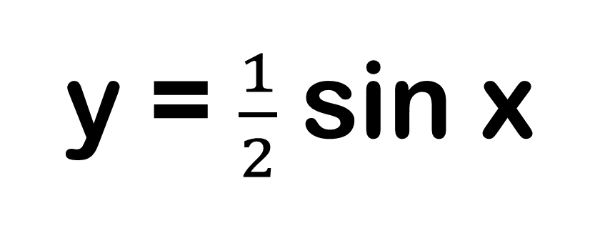
y = $\frac{1}{2}$sin x

Slide 11
y = 1 sin 1x

Slide 12
y = 2 sin 2x

Slide 13
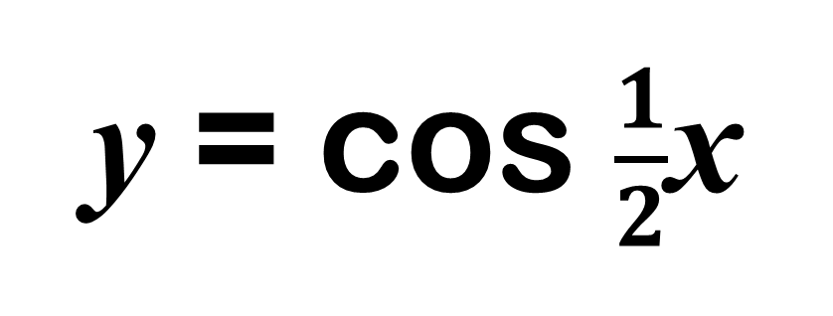
y = cos $\frac{1}{2}$x

Slide 14
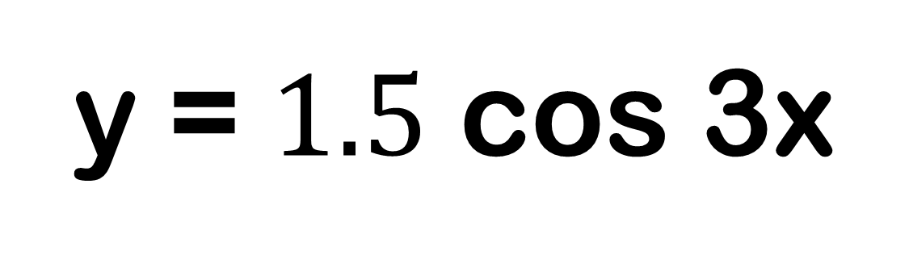
y = $1.5$ cos 3x

Slide 15
y = 3 cos 2x

Slide 16
y = a sin bx
y = a cos bx
a is the magnitude
b is the number of waves in 360°

