Slide 1
LO: Multiply and Dividing
Algebraic Fractions

Slide 2

How do you multiply fractions?
$$\frac{multiply numerators}{multiply denominators}$$

Slide 3

How do you dividing fractions?
flip the diving fraction
then
$$\frac{multiply numerators}{multiply denominators}$$

Slide 4
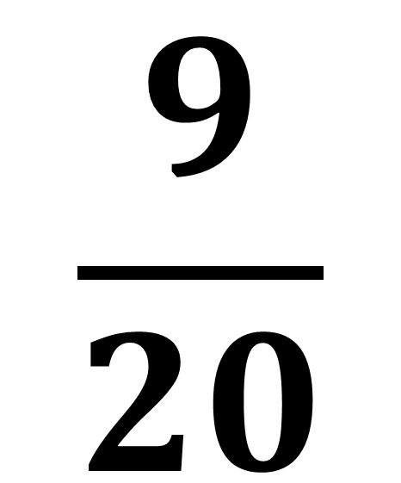
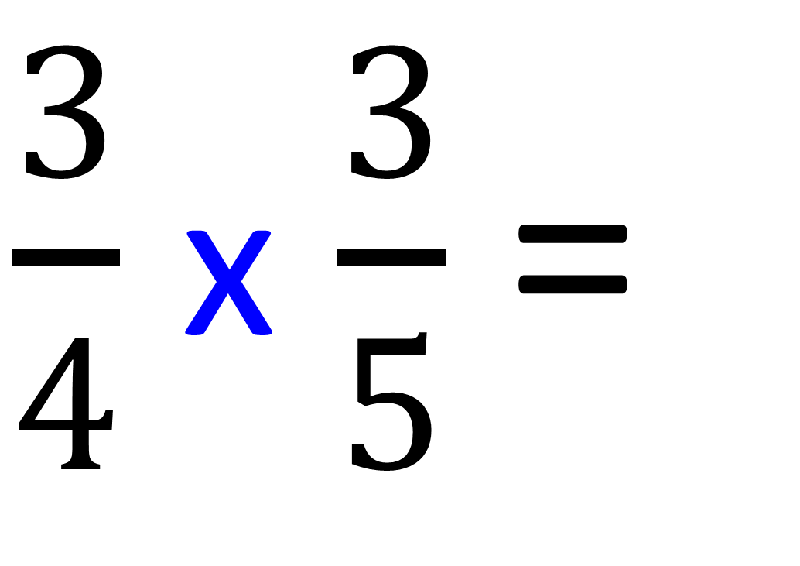
$\frac{3}{4}$ x $\frac{3}{5}$ =
$$\frac{9}{20}$$

Slide 5
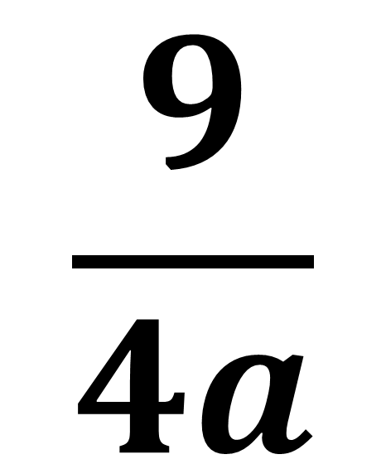
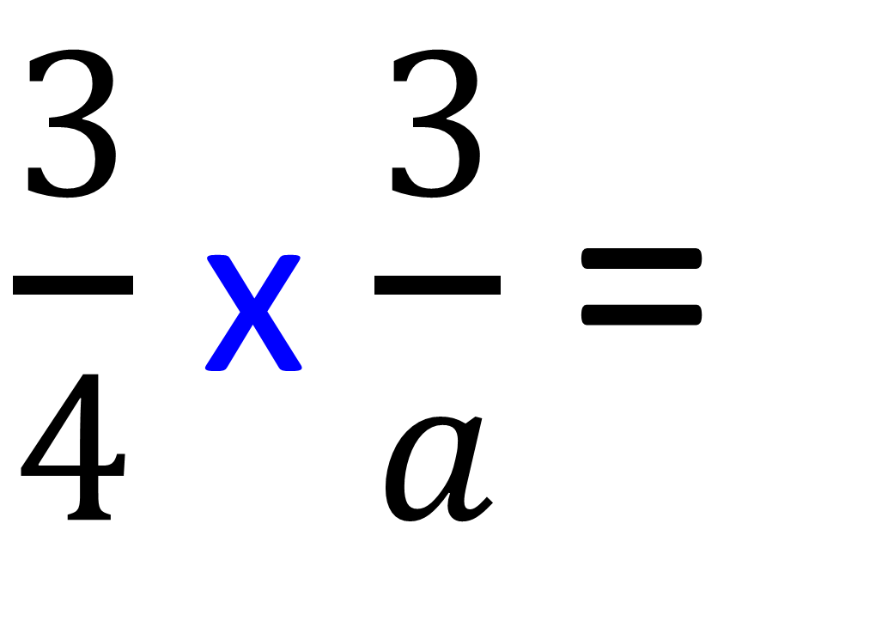
$\frac{3}{4}$ x $\frac{3}{a}$ =
$$\frac{9}{4a}$$

Slide 6

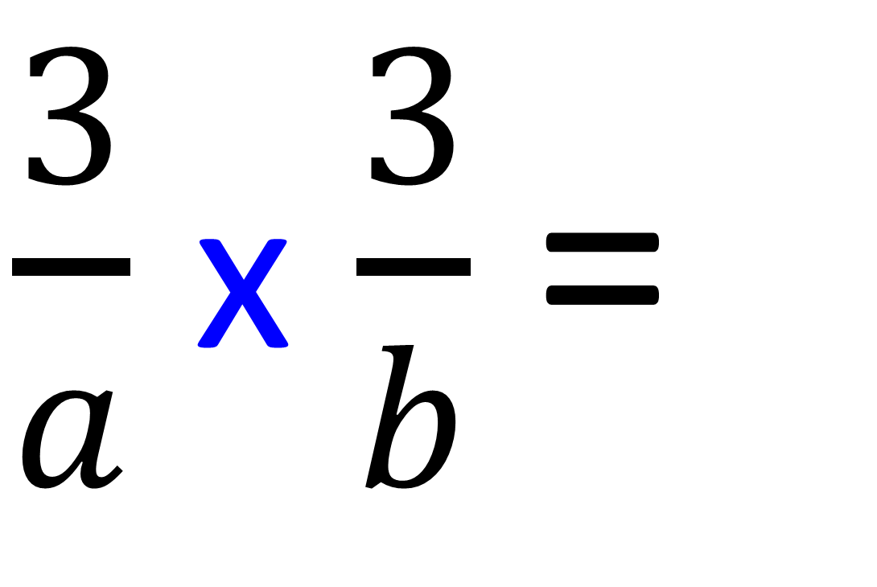
$\frac{3}{a}$ x $\frac{3}{b}$ =
$$\frac{9}{ab}$$

Slide 7

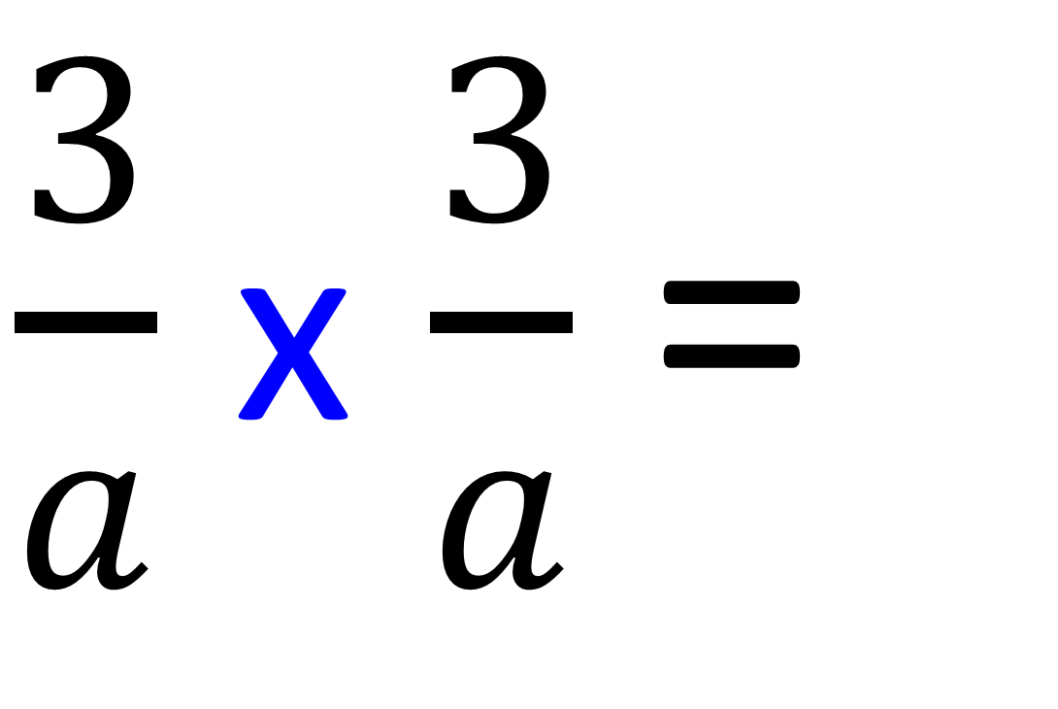
$\frac{3}{a}$ x $\frac{3}{a}$ =
$$\frac{9}{a^{2}}$$

Slide 8
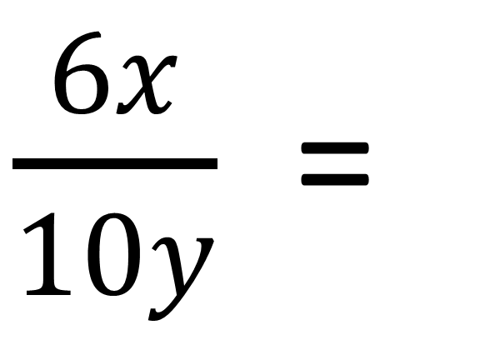
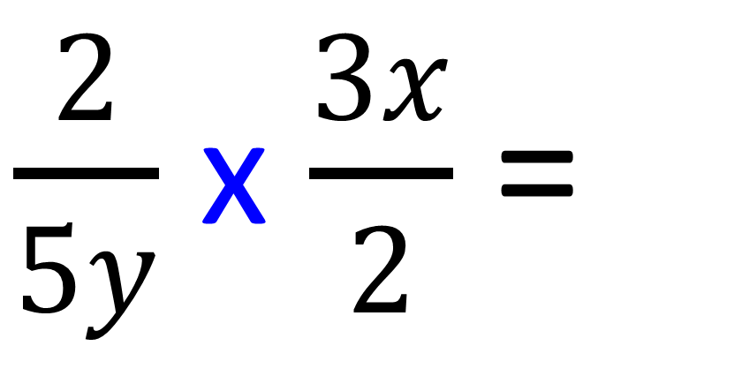
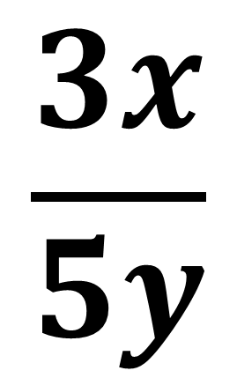
$$\frac{3x}{5y}$$
$\frac{2}{5y}$ x $\frac{3x}{2}$ =
$\frac{6x}{10y}$ =

Slide 9
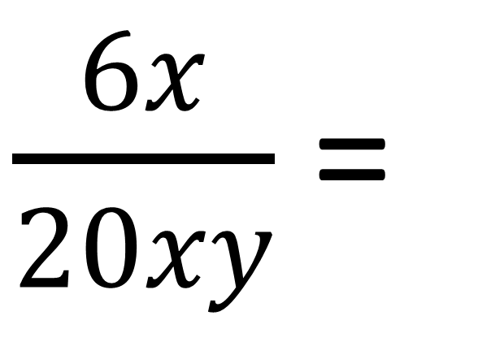
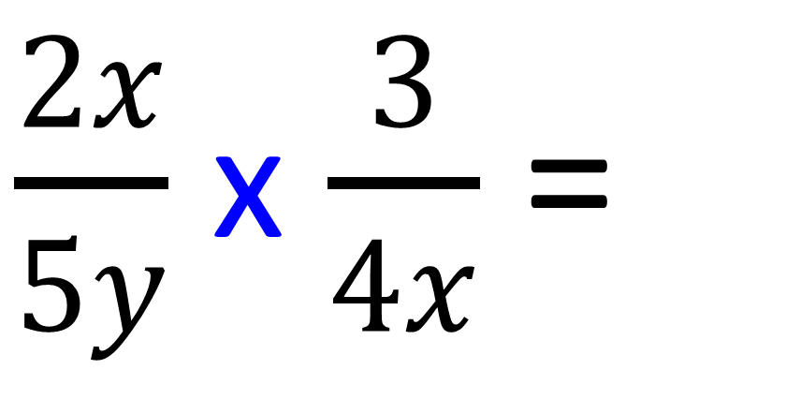
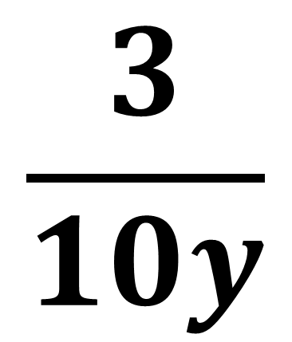
$$\frac{3}{10y}$$
$\frac{2x}{5y}$ x $\frac{3}{4x}$ =
$\frac{6x}{20xy}$ =

Slide 10

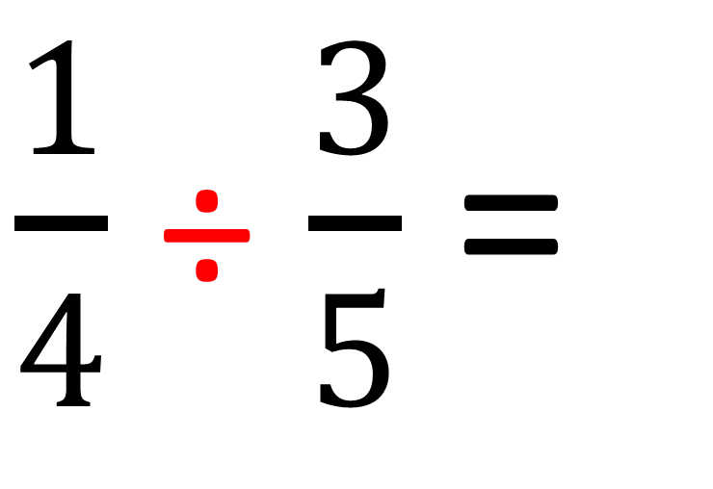
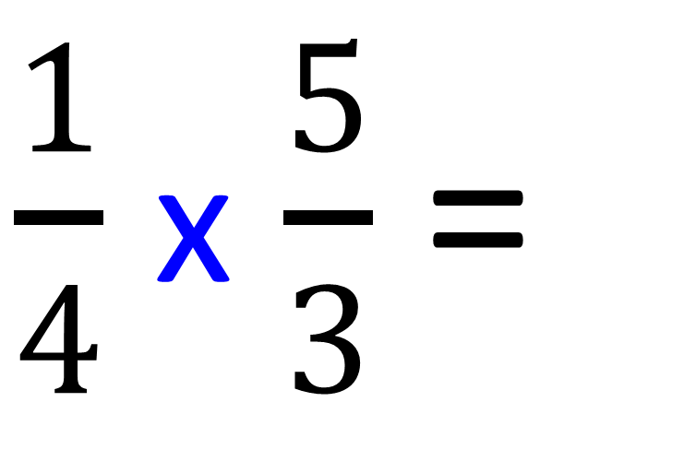
$\frac{1}{4}$ ÷ $\frac{3}{5}$ =
$\frac{1}{4}$ x $\frac{5}{3}$ =
$$\frac{5}{12}$$

Slide 11
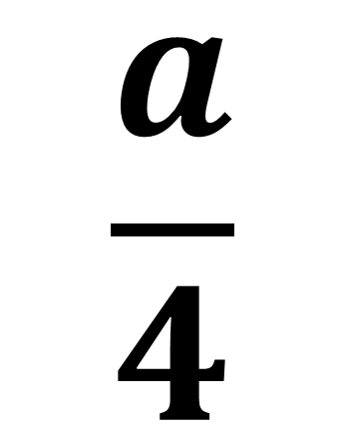
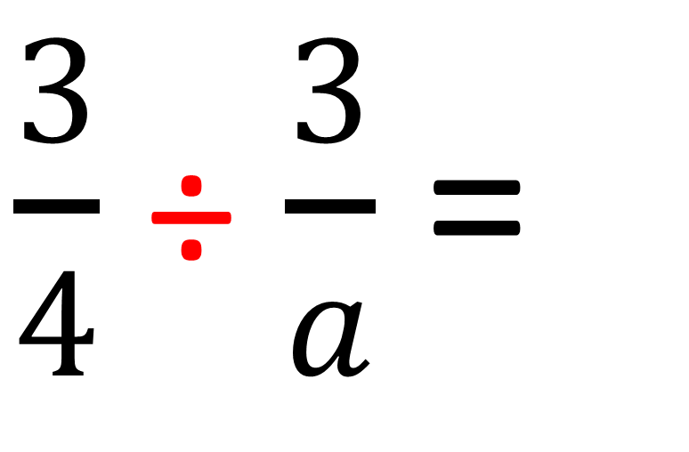
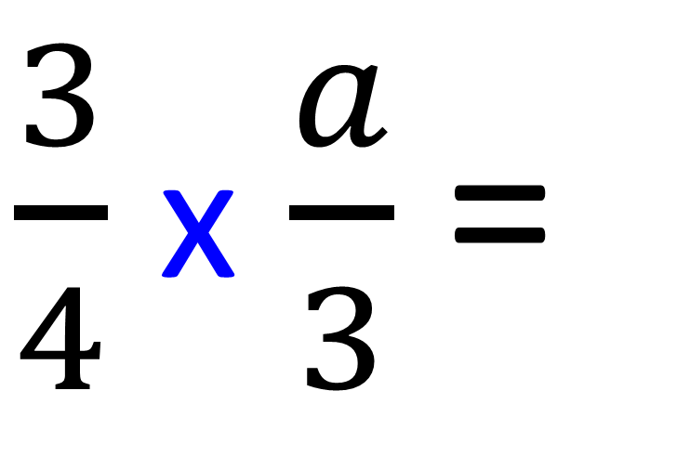
$\frac{3}{4}$ ÷ $\frac{3}{a}$ =
$\frac{3}{4}$ x $\frac{a}{3}$ =
$$\frac{a}{4}$$

Slide 12
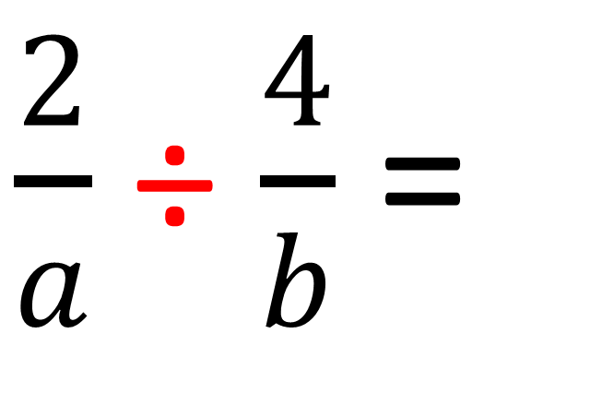

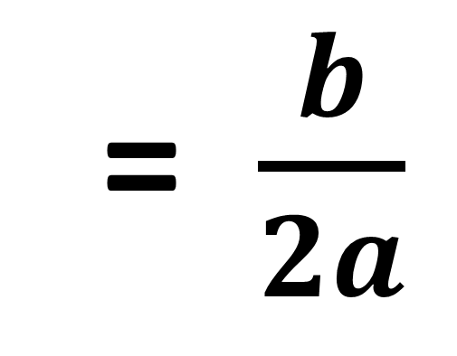
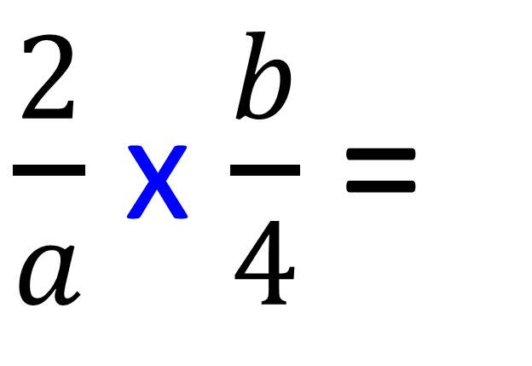
$\frac{2}{a}$ ÷ $\frac{4}{b}$ =
$\frac{2}{a}$ x $\frac{b}{4}$ =
$$\frac{2b}{4a}$$
= $\frac{b}{2a}$

