Slide 1
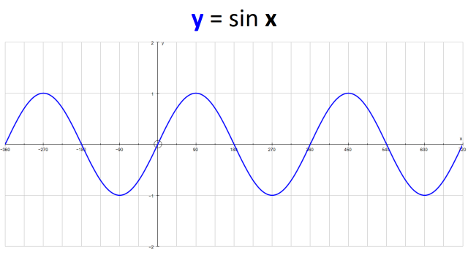
Sine Wave: y = sin x
How long is one cycle?
What is the maximum and minimum y values of the graph?
What are the co-ordinates when the graph intercepts the x axis (from -180 to 720)?
What is the co-ordinate when the graph intercepts the y axis?
When will the graph intercept the x axis again (after 720)?
When sin x = 1, what are the values of x over the interval -180 ≤ x ≤ 720?
When sin x = -1, what are the values of x over the interval -180 ≤ x ≤ 720?

Slide 2
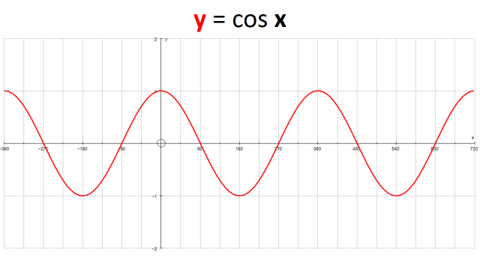
Cosine Wave: y = cos x
How long is one cycle?
What is the maximum and minimum y values of the graph?
What are the co-ordinates when the graph intercepts the x axis (from -180 to 720)?
What is the co-ordinate when the graph intercepts the y axis?
When will the graph intercept the x axis again (after 720)?
When cos x = 1, what are the values of x over the interval -180 ≤ x ≤ 720?
When cos x = -1, what are the values of x over the interval -180 ≤ x ≤ 720?

Slide 3
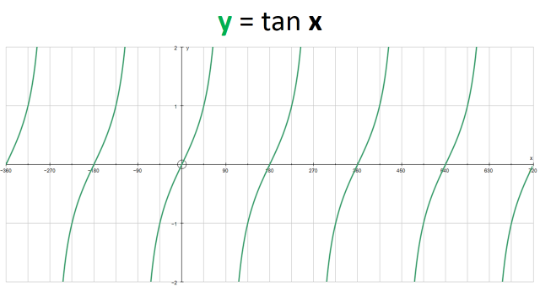
Tan Wave: y = tan x
How long is one cycle?
What is the maximum and minimum y values of the graph?
What are the co-ordinates when the graph intercepts the x axis (from -180 to 720)?
What is the co-ordinate when the graph intercepts the y axis?
When will the graph intercept the x axis again(after 720)?
When tan x = 1, what are the values of x over the interval -180 ≤ x ≤ 720?
When tan x = -1, what are the values of x over the interval -180 ≤ x ≤ 720?

Slide 4
ANSWERS

Slide 5
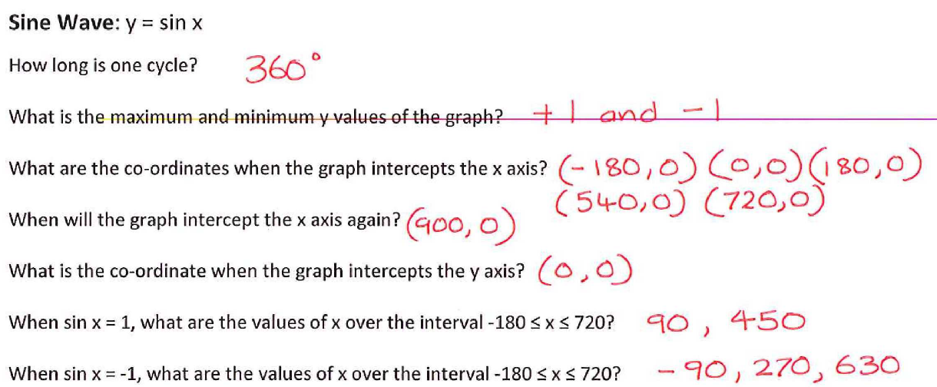
(360,0)

Slide 6
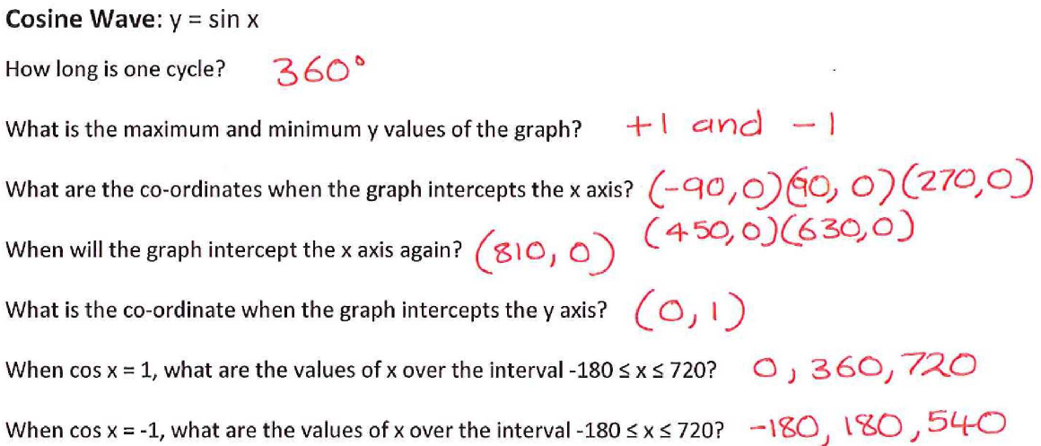

Slide 7
