Slide 1
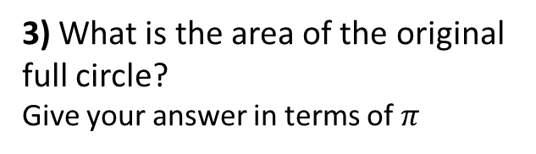
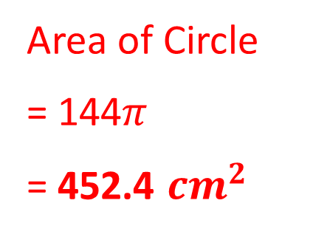
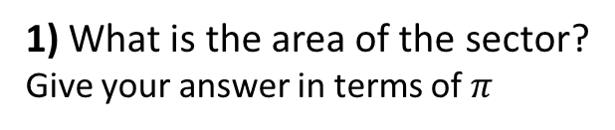
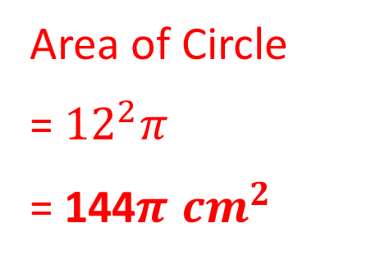
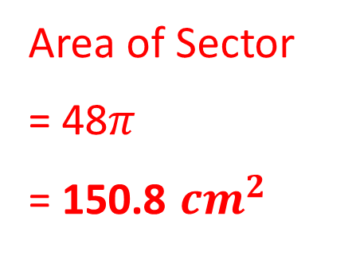
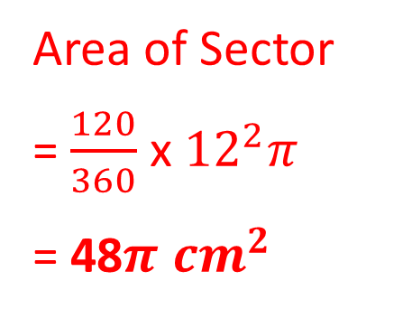
1) What is the area of the sector?
Give your answer in terms of $π$
2) What is the area of the sector?
Give your answer to 1 decimal place
12cm
12cm
Area of Sector
= $\frac{120}{360}$ x ${12}^{2}π$
= 48$π$ ${cm}^{2}$
Area of Sector
= 48$π$
= 150.8 ${cm}^{2}$
120˚
120˚
3) What is the area of the original
full circle?
Give your answer in terms of $π$
4) What is the area of the original
full circle?
Give your answer to 1 decimal place
12cm
12cm
Area of Circle
= ${12}^{2}π$
= 144$π$ ${cm}^{2}$
Area of Circle
= 144$π$
= 452.4 ${cm}^{2}$
120˚
120˚

Slide 2
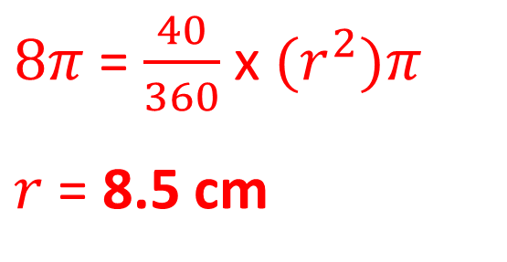
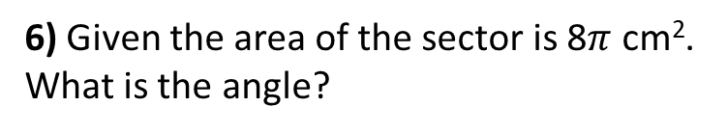
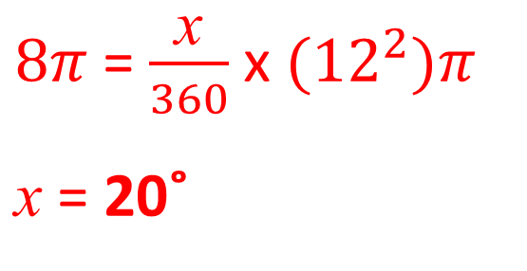
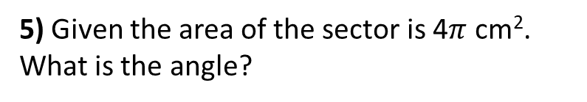
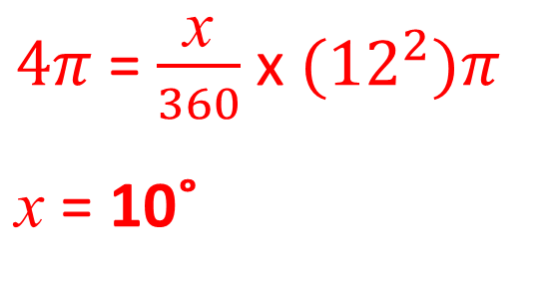
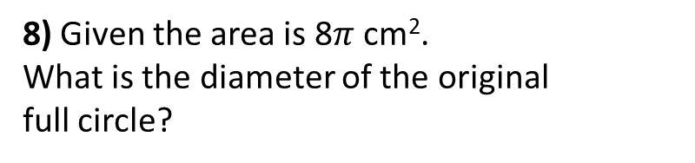

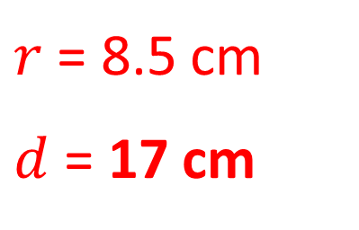
5) Given the area of the sector is 4$π$ cm².
What is the angle?
6) Given the area of the sector is 8$π$ cm².
What is the angle?
12cm
12cm
$4π$ = $\frac{\text{x}}{360}$ x ${(12}^{2})π$
$\text{x}$ = 10˚
x˚
$8π$ = $\frac{\text{x}}{360}$ x ${(12}^{2})π$
$\text{x}$ = 20˚
x˚
7) Given the area is 8$π$ cm².
What is the radius of the sector?
8) Given the area is 8$π$ cm².
What is the diameter of the original
full circle?
40˚
$r$ = 8.5 cm
$d$ = 17 cm
40˚
$8π$ = $\frac{40}{360}$ x ${(r}^{2})π$
$r$ = 8.5 cm

