Slide 1
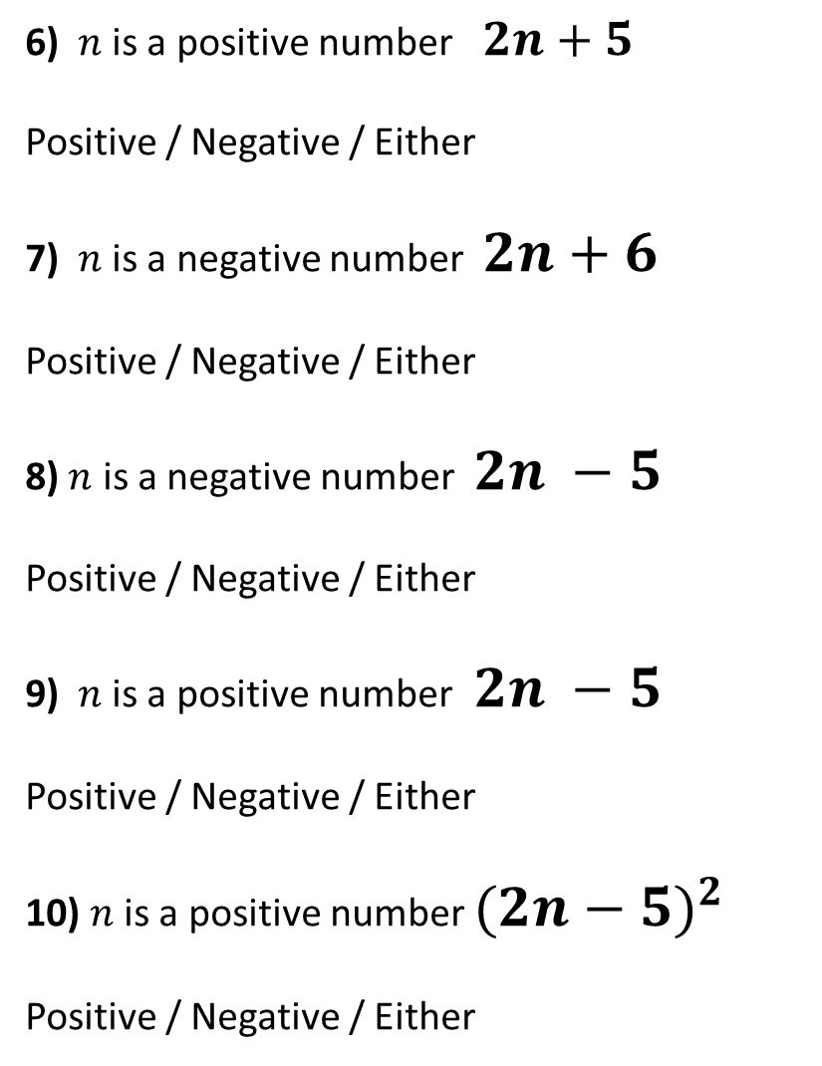
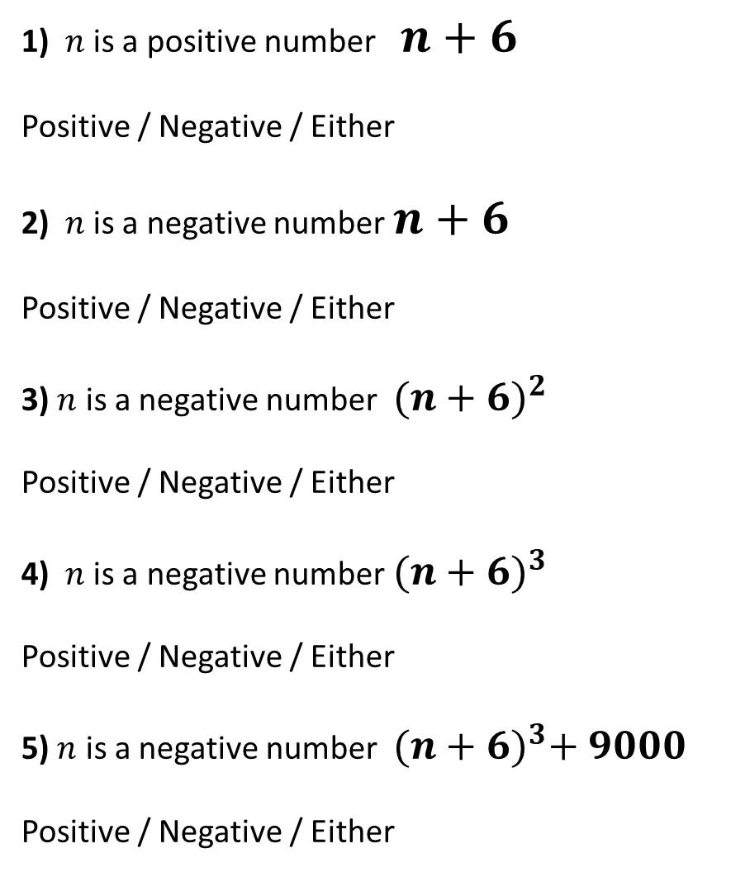
1) $n$ is a positive number $n+6$
Positive / Negative / Either
2) $n$ is a negative number $n+6$
Positive / Negative / Either
3) $n$ is a negative number ${(n+6)}^{2}$
Positive / Negative / Either
4) $n$ is a negative number ${(n+6)}^{3}$
Positive / Negative / Either
5) $n$ is a negative number ${(n+6)}^{3}+ 9000$
Positive / Negative / Either
6) $n$ is a positive number $2n+5$
Positive / Negative / Either
7) $n$ is a negative number $2n+6$
Positive / Negative / Either
8) $n$ is a negative number $2n −5$
Positive / Negative / Either
9) $n$ is a positive number $2n −5$
Positive / Negative / Either
10) $n$ is a positive number ${(2n−5)}^{2}$
Positive / Negative / Either

Slide 2
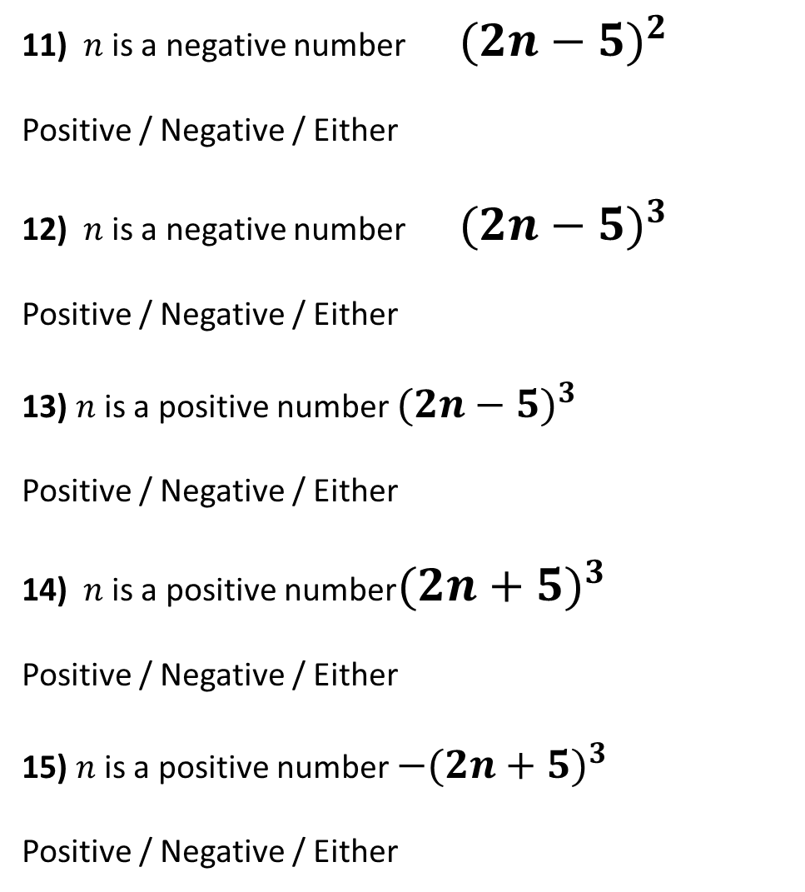
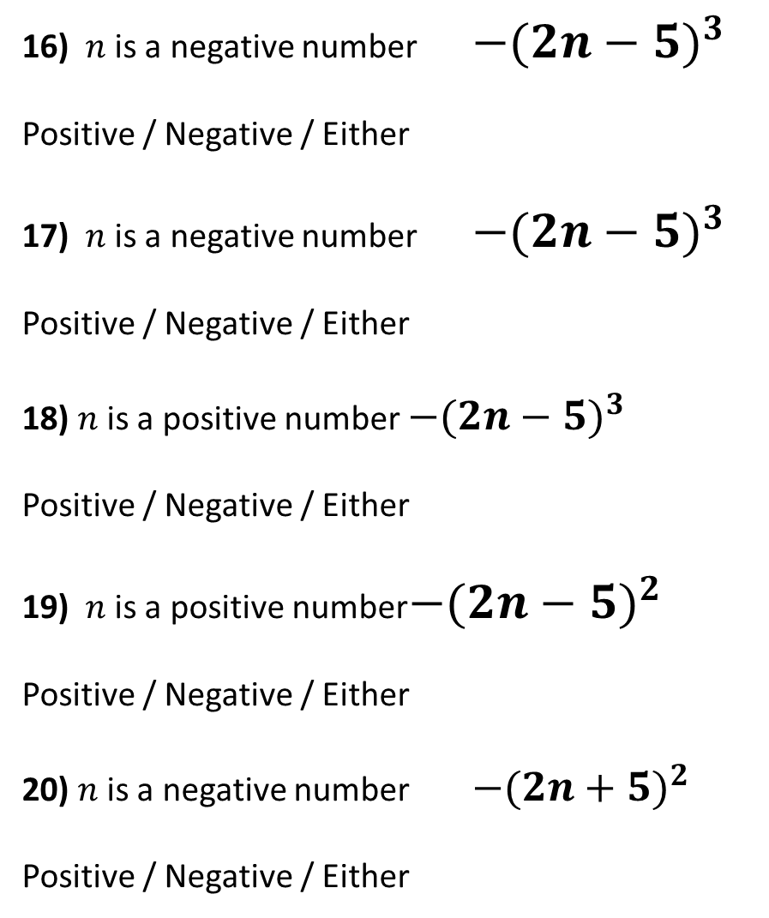
11) $n$ is a negative number ${(2n−5)}^{2}$
Positive / Negative / Either
12) $n$ is a negative number ${(2n−5)}^{3}$
Positive / Negative / Either
13) $n$ is a positive number ${(2n−5)}^{3}$
Positive / Negative / Either
14) $n$ is a positive number ${(2n+5)}^{3}$
Positive / Negative / Either
15) $n$ is a positive number ${−(2n+5)}^{3}$
Positive / Negative / Either
16) $n$ is a negative number $−{(2n−5)}^{3}$
Positive / Negative / Either
17) $n$ is a negative number ${−(2n−5)}^{3}$
Positive / Negative / Either
18) $n$ is a positive number ${−(2n−5)}^{3}$
Positive / Negative / Either
19) $n$ is a positive number ${−(2n−5)}^{2}$
Positive / Negative / Either
20) $n$ is a negative number ${−(2n+5)}^{2}$
Positive / Negative / Either

Slide 3
ANSWERS

Slide 4
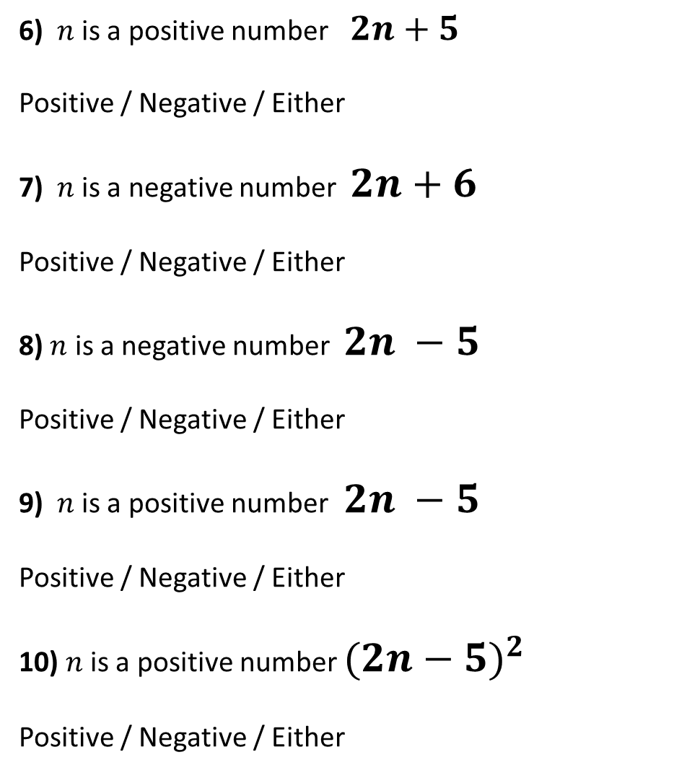
1) $n$ is a positive number $n+6$
Positive / Negative / Either
2) $n$ is a negative number $n+6$
Positive / Negative / Either
3) $n$ is a negative number ${(n+6)}^{2}$
Positive / Negative / Either
4) $n$ is a negative number ${(n+6)}^{3}$
Positive / Negative / Either
5) $n$ is a negative number ${(n+6)}^{3}+ 9000$
Positive / Negative / Either
6) $n$ is a positive number $2n+5$
Positive / Negative / Either
7) $n$ is a negative number $2n+6$
Positive / Negative / Either
8) $n$ is a negative number $2n −5$
Positive / Negative / Either
9) $n$ is a positive number $2n −5$
Positive / Negative / Either
10) $n$ is a positive number ${(2n−5)}^{2}$
Positive / Negative / Either

Slide 5
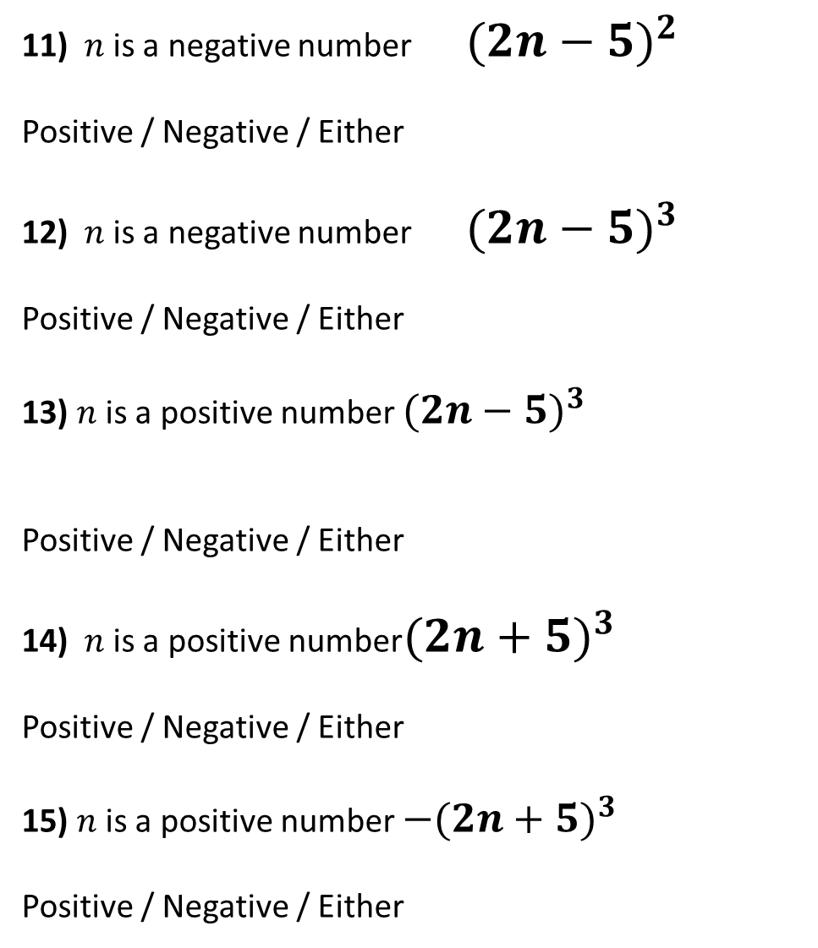
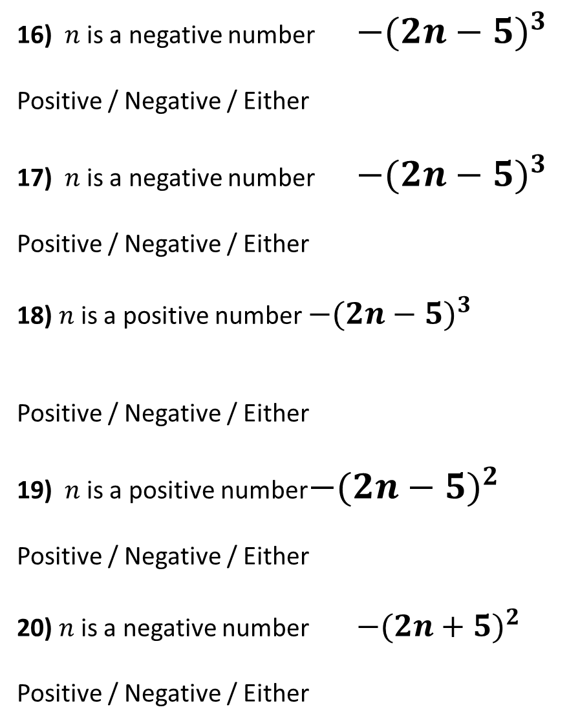
11) $n$ is a negative number ${(2n−5)}^{2}$
Positive / Negative / Either
12) $n$ is a negative number ${(2n−5)}^{3}$
Positive / Negative / Either
13) $n$ is a positive number ${(2n−5)}^{3}$
Positive / Negative / Either
14) $n$ is a positive number ${(2n+5)}^{3}$
Positive / Negative / Either
15) $n$ is a positive number ${−(2n+5)}^{3}$
Positive / Negative / Either
16) $n$ is a negative number $−{(2n−5)}^{3}$
Positive / Negative / Either
17) $n$ is a negative number ${−(2n−5)}^{3}$
Positive / Negative / Either
18) $n$ is a positive number ${−(2n−5)}^{3}$
Positive / Negative / Either
19) $n$ is a positive number ${−(2n−5)}^{2}$
Positive / Negative / Either
20) $n$ is a negative number ${−(2n+5)}^{2}$
Positive / Negative / Either

